Slide 1
Hearing synonyms throughout the story will allow your child to experience and use newly acquired vocabulary.
Daisies Learning for Summer 1
Maths
Counting-We will be practising counting beyond 10 and matching number names to the items we count. We will be talking about the different ways the number 10 can be made.
Numerical patterns-We will be counting objects accurately beyond 10 using one to one correspondence identifying when objects have the same, less that or more than. We will be looking at the composition of numbers and how numbers are made. We will be comparing quantities of objects/numbers.
Shape-We will be using shape names and positional language. We will be comparing size, weight and capacity. We will be looking at 3D shapes names and some of their basic properties. We will be extending our knowledge of repeating patterns.
Additional learning:
We will continue to have a number of the week. Can you join in with the challenges set on dojo and send us a picture?
We will continue to set activities using Maths Seeds. Please log on to Maths Seeds with your child to complete any set activities.
Our book sequence for this half term is
Surprising Sharks by Nicola Davies and Somebody swallowed Stanley by Sarah Roberts.
This term we will be using the story to find out how we can help our environment. We will be looking closely at the environment under the sea and how we can take care of it. We will also be looking at the human impact on the sea and the creatures that live there.
Commotion in the ocean?
Our theme for this half term is Commotion in the ocean? We will be investigating under the sea, what lives there, the human impact on our environment and the sea, the similarities and differences between where we live and the sea and how we can care for the wold in which we live.
Synonyms Using synonyms will help to expand your child’s vocabulary and allow them to experience new language! While reading the Surprising Sharks book I will expose the children to new words. Home challenge, see if you can use synonyms while talking to your child.
Book language | Synonym | Book language | Synonym
Surprising | Shocked | Fin | Appendage
Nightmare | Bad dream | Hungry | Ravenous
Killer | Destroyer | Tough | Strong
Expect | Anticipate | Scratchy | Rough
Surface | Exterior | Jaws | Jawbone
Patterned | Decorated | Teeth | Fangs
Vision | Sight | Skeleton | Shell
Tail | Back end
Species | Type
Vocabulary we will hear and begin to use.
Endangered | A type of animal that is in danger of disappearing for ever.
Extinct | The entire species has died out.
Predator | An animal that hunts other animals for food.
Prey | An animal that is hunted by another for food.
Senses | The five basic senses are sight, hearing, smell, taste, touch.
Human impact | Real world effects of our actions on the environment.
Phonics
Phase 3 phonics will be taught daily in Summer 1. Your child will learn the following:
ai ow
ee oi
igh ear
oa air
oo er
oo words with double letters.
ar longer words
or
ur
The children will then progress onto phase 4 which involves the process of learning to read and write longer words.

Slide 2
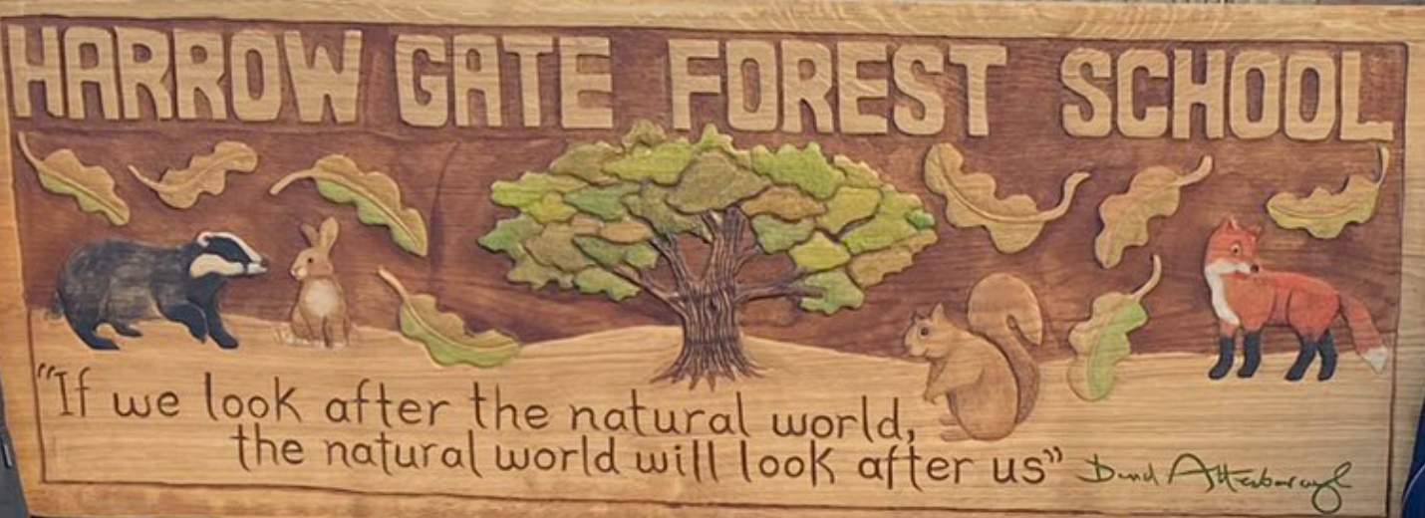
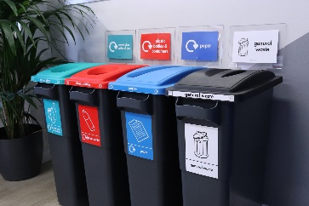
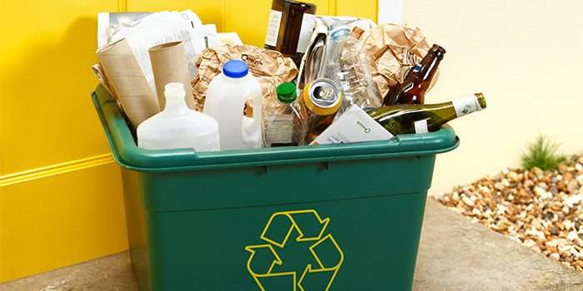
Daisies Learning for Summer 1
Welcome back to Reception!
We hope you have had relaxing and fun time with your families over the Holidays and are excited and ready for the new term ahead.
We are really looking forward to having you back in school.
If you have any questions or concerns, please do not hesitate to talk to a member of the reception team on the door or message via Class Dojo.
EBooks
Your child will be set a new reading book on Collins eBooks. Your child's details were sent out to you last term. It is so important that you are reading at home with your child as much as possible. As a school we can accessed reports to see who has accessed the books and how long a child has spent reading the book. Please read frequently with your child at home.
If you have any issues accessing the eBooks, please let a staff member know.
Forest School sessions offer the opportunity for children to become completely immersed in the natural environment, develop their physical, problem-solving and communication skills.
Forest School will take place every Wednesday.
Please ensure that your child wears comfortable and appropriate clothing on this day. Children’s legs and arms must be covered so long sleeves and trousers or leggings are a must. We will provide children with waterproof suits. We have some spare wellies, but not enough for everyone, so if your child has a pair at home, we would appreciate you sending them in. Children can leave wellies at school as these are use daily.
It is important that they are prepared for all weathers as we will always be going outside.
Home Learning
We will be talking about caring for our immediate environment this half term. Can you be the recycling monitor at your home? Can you find out what you can recycle at home and can you help the people who look after you to recycle at home? Which bins do the different types of rubbish go in?
PE
Children are to come to school in their PE kits on Mondays and Tuesdays.
Please can we remind parents and carers to put your child’s name in their jumpers and cardigans as this makes it easier- Thank you.

