Slide 1
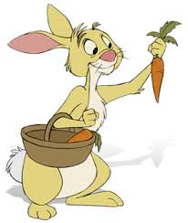
Welcome to Reception

Slide 2
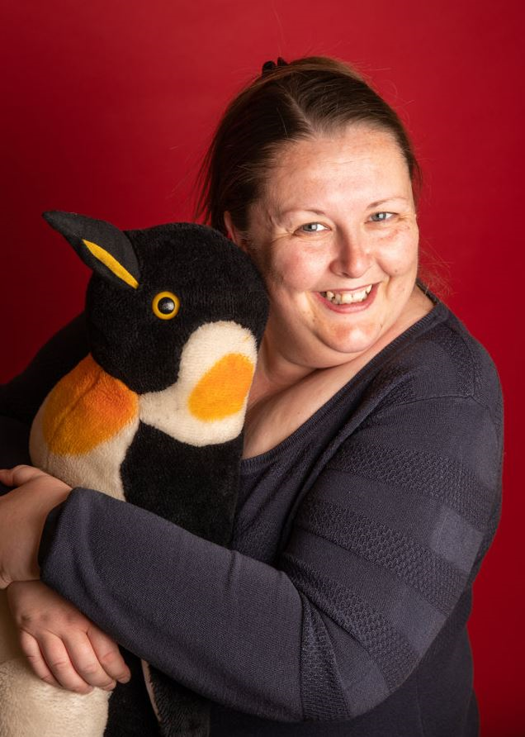
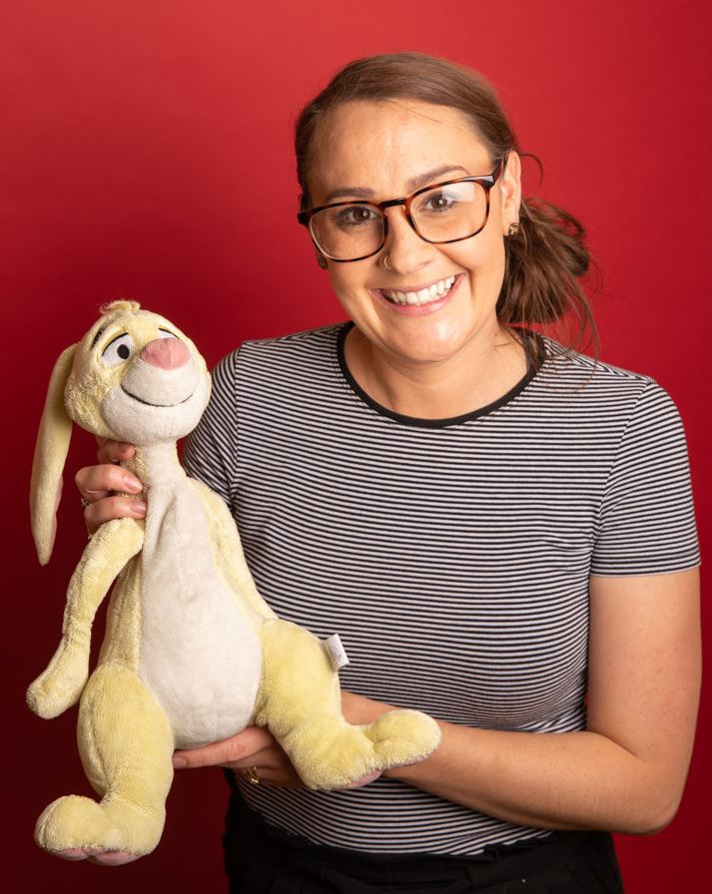
Your new teacher is Miss Clough.
You are in Rabbits in Reception
The teaching assistant in your class is Mrs Wilson.

Slide 3
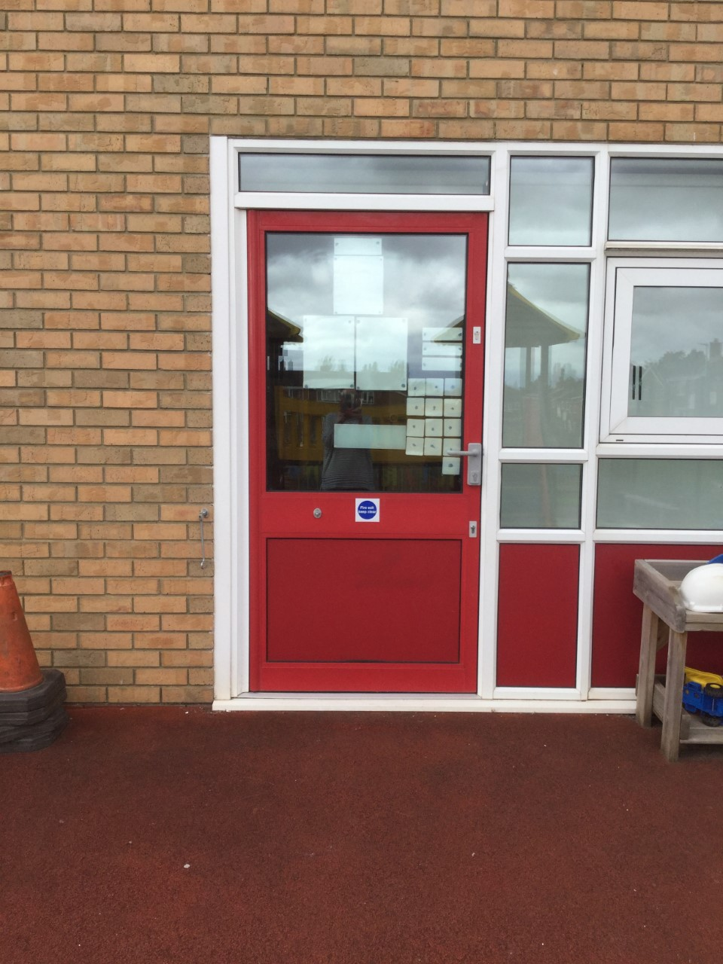
School starts at 8:45am
This is the door you will go into school.
There will be an adult from your new year group to help you get to the classroom.

Slide 4
You will hang your coat here.

Slide 5
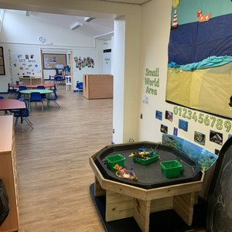
This is your classroom.

Slide 6
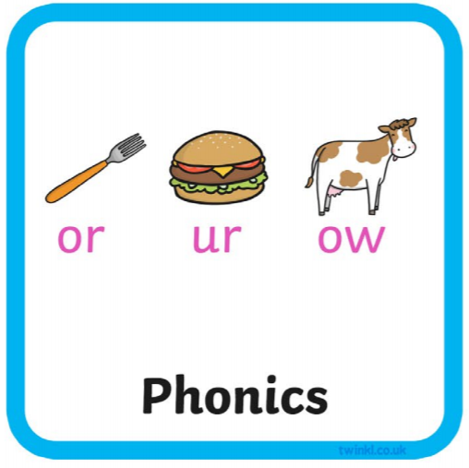
Everyday we do…
Notes:
You could add extra information around English……this half term we will be focusing on…
Maths this half term will be……..
The class reader will be……..

Slide 7
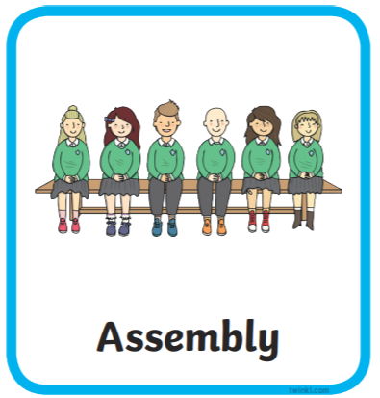
Here are subjects and activities we will do each week in the first term.

Slide 8
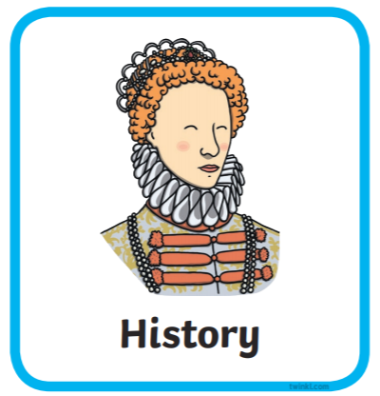
Our topics when you come back are …
Our science question for the half term is “What plants can I find in my local area?”
Our history question for the term is “Why do we celebrate Christmas and what other celebrations are similar?”

Slide 9
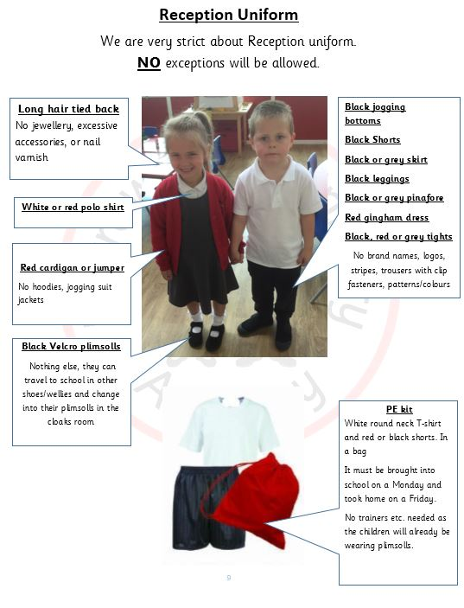
Other information
A set timetable, including PE days,
will be shared in September.

Slide 10
You will go home at 3.10pm from this door.

