Slide 1
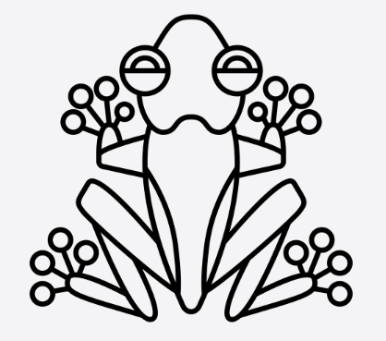
Science – Y4 – Living Things and Their Habitats
 | Biology | Biology is the branch of science that studies life and living organisms.
 | classification | the act of arranging into groups of similar things
 | vertebrate | Animals with a back bone
 | invertebrate | Animals without a backbone
 | amphibian | An animal that lives on land but breeds offspring in the water such as a frog or a toad.
 | reptile | A cold blooded animal that lays eggs on land such as a snake or crocodile.
 | bird | A two-legged animal with feathers and wings which lays eggs and can usually fly.
 | fish | A cold blooded animal that lives in water with a backbone, gills, fins and skin covered in scales
 | mammal | A warm-blooded animal such as a human, dog or whale. The female gives birth to live young and produces milk to feed them.
 | environment | The area in which people, animals and plants live
 | human impact | how humans are affecting the earth and its environments

Slide 2
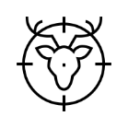
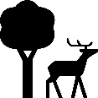
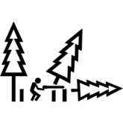
 | waste | unwanted or unusable material, substances, or by-products.
 | global warming | the term used to describe the rising of the average temperature on Earth.
 | poaching | the illegal hunting of animals
 | nature reserve | A nature reserve is a protected area where wildlife, flora (plants) and fauna (animals), are left undisturbed.
 | plastic | a synthetic material made from a wide range of organic polymers such as polyethylene that can be moulded into shape while soft, and then set into a rigid or slightly elastic form.
 | litter | rubbish such as paper, cans, and bottles left lying in an open or public place
 | deforestation | the action of clearing a wide area of trees.

