Slide 1
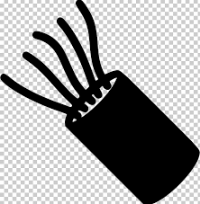
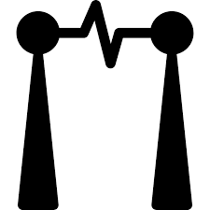
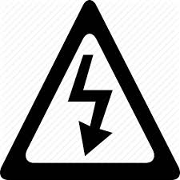
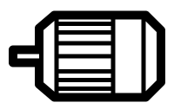
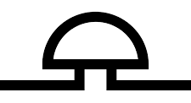
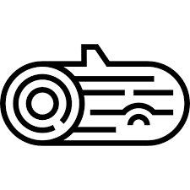
Physicist
chemist
expert
Famous
Invention
Experiment
current
metals
Zinc
Copper
Electrodes
conductors
Sulphuric acid
Saltwater
Electric current
Voltage
Different
metals
Measure
electric charge
Volts (v)
1745
Italy
Alessandro Volta 1745 - 1827
Energy used to power electrical items
circuit
Results from charged particles
cell
wires
motor
mains
buzzer
bulb
battery
switch
Electricity
Insulators
Conductors
Electricity can be dangerous
plastic
iron
Never place anything into a socket
Never touch with wet hands
wood
copper
Never use near water
glass
Always hold the plastic
rubber
steel

Slide 2
Alessandro Volta 1745 - 1827
Electricity

