Slide 1
Primary Survival Pack
Week 3
Facebook – @northfieldssp
Twitter - @northfieldssp
Website – https://northfieldssc.org/ssp

Slide 2
Learn it
Move It
Try It
Physical Education is the planned, progressive learning that takes place in school curriculum timetabled time and which is delivered to all pupils. This involves both ‘learning to move’ (i.e. becoming more physically competent) and ‘moving to learn’ (e.g. learning through movement, a range of skills and understandings beyond physical activity, such as co-operating with others). The context for the learning is physical activity, with children experiencing a broad range of activities, including sport and dance.
Physical Activity is a broad term referring to all bodily movement that uses energy. It includes all forms of physical education, sports and dance activities. However, it is wider than this, as it also includes indoor and outdoor play, work-related activity, outdoor and adventurous activities, active travel (e.g. walking, cycling, rollerblading, scooting) and routine, habitual activities such as using the stairs, doing housework and gardening
School Sport is the structured learning that takes place beyond the curriculum (i.e. in the extended curriculum) within school settings; this is sometimes referred to as out-of-school-hours learning. Again, the context for the learning is physical activity. The ‘school sport’ programme has the potential to develop and broaden the foundation learning that takes place in physical education. It also forms a vital link with ‘community sport and activity’.

Slide 3
Learn it
Move It
Try It
Have fun this week playing a variety of games to practise and develop the skill of sending an object.
Timing, along with judgement of distance & direction are important skills in a variety of invasion, net/wall and target games.
Children can also consider honesty when keeping their own score and hitting the target. Determination to keep trying if they are not always successful and creativity in developing their own games.
This week is all about our CORE.
Core strength supports fine motor skills, such as handwriting, and participating in gross motor activities like school sport.
Musical Balance is a great game which lets young people be creative adding their own moves and rules.
Cosmic Kids is a great resource using Yoga through the young people’s favourite films and cartoons.
Check out our next 3 personal best challenge cards.
1. Figure of 8
2. Fast Feet
3. Climb the Mountain
Each card is a 60sec challenge for the children to try their best or compete against a family member. Don’t forget to look on the cards for ways to make the challenges easier or alternatives if you don’t have the equipment at home.

Slide 4
Learn It – Sending an object EYFS/KS1
These activities can be made easier or harder depending on the child’s age/ability.
You can start with rolling and move on to underarm throws.
For an additional activity, which includes some maths, have a look at this video from Yorkshire Sport #This is PE which uses both rolling and throwing towards a target.
These activities can help develop judgement, timing and strength on release.

Slide 5
Learn It – Sending KS2
Beanbags are perfect for playing our game of battleships but if you don’t have beanbags then rolled up socks are a great substitute!
Extension:
Can you create your own target game that involves accuracy of rolling/throwing an object? How can you make it harder/easier to play?
Are your rules clear?
Teach your game to a family member.

Slide 6
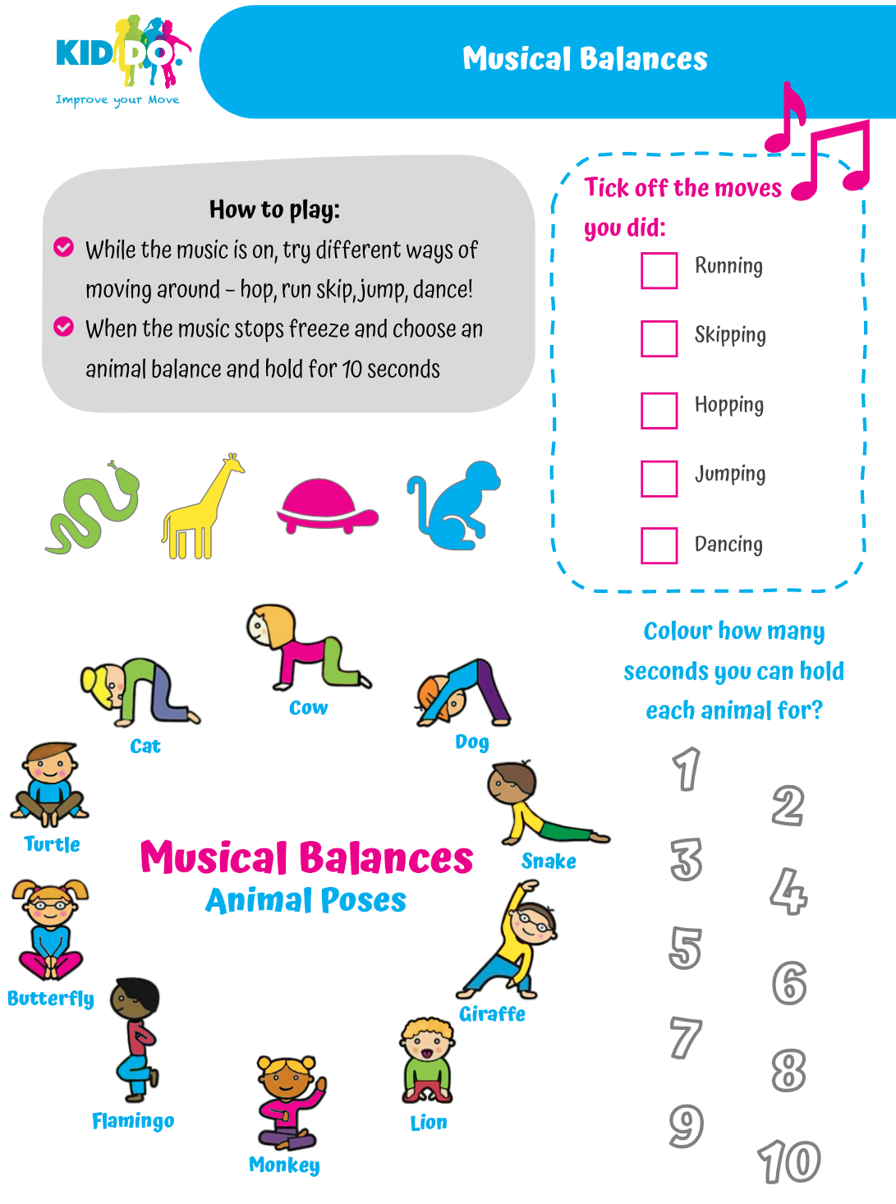
Move It – Physical Activity

Slide 7
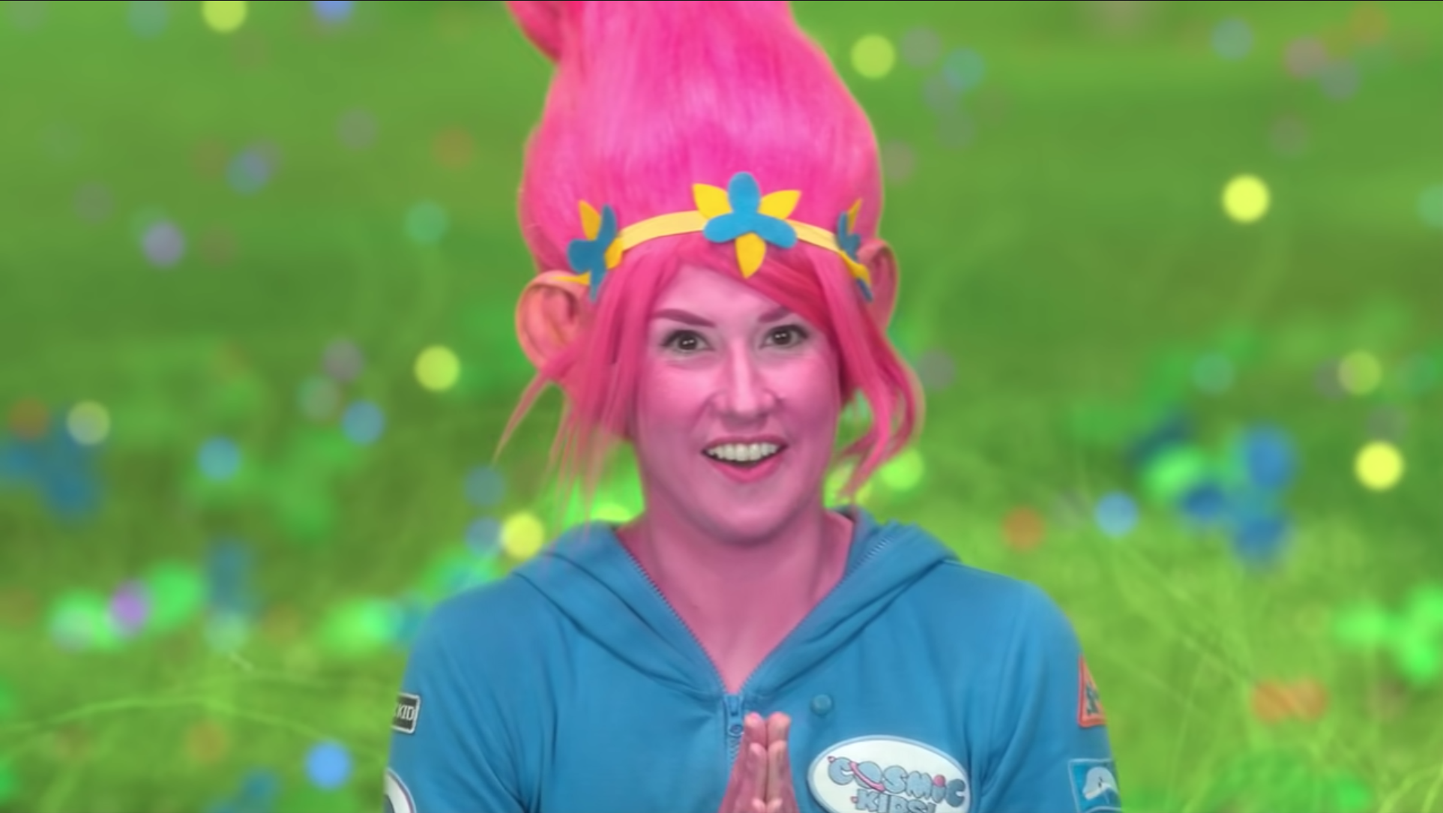
Move It – Physical Activity
Cosmic Kids Yoga
Follow the link to join the Cosmic Kids on another Yoga adventure.
A Cosmic Kids yoga adventure with the Trolls all about bringing happiness to the world!
Follow the link to find more adventures and some of our favourite characters.
https://youtu.be/U9Q6FKF12Qs

Slide 8
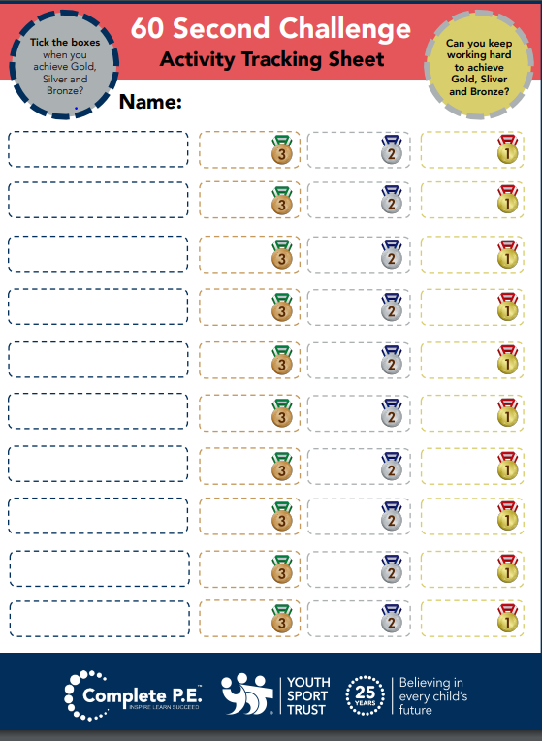
Try It – Competition & Challenge

Slide 9
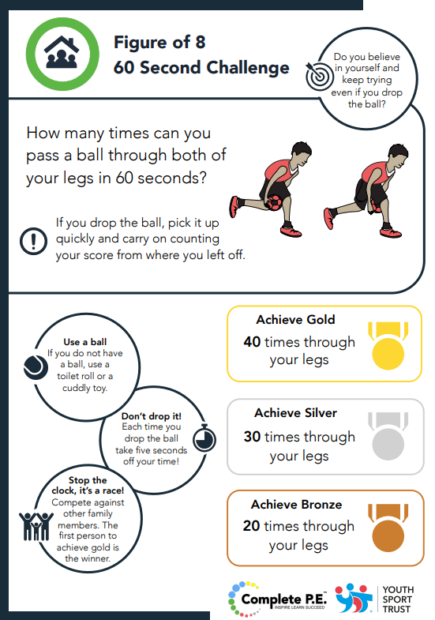
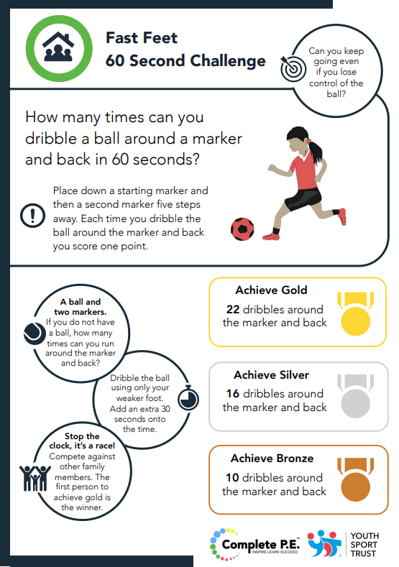
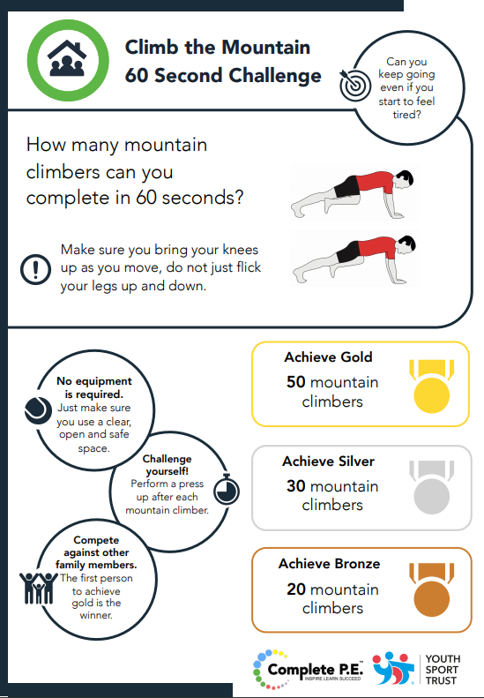
Try It – Competition & Challenge

Slide 10
Social media – Links of the Week
Further resources to support our PE offer from the Youth Sport Trust - https://www.youthsporttrust.org/primary-pe-activities
Disney inspired 10min shake-ups - https://www.nhs.uk/10-minute-shake-up/shake-ups
Some great free resources from our friends at Sedgefield SSP. https://www.go-well.org/lockdown-3-free-resources/?fbclid=IwAR13juMJ3gj79ZZfRTj0z3DLLddLQWHYKis_jExyZfP0KhayGOEmXH5l75c

