Slide 1
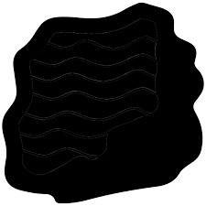
Science – Y3 – Rocks and Soils
 | Chemistry | Chemistry is the branch of science that studies the properties of matter and how matter interacts with energy.
 | Rocks and Soils
 | igneous | Igneous rocks are rocks that have formed by the cooling and hardening of molten lava or magma
 | sedimentary | Sedimentary rocks are made when sand, mud and pebbles get laid down in layers. Over time, these layers are squashed under more and more layers. Eventually, the layers are lithified – turned to rock.
 | metamorphic | Metamorphic rocks are formed when other rocks are affected by great temperatures and pressures.
 | fossils | Fossils are the remains or traces of plants and animals that lived long ago found in rocks. Fossils give scientists clues about the past
 | soil | A complex mixtures of minerals, water, air, organic matter, and decaying remains. Soil is capable of supporting plant life and is vital to life on earth.
 | soil layers | Soil is made up of distinct horizontal layers; these layers are called horizons. They range from rich, organic upper layers (humus and topsoil) to underlying rocky layers ( subsoil, regolith and bedrock).
 | hard (Y1) | Not easily broken
 | soft (Y1) | Easy to mould, cut or fold
 | scratch | to scrape or rub lightly leaving a mark

Slide 2
 | crumble | to break or crush into bits or crumbs
 | polish | Polishing is the process of creating a smooth and shiny surface by rubbing it or by applying a chemical treatment
 | permeable | having pores or openings that let liquids or gases pass through
 | impermeable | Something that is impermeable will not allow liquids or gases to pass through it

