Slide 1
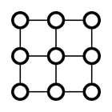
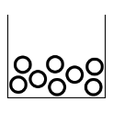
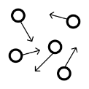
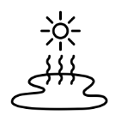
Science – Y4 – States of Matter
 | Chemistry | Chemistry is the branch of science that studies the properties of matter and how matter interacts with energy.
 | solid | Has a fixed shape and does not take the shape of a container, can be held
 | Liquid | Can be poured and take the shape of a container
 | gas | Has no fixed shape.
 | Freezing | Turn or be turned into ice or another solid as a result of extreme cold
 | melting | Becoming a liquid by heat
 | evaporation | If water (liquid) is heated, it changes to water vapour (gas). This change is called evaporation.
 | condensation | If water vapour (gas) is cooled down, it changes into water (liquid). This change is called condensation.
 | precipitation | Precipitation is water vapour or moisture that falls from the clouds in the form of rain, sleet, snow or hail.
 | water vapour | water in a gas form
 | water cycle | The water cycle is the continuous journey water takes from the sea, to the sky, to the land and back to the sea

