Slide 1
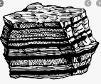
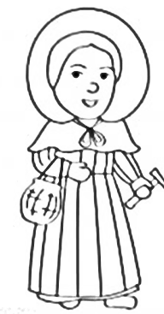
Sedimentary
Igneous
Metamorphic
Anthropic
Types of rocks
6000 ft deep
Rocks and Soils
The Grand Canyon
Mary Anning
How fossils are formed
How soil is formed
Schist at bottom
Is 2 billion years
old
Colorado river
Made up of 4 things:
Worn down rock
Organic matter
Water
Air
Sandy soil
Clay soil
Gravelly soil

