Slide 1
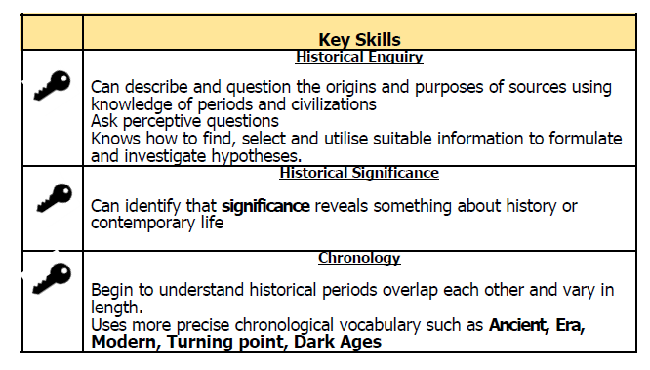
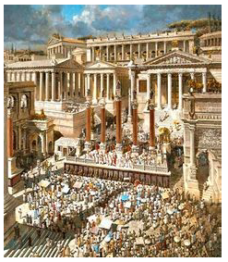
YEAR 4/5 Knowledge Organiser Term 2
The Ancient Greeks

Slide 2
