Slide 1
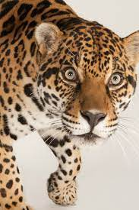
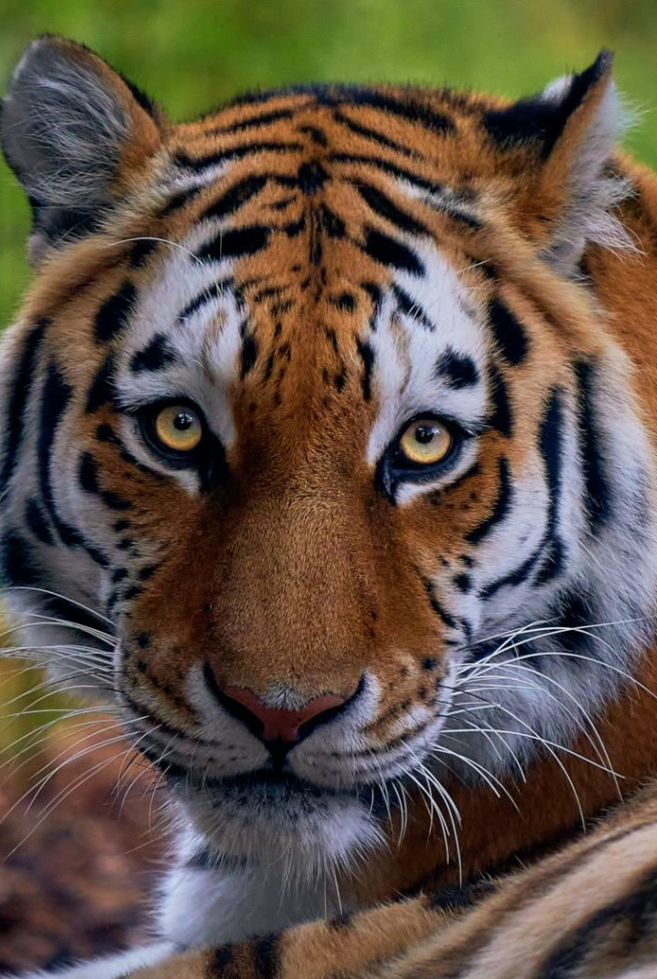
Tiger and Jaguar Class
Term 1
Knowledge Organisers

Slide 2
Maths

Slide 3
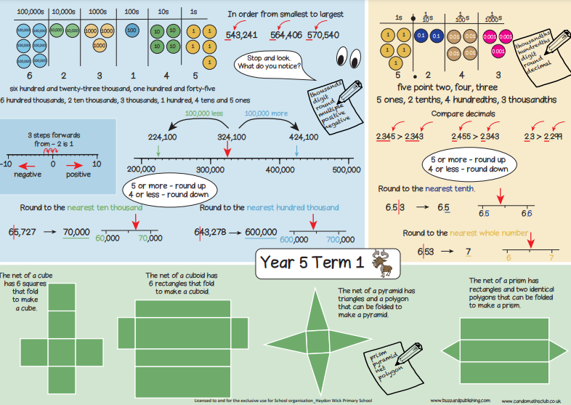

Slide 4
Maths

Slide 5
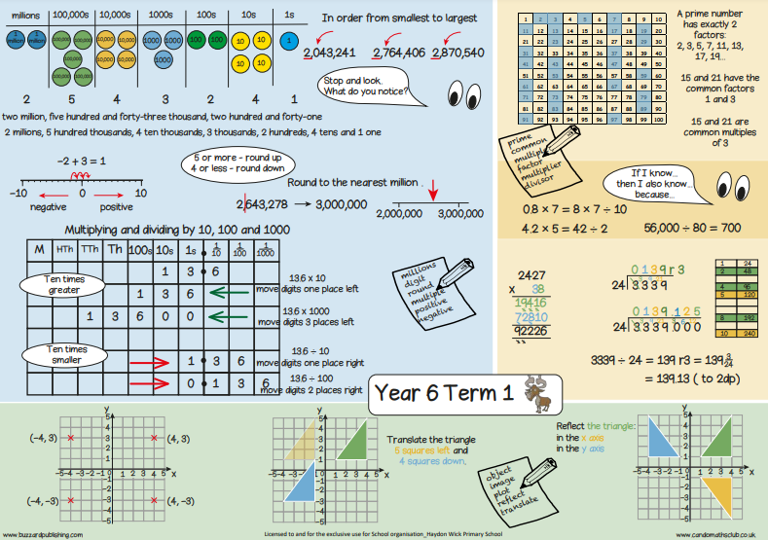

Slide 6
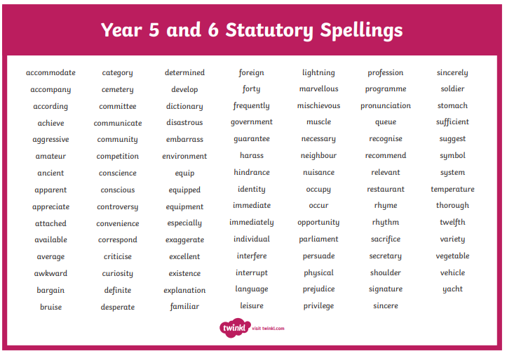

Slide 7
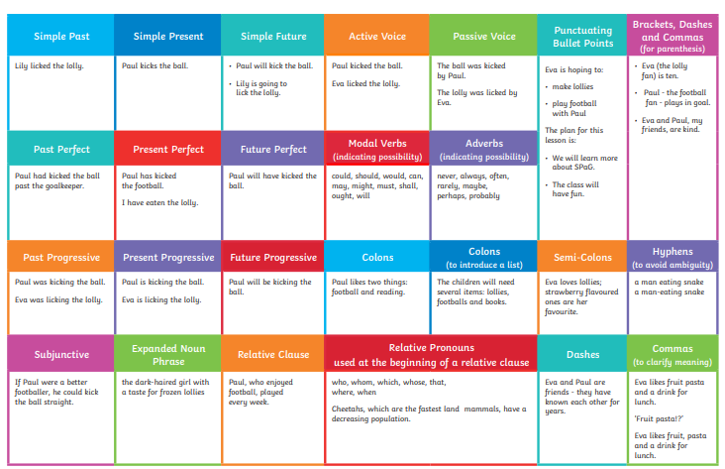

Slide 8
Geography

Slide 9
Science

Slide 10
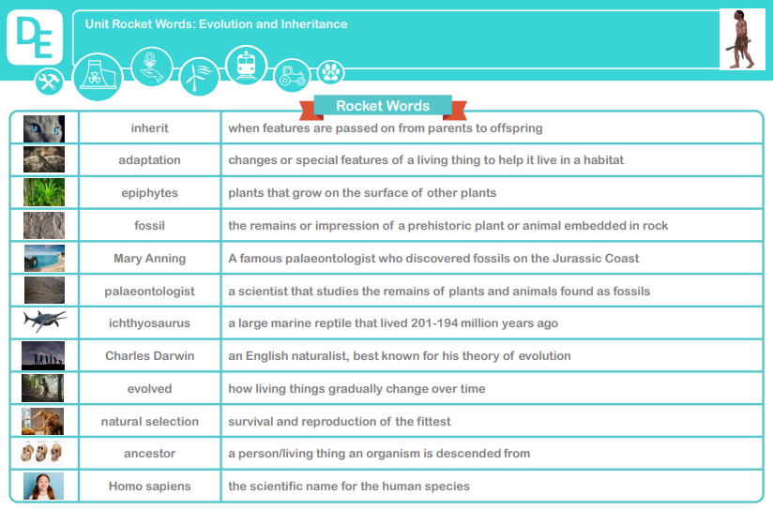
Science

Slide 11
Art

Slide 12
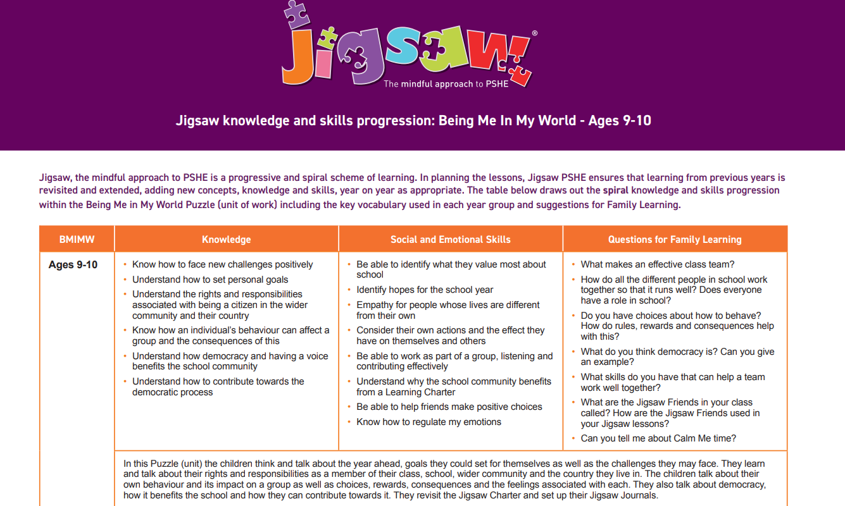
PSHE

Slide 13
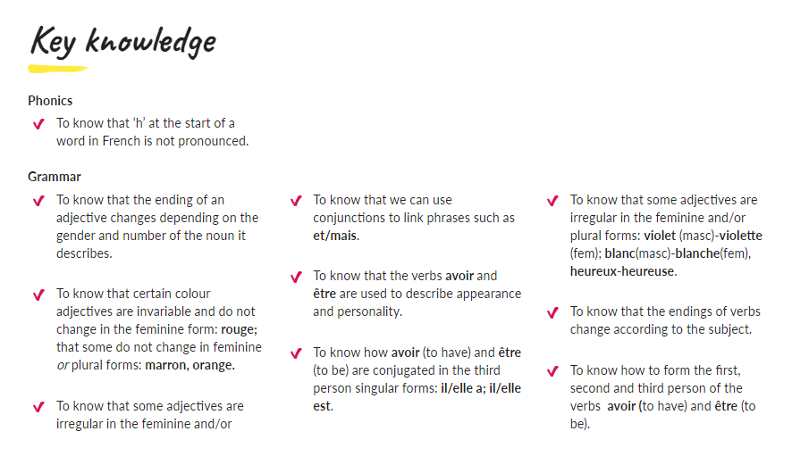

Slide 14
PE Gymnastics
PE Fitness

