Slide 1
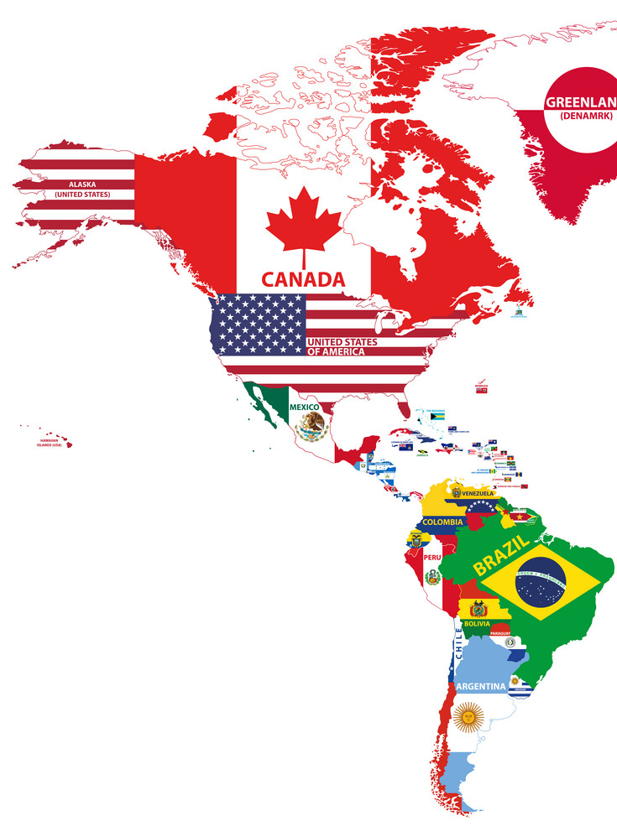
Term 2 – knowledge organisers
Amazing Americas

Slide 2
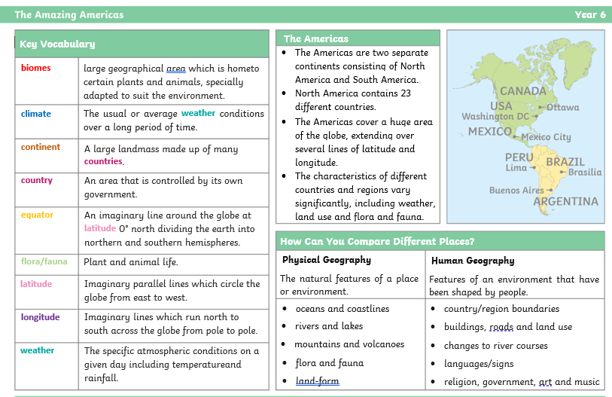

Slide 3
