Slide 1
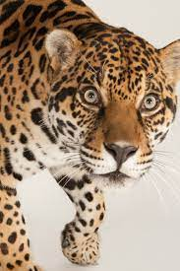
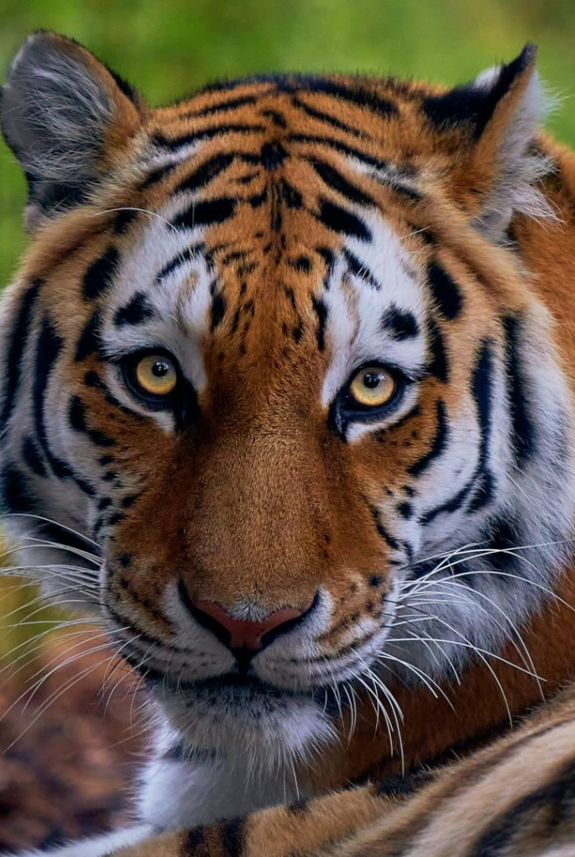
Tiger and Jaguar Class
Term 4
Knowledge Organisers

Slide 2
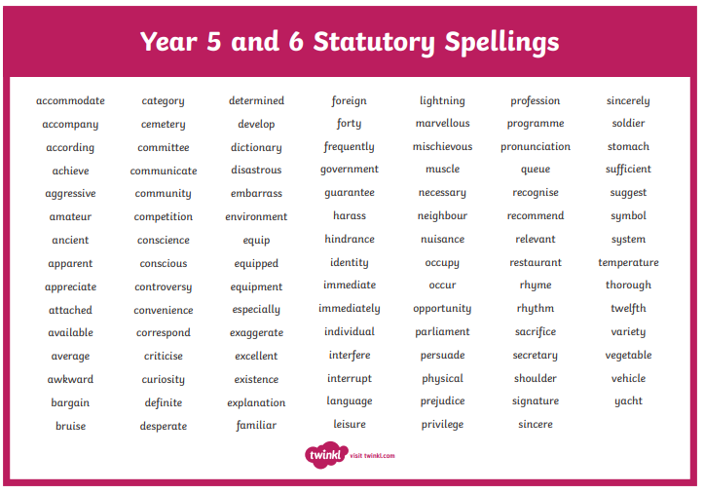

Slide 3
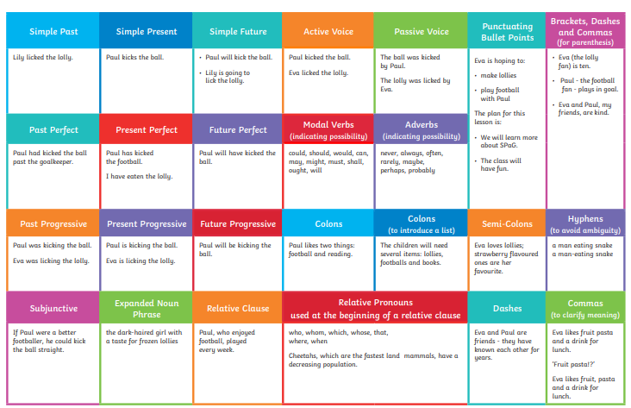

Slide 4
Maths
Y5

Slide 6
Maths
Y6

Slide 9
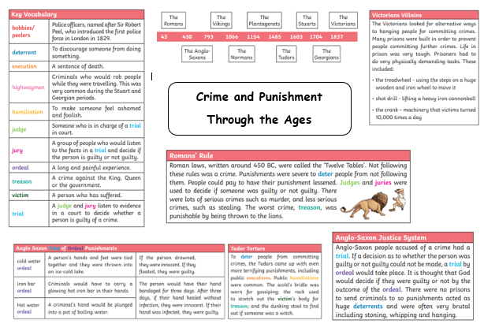
History

Slide 10
Science

Slide 11
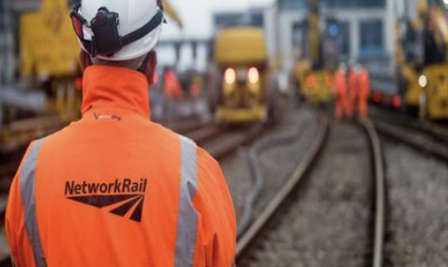
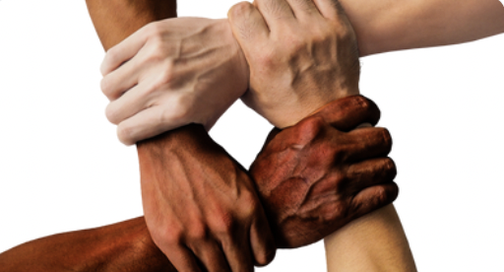
Knowledge Organiser: Year 6 Light
Careers connected to the human body:
doctor, nurse, massage therapist, personal trainer, theatre technician
Before and After Test
True (T) or False (F) ?
Light rays reflect off shiny surfaces.
Light travels in wavy lines.
An iPhone is a light source.
The moon is a light source.
White light is made up of 5 different colours.
Green objects look green because the green is reflected into our eyes, but the other colours are absorbed by the object.
Add arrows to the diagram below to show how we see things.
Use these words to help you write an explanation of how we see:
Light rays straight lines pupil reflect
________________________________________________________________________________________________________________________________________________________________________________________________________________________
Describe how a puppet’s shadow changes if it is moved closer to a light source.
__________________________________________________________________
Label the statements below ‘reflection’ or ‘refraction’.
Light reflects off shiny, bright or light surfaces. That is why you can see your reflection when you look in a mirror.
___________________
Water and bent shiny surfaces cause light rays to be reflected at different angles, meaning the reflection of the image is distorted.
___________________
Why doesn’t glass create a shadow when a light source is shining on it?
________________________________________________________________________________
Developing Experts Copyright 2022 All Rights Reserved

Slide 12
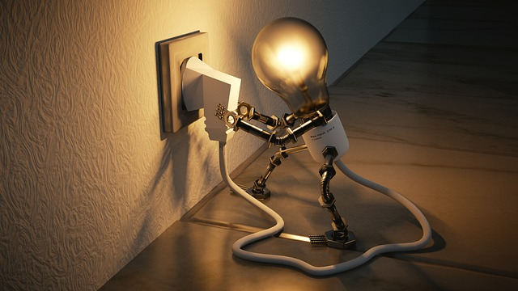
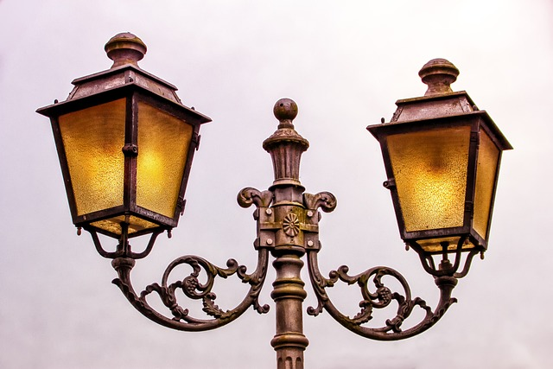
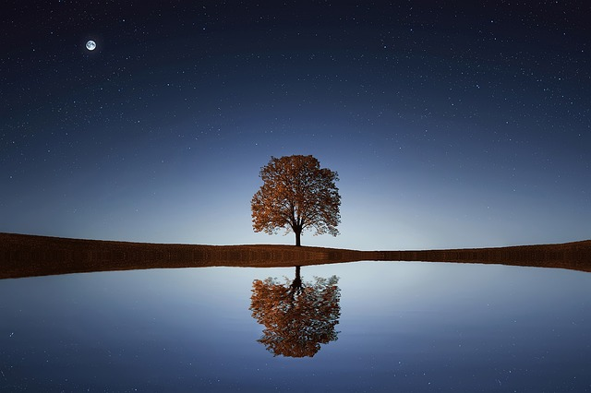
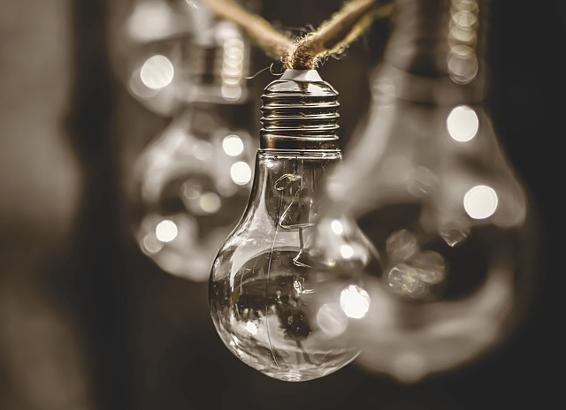
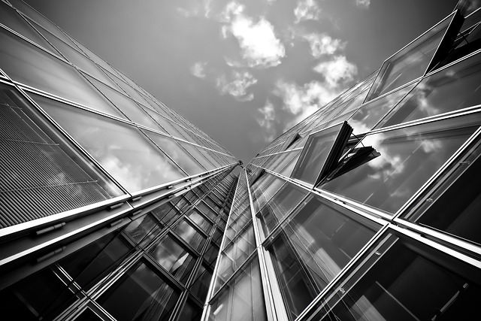
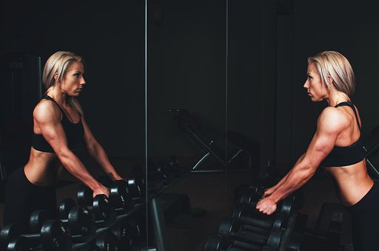
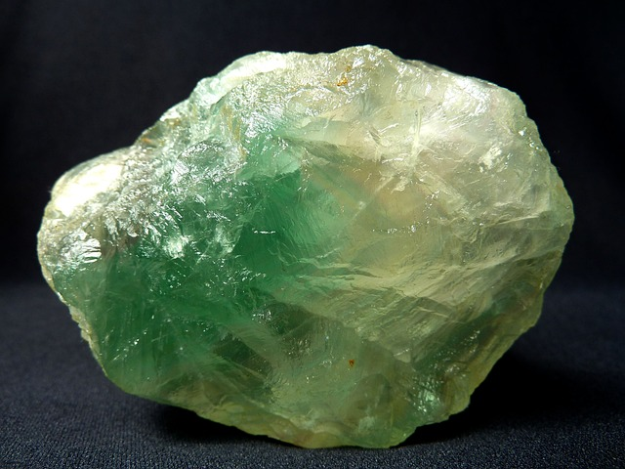
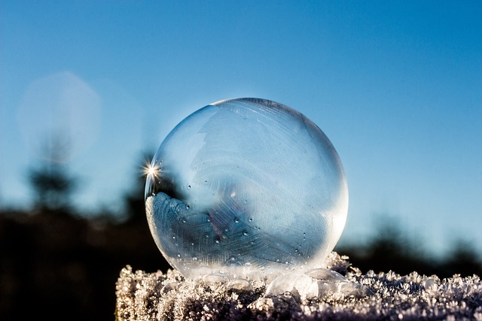
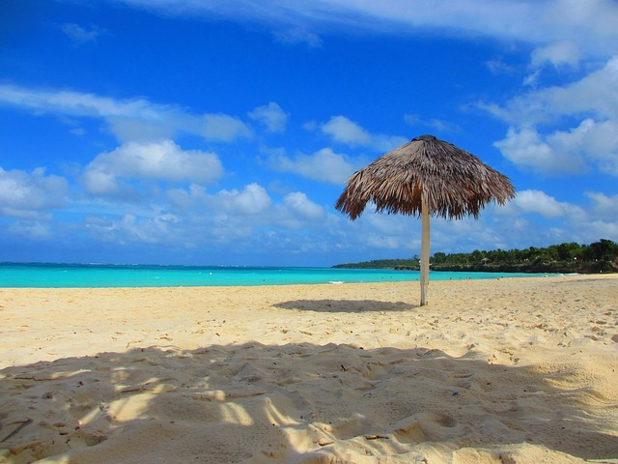
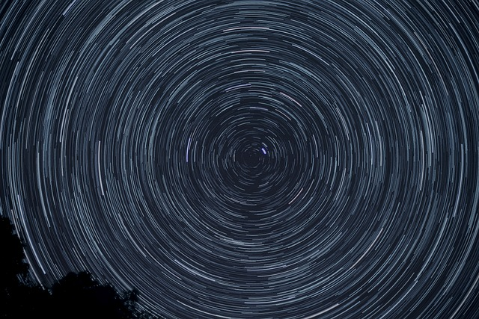
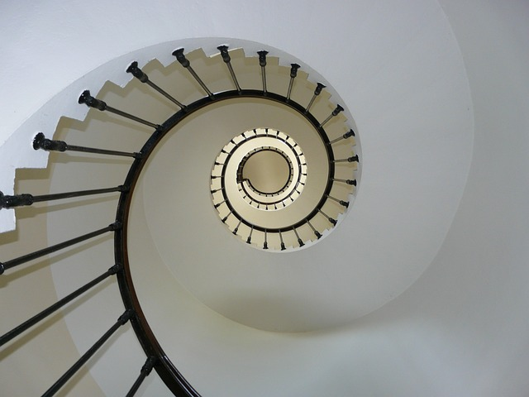
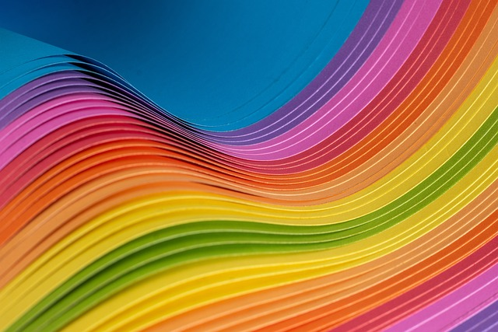
Unit Rocket Words: Year 6 Light
Careers connected to the human body:
doctor, nurse, massage therapist, personal trainer, theatre technician
Rocket Words
 | light | a form of energy
 | light source | an object that provides its own light
 | reflected | when light shines on a surface and bounces back
 | variable | any one of the elements of an experiment which could be changed
 | angle | the space between 2 intersecting lines
 | mirror | a surface that reflects a clear image
 | opaque | it describes materials which do not allow light to travel through
 | transparent | it describes materials which allow all light to travel through
 | sunshade | a device giving protection from the sun
 | rotate | to turn an object around a centre point
 | optical | relating to the science of optics
 | spectrum | a band of several colours
Developing Experts Copyright 2022 All Rights Reserved

Slide 13
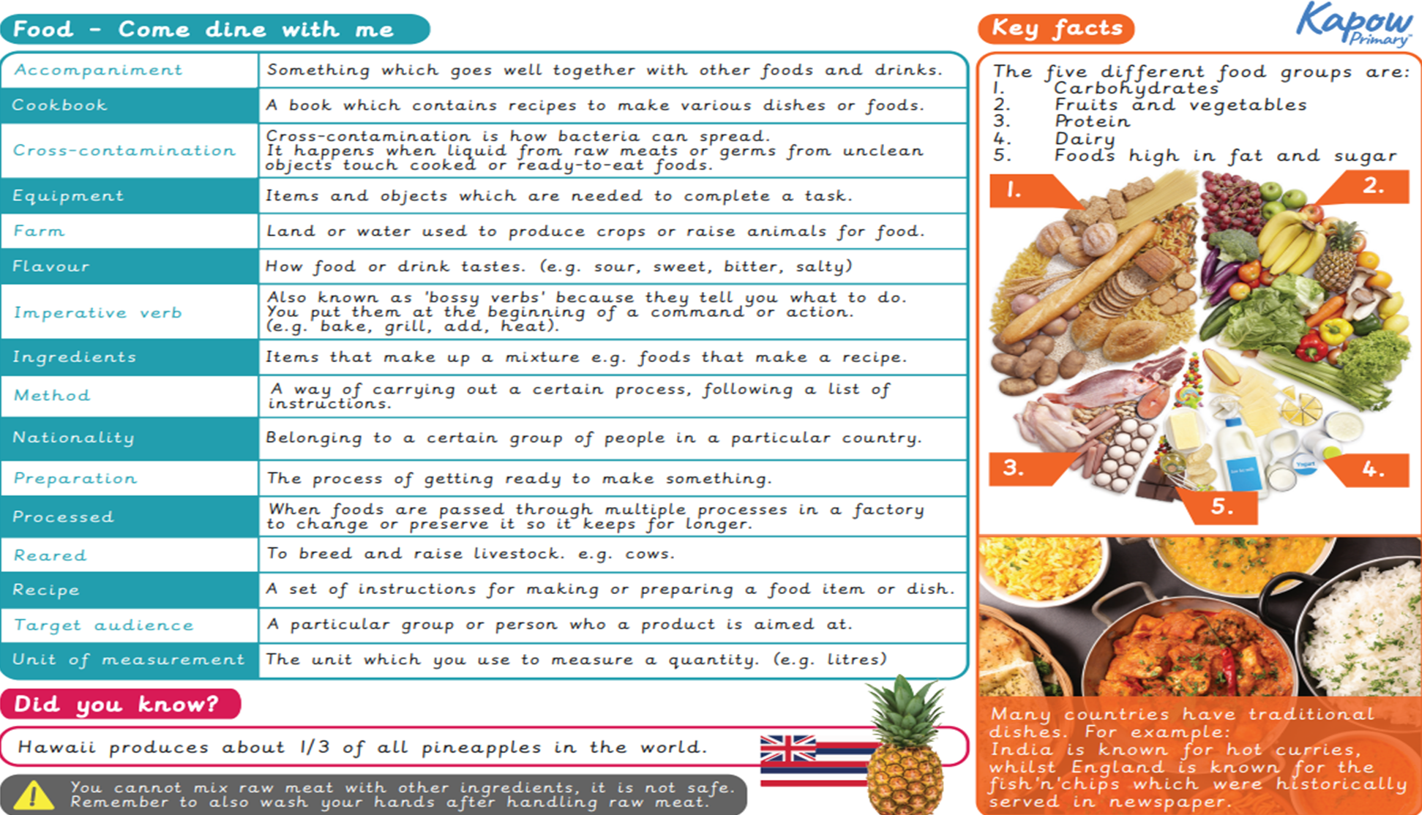
DT

Slide 14
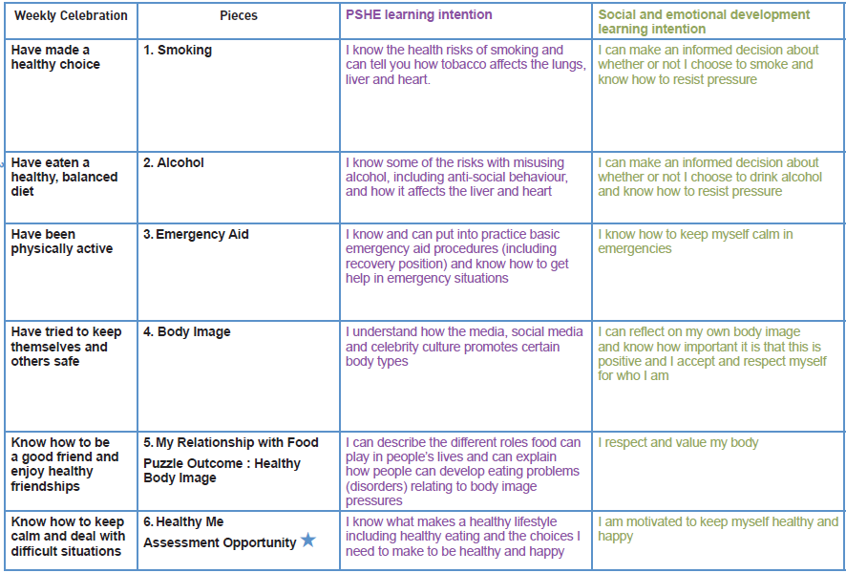
PSHE

Slide 15
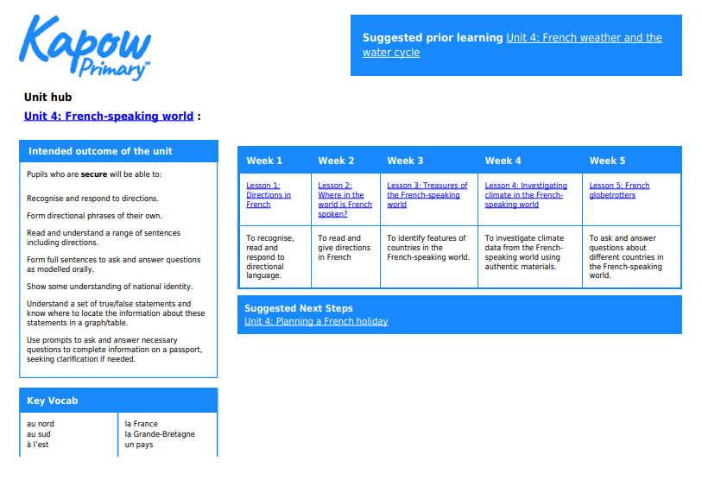
French

Slide 16
PE

