Slide 1
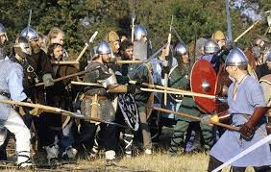
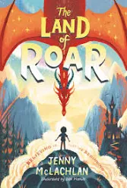
English
We are reading the text, ‘The Land of Roar’ and we will be retelling the story. Writing Focus:
Narrative and a Recount
Grammar Focus:
Speech
Subordination
Noun phrases
Adverbs
Values & PHSE We will focus on the values of Happiness and Courage. Jigsaw – Changing Me. We will be looking at ow our bodies change as we get older.
Maths
This term, we will focus on measurement, angles, statistics and problem solving. We will also focus on times tables. See Knowledge Organiser for Maths.
Year 4/5
Term 6 2026
Settlers and Storytellers
DT:
We are learning about adapting recipes and making cookies. We will be focusing on how ingredients can change the taste and texture of food. We will learn how to measure ingredients safely and use kitchen equipment correctly. Later, we will make and evaluate our own cookies.
PE
We will follow Get set 4 PE with a focus on Rounders and OAA. We will be using a variety of skills in order to work as a team.
Year 3 children will be going Swimming. See Knowledge Organiser for PE.
Reading
Children are rewarded every 20 reads with a new rainbow reading book mark.
We expect children to read at least 4 times a week.
History
We are learning about the Anglo-Saxons and how they lived in Britain long ago. We will be focusing on who the Anglo-Saxons were and how their lives were different from the Celts. We will be learning about Anglo-Saxon homes, food, clothing, and beliefs, and comparing these to the way the Celts lived. We will also look at how the Anglo-Saxons changed Britain and what evidence they left behind. See the Knowledge Organiser for History.
Science – Animals including Humans.
We are learning about animals, including humans, and how living things grow and survive. We will be focusing on the different parts of the human body and what they do. We will be learning about healthy eating, exercise, and how to keep our bodies healthy and strong. We will also look at different animals, their habitats, and how they care for their young. Later, we will carry out investigations and observations to help us learn more about animals and humans.
. See the Knowledge Organiser for Science.
Computing
Information Technology – We will be focussing on spreadsheets. Online Safety: Managing Online Information.

