Slide 1
Welcome to Frogs Class

Slide 2
Who is in our Class?
Class Teacher:
Miss Jefferies
Class Teaching Assistants:
Miss Remnant – in class everyday
Mrs Jeapes – supporting children throughout the week with both class activities and phonics interventions

Slide 3
Coming to school
New school times
Monday to Thursday
8.30am – 3.30pm
Friday
8.30am – 1pm
School gates and classrooms open at 8.20am
Children to be in classroom and ready for learning by 8.30am

Slide 4
Coming to school
We open the classroom doors at 8.20am and the children are welcome to come into the classroom as soon as the door is opened by a member of staff. As the cloakroom is limited on space, we politely ask that you encourage your child to come into the classroom independently by leaving them at the planters just outside the cloakroom door.
If your child is late, they need to come into school via the office.
If you have any concerns or messages, please speak to me at drop off or pick up, or via email –
Frogs@haydonwick.swindon.sch.uk

Slide 5
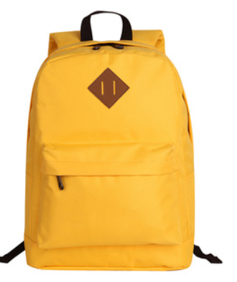
What do I need to bring with me?
Water bottle – filled with water only, due to spillages
PE kit – to be kept in school at all times, taken home every half term. Please make sure this is named. (coloured PE t-shirt, black or burgundy shorts/leggings/joggers, trainers/daps). Our PE day is currently Friday.
Wellington boots -named and pegged together
Book bag – reading record, reading books (and eventually phonics keyring and spelling book). This needs to be in school every day.
Snack money - £2 each term or £12 for the year.
Milk – when a child turns 5 they are no longer entitled to free milk. If you would like your child to continue to have milk with their snack, please speak to the office.

Slide 6
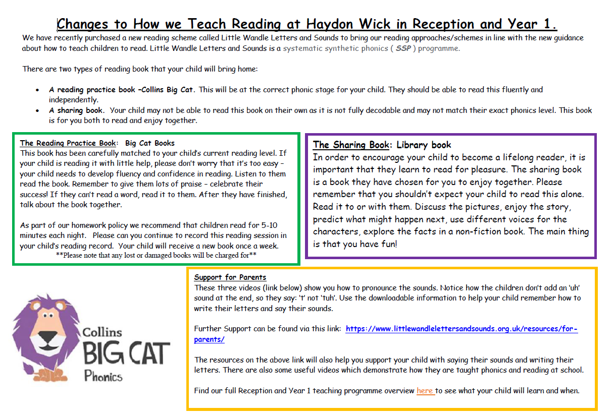
Reading Books

Slide 7
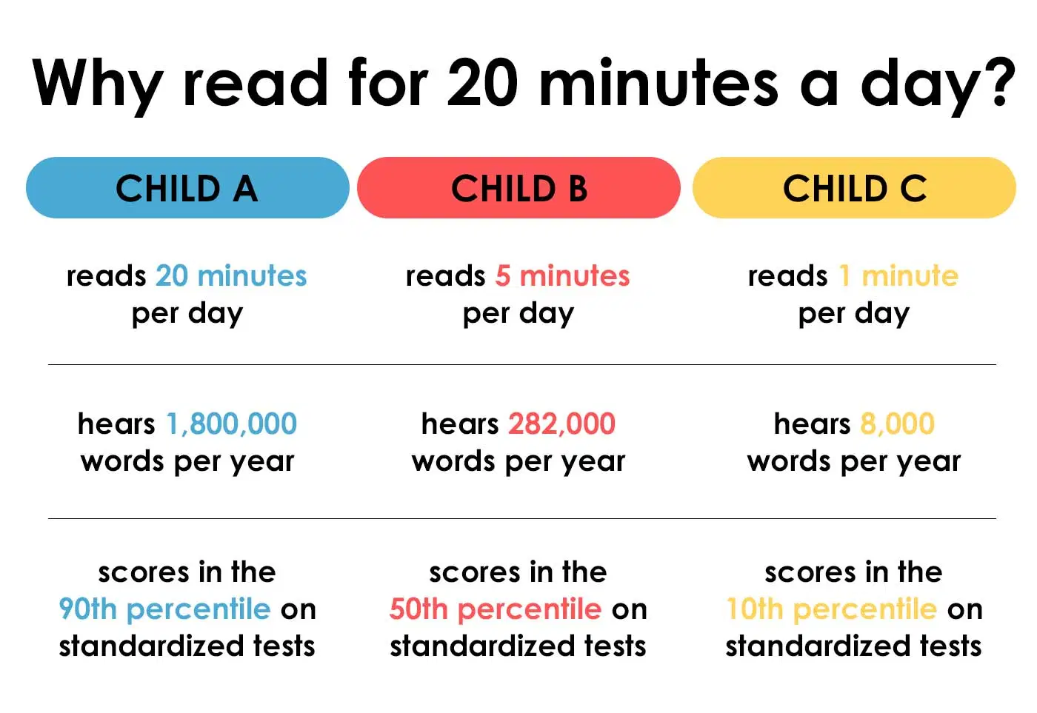
We would your child to read to an adult every night and practise their phonics sounds, where possible. If you are unable to do this, why not share a book together!
This is a crucial time for your child to learn how to read.

Slide 8
Spellings
These will align with the sounds they are learning in their phonics lessons.
Spellings will be set on a Friday.
We will test the spellings the following Thursday.
Please encourage your child to practise spellings in their spellings books which will begin in Term 2.

Slide 9
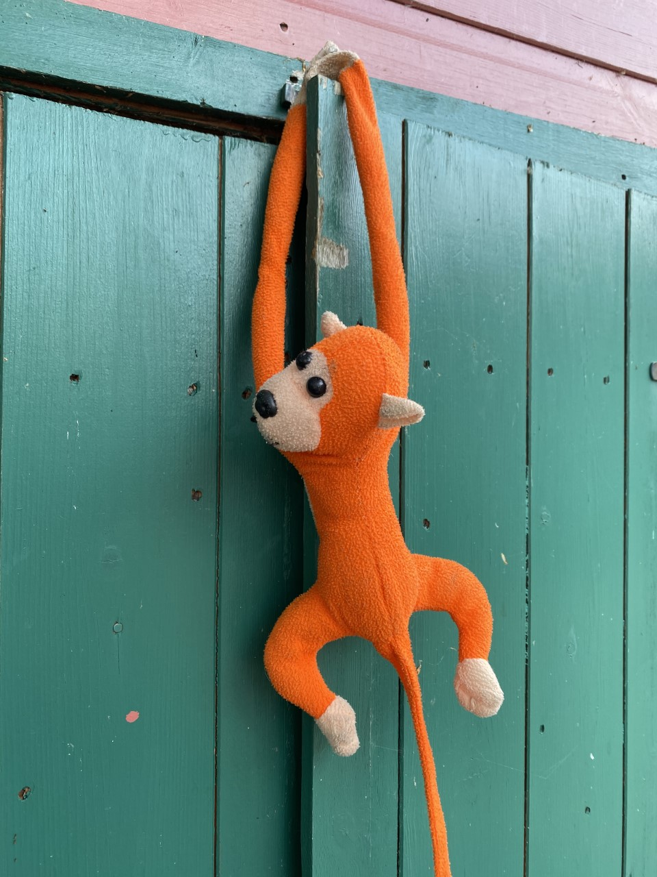
Maths Monkey - Whame
The Maths Monkey will go home with a child who has shown resilience and perseverance within our maths lessons over the week.
The Monkey will go home on a Friday and will need to be returned the by the following Wednesday at the latest.
Please encourage your child to teach the monkey new maths skills and share this in the book sent home.

Slide 10
Values Owl
The Values Owl will go home with a child who has shown our value of the month over the week.
They will also have a hot chocolate with Mr Neal and Mrs Palmer on Friday at morning play time.
The Owl will go home on a Friday and will need to be returned the following Monday.

Slide 11
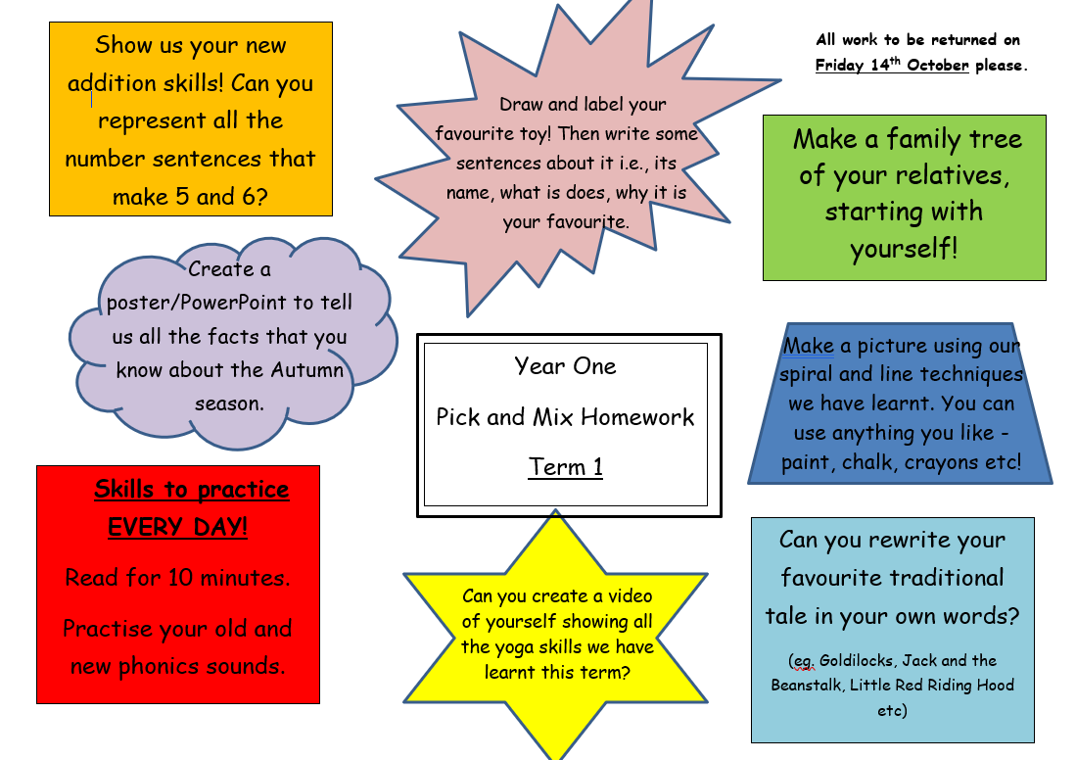
Homework
Homework will go out once a term and is a ‘Pick and Mix’ style homework.
Children should bring in their homework by Friday 14th October.
We invite all parents in to share all the wonderful work the children have done. This is scheduled for Monday 17th October at 3pm.

Slide 12
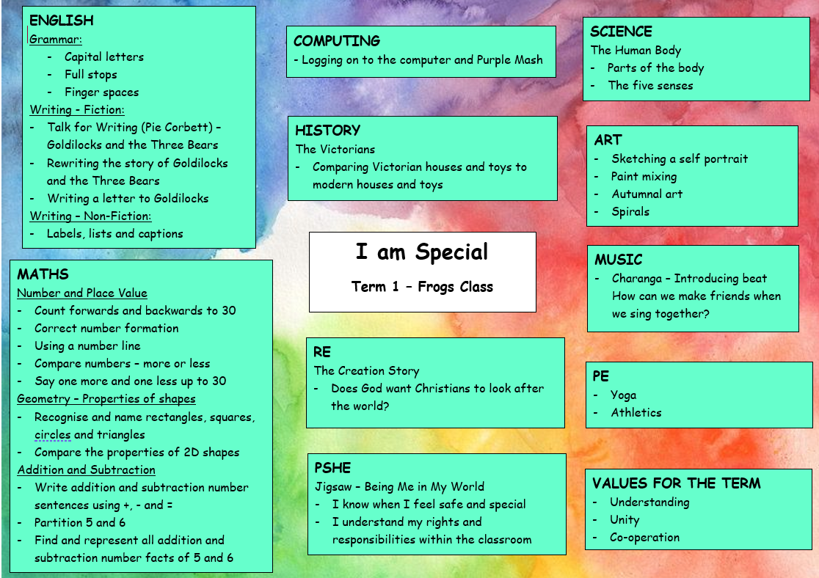
Topic Web
Our topic web for each term will be available on the class page of the website. This is an overview of the terms learning.
Our topics this year:
I am Special
Winter Wonderland
Castle on a Cloud
The Secret Life of Animals
Island Life
Living and Growing

Slide 13
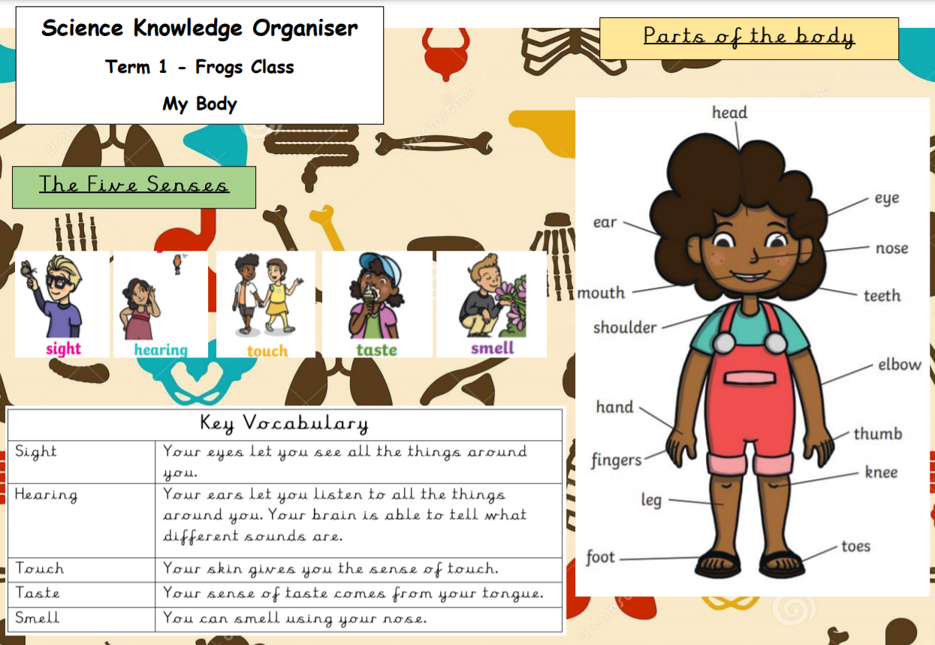
Knowledge Organisers
Knowledge organisers for each term will be available on the class page of the website.
This is usually Maths, Science, PSHE and then topic (either geography or history).
This is the knowledge the children will be learning and what they are expected to know at the end of the topic.

Slide 14
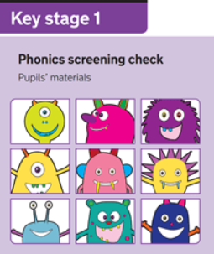
Phonics and Screening Test
The children have learnt Phase 2, 3 and 4 Phonics in Reception.
They will now move onto Phase 5 in Year One – over 50 new sounds!
The children will receive phonics keyrings in which they will add their new sounds to it every week.
Children usually sit the phonics screening test in Year 1 in June.
We will keep you informed of your child’s phonics progress throughout the year and an information meeting about the phonics screening will take place nearer the time in 2023.

Slide 15
Communication with Staff
If you have any worries or concerns please either:
Catch me at drop off or pick up
Email me at: Frogs@haydonwick.swindon.sch.uk
Leave a message with the office
Key messages will be sent out via a letter, written on the whiteboard outside the cloakroom and posted on Class Dojo. Please regularly check your child’s bookbag and Class Dojo so you don’t miss any important information.

Slide 16
Communication with Staff
If anyone other than yourself is picking your child up at the end of the school day, please let either myself or the office know. This is for safeguarding reasons.
Please make sure this is communicated either verbally to myself or the office, or via an email. These messages will be picked up quicker than a message on Class Dojo, as this is not monitored as frequently.

