Slide 1
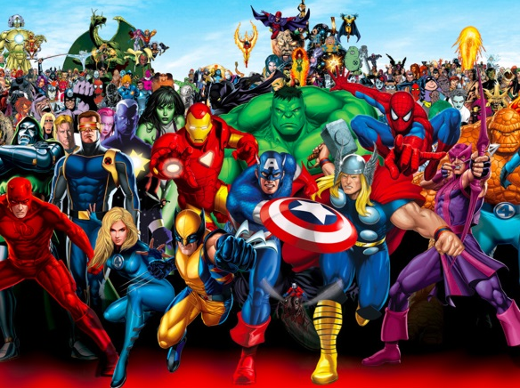



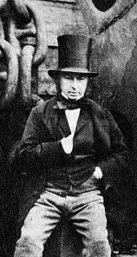
English
We are reading the text ‘The Lighthouse Keeper’s lunch and The Lighthouse Keepers Cat:
Diary writes
Writing a sequence
Persuasive letter
Grammar Focus:
Using ‘and’ to join sentences
Using capital letters for proper nouns
Use exclamation marks
Values & PHSE
We will focus on the values of Love and Humility and discuss the British Value of Mutual Respect. Jigsaw – Healthy Me. We will focus on healthy choices and how to stay physically active.
Maths
We will be learning addition and subtraction facts of number 16-20 and learn how about ½ and ¼. We will learn positional language and learn about turns.
See Knowledge Organiser for Maths.
Year 1Term 4 2026
Super Heroes
D&T – Mechanisms
We will practise and learn the skills needed to design and make a moving Ferris wheel (inspired by Brunel’s designs!)
We will evaluate our own work and think of ways to improve.
To add sounds to a 2Create a Story file.
PE - We will follow Get set 4 PE and will be learning about target games and invasion skills.
See Knowledge Organiser for PE
Reading
Children are rewarded every 20 reads with a new rainbow reading book mark.
We expect children to read at least 4 times a week.
Computing
Children to understand the difference between traditional and digital books. The children will use 2Create a Story to design their own character, background, animation and text.
History Famous Heroes in History and how they have changed our lives.
We learn about Isambard Kingdom Brunel and think about how he has affected our local area.
See Knowledge Organiser
for History.
Science - Materials
We will continue our topic on materials. We will look at how to make products wind and waterproof. We will think about why certain materials are chosen for different items and why they are suitable.
See Knowledge organiser for Science.

