Slide 1
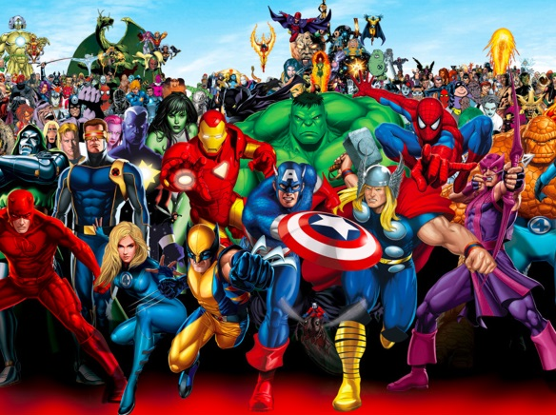



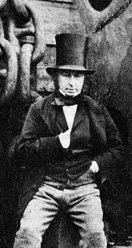
English
We are reading the text ‘The Lighthouse Keeper’s lunch and George’s Marvellous Medicine.’ Writing Focus:
Diary writes
Writing a sequence
Persuasive letter
Grammar Focus:
Using noun phrases, conjunctions and complex sentences.
Editing and improving sentences
Values & PHSE
We will focus on the values of Love and Humility and discuss the British Value of Mutual Respect. Jigsaw – Healthy Me. We will focus on ways to stay healthy physically and emotionally. We will think about healthy eating and medicine safety.
Maths
We will be learning factions and how to find fractions of shapes and numbers. We will learn measures including time and then we’ll focus on money.
See Knowledge Organiser for Maths.
Year 2 Term 4 2026
Super Heroes
D&T – Mechanisms
We will practise and learn the skills needed to design and make a moving Ferris wheel (inspired by Brunel’s designs!)
We will evaluate our own work and think of ways to improve.
PE - We will follow Get set 4 PE and will be learning about target games and invasion skills.
See Knowledge Organiser for PE
Reading
Children are rewarded every 20 reads with a new rainbow reading book mark.
We expect children to read at least 4 times a week.
Computing
Learners will learn the term ‘data’ and begin to understand what data means and how this can be collected in the form of a tally chart. They will then progress onto presenting data in the form of pictograms and finally block diagrams
History Famous Heroes in History and how they have changed our lives.
We learn about Isambard Kingdom Brunel and think about how he has affected our local area.
See Knowledge Organiser
for History.
Science - Living things and their habitats
We will follow an enquiry to learn about what habitats and microhabitats are and how these enable plants, animals and humans to stay alive. We will focus on the difference between things that are living, dead and things that have been never alive. We will look at food chains and then look at the journey that food takes from the farm to the supermarket.

