Slide 1




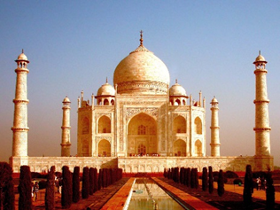

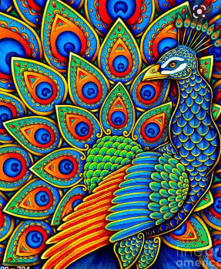
English
We will start the term writing a character description on a monster we will be designing. We are also reading the texts ‘The Pirate Cruncher,’ and ‘Clean Up.’ Writing Focus:
Descriptions
Information texts
Grammar Focus:
Commas in lists
Possessive Apostrophes
Adverbs
Subordinate clauses
Expanded noun phrases
Values & PHSE We will focus on the values of Honesty and Caring.
Jigsaw – Relationships. We will focus on the importance of family, friendship, trust and kindness.
Maths
This term we will be looking at data handling .We will learn about pictograms and how to interpret what these says. We will look at temperatures and measuring capacities and learn about litres and millilitres.
See Knowledge Organiser for Maths
Year 2 Term 5 2026
Incredible India
Art
We will start the lesson by exploring through making. We will learn about worry dolls and plan, design and then make our own worry dolls. We will then evaluate our work and think about how we would improve it if we did it again.
Science – Living things and their habitats - around the world
We will be learning about habitats and microhabitats around the world. We will look at how habitats can change and will compare the Artic to Antarctica.
See Knowledge Organiser for Science
Geography – Where in the world is India?
We use be using atlases to locate where we are in the world and where India is. We will learn the oceans of the world and what it means to be near the equator.
We will also be looking at features of life in an Indian village and comparing them to the UK. We are looking forward to tasting some Indian food and comparing it typically British Food.
We will also then create our own maps.
See Knowledge Organiser for Geography
Computing
We are learning about online relationships and how to communicate safely. We will also look at music and sound and how to create atmosphere with music software.
Reading
We expect children to read at least 4 times a week. This term we will continue to use our reading buddies and rainbow reading to encourage reading at home.

