Slide 1
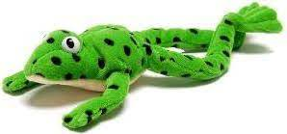
Word Time!
1.1
Don’t forget to use your Fred Talk if you need to.
Then….
Fred in your head!

Slide 2

1.1 green words
Please help your child read and write these words.

Slide 3
mad

Slide 4
sad

Slide 5
dad

Slide 6
mat

Slide 7
sat

Slide 8
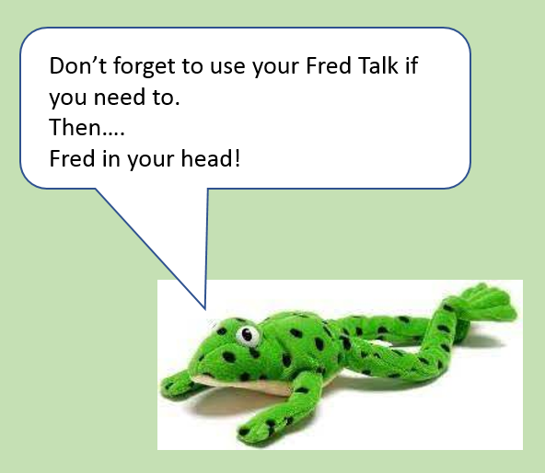
Word Time!
1.2

Slide 9
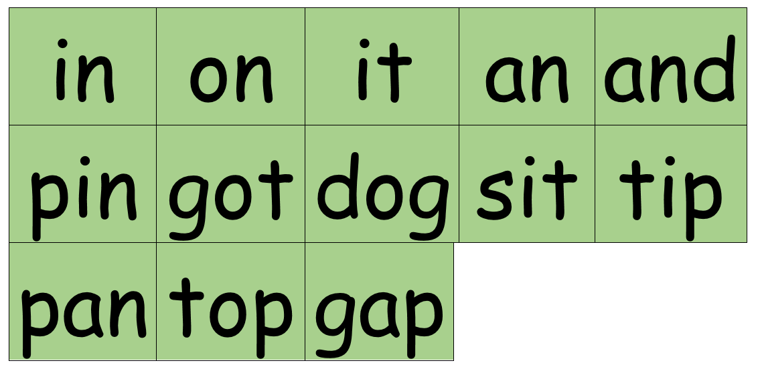
1.2 green words
Please help your child read and write these words.

Slide 10
in

Slide 11
on

Slide 12
it

Slide 13
an

Slide 14
and

Slide 15
pin

Slide 16
got

Slide 17
dog

Slide 18
sit

Slide 19
tip

Slide 20
pan

Slide 21
top

Slide 22
gap

Slide 23
Word Time!
1.3

Slide 24
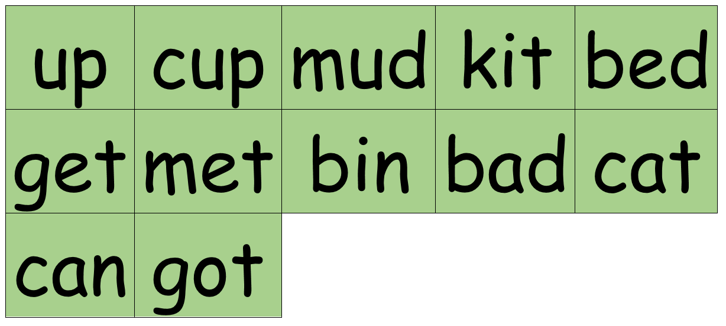
1.3 green words
Please help your child read and write these words.

Slide 25
up

Slide 26
cup

Slide 27
mud

Slide 28
kit

Slide 29
bed

Slide 30
get

Slide 31
met

Slide 32
bin

Slide 33
bad

Slide 34
cat

Slide 35
gap

Slide 36
can

Slide 37
got

Slide 38
Word Time!
1.4

Slide 39
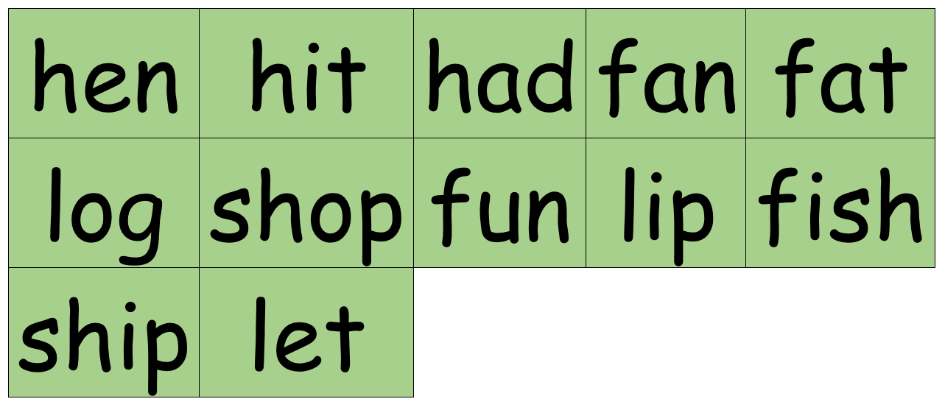
1.4 green words
Please help your child read and write these words.

Slide 40
hen

Slide 41
hit

Slide 42
had

Slide 43
fan

Slide 44
fat

Slide 45
log

Slide 46
shop

Slide 47
fun

Slide 48
lip

Slide 49
fish

Slide 50
ship

Slide 51
let

Slide 52
Word Time!
1.5

Slide 53
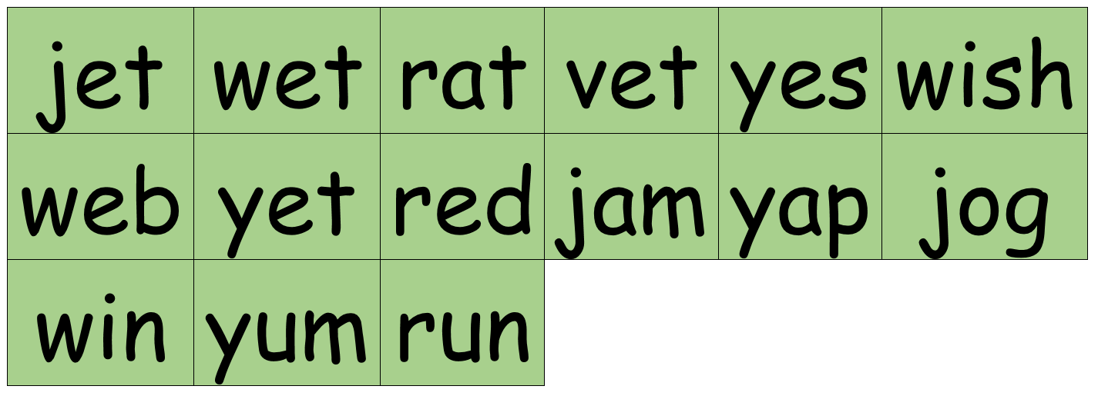
1.5 green words
Please help your child read and write these words.

Slide 54
jet

Slide 55
wet

Slide 56
rat

Slide 57
vet

Slide 58
yes

Slide 59
wish

Slide 60
web

Slide 61
yet

Slide 62
red

Slide 63
jam

Slide 64
yap

Slide 65
jog

Slide 66
win

Slide 67
yum

Slide 68
run

Slide 69
Word Time!
1.6

Slide 70
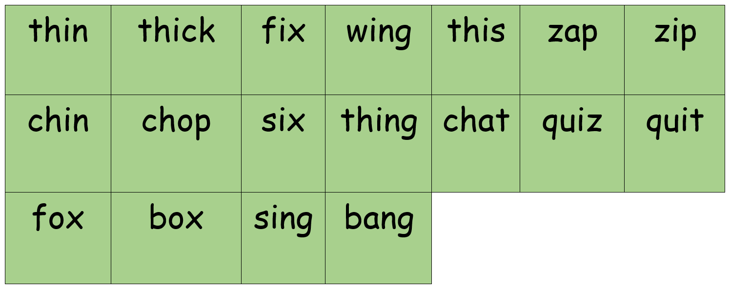
1.6 green words
Please help your child read and write these words.

Slide 71
thin

Slide 72
thick

Slide 73
fix

Slide 74
wing

Slide 75
this

Slide 76
zap

Slide 77
zip

Slide 78
chin

Slide 79
chop

Slide 80
six

Slide 81
thing

Slide 82
chat

Slide 83
quiz

Slide 84
quit

Slide 85
fox

Slide 86
box

Slide 87
sing

Slide 88
bang

Slide 89
Word Time!
1.7

Slide 90
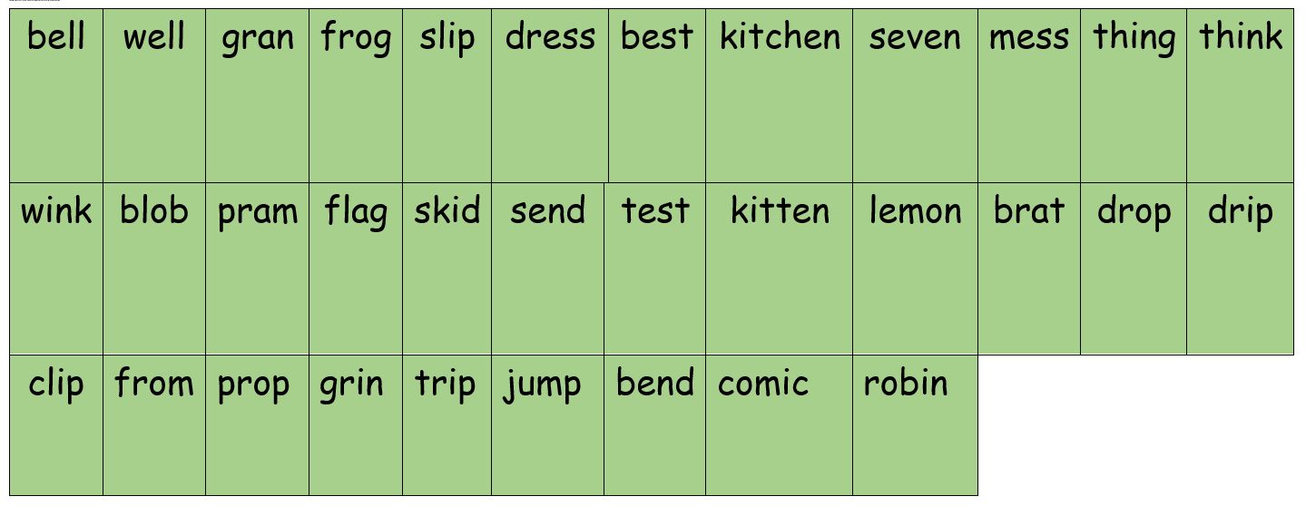
1.7 green words
Please help your child read and write these words.

Slide 91
bell

Slide 92
well

Slide 93
gran

Slide 94
frog

Slide 95
slip

Slide 96
dress

Slide 97
best

Slide 98
kitchen

Slide 99
seven

Slide 100
mess

Slide 101
thing

Slide 102
think

Slide 103
wink

Slide 104
blob

Slide 105
pram

Slide 106
flag

Slide 107
skid

Slide 108
send

Slide 109
test

Slide 110
kitten

Slide 111
lemon

Slide 112
brat

Slide 113
drop

Slide 114
drip

Slide 115
clip

Slide 116
from

Slide 117
prop

Slide 118
grin

Slide 119
trip

Slide 120
jump

Slide 121
bend

Slide 122
comic

Slide 123
robin

