Slide 1
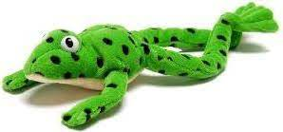
Set 3 Sounds
Green Words
Don’t forget to use your Fred Talk if you need to.
Then….
Fred in your head!

Slide 2
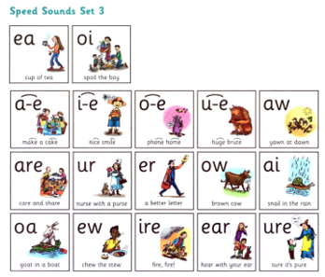
Set 3 Green words
Please help your child read and write these words.

Slide 3

clean

Slide 4
seat

Slide 5
dream

Slide 6
cream

Slide 7
please

Slide 8
scream

Slide 9

join

Slide 10
voice

Slide 11
coin

Slide 12

make

Slide 13
cake

Slide 14
name

Slide 15
same

Slide 16
late

Slide 17
date

Slide 18

smile

Slide 19
white

Slide 20
nice

Slide 21
like

Slide 22
time

Slide 23
hide

Slide 24

home

Slide 25
hope

Slide 26
spoke

Slide 27
note

Slide 28
broke

Slide 29
phone

Slide 30

rude

Slide 31
brute

Slide 32
June

Slide 33

saw

Slide 34
lawn

Slide 35
dawn

Slide 36
crawl

Slide 37
paw

Slide 38
yawn

Slide 39

share

Slide 40
dare

Slide 41
scare

Slide 42
square

Slide 43
bare

Slide 44
care

Slide 45

burn

Slide 46
turn

Slide 47
spurt

Slide 48
nurse

Slide 49
purse

Slide 50
hurt

Slide 51

never

Slide 52
better

Slide 53
weather

Slide 54
after

Slide 55
proper

Slide 56
corner

Slide 57

how

Slide 58
down

Slide 59
brown

Slide 60
cow

Slide 61
town

Slide 62
now

Slide 63

paid

Slide 64
train

Slide 65
paint

Slide 66
rain

Slide 67

goat

Slide 68
boat

Slide 69
road

Slide 70
throat

Slide 71
toast

Slide 72
coat

Slide 73

chew

Slide 74
new

Slide 75
blew

Slide 76
flew

Slide 77
drew

Slide 78
grew

Slide 79

fire

Slide 80
hire

Slide 81
wire

Slide 82
bonfire

Slide 83
inspire

Slide 84
conspire

Slide 85

hear

Slide 86
dear

Slide 87
fear

Slide 88
near

Slide 89
year

Slide 90
ear

Slide 91

picture

Slide 92
mixture

Slide 93
creature

Slide 94
future

Slide 95
adventure

Slide 96
temperature

Slide 97
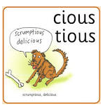
delicious

Slide 98
suspicious

Slide 99
viscious

Slide 100
scrumptious

Slide 101
precious

Slide 102
ferocious

Slide 103
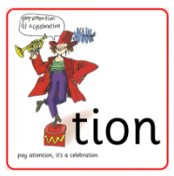
tradition

Slide 104
attention

Slide 105
celebration

Slide 106
conversation

Slide 107
congratulation

Slide 108
exploration

