Slide 1
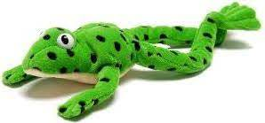
Set 2 Sounds
Green Words
Don’t forget to use your Fred Talk if you need to.
Then….
Fred in your head!

Slide 2
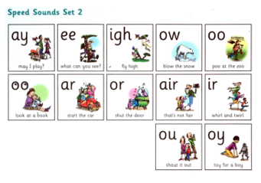
Set 2 Green words
Please help your child read and write these words.

Slide 3
play

Slide 4
may

Slide 5
say

Slide 6
day

Slide 7
way

Slide 8
spray

Slide 9
see

Slide 10
been

Slide 11
seen

Slide 12
three

Slide 13
green

Slide 14
sleep

Slide 15
high

Slide 16
light

Slide 17
bright

Slide 18
blow

Slide 19
know

Slide 20
low

Slide 21
snow

Slide 22
show

Slide 23
slow

Slide 24
fair

Slide 25
hair

Slide 26
chair

Slide 27
stair

Slide 28
air

Slide 29
lair

Slide 30
girl

Slide 31
bird

Slide 32
third

Slide 33
whirl

Slide 34
twirl

Slide 35
dirt

Slide 36
out

Slide 37
shout

Slide 38
loud

Slide 39
mouth

Slide 40
round

Slide 41
found

Slide 42
toy

Slide 43
boy

Slide 44
enjoy

Slide 45
too

Slide 46
food

Slide 47
moon

Slide 48
zoo

Slide 49
poo

Slide 50
spoon

Slide 51
took

Slide 52
book

Slide 53
cook

Slide 54
look

Slide 55
shook

Slide 56
foot

Slide 57
car

Slide 58
part

Slide 59
hard

Slide 60
start

Slide 61
star

Slide 62
sharp

Slide 63
sort

Slide 64
short

Slide 65
horse

Slide 66
sport

Slide 67
snort

