Slide 1

Welcome to Year 1
Information PowerPoint
Autumn 2026

Slide 2
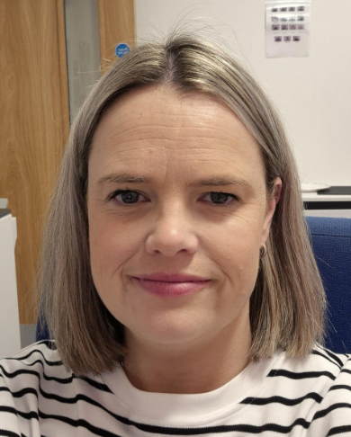
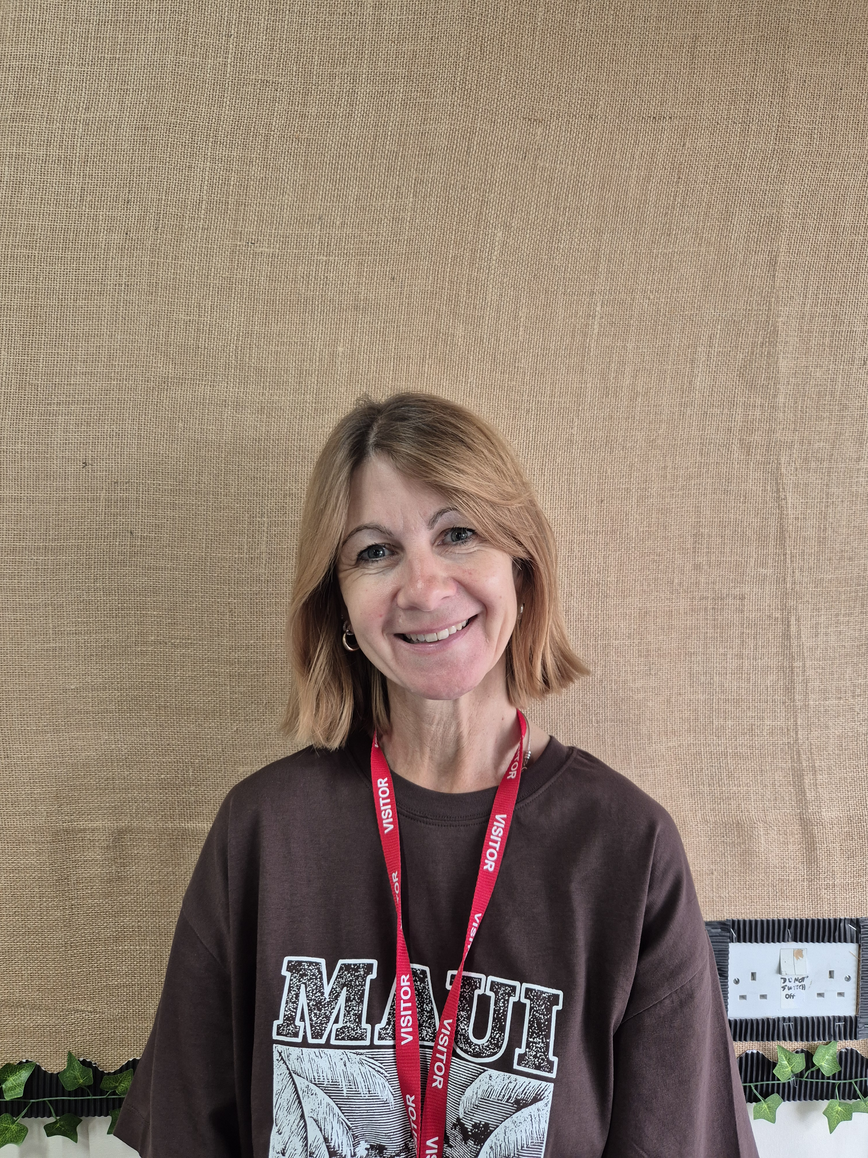
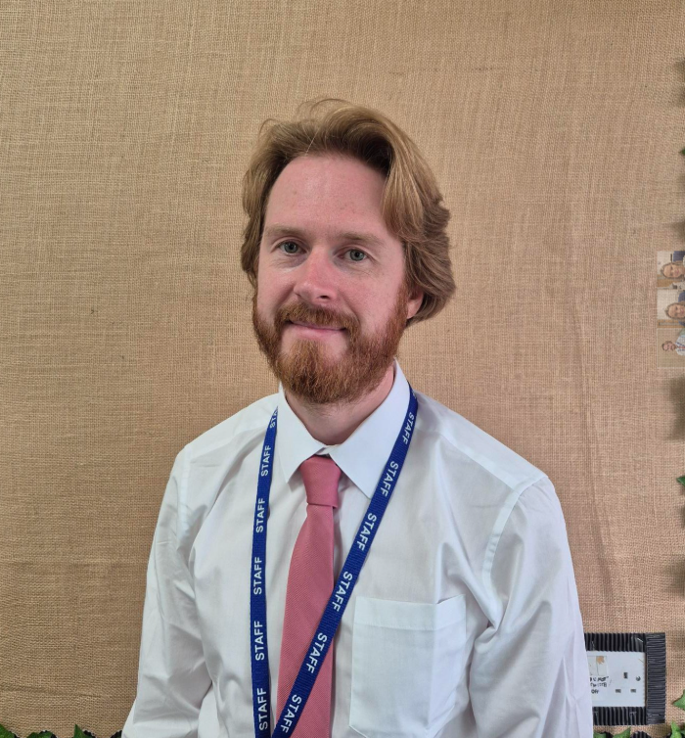
Meet the Year 1 Team
Mrs Cambell
Learning Support Assistant
Miss MacIntyre
Class Teacher
Mr Gray
HLTA

Slide 3

Year 1 Timetable
Time | Activity
8:40-8:50am | Morning Activity
8:50am | Registration
9:00-9:40am | Phonics
9:45-10:30am | English
10.30-10:45am | Assembly
10:45-11.00am | Breaktime
11:00-11.15am | Story / Snack
11.15-12.00noon | Maths
12.00 - 1:00pm | Lunchtime
1:05-2:05pm | Foundation Subjects / Discovery
2.10-2.25pm | Playtime
Time | Activity
8:40-8:50am | Morning Activity
8:50am | Registration
9:00-9:40am | Phonics
9:45-10:30am | English
10.30-10:45am | Assembly
10:45-11.00am | Breaktime
11:00-11.15am | Story / Snack
11.15-12.00noon | Maths
12.00 - 1:00 | Lunchtime
2.30-3.15 | Guided Reading / Mastering Numbers / H.W
3.20pm | Hometime

Slide 4
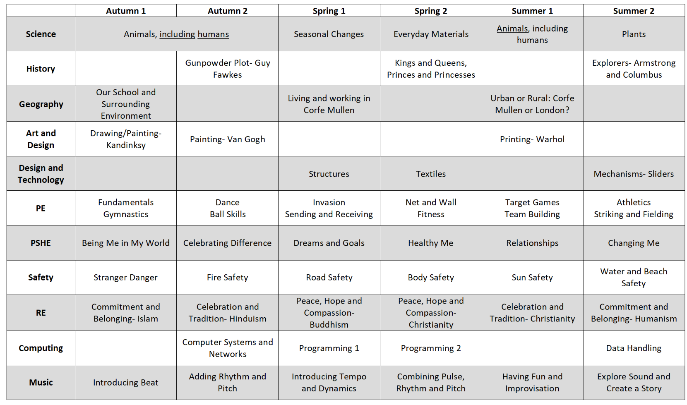
Our Learning Journeys

Slide 5
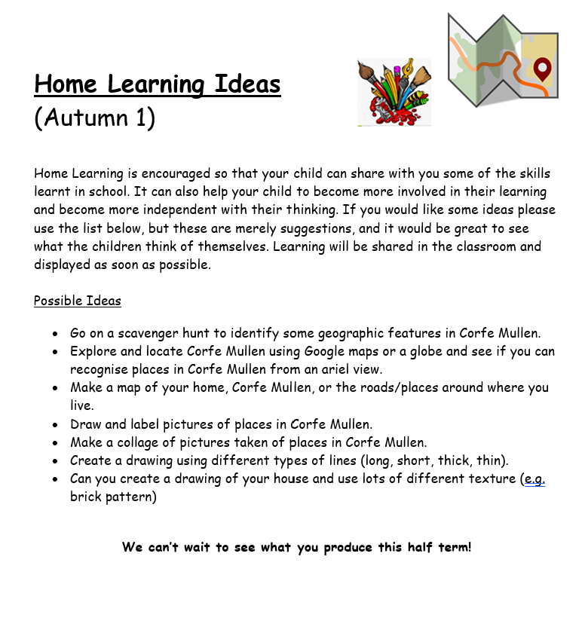
Home Learning
You will receive a curriculum leaflet and home learning sheet with ideas of learning the children could do at home. Please only use this as a guide as I know the children will have lots of other imaginative ideas!
We love seeing all of the home learning the children get up to and the children really enjoy sharing their experiences with their peers. If you would prefer not to send learning into school, please email me a picture of the learning or places you have been and we can continue to share what the children have been up to.
This will be sent home on Friday

Slide 6


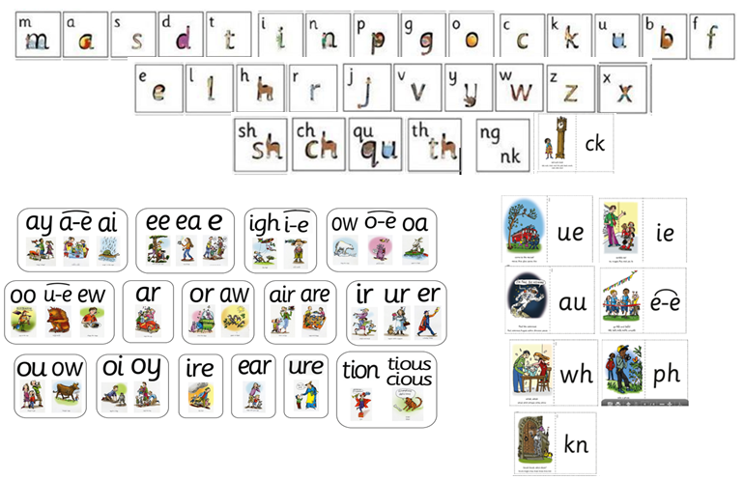
Phonics
We will have another meeting later in the year focusing on The Year 1 Phonics Screening.
We teach phonics and reading for 40 minutes a day. The class will be split into further groups to enable us to provide learning more tailored and responsive to each individual.
As a rule of thumb, children in Year 1 review Set 2 sounds from Reception and secure all Set 2 sounds for reading and spelling. They are then taught to read and spell words using Set 3 sounds with fluency and accuracy, including additional uncommon digraphs (e.g ie, au, ear, ue)

Slide 7
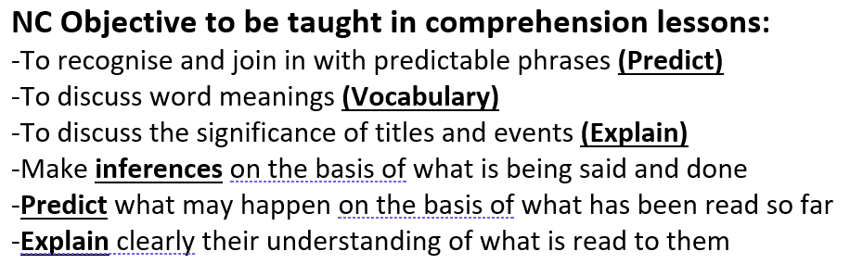




Reading
In addition to reading in their Phonics’ groups, the children will also participate in whole class guided reading lessons.

Slide 8



Books Going Home
Learn to Read Book
Your child will read this confidently as they have read it all week at school and it matches the phonics they have been learning so far.
Book Bag Book
Matches your child’s current phonics learning and knowledge of red words but gives your child the opportunity to read these in a book they haven’t seen before.
Love to Read Book
A book chosen by your child from the library to share together at home.

Slide 9

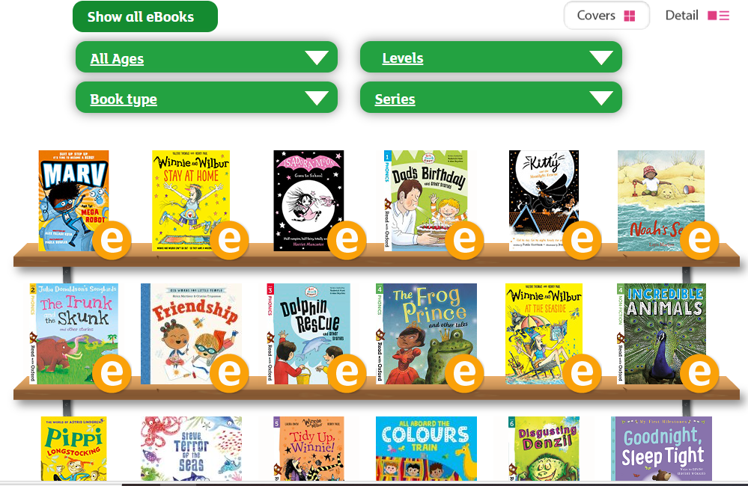
Free eBook library | Oxford Owl from Oxford University Press

Slide 10
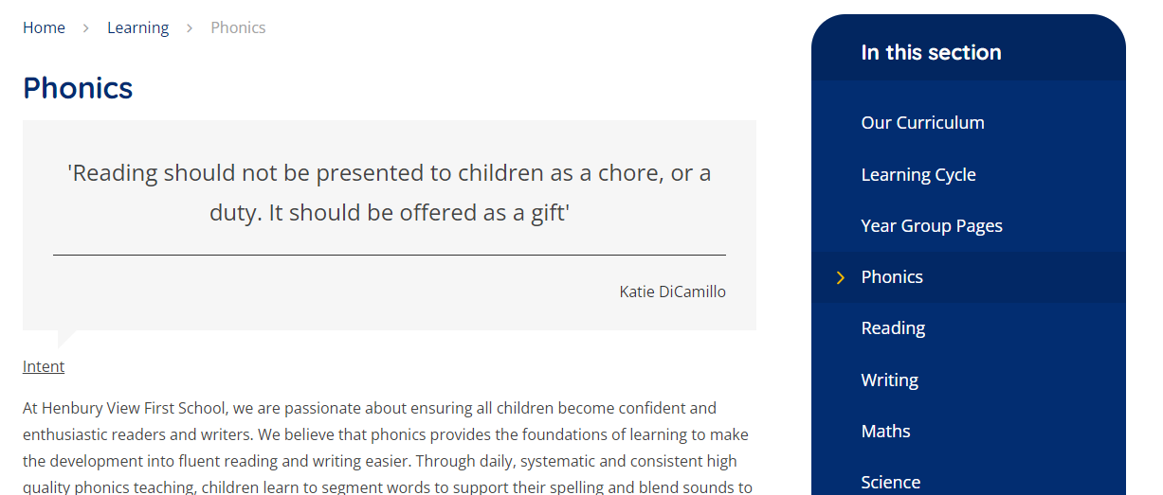
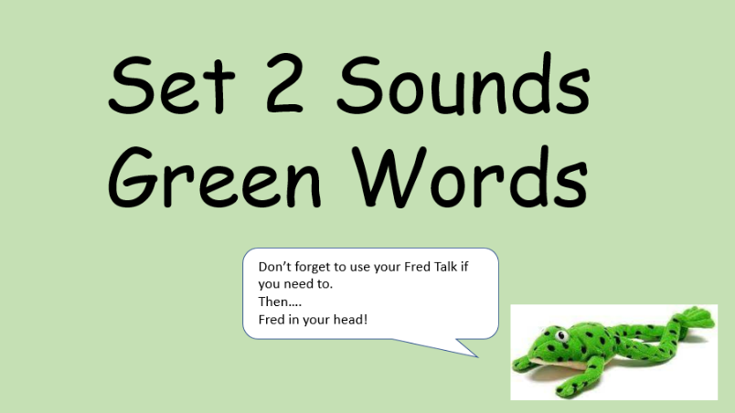
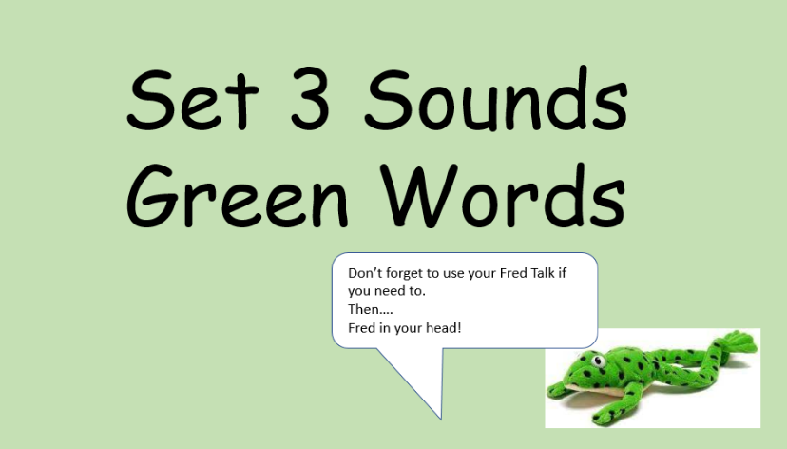
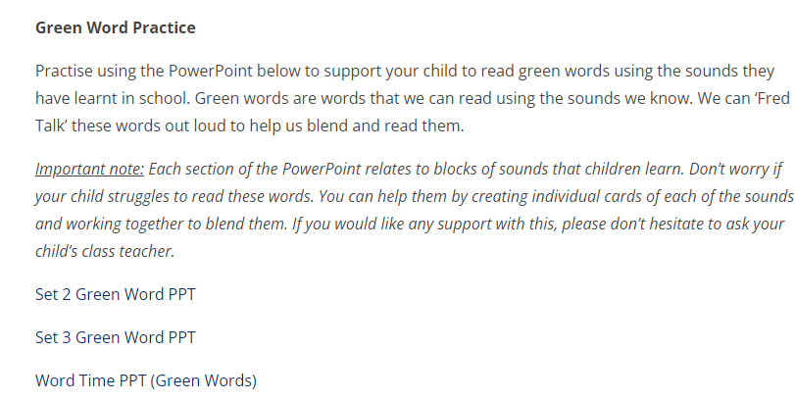

Resources on Our School Website

Slide 11


Reading Records
You don’t need to write too much!
Examples:
*A signature and tick three times stating you have simply read the book is great!
“X read most green words independently but struggled with sh sound so we worked on this together.”
“X read all of the speedy green words in under 1 minute. We played games to beat her time.”
“After the third read, X was confident on all sounds apart from nk.”
Learn to Read Books
These are the books we would love to see recorded in your reading record at least x3 per week.
You can of course log other reads from your own selection and library books too!
Reading with your child is one of the most important things you can do to help at home. We will keep a weekly check of who is reading at least x3 times per week, please do let us know if you want any further support. We are always happy to help!

Slide 12
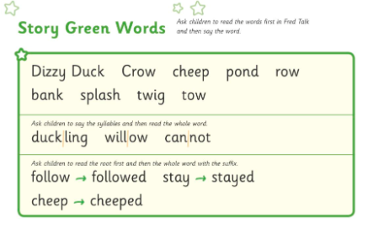
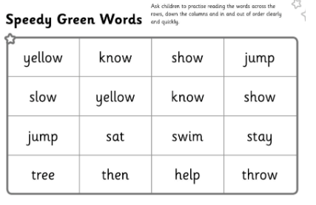
Learn to read books
Encourage your child to use the phrase ‘Fred talk, read the word’ when they are practising key story green words that will appear in the book.
It is useful to go through these words before reading the book.
These words will be at the back of the book. Encourage your child to read these speedily. Keep revising and practising the words that your child is less confident with over the week.

Slide 13
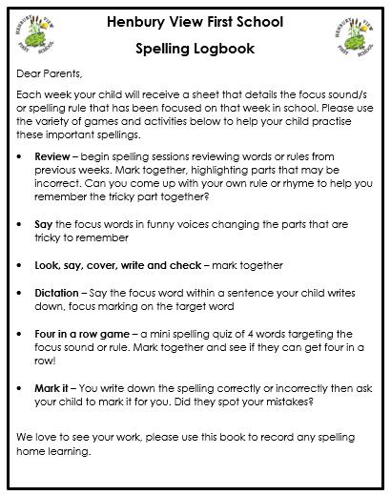
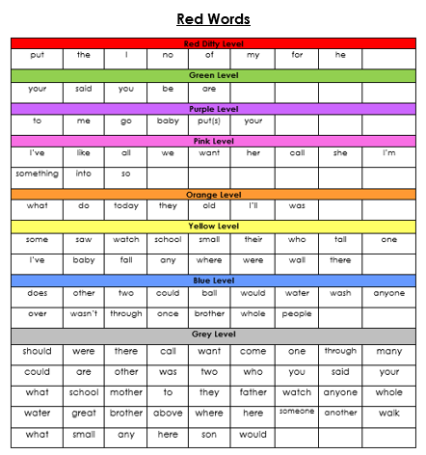


Log Books

Slide 14
Please remember to bring book bags into school every day with these key items in
There are routines and systems in place that ensures your child will receive all of the books they need as well as new log book slips for the week.
It is difficult for us to manage this if book bags are not in school every day with all of these items.

Slide 15

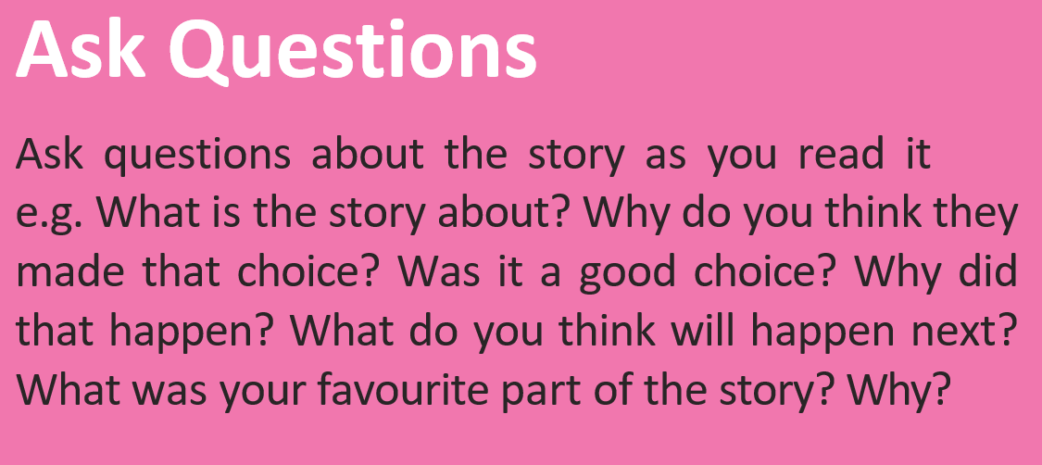
Top Tips for reading at home
Ask your child to read the title
Look at the picture on the cover
Talk about what the book might be about based on the image and title
I think this book could be about…….because…..
On the cover I can see…..and this makes me think….
The title says…..so I think…………

Slide 16
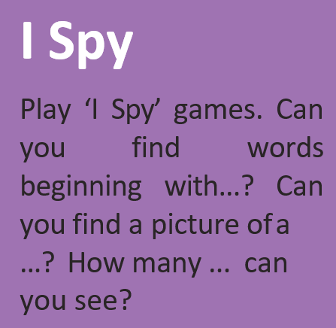


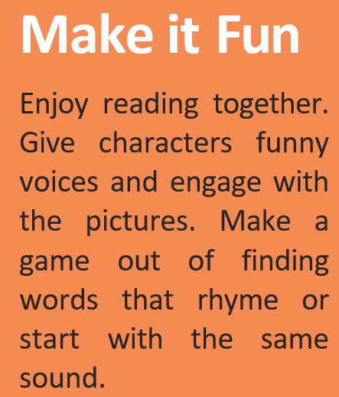


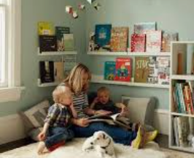
Top Tips for reading at home

Slide 17

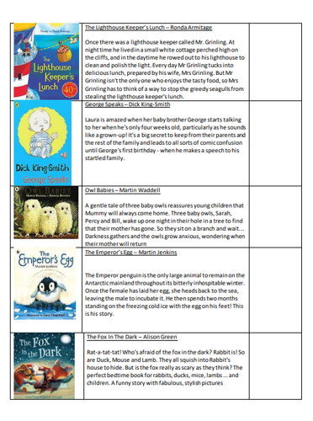
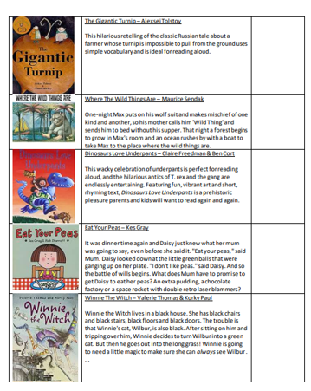



Reading Awards
Please do not feel you need to buy the books on this list, you can borrow many of these from school using our class book swap.
We will check the lists once a term to see who needs to be celebrated with a certificate in assembly. Please email the Y1 email once achieved and bring in your ticked sheets on these dates:
Return dates will be on Year 1 Leaflet that comes out on Friday

Slide 18
English- Writing
Over the year, we will ensure that the children experience and write both fiction and non-fiction, and different writing styles within these (e.g. letter writing, instructions, recounts, etc.). Our work during our reading sessions will support the writing, both through looking at structure and vocabulary. The children will have a clear purpose and audience for each piece of writing.
Text Immersion
Vocabulary & Dictation
Grammar & Dictation
Sentence Construction
Planning
Let’s Write and Edit

Slide 19

English- Key Texts for Autumn

Slide 20
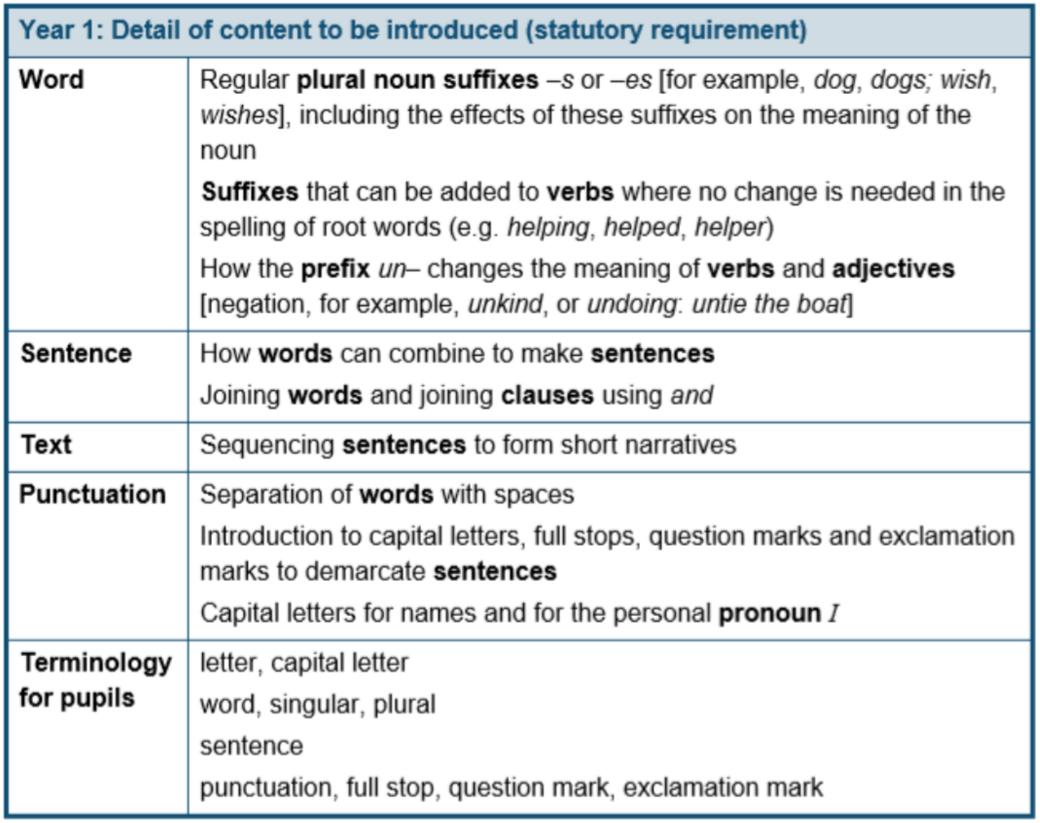


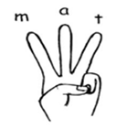

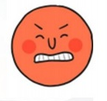
English- Writing
We would encourage the children to write at home if they would like, but even picking out these features (e.g. finger spaces, capital letters and full stops) when reading at home would be a good reminder for them..
Appendix 2

Slide 21

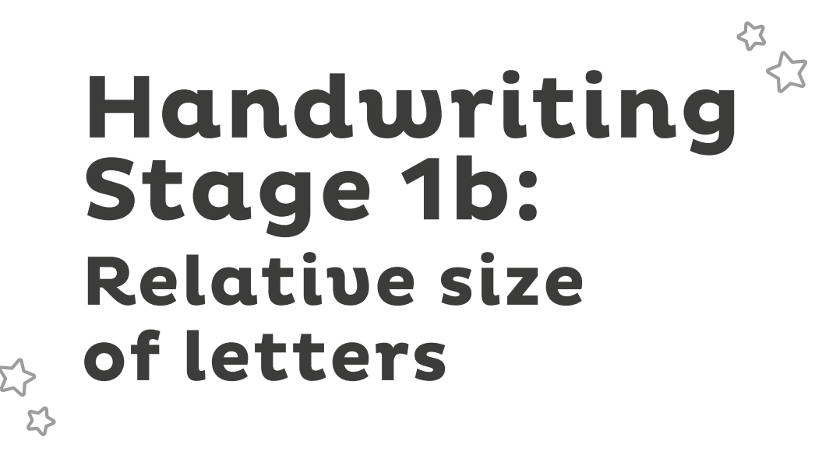



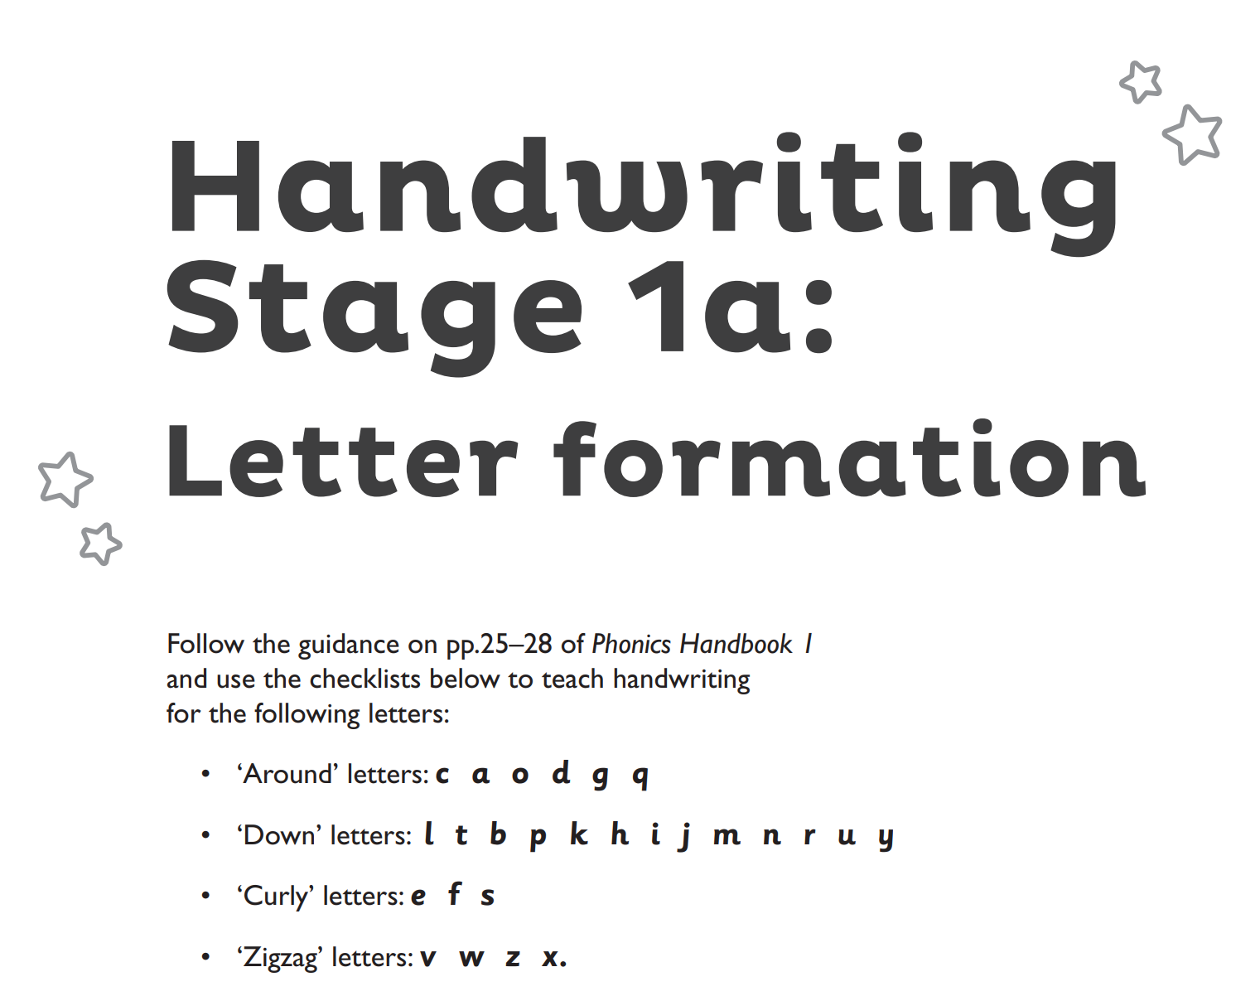
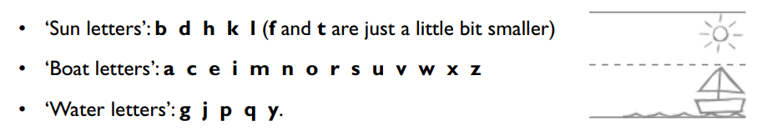
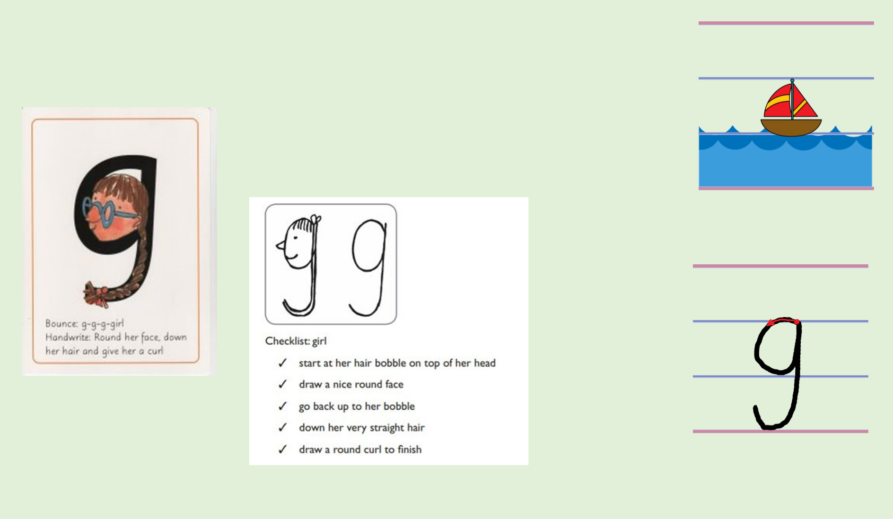
Handwriting
https://www.henburyview.dorset.sch.uk/page/?title=Writing&pid=93&action=saved

Slide 22



Maths
In Maths, we follow this daily lesson structure:
This allows children to constantly consolidate their number facts, which supports them when approaching new concepts and more complex problems.
We will primarily use NCETM as our guide for teaching the main activities. This also provides us with high-quality pictorial representations of the mathematical concepts we are teaching (for Place Value, Addition and Subtraction, Multiplication and Division and Fractions). For other areas of the curriculum and to supplement our learning, we will use White Rose resources (for measures, statistics, geometry).

Slide 23
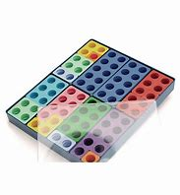
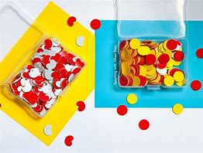
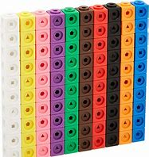
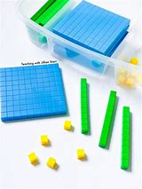
Maths
We will continue to use concrete resources and pictorial representations to help our learning journey, ensuring the children develop conceptual understanding of the concepts that we look at. The children will be given time to ‘experience’ the maths by using hands on thinking before moving through the learning journey. At all stages the children will be given opportunities to problem solve and make connections between different areas of maths. Maths can often be very abstract, so we aim to ensure that the children notice the real world applications of maths and see the worth in what they are learning about.

Slide 24
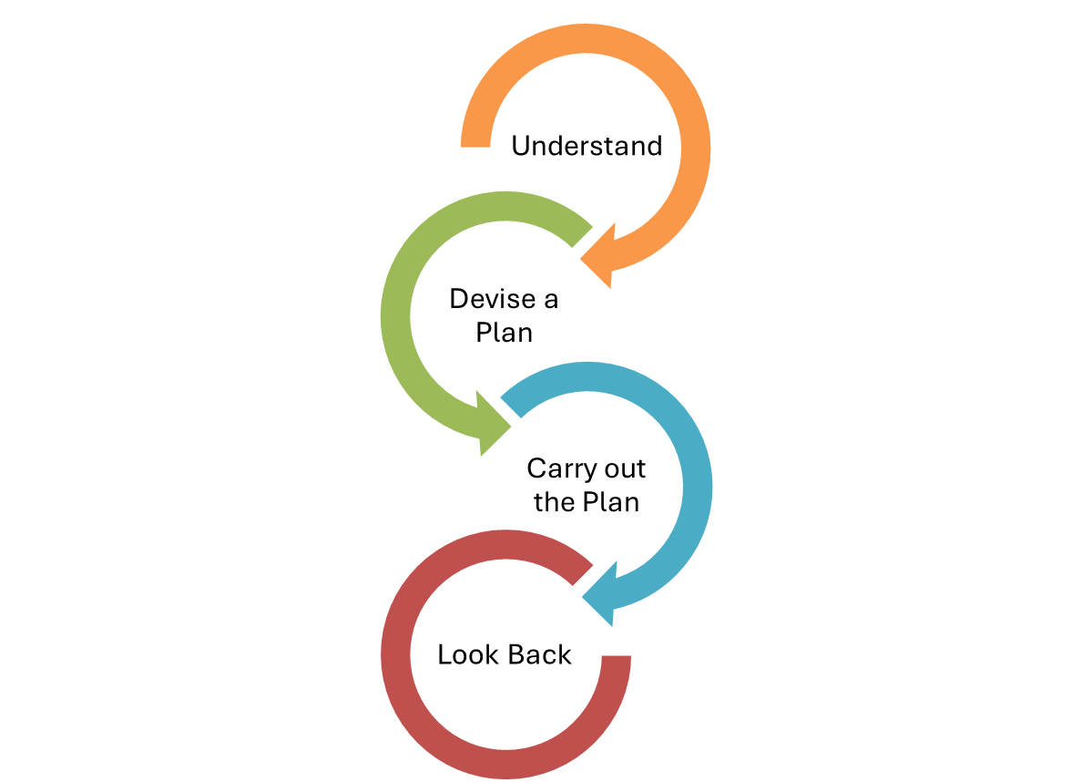

Maths – problem solving
Problem solving and reasoning are not just tasks to complete, it’s a way of working and thinking mathematically:
Being able to draw on a range of strategies
Being systematic and methodical
Knowing how to approach a problem and having the confidence to try
Perseverance and patience
Grappling – being flexible with their approach
Applying a range of knowledge and knowing what knowledge could apply
Justifying and discussing their ideas
Strategies
Trial and Improvement (Aut 1)
Working systematically
Working backwards
Visualising and manipulating
Reasoning and convincing
Conjecturing and generalizing
Pattern spotting

Slide 25
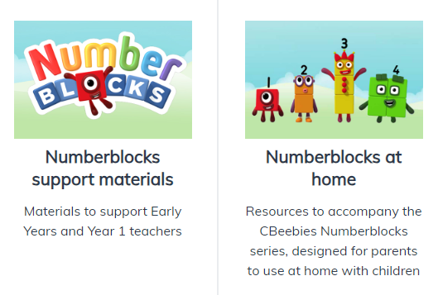
Maths – mastering number
In Year 1 and Year 2, we will also be using the Mastering Number programme to supplement our learning.
This programme aims to to secure firm foundations in the development of good number sense for all children from Reception through to Year 2. The aim over time is that children will leave KS1 with fluency in calculation and a confidence and flexibility with number.
It utilises Number Blocks as a
high-quality support for learning mathematics and it is fun!

Slide 26


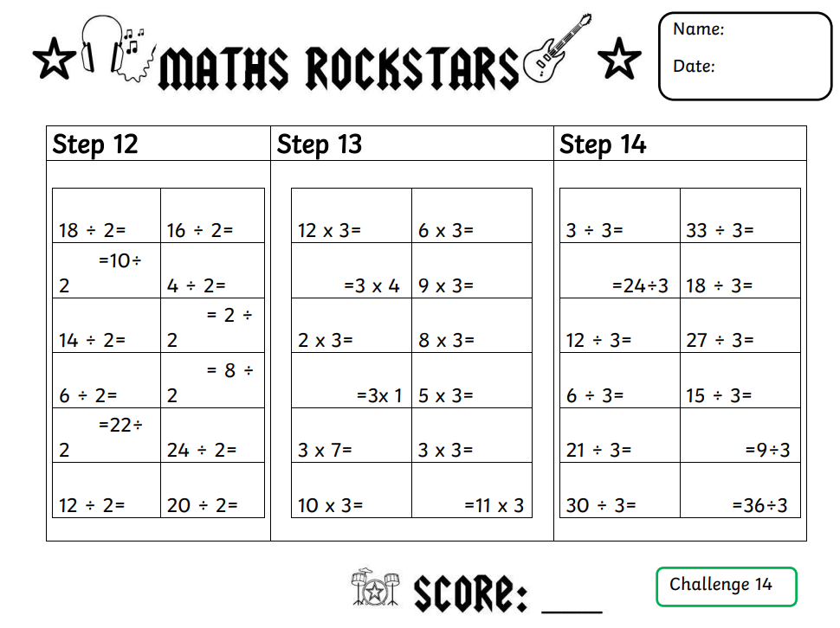
Maths- Times Tables
Times tables are used in lots of areas of mathematics, for example fractions, area, perimeter, money as well as multiplication and division calculations. Fluency and quick recall are also essential for multi-step problem solving and real word applications.
We are going to teach times tables for 1 lesson per week as well as during daily starters. This lesson will involve a chance for children to be tested on their steps, independent practice of their next step and teacher led teaching of the times table.
Maths Rockstars
Children assessed at the start of each year to gain a baseline
Have a step at a time to achieve- to move up, they must be able to recall previous 2 steps and complete new step within 5 minutes
Children to have pupil log in book bags to show progress
Please ensure Maths Rockstars logs are in bookbags on a Friday

Slide 27

PE
Our PE sessions are scheduled for Monday and Tuesday. Monday’s session will be an outdoor lesson (weather dependent!) and on Tuesday we will be inside
Please ensure that PE kits come into school on a Monday and we will send them home on a Friday to be washed. Please also check that all PE kit is clearly named and that the children have some warmer clothes (e.g. joggers, PE jumper) for when the weather starts to get colder

Slide 28




Forest School
Every Wednesday
Learning, growing and exploring outdoors
Every Wednesday
Our Ethos
Forest School takes place weekly, on Wednesdays, for the whole class. Morning or afternoon sessions.
Forest School is hands-on, child-led learning outdoors. Through play, exploration and managed risk-taking in our woodland area, children build confidence, resilience, teamwork and a lifelong connection with nature — come rain or shine!
Non-School Uniform
Please send your child in old clothes they don’t mind getting wet or muddy — no school uniform on Forest School days.
Waterproofs & Boots
Sessions are led by Mr. Guppy and run in all but the most severe weather.
Pack waterproofs and wellies/boots in a separate, named bag, ready to change into.

Slide 29




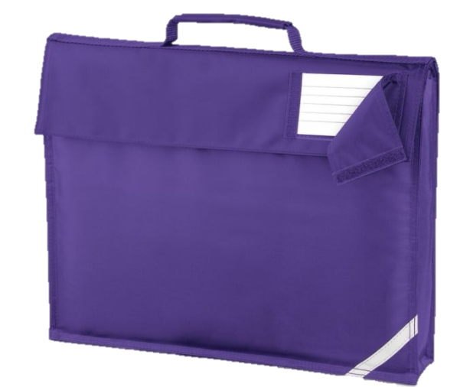

Things to Remember
Home Learning
We love sharing home learning at school so please bring this in whenever you wish
PE Kits
PE kits need to come in on a Monday and will be sent home every Friday
Bookbags and Reading Records
Please ensure bookbags come into school everyday. This is so we can record any reading we do or give out any letters.
Snack
Children are provided fruit at breaktime, however if you prefer to provide your own snack, we ask if this could still be a healthy choice.

Slide 30
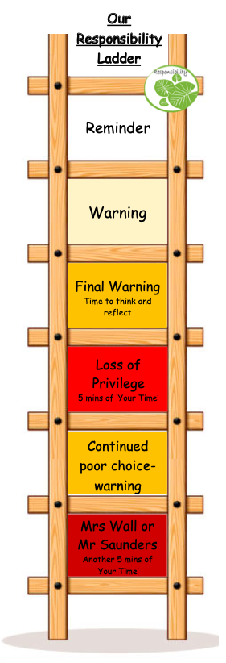
Responsibility Ladder and ‘Your Time’
We continue to use our responsibility ladder as part of our behaviour policy. This ensures that there is consistency across classrooms and members of staff. Rewards and praise are used across the school to celebrate successes and positive behaviour and learning choices (e.g. team points, stickers, etc.)
‘Your Time’ is a 30-minute session on a Friday afternoon, where children get to choose an activity that they would like to do. This allows them to be individuals, work with staff and children from across the school and follow areas of interest. Each child starts each week with 30-minutes of ‘Your Time’, and minutes are deducted for negative behaviour choices (see ladder). This ensures that children that always make the correct choices, whether that be inside or outside of the classroom, are celebrated and rewarded for their behaviour.

Slide 31


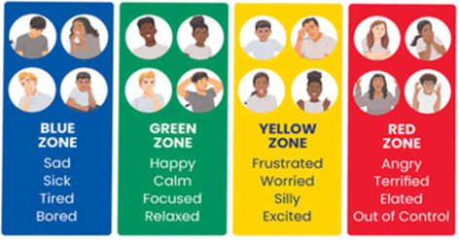

We will begin by teaching the children what regulation is.
As the year goes on, children will learn to identify which ‘zone’ they are in at different points during the day. They will then learn different strategies that they can use to regulate their emotions, so that they are able to cope with how they are feeling in a healthy way.

Slide 32
Contact us…
We are really looking forward to an exciting year ahead. We hope you have found this information useful. There is also lots of information on the website:
Henbury View First School - Year 1
If you have any questions about anything in this PowerPoint, or if you have any questions or queries at any point during the year, please don’t hesitate to email us or the school office at:
office@henburyview.dorset.sch.uk
year1@henburyview.dorset.sch.uk

