Slide 1

Welcome to Year 3
Information PowerPoint
Autumn 2026

Slide 2
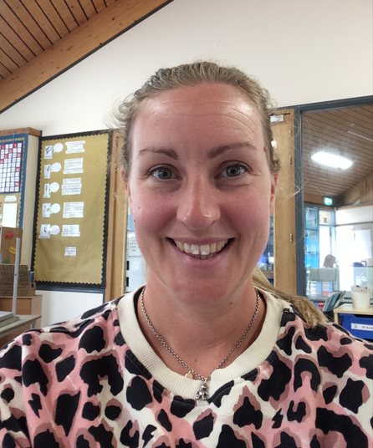
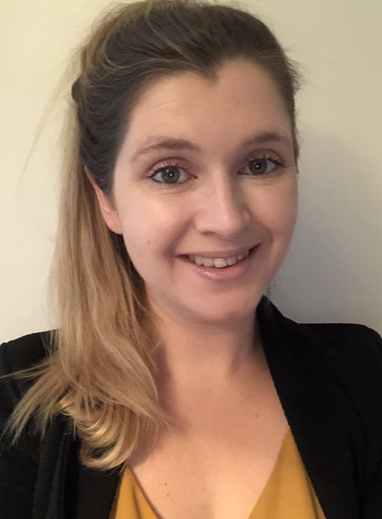
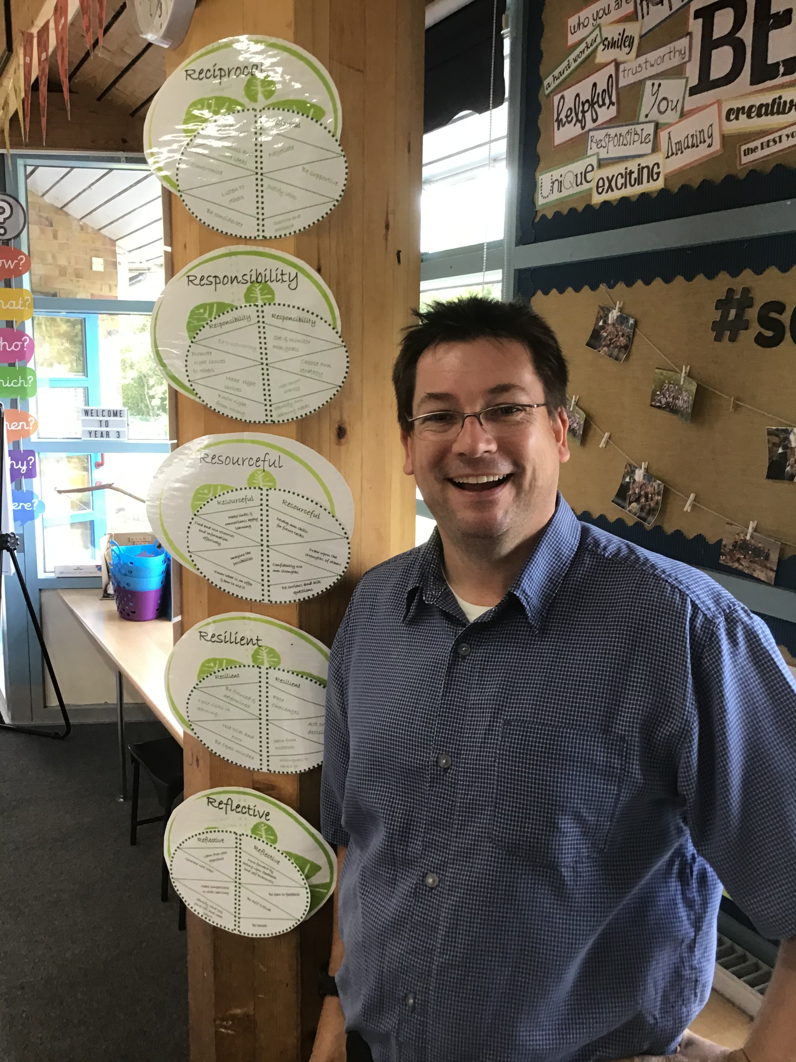
Meet the Year 3 Team
Miss Stainton
Class Teacher
Mon & Tues
Mrs Nicoll
Class Teacher
Weds, Thurs, Fri
Mr Guppy
HLTA

Slide 3
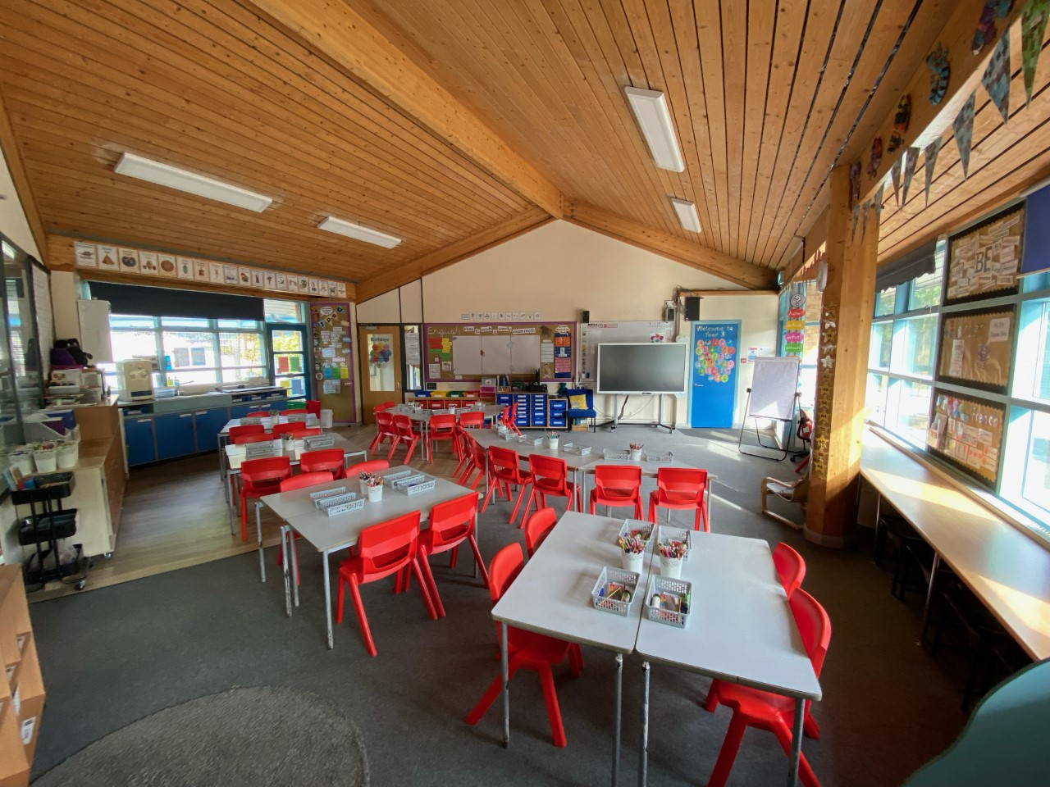
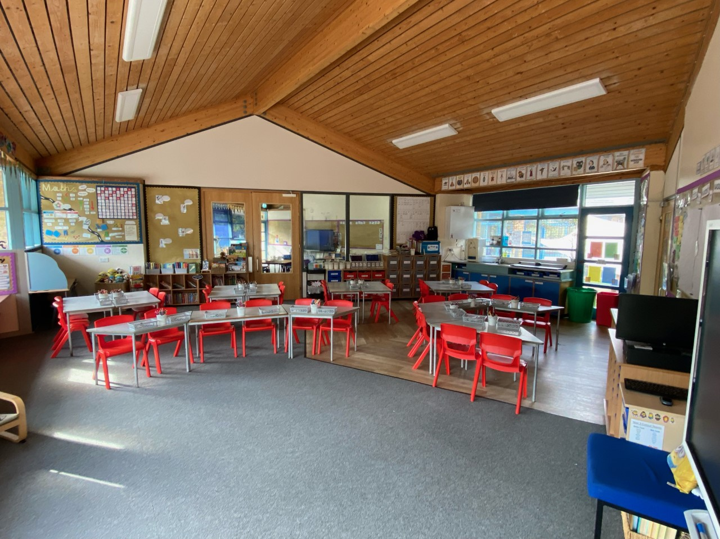
Our Classroom

Slide 4

Year 3 Timetable
Time | Activity
8:40-8:50am | Morning Activity
8:50-9am | Registration
9-9:40am | Guided Reading
9:40-10:30am | English
10:30-10:45am | Assembly
10:45-11:00am | Breaktime
11:00-12noon | Maths
12-1pm | Lunchtime
1-1:25pm | Spelling
1:25-2:55pm | Foundation Subjects
2:55-3:15pm | Whole Class Read
3:20pm | Home

Slide 5
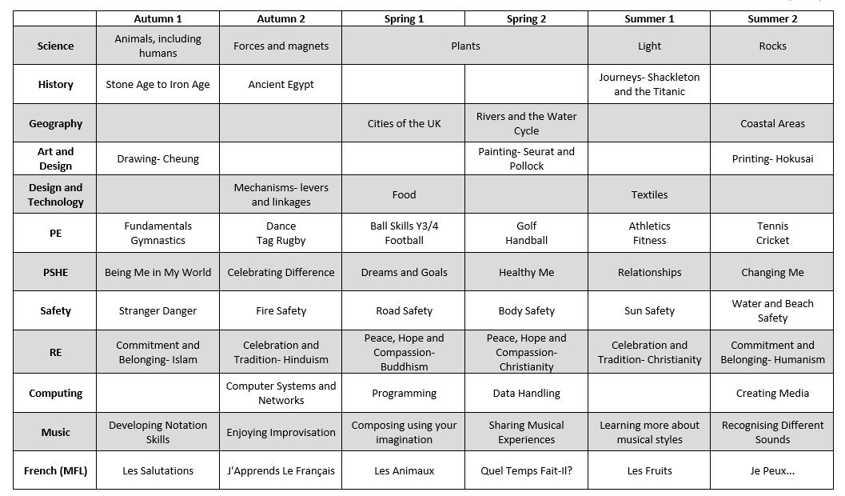
Our Learning Journeys

Slide 6

Homework
Each Week
Piece of English, Maths or topic-based learning (in purple book)
Reading x 3 a week (in homework log)
Spellings (in spelling log)
Times Tables (Maths Rockstars)
Each week, children in KS2 receive homework. This is a bridging step to support the preparation for middle school and the expectations middle schools have.
Initially, this homework will be very short and brief to help get the children into the routine of completing and handing it in.
Homework is given out on a Friday and handed in on Wednesday (or before if you prefer). Homework will reflect many different areas of the curriculum and will often be in response or prepare for learning in school.

Slide 7
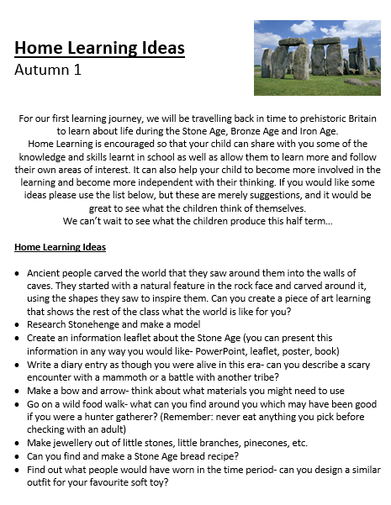
Home Learning
You will have received a curriculum leaflet and home learning sheet with ideas of learning the children could do at home. Please only use this as a guide as I know the children will have lots of other imaginative ideas!
This is completely optional but gives you some ideas if your children want to do something at home.
We love seeing all of the home learning the children get up to and the children really enjoy sharing their experiences with their peers. If you would prefer not to send learning into school, please email a picture of the learning or places you have been and we can continue to share what the children have been up to.

Slide 8




Books Going Home
Children will bring home a Learn to Read book that is colour banded.
Colour bands for Years 3 and 4 are now:
Brown 8
Brown 9
Brown 10
Brown 11
Grey 12
Grey 13
Grey 14
Dark Blue 15
Dark Blue 16
Dark Red 17
Love to Read Book
A book chosen by your child from the library to share together at home.

Slide 9


Reading Records
Examples:
*A signature and tick three times stating you have simply read the book is great!
*Children can record the title, date and number of pages they have read at each read and you can just sign.
*We encourage the children to change their books weekly to ensure they read a variety of texts although we understand children reading lengthy titles will need longer to finish a book.
Learn to Read Book
This is the book we would love to see recorded in your reading record at least x3 per week.
You can of course log other reads from perhaps your library book or even your own books but this is the one we really want to see logged.
Reading with and encouraging your child to read is one of the most important things you can do to help at home. We will keep a weekly check of who is reading at least x3 times per week, please do let us know if you want any further support. We are always happy to help!

Slide 10

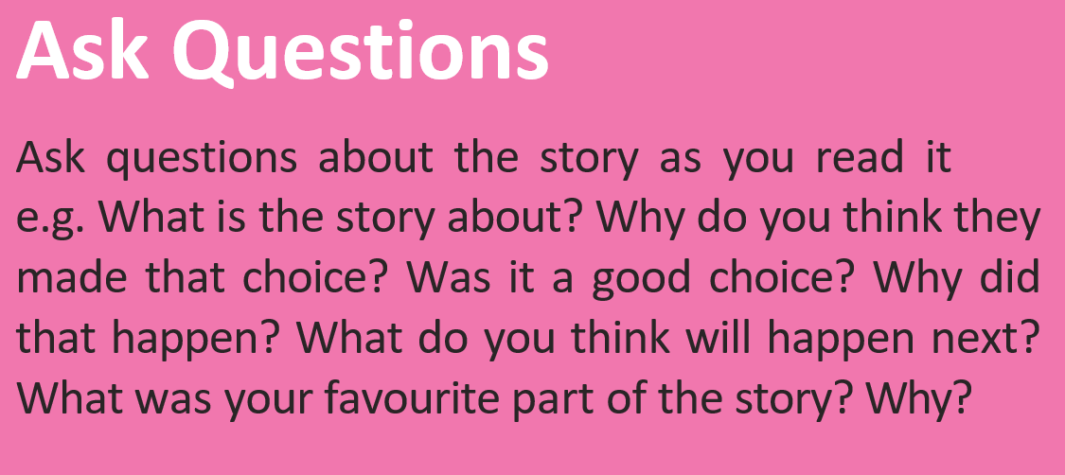
Top Tips for reading at home
Ask your child to read the title
Look at the picture on the cover
Talk about what the book might be about based on the image and title
I think this book could be about…….because…..
On the cover I can see…..and this makes me think….
The title says…..so I think…………

Slide 11


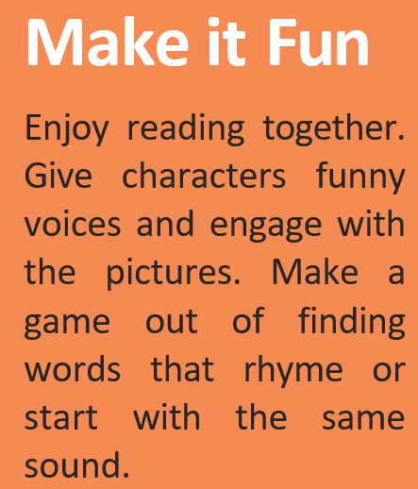


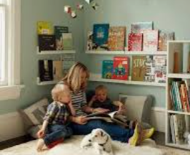
Top Tips for reading at home

Slide 12







Reading Awards
Please do not feel you need to buy the books on this list, you can borrow many of these from school using our class book swap.
We will check the lists once a term to see who needs to be celebrated with a certificate in assembly. Please look out on school bulletins for date to bring in your ticked sheets (usually the last week of term).

Slide 13
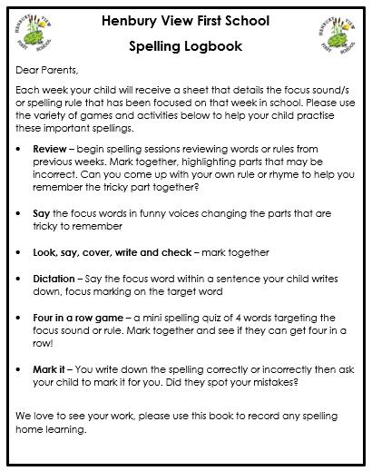
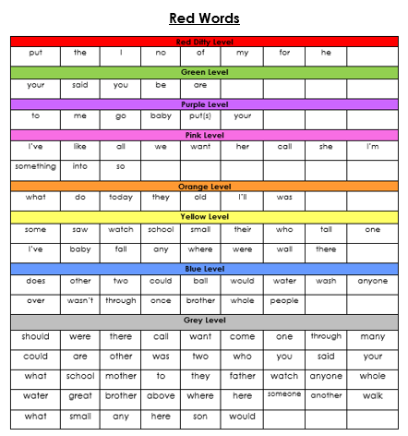
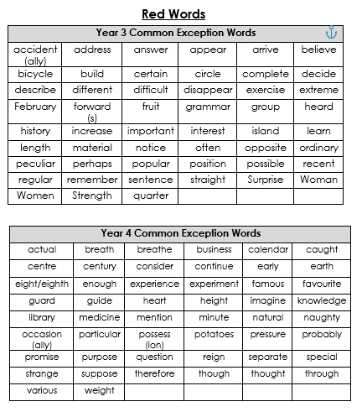


Spelling Logbooks

Slide 14
Please remember to bring book bags into school every day with these key items in
There are routines and systems in place that ensures your child will receive all of the books they need as well as new spelling slips for the week.
It is difficult for us to manage this if book bags are not in school every day with all of these items.

Slide 15

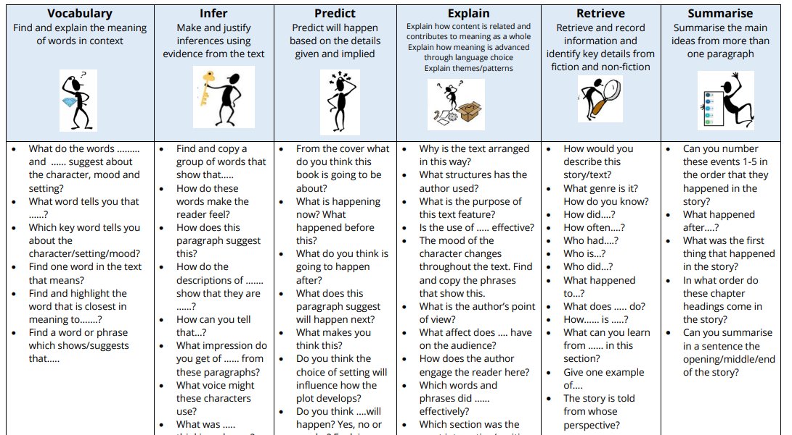



English- Reading
The children will read as a class every day. As the children’s word reading becomes more fluent, the focus becomes more on their understanding of what they have read.

Slide 16
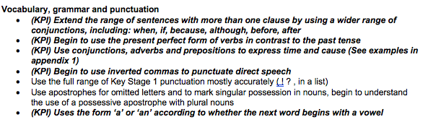
English- Writing
Over the year, we will ensure that the children can experience and write both fiction and non-fiction, and different writing styles within these (e.g. letter writing, instructions, recounts, etc.). Our work during our reading sessions will support the writing, both through looking at structure and vocabulary. The children will have a clear purpose and audience for each piece of writing.
For writing, we follow the Reading into Writing process. This ensures that children are fully immersed in the genre and have the opportunity to pick apart excellent examples of the genre before writing their own pieces. The children create a toolkit if the skills they need which acts as a success criteria for their own writing.
Punctuation and grammar skills will continue to be taught throughout the year. We will start by revisiting and securing the independent application of the skills from Year 2 before moving on the Year 3 curriculum. Here are the Year 3 punctuation and grammar objectives that we will focus on this year:
When reading at home, please pick out these skills and if the children choose to write, please edit with the children to include these accurately.

Slide 17
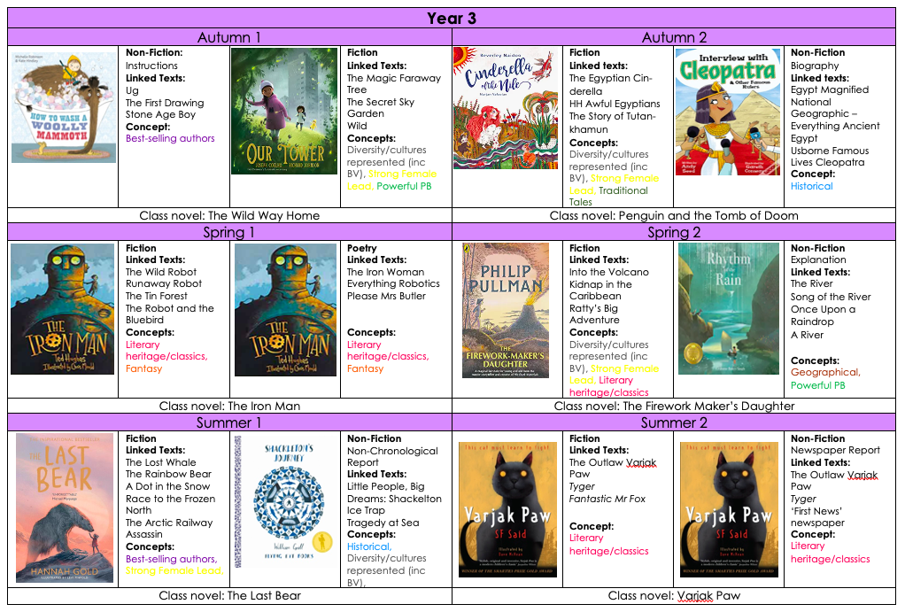
English- Writing LTP

Slide 18



We use a scheme that follows on from Read Write Inc handwriting that the children will be used to from KS1.

Slide 19



Maths
In Maths, we follow this daily lesson structure:
This allows children to constantly consolidate their number facts, which supports them when approaching new concepts and more complex problems.
We will primarily use NCETM as our guide for teaching the main activities. This also provides us with high-quality pictorial representations of the mathematical concepts we are teaching (for Place Value, Addition and Subtraction, Multiplication and Division and Fractions). For other areas of the curriculum and to supplement our learning, we will use White Rose resources (for measures, statistics, geometry).

Slide 20
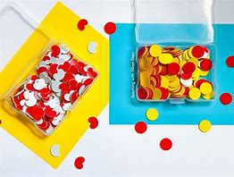
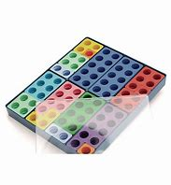
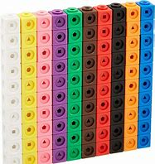
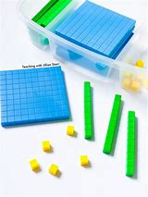
Maths
We will continue to use concrete resources and pictorial representations to help our learning journey, ensuring the children develop conceptual understanding of the concepts that we look at. The children will be given time to ‘experience’ the maths by using hands on thinking before moving through the learning journey. At all stages the children will be given opportunities to problem solve and make connections between different areas of maths. Maths can often be very abstract, so we aim to ensure that the children notice the real world applications of maths and see the worth in what they are learning about.

Slide 21
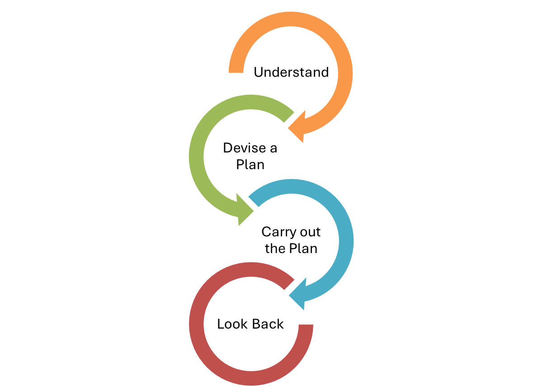
Maths- Problem Solving
Every half term the children will take part in discrete problem solving lessons, which will give the children dedicated time to learn problem solving skills and strategies.
Problem solving and reasoning are not just tasks to complete, it’s a way of working and thinking mathematically:
Being able to draw on a range of strategies
Being systematic and methodical
Knowing how to approach a problem and having the confidence to try
Perseverance and patience
Grappling – being flexible with their approach
Applying a range of knowledge and knowing what knowledge could apply
Justifying and discussing their ideas

Slide 22
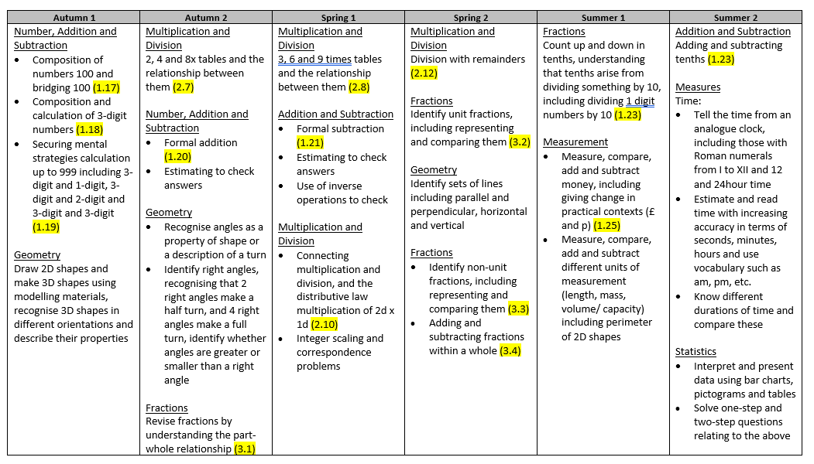
Maths- LTP

Slide 23

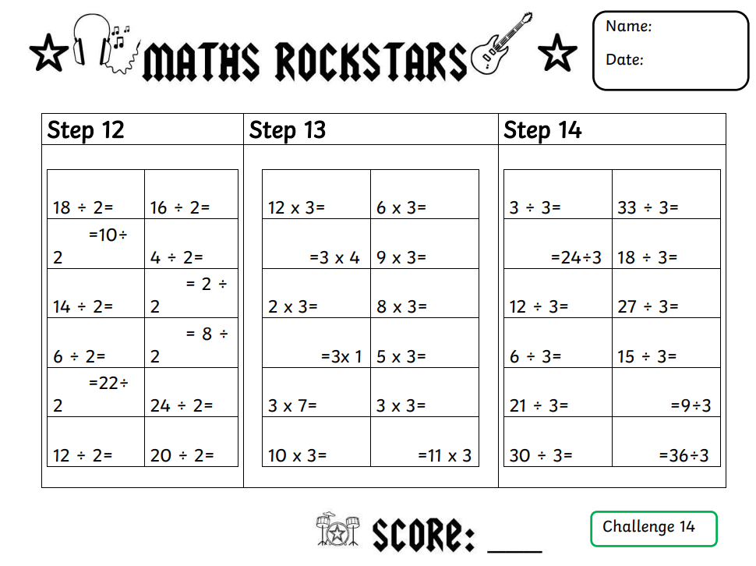
Maths- Times Tables
Times tables are used in lots of areas of mathematics, for example fractions, area, perimeter, money as well as multiplication and division calculations. Fluency and quick recall are also essential for multi-step problem solving and real word applications.
We are going to teach times tables for 1 lesson per week as well as during daily starters. The weekly lesson will involve a chance for children to be tested on their steps, independent practise of their next step and teacher led teaching of the times table.
Maths Rockstars
Children will start the year 2 steps behind where they finished Year 2
They will have a step at a time to achieve- to move up, they must be able to recall previous 2 steps and complete new step within 3 minutes
Please ensure Maths Rockstars logs are in bookbags on a Friday

Slide 24

PE
Our PE sessions are scheduled for Thursday and Friday. Thursday’s session will be an indoor lesson and on Friday we will be outside (weather dependent!)
Please ensure that PE kits come into school on a Monday and we will send them home on a Friday to be washed. Please also check that all PE kit is clearly named and that the children have some warmer clothes (e.g. joggers, PE jumper) for when the weather starts to get colder

Slide 25




Forest School
Every Wednesday
Learning, growing and exploring outdoors
Every Wednesday
Our Ethos
Forest School takes place weekly, on Wednesdays, for the whole class. Morning or afternoon sessions.
Forest School is hands-on, child-led learning outdoors. Through play, exploration and managed risk-taking in our woodland area, children build confidence, resilience, teamwork and a lifelong connection with nature — come rain or shine!
Non-School Uniform
Please send your child in old clothes they don’t mind getting wet or muddy — no school uniform on Forest School days.
Waterproofs & Boots
Sessions are led by Mr. Guppy and run in all but the most severe weather.
Pack waterproofs and wellies/boots in a separate, named bag, ready to change into.

Slide 26
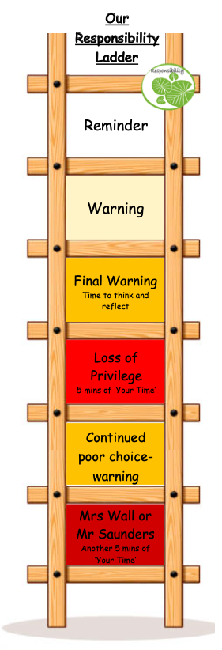
Responsibility Ladder and ‘Your Time’
We continue to use our responsibility ladder as part of our behaviour policy. This ensures that there is consistency across classrooms and members of staff. Rewards and praise are used across the school to celebrate successes and positive behaviour and learning choices (e.g. team points, stickers, etc.)
‘Your Time’ is a 30-minute session on a Friday afternoon, where children get to choose an activity that they would like to do. This allows them to be individuals, work with staff and children from across the school and follow areas of interest. Each child starts each week with 30-minutes of ‘Your Time’, and minutes are deducted for negative behaviour choices (see ladder). This ensures that children that always make the correct choices, whether that be inside or outside of the classroom, are celebrated and rewarded for their behaviour.

Slide 27




Children will be able to access the Calm Corner if they need to regulate, or if they are finding it difficult to focus on their work and need a change of space.
Last year we introduced the children to the Zones of Regulation. This year we would like to build on this by giving the children more strategies to deal with their emotions, without necessarily needing a physical tool.
“It’s OK to feel cross with your friend, but it’s not OK to shout at them. What can you do instead when you feel cross?”

Slide 28




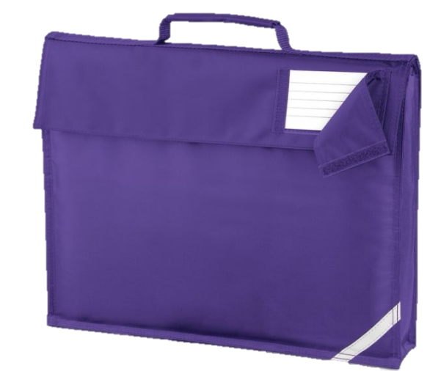
Things to Remember
Spelling Logs
Please ensure spelling logs come into school in the bookbag on a Friday so the new spellings can be stuck in
Bookbags and Homework Logs
Please ensure bookbags come into school everyday. This is so we can record any reading we do or give out any letters.
In KS2, the children can change their choice book whenever they wish. We will endeavor to remind the children daily to change their books if they need to.
We will be checking reading every Friday to acknowledge any comments you have made.
Home Learning
We love sharing home learning at school so please bring this in whenever you wish
PE Kits
PE kits need to come in on a Monday and will be sent home every Friday
Homework
Books in on a Wednesday, returned on Friday
Snack
In KS2, the children are no longer provided fruit at breaktime. Please send your child to school with a snack if you wish to, and we ask if this could still be a healthy choice

Slide 29
Contact us…
We are really looking forward to an exciting year ahead. We hope you have found this information useful. There is also lots of information on the website:
https://www.henburyview.dorset.sch.uk/
If you have any questions about anything in this PowerPoint, or if you have any questions or queries at any point during the year, please don’t hesitate to email us or the school office at:
office@henburyview.dorset.sch.uk
year3@henburyview.dorset.sch.uk

