Slide 1

Welcome to Year 4
Information PowerPoint
Autumn 2026

Slide 2
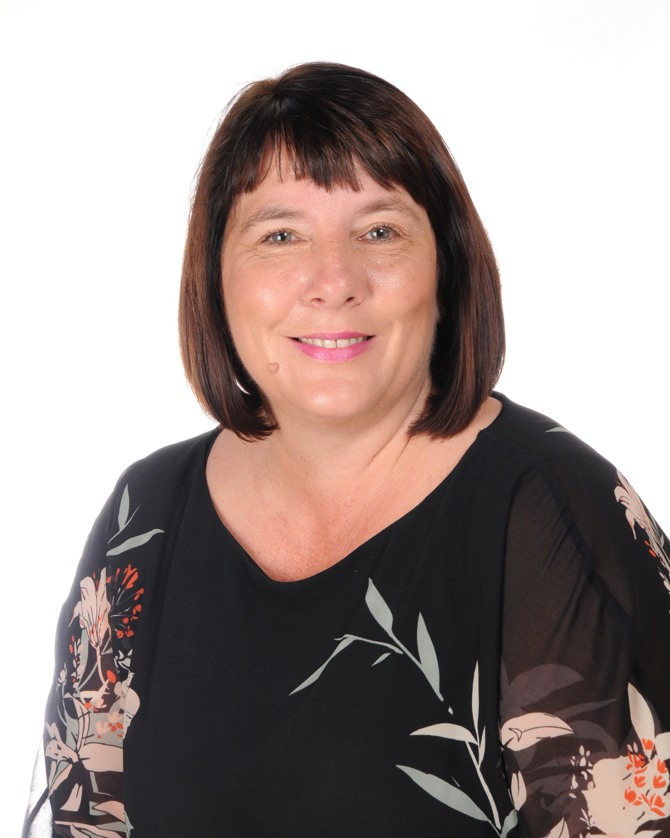
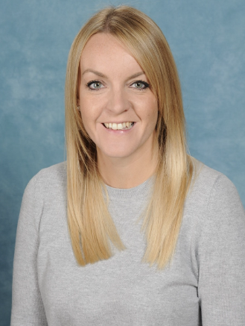
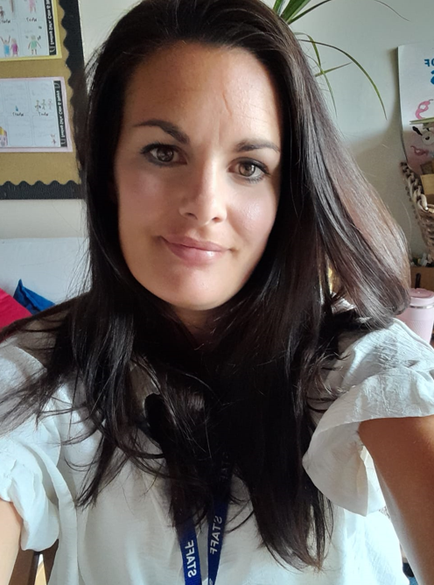
Meet the Year 4 Team
Mrs Dawson
Class Teacher
Mrs Hunt
HLTA
Mrs Bennett
Class Teacher

Slide 3
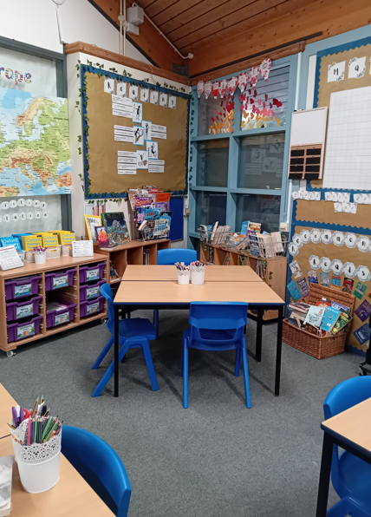
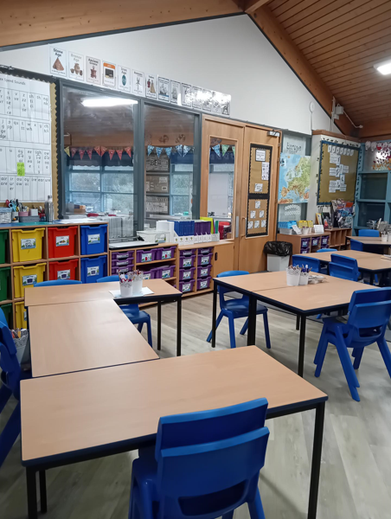
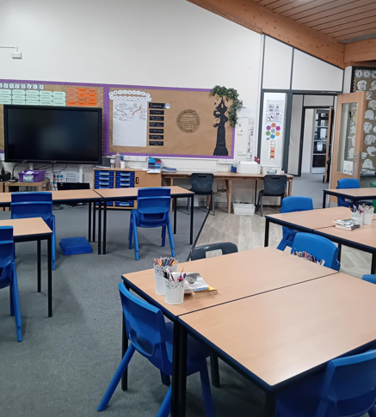
Our Classroom

Slide 4
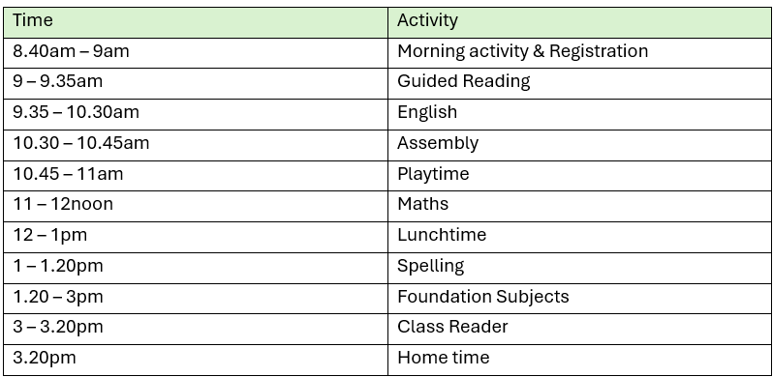

Year 4 Timetable

Slide 5
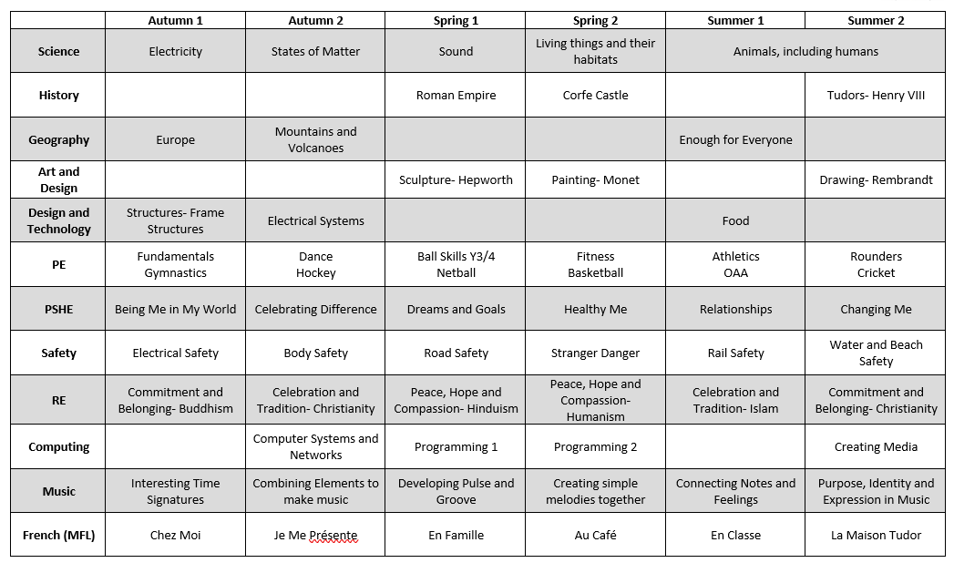
Our Learning Journeys

Slide 6
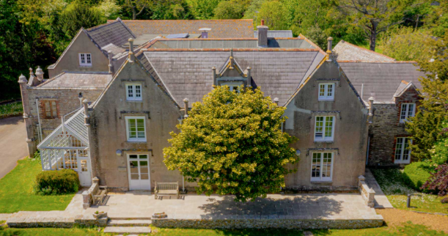
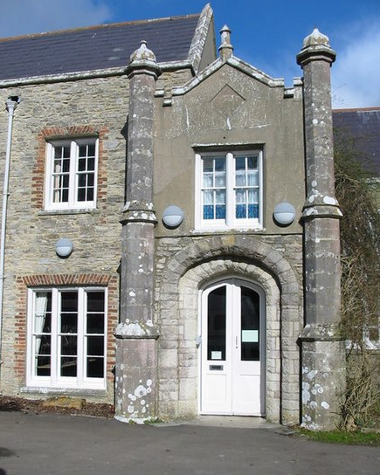
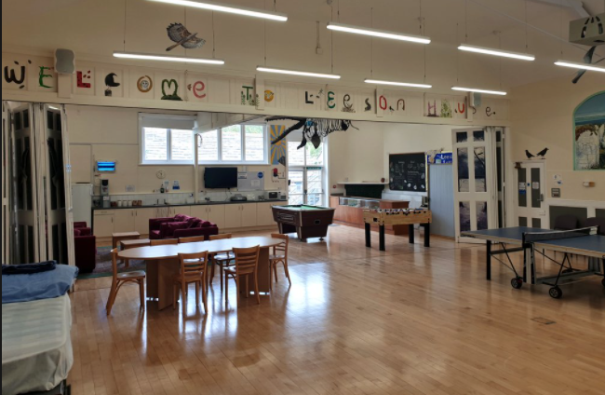
Year 4 Residential
Leeson House
Thursday 6th & Friday 7th May 2027
Further details will follow when we hold a meeting in December/January to discuss payment options and further details.
Last year’s cost £65

Slide 7

Homework
Each Week
Piece of English, Maths or topic-based learning (in purple book)
Reading x 3 a week (in homework log)
Spellings (in spelling log)
Times Tables (Maths Rockstars)
Each week, children in KS2 receive homework. This is a bridging step to support the preparation for middle school and the expectations middle schools have.
Initially, this homework will be very short and brief to help get the children into the routine of completing and handing it in.
Homework is given out on a Thursday or Friday and handed in on Wednesday (or before if you prefer). Homework will reflect many different areas of the curriculum and will often be in response or prepare for learning in school.

Slide 8

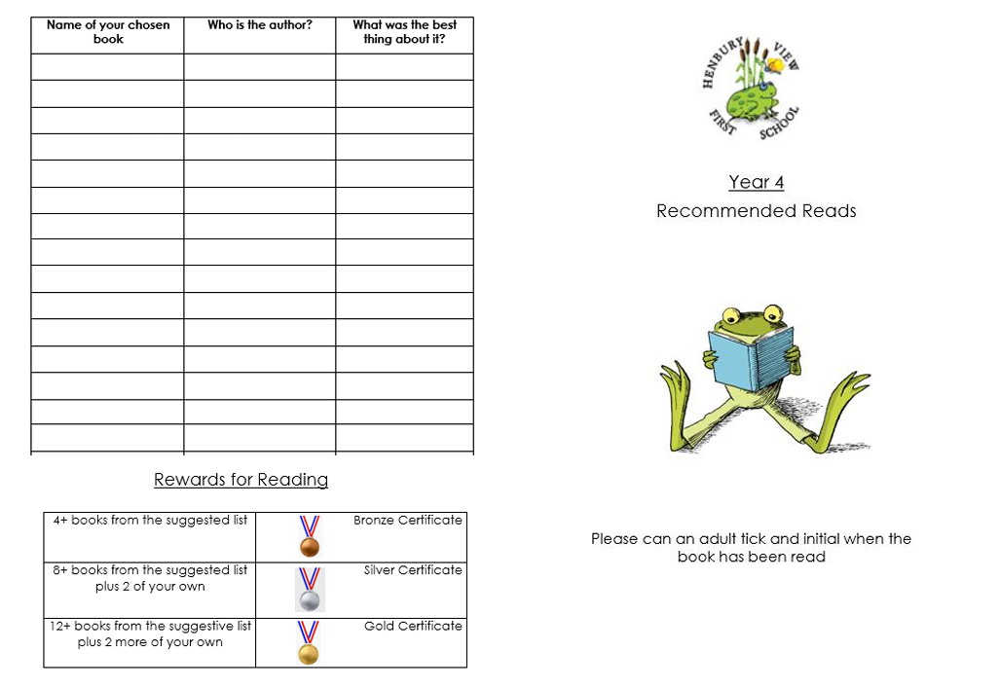



Children will bring home a Learn to Read book that is colour banded.
Colour bands for Years 3 and 4:
Brown 8
Brown 9
Brown 10
Brown 11
Grey 12
Grey 13
Grey 14
Dark Blue 15
Dark Blue 16
Dark Red 17
Books Going Home
Love to Read Book
A book chosen by your child from the library to share together at home.

Slide 9

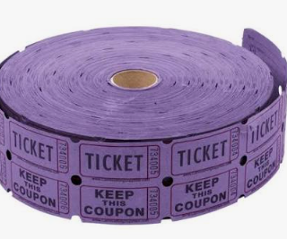
Reading Records
Examples:
*A signature and tick three times stating you have simply read the book is great!
*Children can record the title, date and number of pages they have read at each read and you can just sign.
*We encourage the children to change their books weekly to ensure they read a variety of texts although we understand children reading lengthy titles will need longer to finish a book.
Please record at least x3 per week.
You can of course log other reads from perhaps your library book or even your own books.

Slide 10







Reading Awards
Please do not feel you need to buy the books on this list, you can borrow many of these from school using our class book swap.
We will check the lists once a term to see who needs to be celebrated with a certificate in assembly. Look out for the dates we will be checking these on the bulletin or our curriculum leaflets.

Slide 11

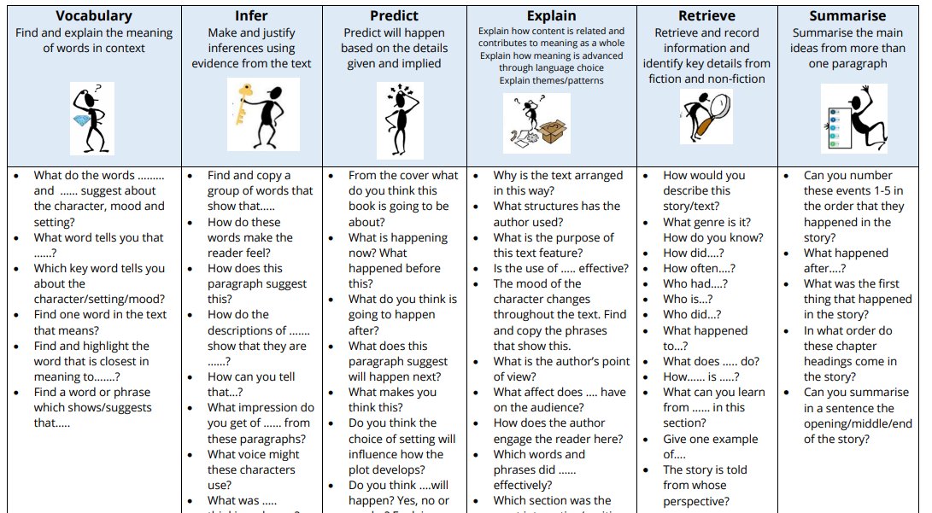



English- Reading
The children will read as a class every day. As the children’s word reading becomes more fluent, the focus becomes more on their understanding of what they have read.

Slide 12
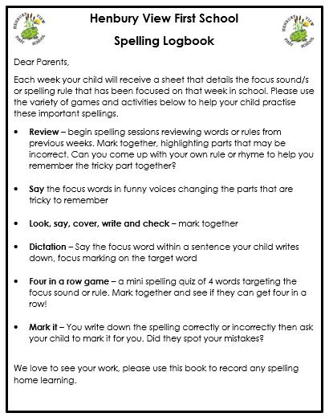

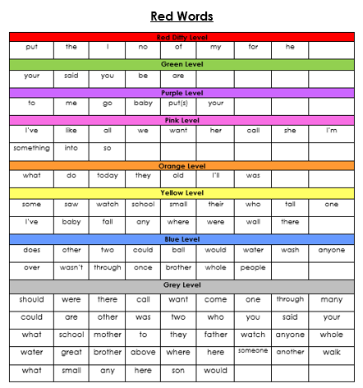

Log Books

Slide 13


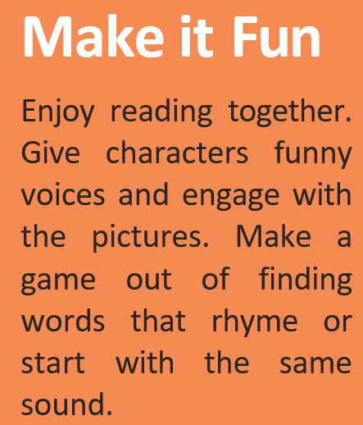


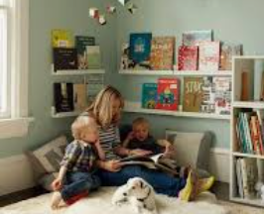
Top Tips for reading at home

Slide 14






English

Slide 15
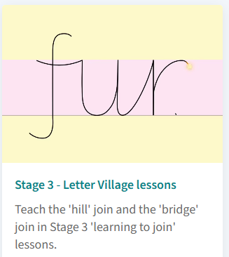
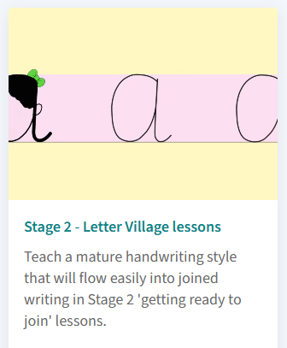
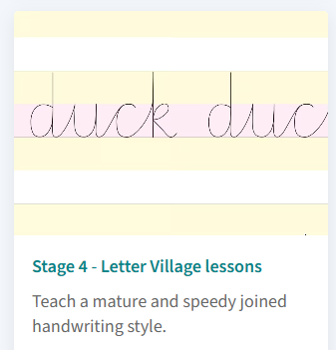
Handwriting
We are continuing our handwriting programme this year; RWI Handwriting. The children will revise and practise joins to all varieties of letters using the ‘hill’ join and the ‘bridge’ join.

Slide 16



Maths
In Maths, we follow this daily lesson structure:
This allows children to constantly consolidate their number facts, which supports them when approaching new concepts and more complex problems.
We will primarily use NCETM as our guide for teaching the main activities. This also provides us with high-quality pictorial representations of the mathematical concepts we are teaching (for Place Value, Addition and Subtraction, Multiplication and Division and Fractions). For other areas of the curriculum and to supplement our learning, we will use White Rose resources (for measures, statistics, geometry).

Slide 17
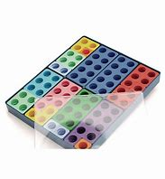
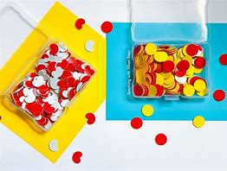
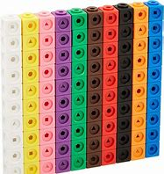
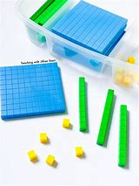
Maths
We will continue to use concrete resources and pictorial representations to help our learning journey, ensuring the children develop conceptual understanding of the concepts that we look at. The children will be given time to ‘experience’ the maths by using hands on thinking before moving through the learning journey. At all stages the children will be given opportunities to problem solve and make connections between different areas of maths. Maths can often be very abstract, so we aim to ensure that the children notice the real world applications of maths and see the worth in what they are learning about.

Slide 18
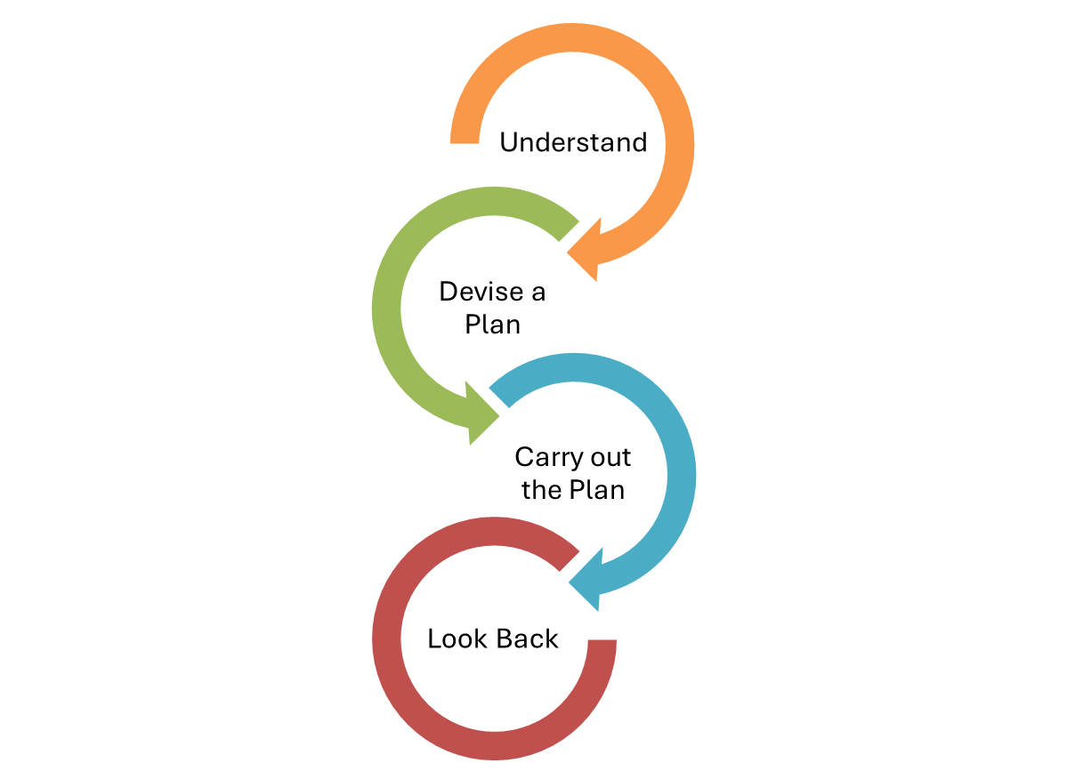

Maths – problem solving
A new addition to our maths curriculum this year will be dedicated time to teaching problem solving skills and strategies.
Strategies
Trial and Improvement (Aut 1)
Working systematically
Working backwards
Visualising and manipulating
Reasoning and convincing
Conjecturing and generalizing
Pattern spotting
Problem solving and reasoning are not just tasks to complete, it’s a way of working and thinking mathematically:
Being able to draw on a range of strategies
Being systematic and methodical
Knowing how to approach a problem and having the confidence to try
Perseverance and patience
Grappling – being flexible with their approach
Applying a range of knowledge and knowing what knowledge could apply
Justifying and discussing their ideas

Slide 19


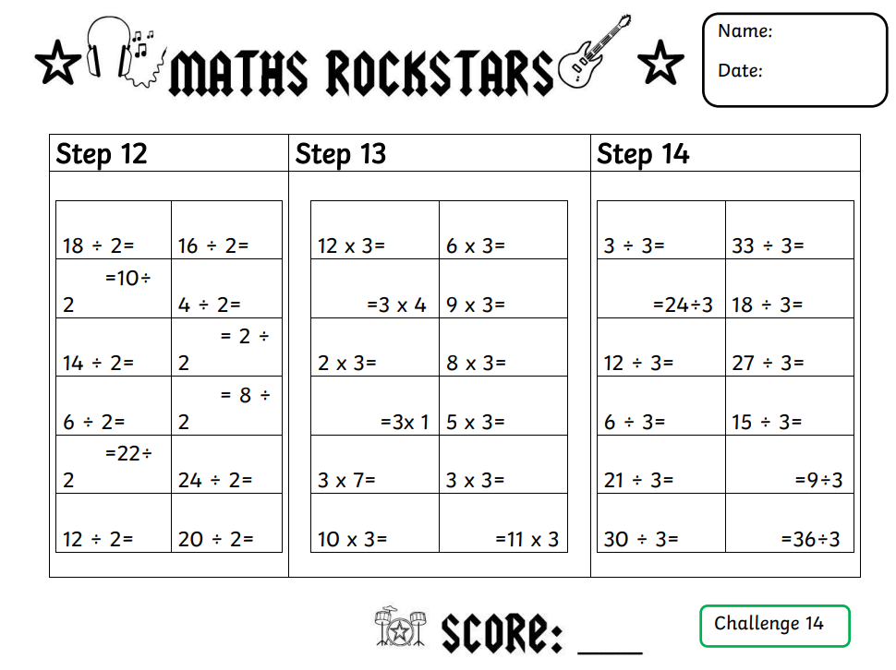
Maths- Times Tables
Times tables are used in lots of areas of mathematics, for example fractions, area, perimeter, money as well as multiplication and division calculations. Fluency and quick recall are also essential for multi-step problem solving and real word applications.
We are going to teach times tables for 1 lesson per week as well as during daily starters. This lesson will involve a chance for children to be tested on their steps, independent practice of their next step and teacher led teaching of the times table.
Maths Rockstars
Children assessed at the start of each year to gain a baseline
Have a step at a time to achieve- to move up, they must be able to recall previous 2 steps and complete new step within 3 minutes
Children to have pupil log in book bags to show progress
Please ensure Maths Rockstars logs are in bookbags on a Wednesday

Slide 20

PE
Our PE sessions are scheduled for Tuesday and Wednesday. Tuesday’s session will be an outdoor lesson and on Wednesday, we will be inside.
Please ensure that PE kits come into school on a Monday and we will send them home on a Friday to be washed. Please also check that all PE kit is clearly named and that the children have some warmer clothes (e.g. joggers, PE jumper) for when the weather starts to get colder

Slide 21




Forest School
Every Wednesday
Learning, growing and exploring outdoors
Every Wednesday
Our Ethos
Forest School takes place weekly, on Wednesdays, for the whole class. Morning or afternoon sessions.
Forest School is hands-on, child-led learning outdoors. Through play, exploration and managed risk-taking in our woodland area, children build confidence, resilience, teamwork and a lifelong connection with nature — come rain or shine!
Non-School Uniform
Please send your child in old clothes they don’t mind getting wet or muddy — no school uniform on Forest School days.
Waterproofs & Boots
Sessions are led by Mr. Guppy and run in all but the most severe weather.
Pack waterproofs and wellies/boots in a separate, named bag, ready to change into.

Slide 22




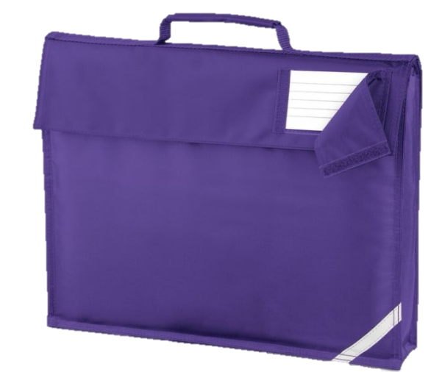
Things to Remember
Spelling Logs
Please ensure spelling logs come into school on a Wednesday so the new spellings can be stuck in and the previous week can be marked.
Bookbags and Reading Records
Please ensure bookbags come into school everyday. This is so we can record any reading we do or give out any letters.
In KS2, the children can change their choice book whenever they wish. We will endeavor to remind the children daily to change their books if they need to.
We will be checking reading records every Wednesday to acknowledge any comments you have made and to monitor children reading regularly.
Home Learning
Out on a Thursday or Friday - please hand in by Wednesdays.
PE Kits
PE kits need to come in on a Monday and will be sent home every Friday.
Snack
Please send your child to school with a snack if you wish to, we ask if this could be a healthy choice.
Y4’s Tuck Shop day is Friday

Slide 23
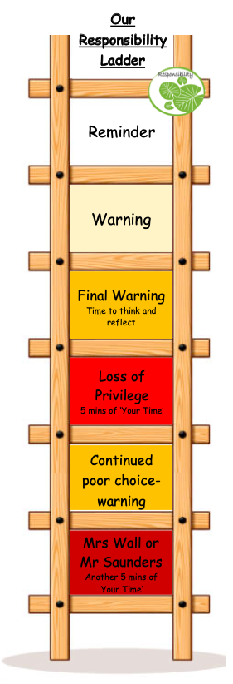
Responsibility Ladder and ‘Your Time’
We continue to use our responsibility ladder as part of our behaviour policy. This ensures that there is consistency across classrooms and members of staff. Rewards and praise are used across the school to celebrate successes and positive behaviour and learning choices (e.g. team points, stickers, etc.)
‘Your Time’ is a 30-minute session on a Friday afternoon, where children get to choose an activity that they would like to do. This allows them to be individuals, work with staff and children from across the school and follow areas of interest. Each child starts each week with 30-minutes of ‘Your Time’, and minutes are deducted for negative behaviour choices (see ladder). This ensures that children that always make the correct choices, whether that be inside or outside of the classroom, are celebrated and rewarded for their behaviour.
Thinking time
Supported conversation
Ms Budden/
Mr Fraser-Hurst
5mins Your Time

Slide 24

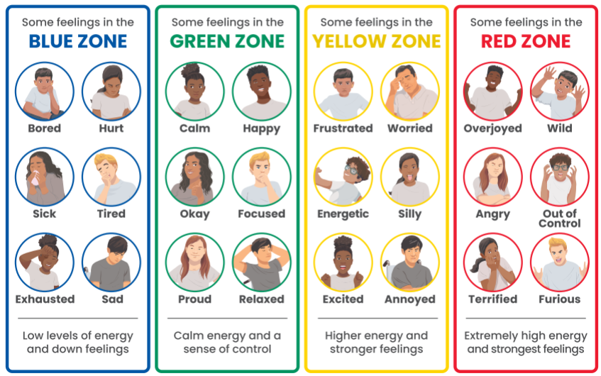

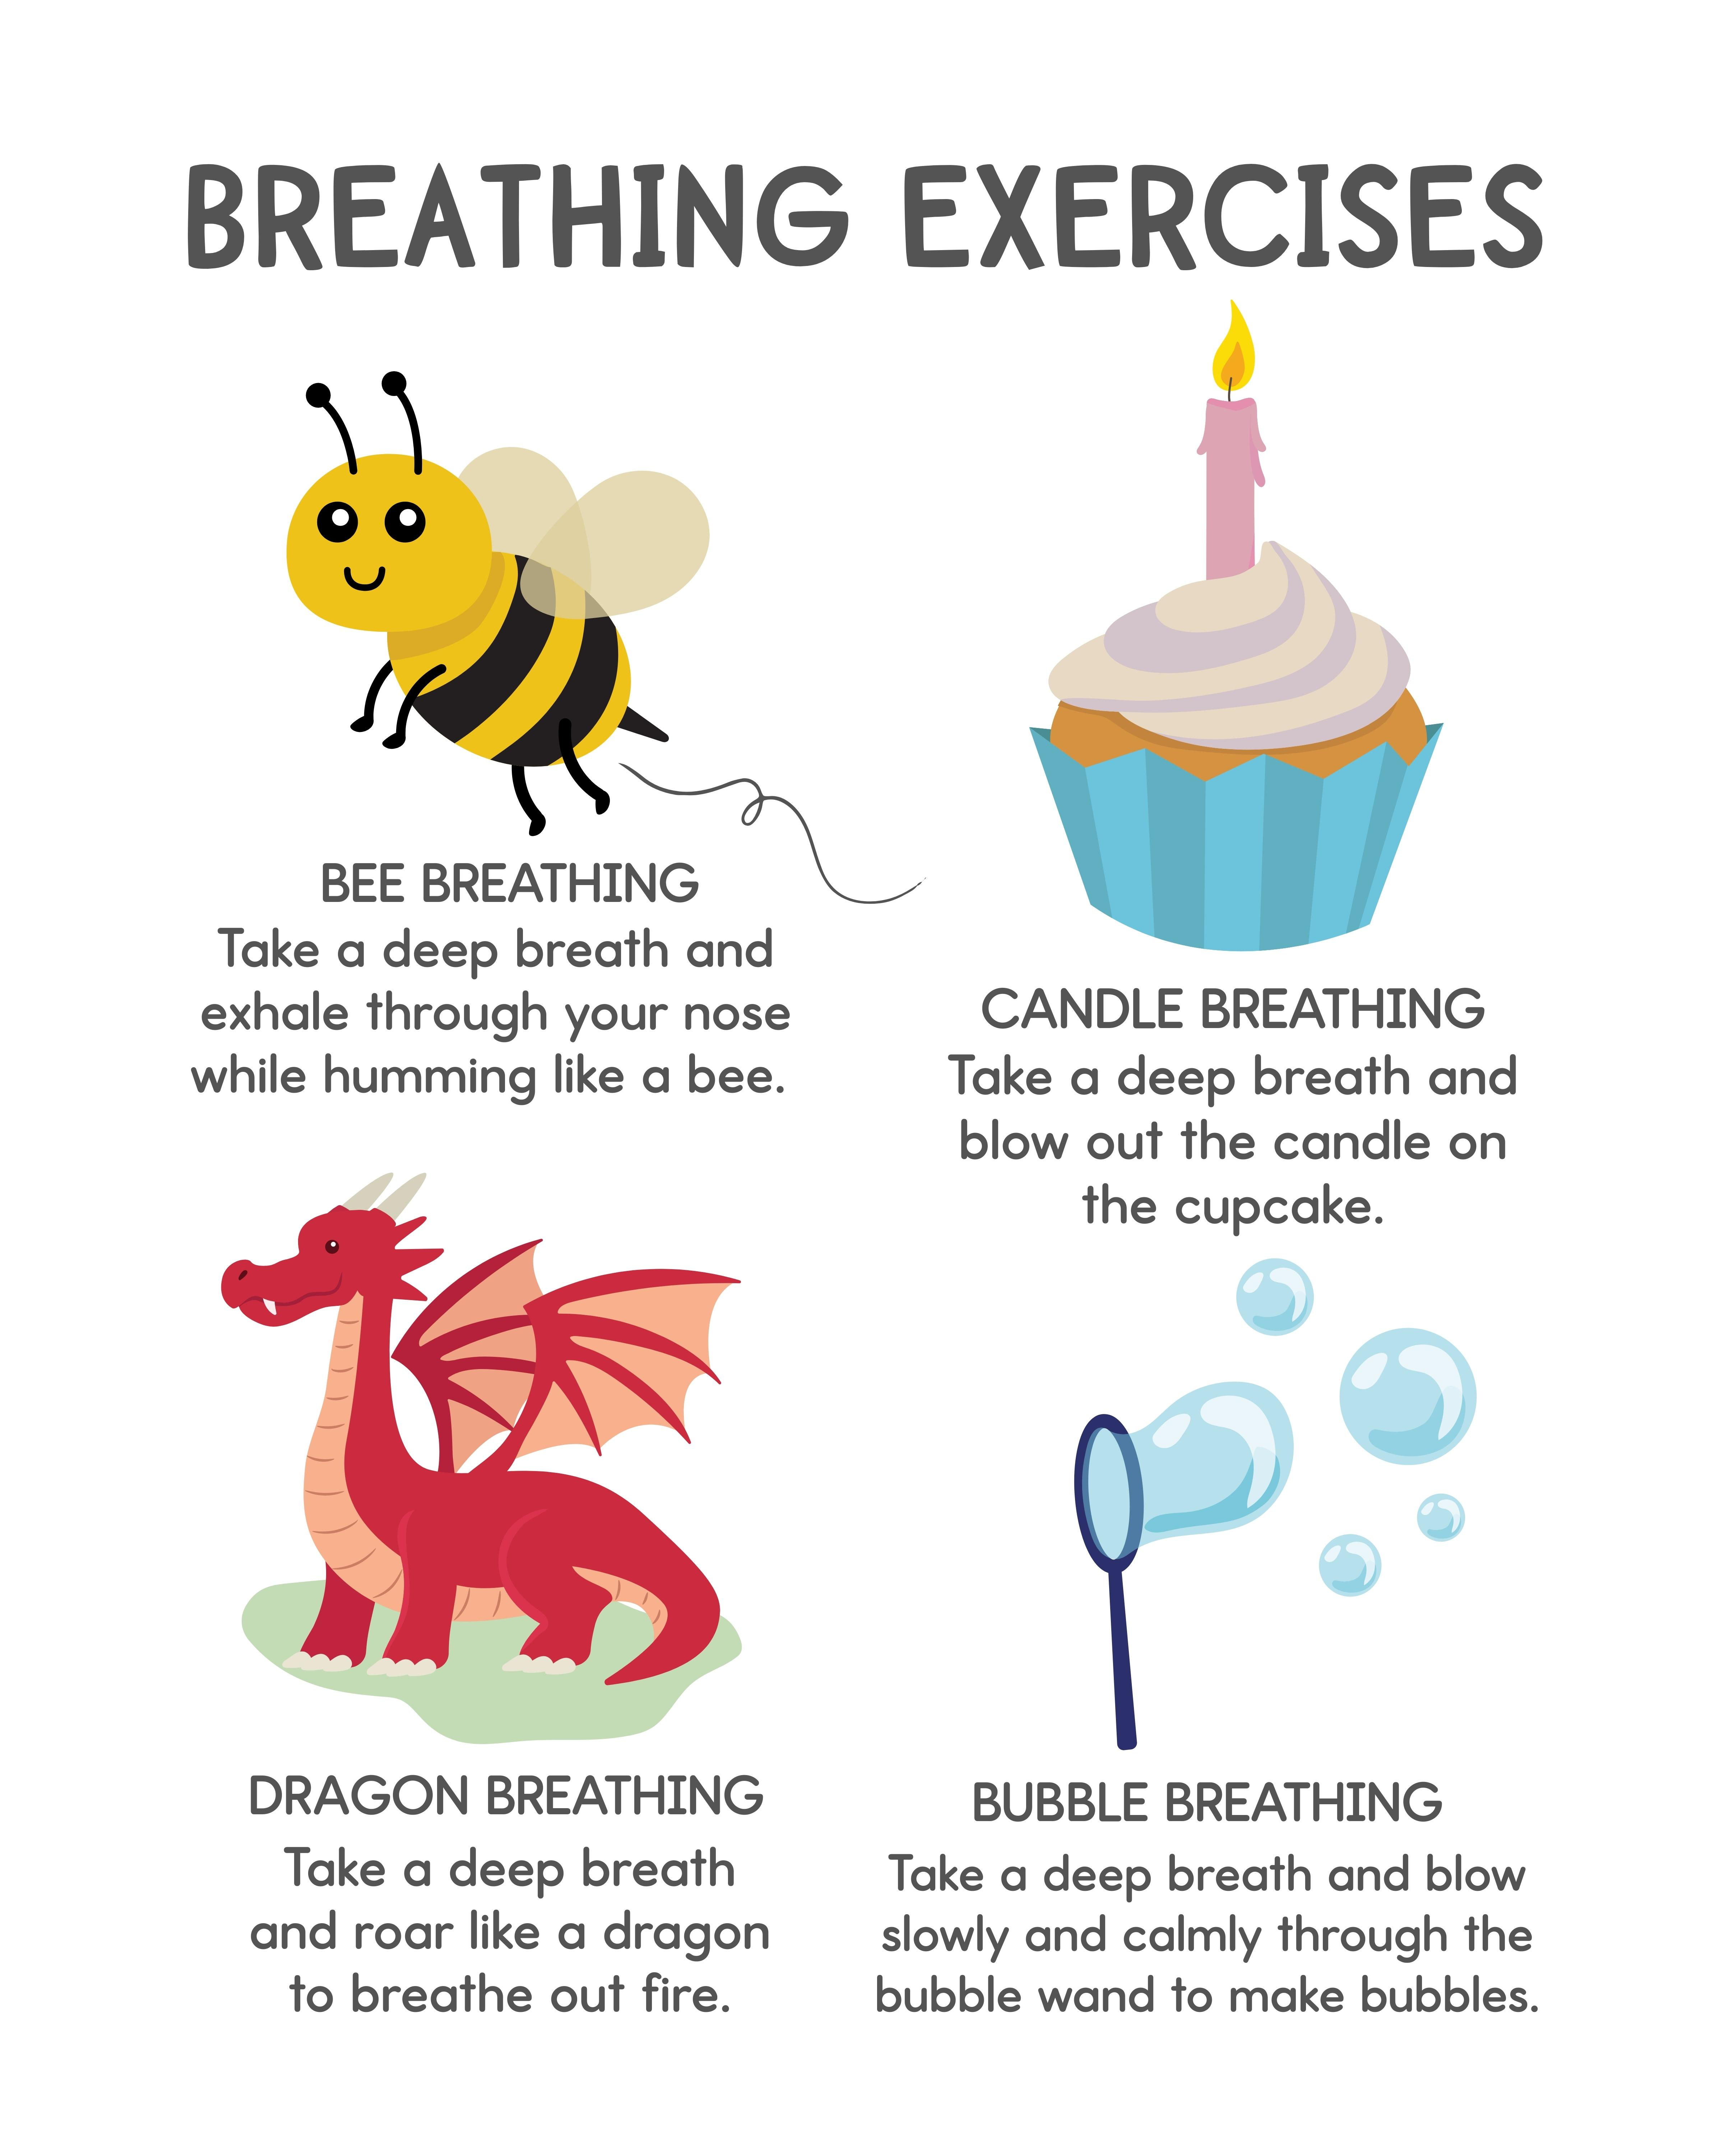


Zones of Regulation

Slide 25
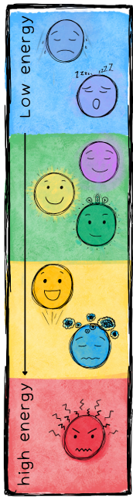
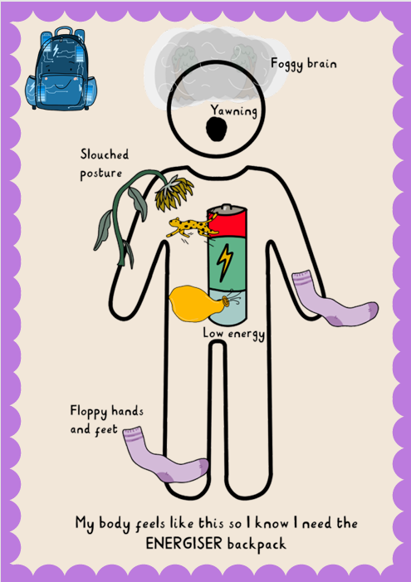
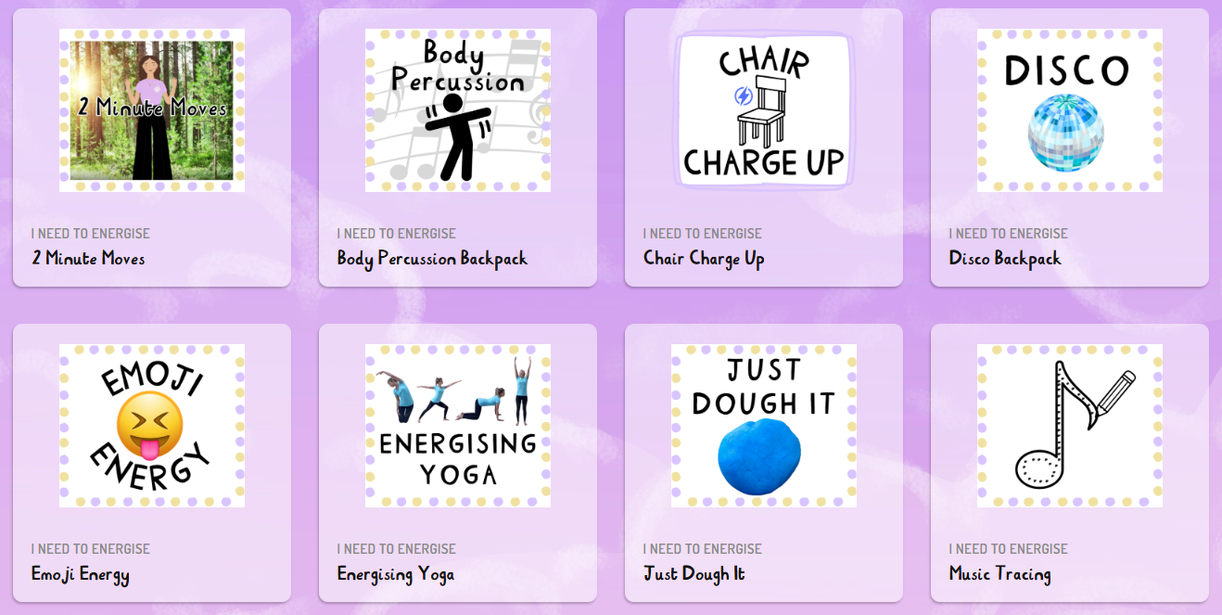
Supporting Regulation

Slide 26
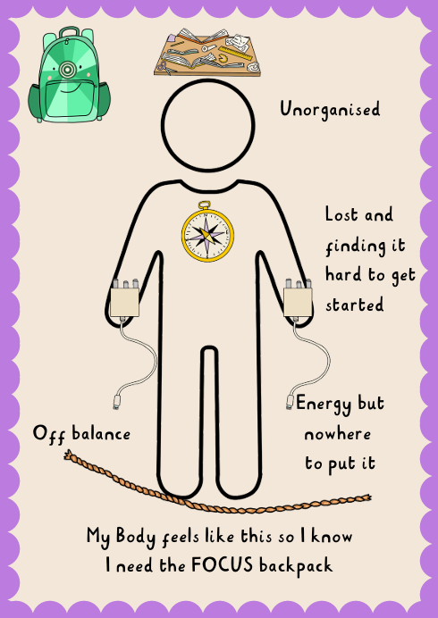
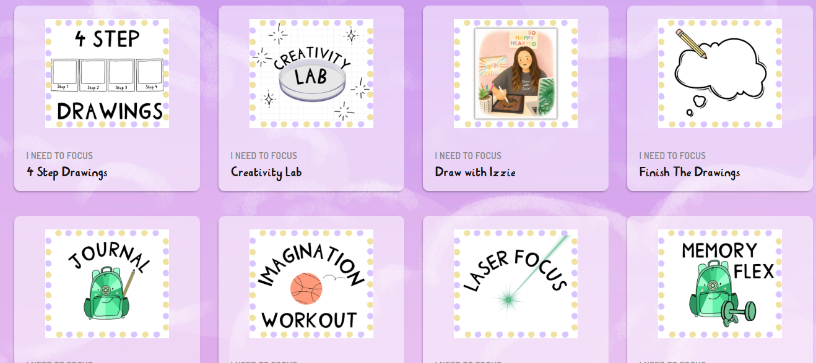
Supporting Regulation

Slide 27
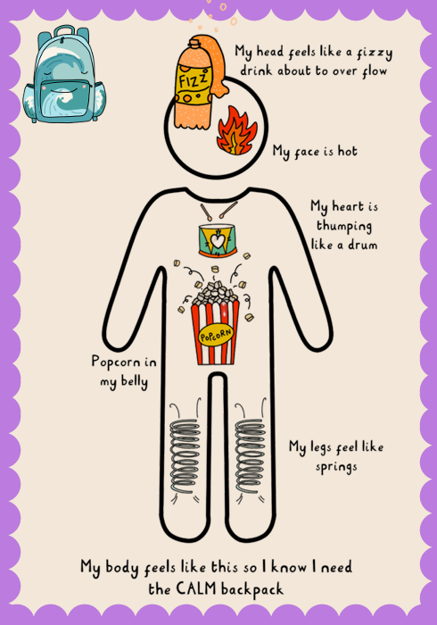
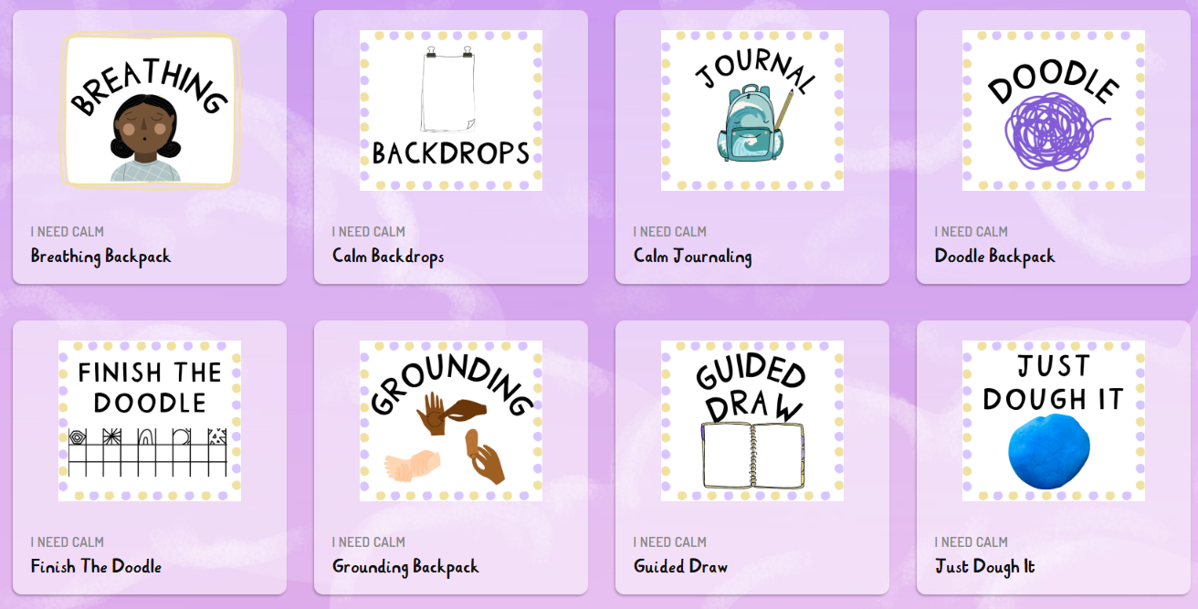
Supporting Regulation

Slide 28
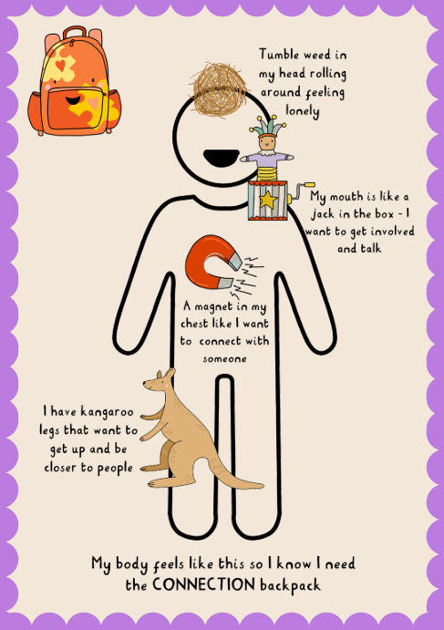
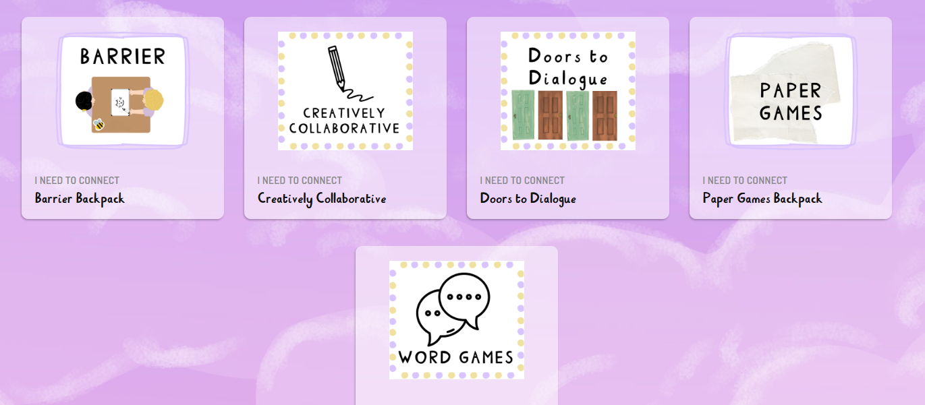
Supporting Regulation

Slide 29
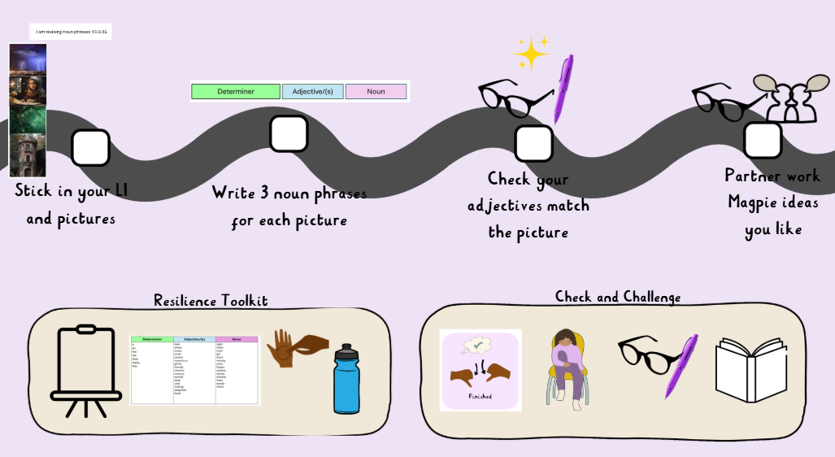
Notes:
Under guidance of the teacher
Matrix to support cognitive load.
Children to have a strip of images to stick in their books. They can then record their own examples of noun phrases next to each picture building a bank for later on.
Images could be – Weather, main character (young girl), owl, window, tower, forest, witch
Teacher to gather and collate whole class bank for working wall.

Slide 30
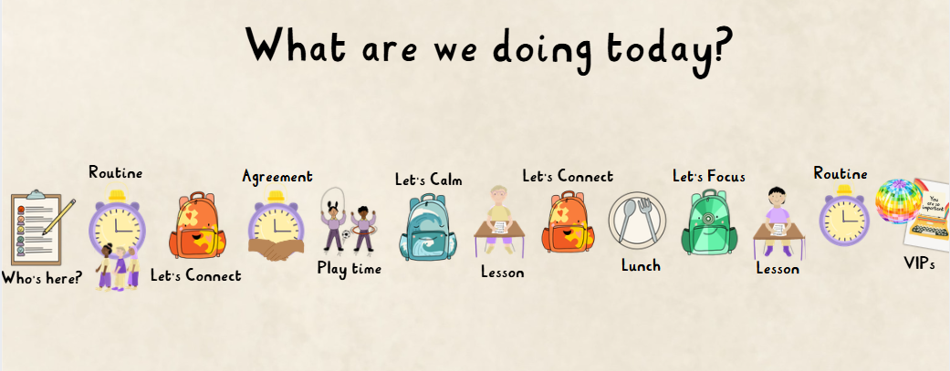
Supporting Regulation

Slide 31
Contact us…
We are really looking forward to an exciting year ahead. We hope you have found this information useful. There is also lots of information on the website:
Henbury View First School - Year 4
If you have any questions about anything in this PowerPoint, or if you have any questions or queries at any point during the year, please don’t hesitate to email us or the school office at:
office@henburyview.dorset.sch.uk
year4@henburyview.dorset.sch.uk

