Slide 1
Welcome
By Head Boy and Head Girl

Slide 2
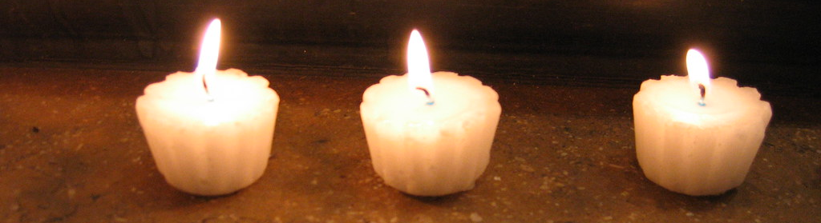
Lighting the candles

Slide 3
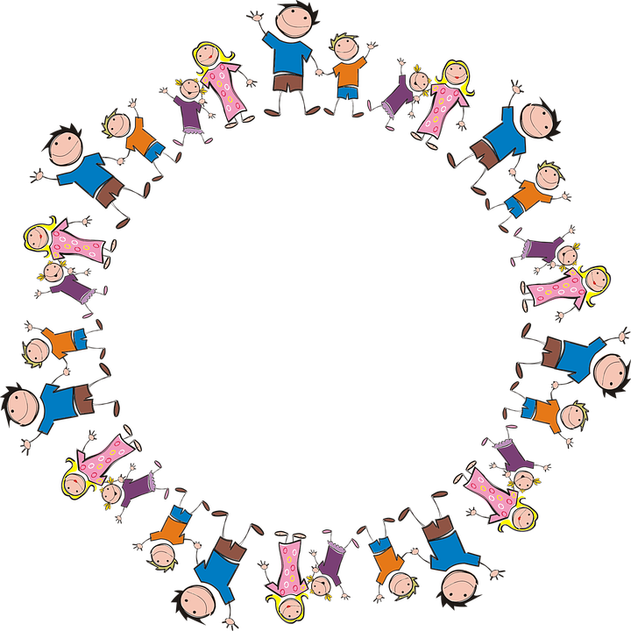
Sophie and Alfie - The Gathering

Slide 4


Slide 5
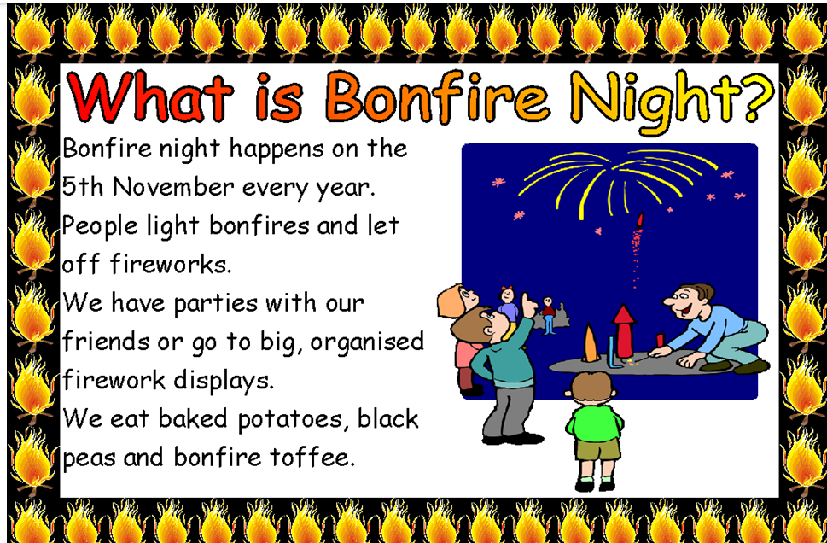

Slide 6
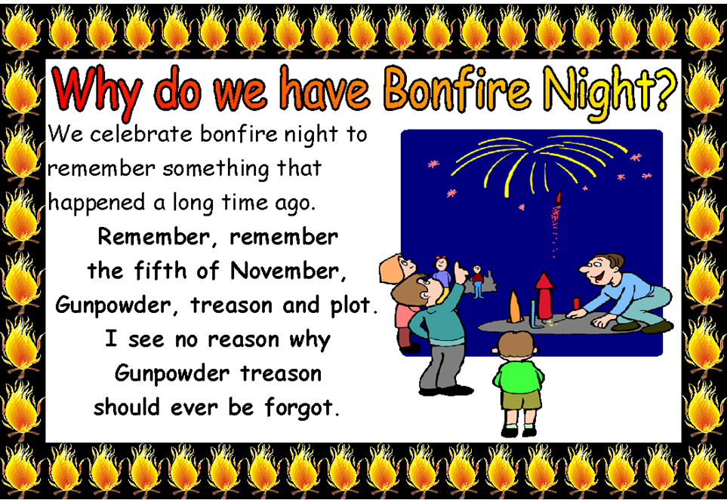

Slide 7
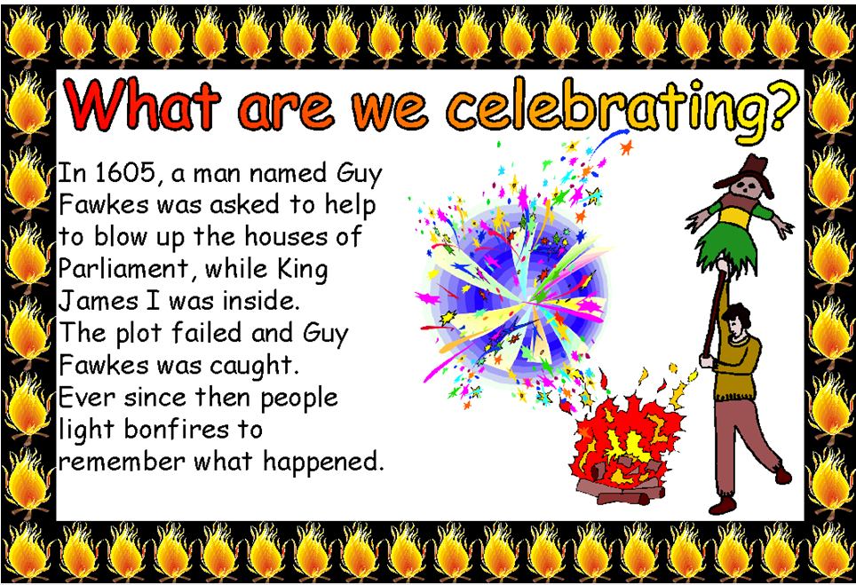

Slide 8


Slide 9
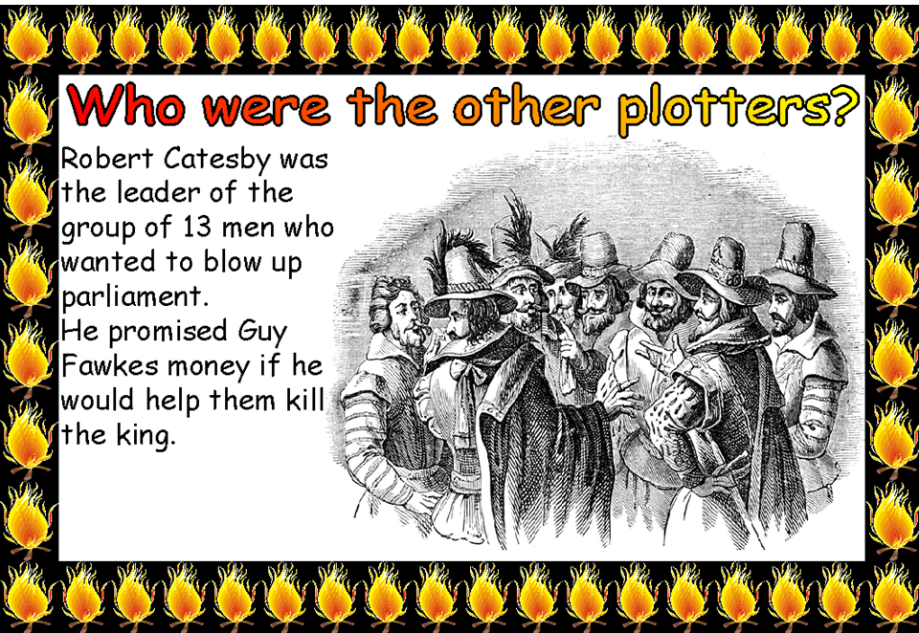

Slide 10


Slide 11
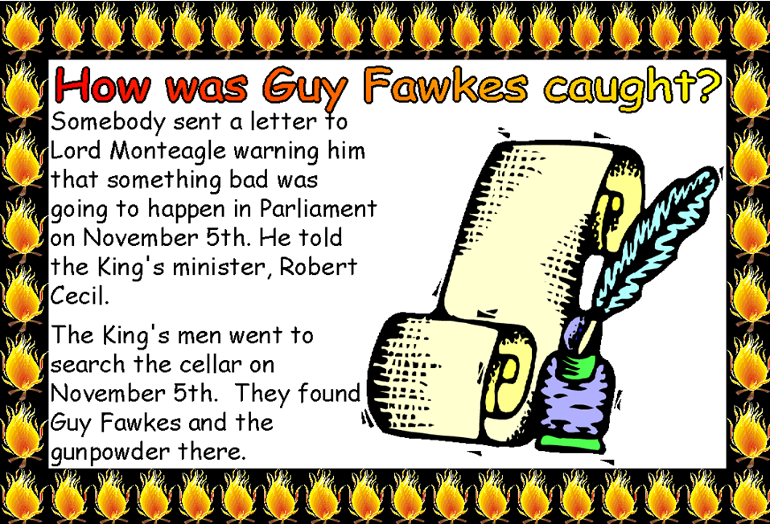

Slide 12


Slide 13
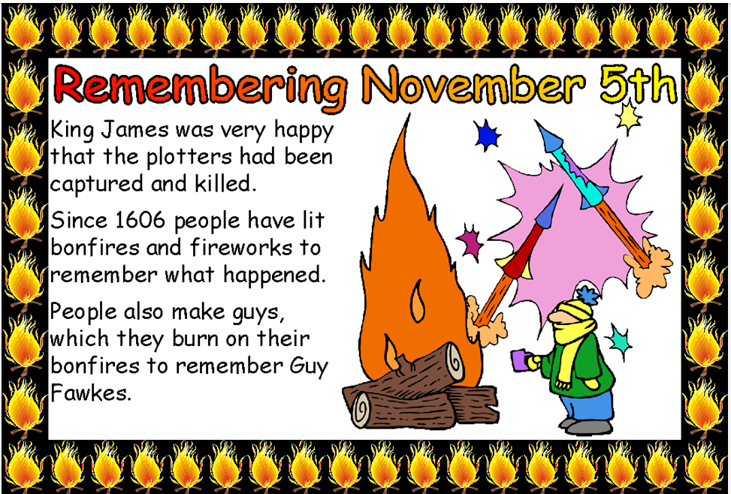

Slide 14
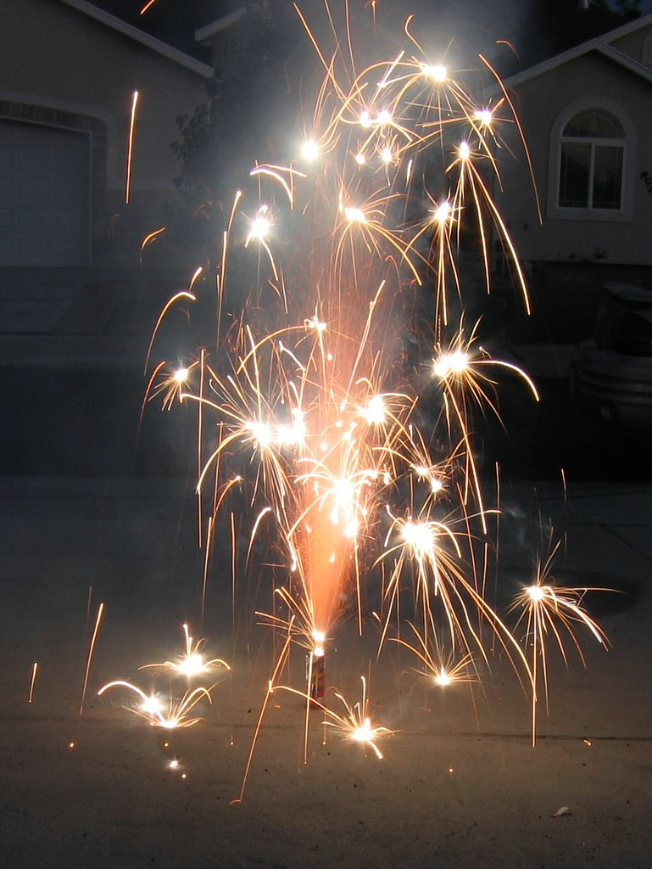
How to be safe on bonfire night?
This Photo by Unknown Author is licensed under CC BY-SA-NC

Slide 15
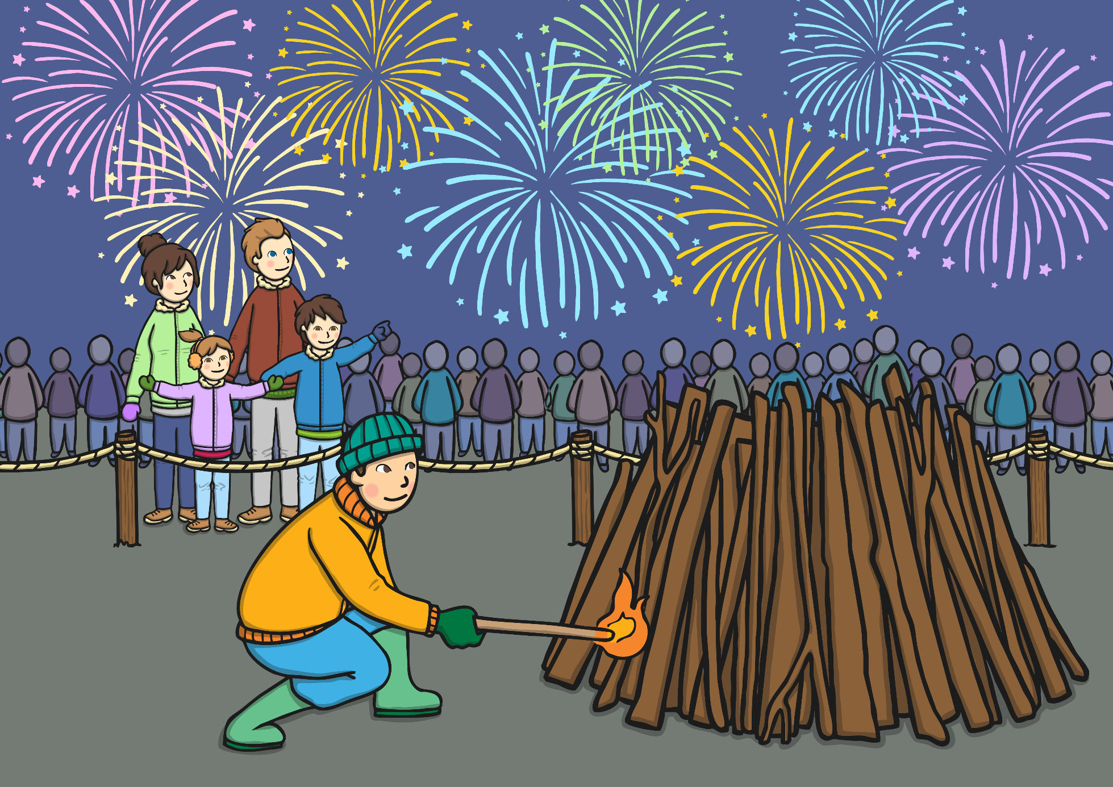
How Do People Celebrate Bonfire Night?
How Do People Celebrate Bonfire Night?
Bonfire Night can be a lot of fun but it is important that you stay safe.

Slide 16


Keep fireworks in a closed box
Keep fireworks in a closed box
They should be stored in a closed box or tin in a safe space away from animals and young children.
Fireworks should only ever be handled by adults.

Slide 17


Never throw fireworks
Never throw fireworks
Never keep fireworks in your pocket of throw them. Fireworks can be very dangerous if they are not used correctly.
Remember: Only adults should handle fireworks.

Slide 18

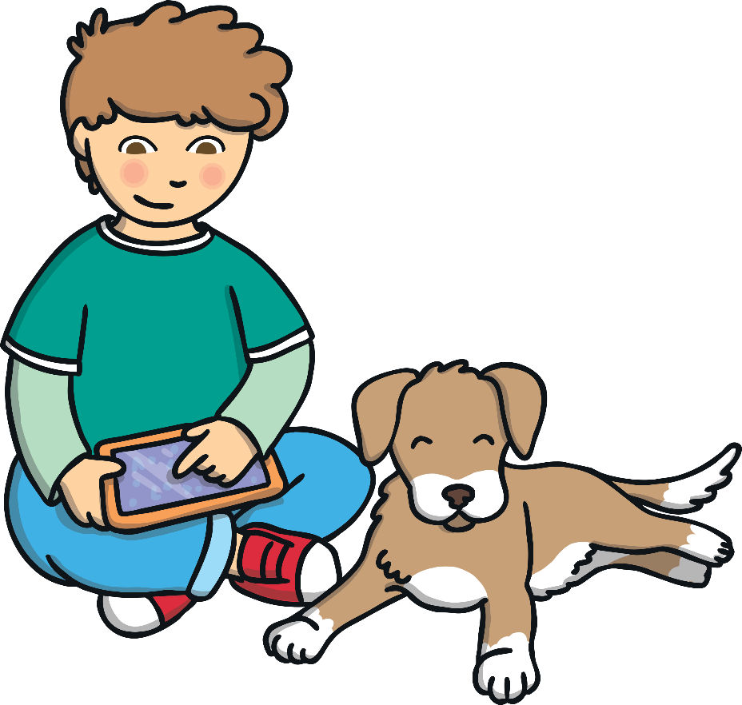
Keep pets indoors.
Keep pets indoors.
Keep pets inside and try and keep them as comfortable as possible.
They may become scared or unsettled if fireworks are loud.

Slide 19
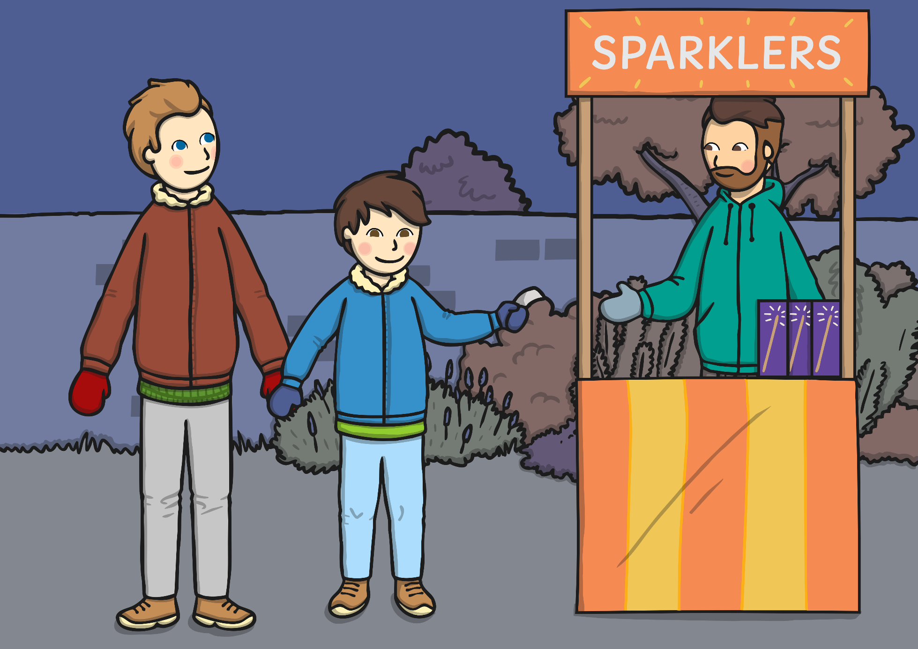

Sparklers must always be used under adult supervision.
Wear gloves when handling a sparkler and hold them at arm's length.
Always stand in a space away from obstacles and never wave them near others.
Put used sparklers in a bucket of earth or water once they go out.

Slide 20




When watching fireworks or bonfires, make sure you keep a safe distance at all times.

Slide 21



Never approach a lit firework. Even if you think it isn’t working, it could explode at any time.
Walk away as quickly as possible and tell an adult.

Slide 22
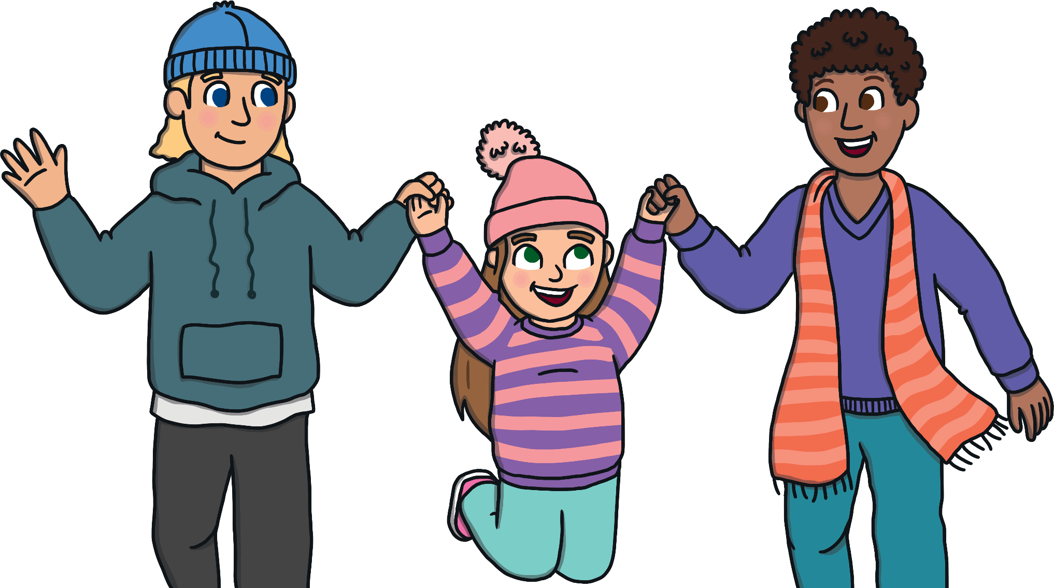
Firework and bonfire displays can be a lot of fun but they are often busy, dark and loud. It is important that you stay with your adult at all times.

Slide 23
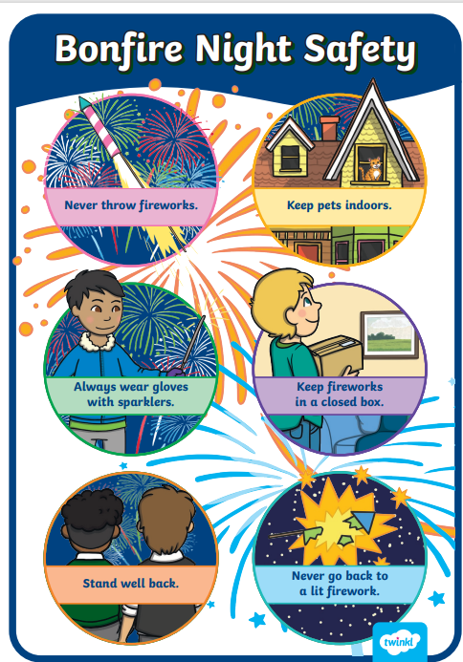

Slide 24
Let us pray
Dear Heavenly Father Friend of all children Bless our school at Henley All the children and staff who work here Help us do our best Be kind to one another And to be cheerful all day long Amen

Slide 25
The Blessing

