Slide 1
Welcome
By Head Boy and Head Girl

Slide 2
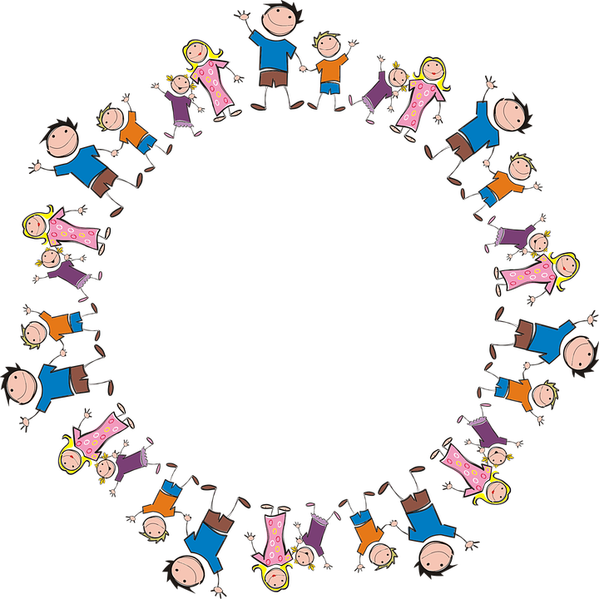
Sophie and Alfie - The Gathering

Slide 3
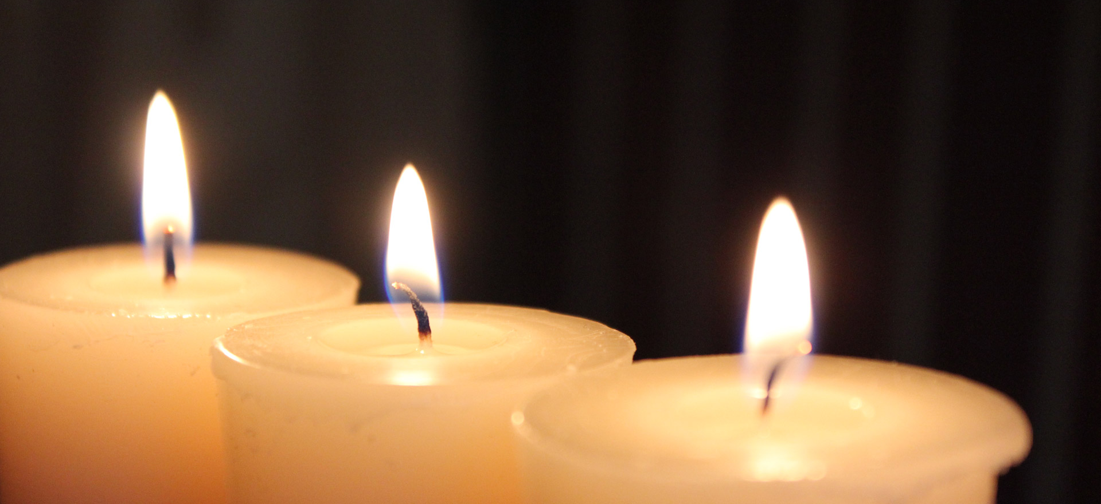
LIGHTING THE CANDLES
God’s love brings light to the world and we light 3 candles to remember God is Father, Son and Holy Spirit. The Trinity.
Jesus light of the world is here.

Slide 4

We welcome the Bible; it guides us in everything we try to do.
We welcome God’s words.

Slide 5
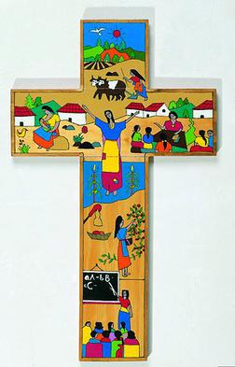
We welcome the cross; it reminds us of what Jesus gave for us.
We thank you Jesus.

Slide 6
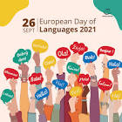
EUROPEAN DAY OF LANGUAGES
26TH of sepTember 2022

Slide 7
Europe is not the biggest continent in the world it is one of the smallest if not the smallest. Do you know what the european flag looks like?

Slide 8

This is the Europe flag

Slide 9



These are the main languages spoken in Europe. English, French Deutsch (German).

Slide 10
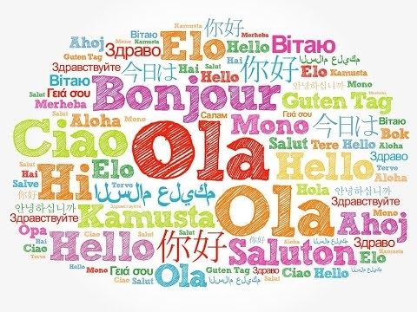
Can you say hello in a different language? https://www.youtube.com/watch?v=jG-mW3vjEHc

Slide 11
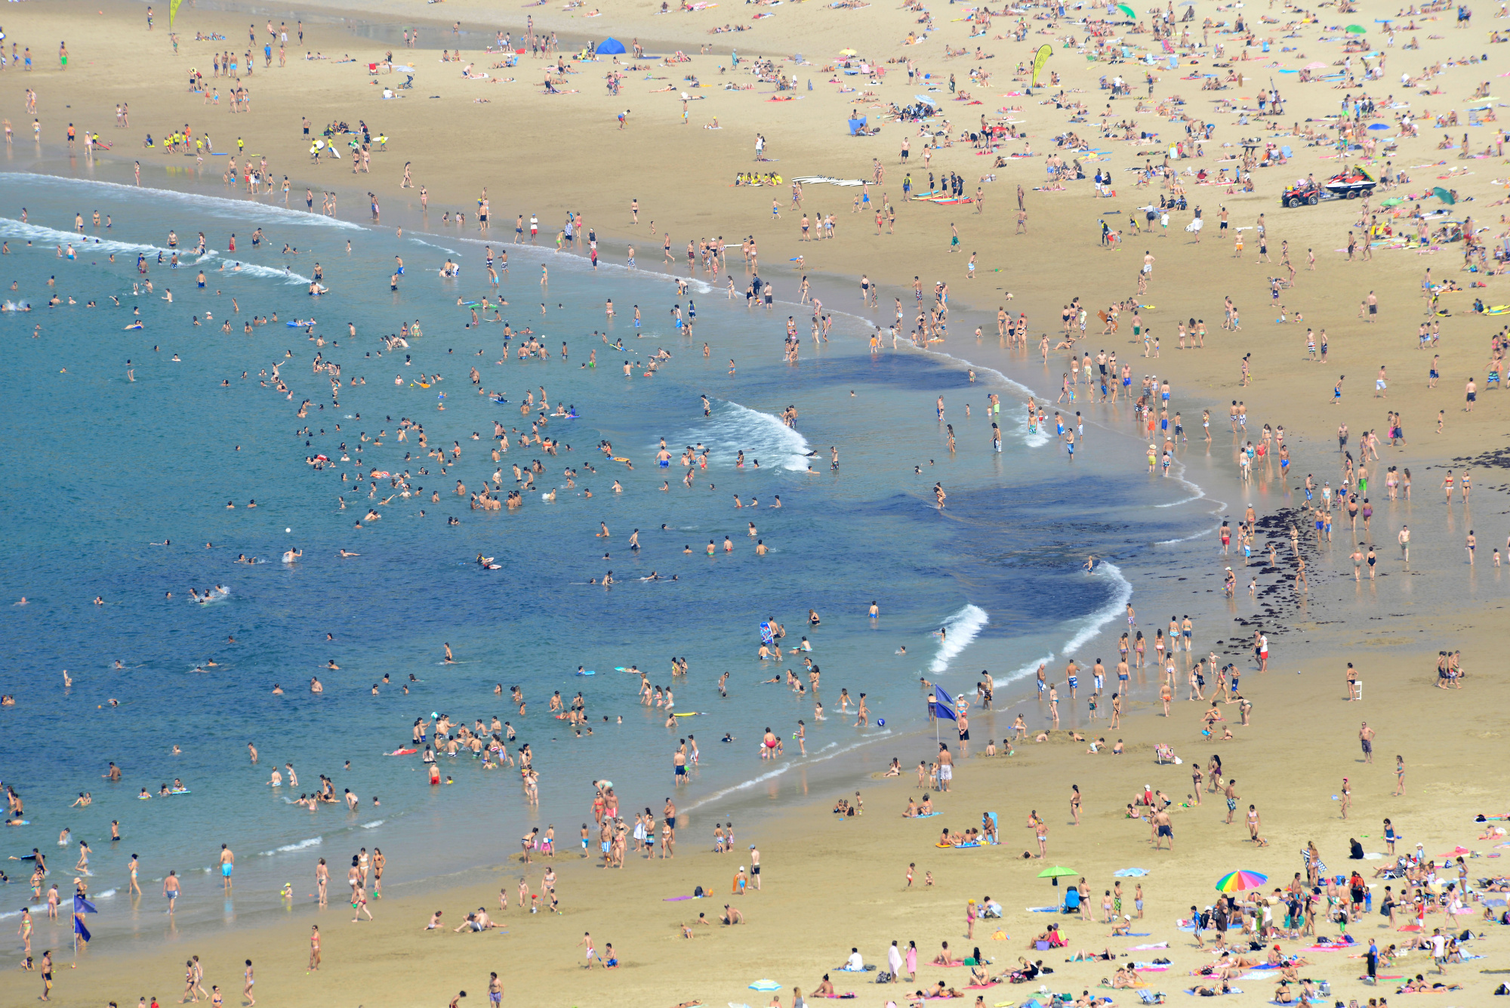
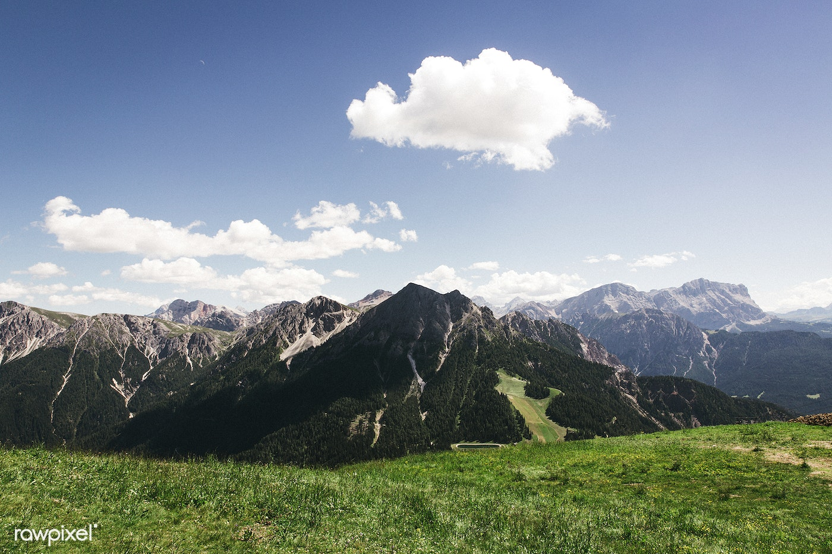
The landscape of Europe is very important for tourists from different continents
This is some beautiful European landscape (you can see that is very mountainous so it would be one of the more mountainous countries)
This is a European beach you can see allot of people in the ocean (sea)
This Photo by Unknown Author is licensed under CC BY-NC

Slide 12
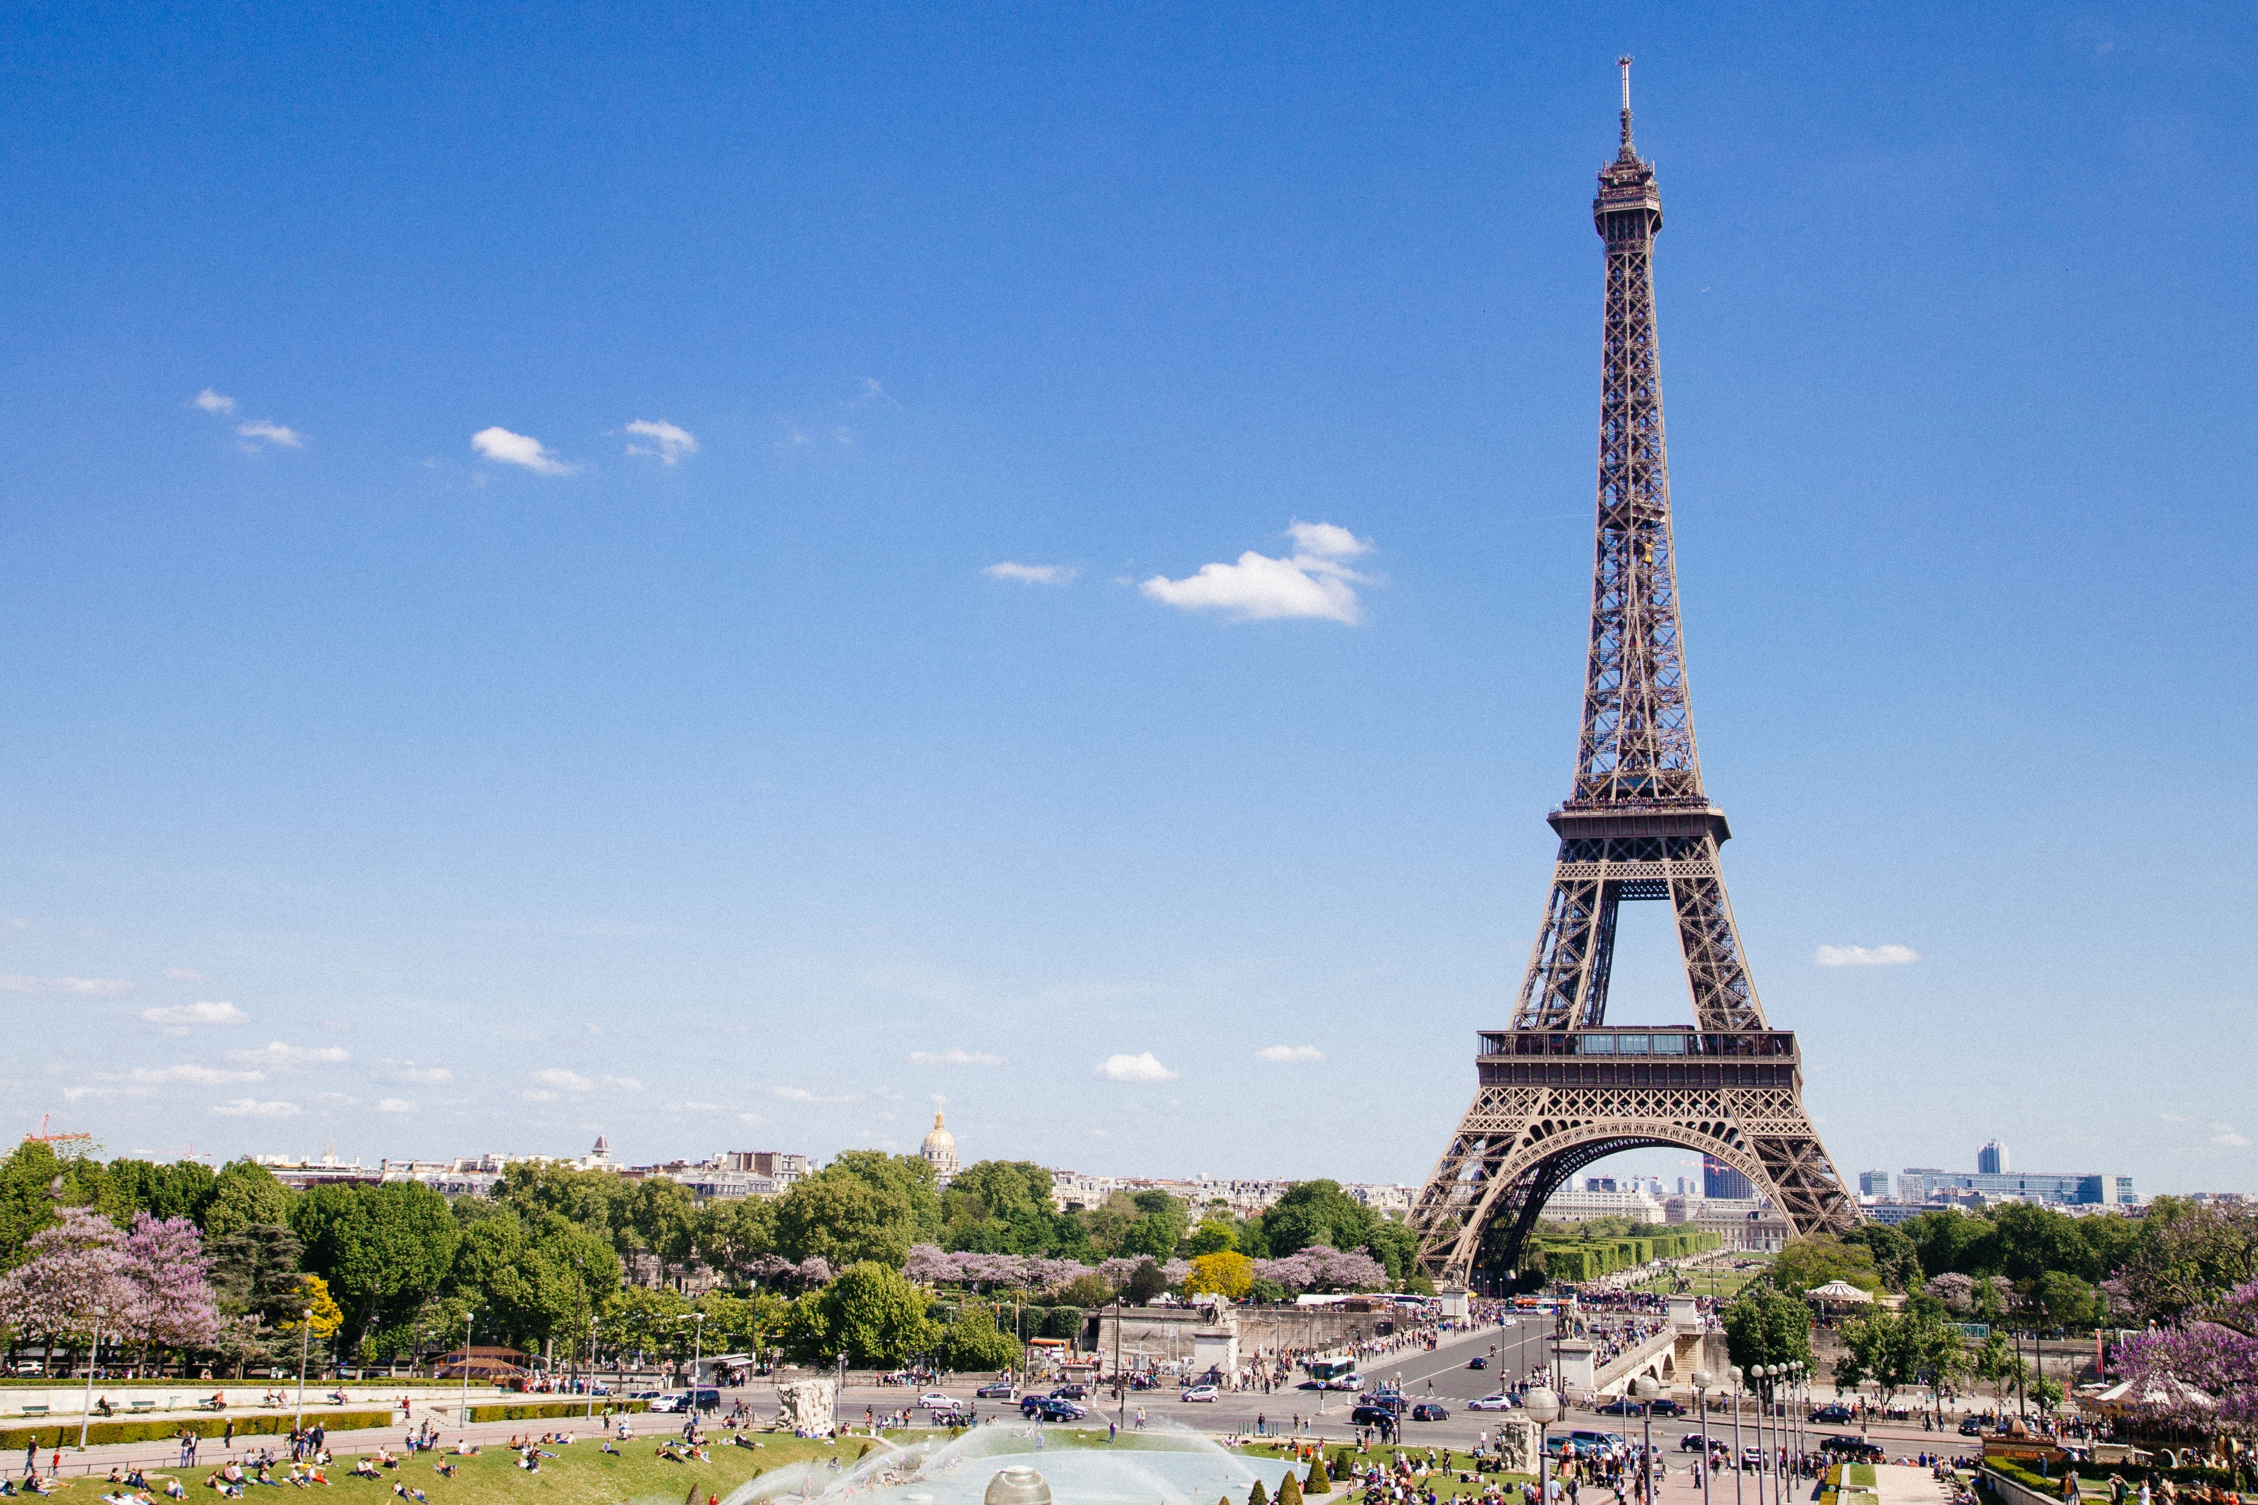
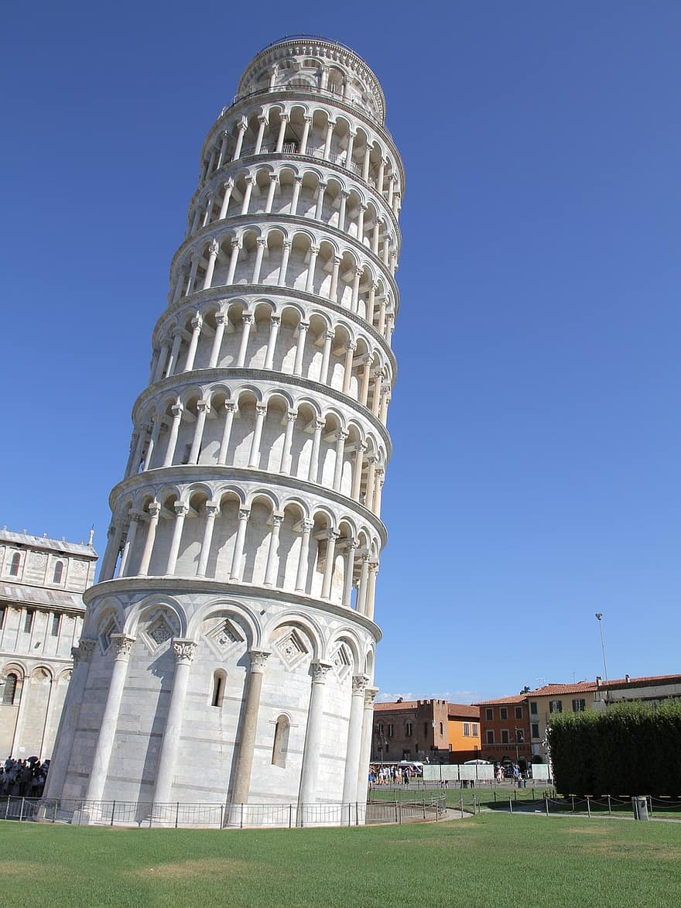
Two tourist attractions of Europe
This is the leaning tower of Pisa
This is the Eiffel tower in Paris

Slide 13
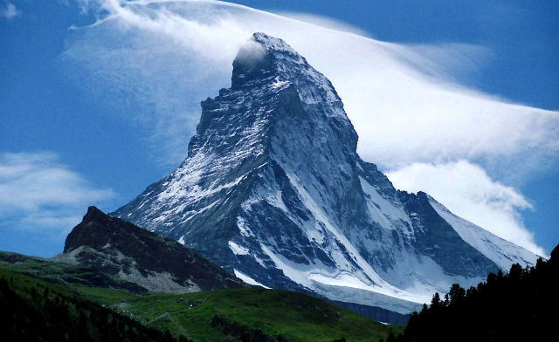
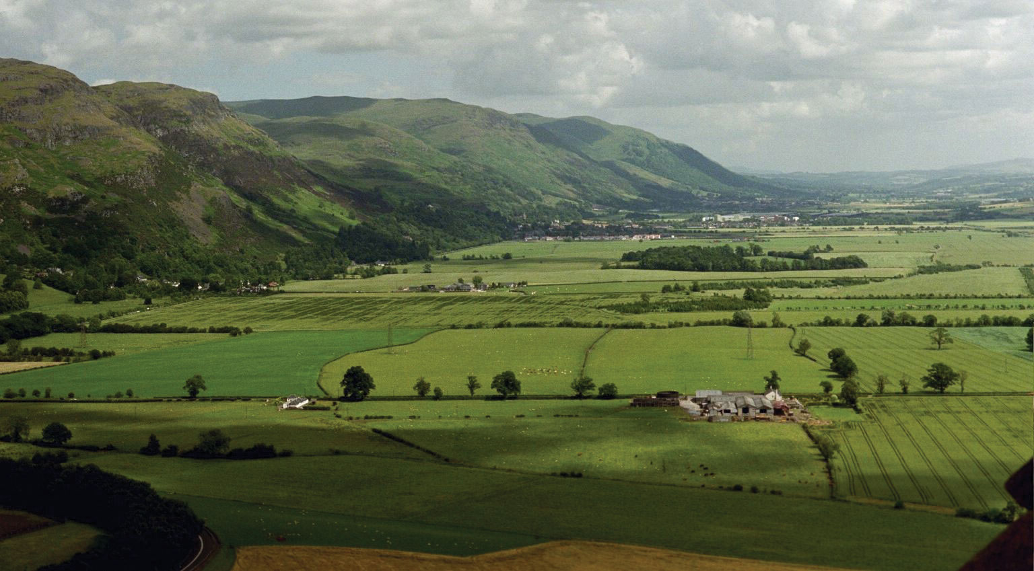
Europe's points
This is Europe's highest point.
This is Europe's lowest mountain
This Photo by Unknown Author is licensed under CC BY
This Photo by Unknown Author is licensed under CC BY-SA-NC

Slide 14
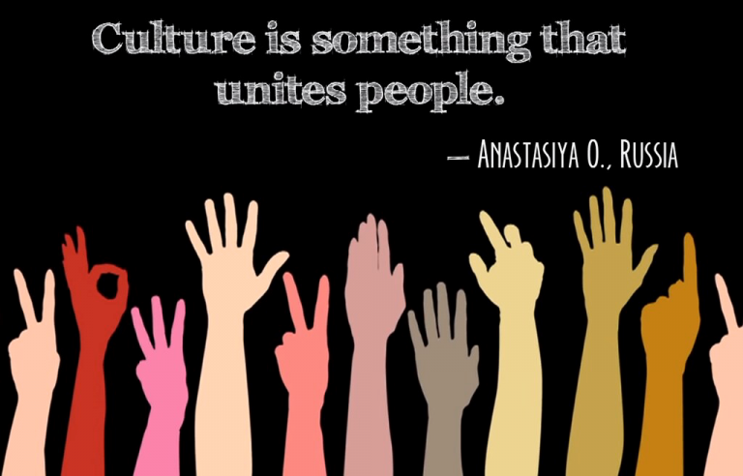
If you hear someone talking in a different language, always show them your respect.
This Photo by Unknown Author is licensed under CC BY

Slide 15
Let us pray
Dear Heavenly Father Friend of all children Bless our school at Henley All the children and staff who work here Help us do our best Be kind to one another And to be cheerful all day long Amen

Slide 16
The Blessing

