Slide 1
Welcome
By Head Boy and Head Girl

Slide 2
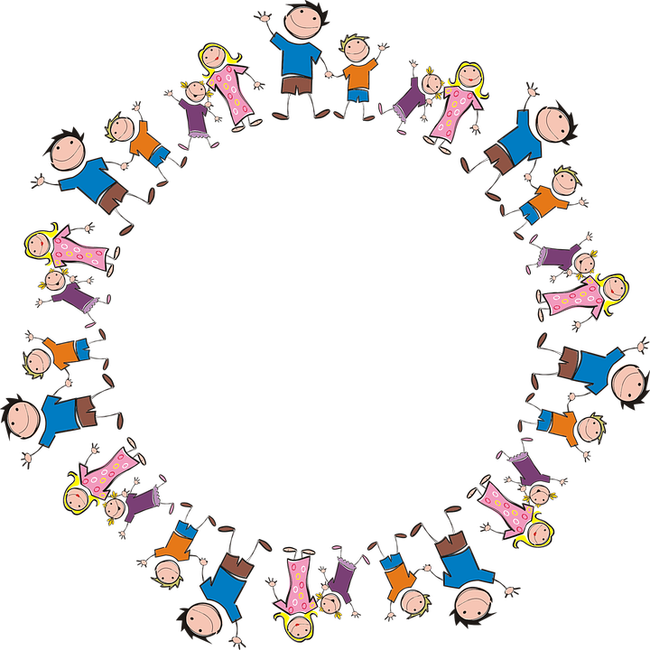
Sophie and Alfie - The Gathering

Slide 3
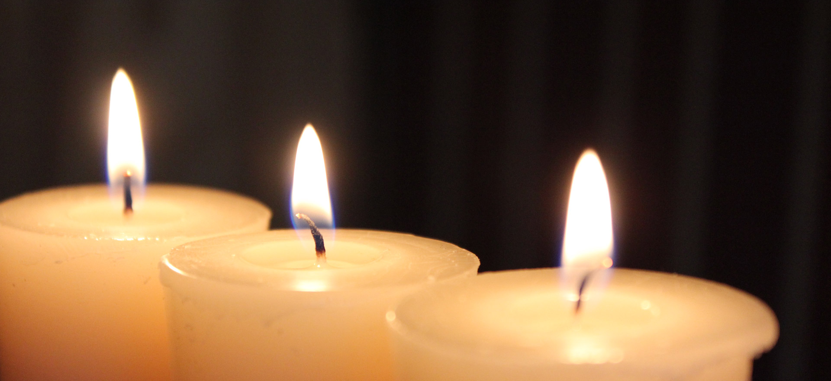
LIGHTING THE CANDLES
God’s love brings light to the world and we light 3 candles to remember God is Father, Son and Holy Spirit. The Trinity.
Jesus light of the world is here.

Slide 4

We welcome the Bible; it guides us in everything we try to do.
We welcome God’s words.

Slide 5
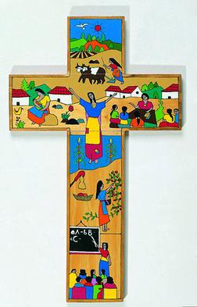
We welcome the cross; it reminds us of what Jesus gave for us.
We thank you Jesus.

Slide 6
That’s not fair!
By Jeevan and Ethan

Slide 7
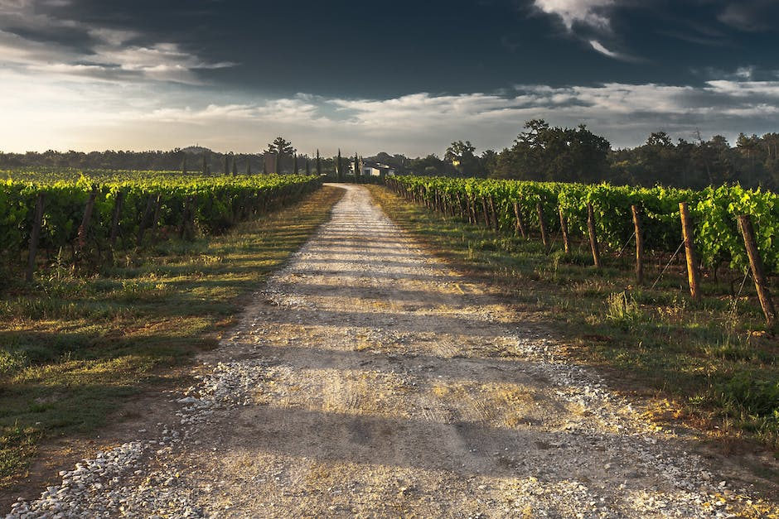
That's Not Fair!
Jesus told a story about a landowner who was hiring men to work in his vineyard. He hired some of them early in the morning, some in the middle of the day, and some he hired just before quitting time.

Slide 8

When it was time to pay the workers, he paid them all the same. The workers who were hired early in the morning began to complain, "Hey!
This Photo by Unknown Author is licensed under CC BY-NC-ND

Slide 9
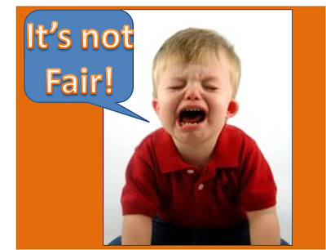
That's not fair! You paid the workers who worked only one hour the same as those of us who worked all day."

Slide 10
The owner of the vineyard said, "I am not being unfair to you. I paid you what I agreed to pay you. Don't I have the right to do what I want with my own money? Are you jealous because I am generous?"

Slide 11
What is the point of the story that Jesus told?
The point is that there are some people who trust in Jesus and serve him all the days of their life.

Slide 12
What is their reward?
Their reward is eternal life in heaven.

Slide 13
There are other people who live most of their life in sin. They don't serve the Lord at all. Then, just before their life comes to an end, they put their trust in Jesus and accept him as their Savior.

Slide 14
What is their reward?
Their reward is the same as one who has served the Lord all their life -- eternal life in heaven.

Slide 15
Is that fair?
We might not think it's fair, but if we got what was fair, none of us would go to heaven. The Bible says, "All have sinned and fall short of the glory of God." I don't know about you, but I'm glad that God doesn't give me what is fair, but gives me his love and grace, in spite of what I deserve!

Slide 16
Prayer
Father, we thank you for your love and grace that gives us everlasting life -- in spite of what we deserve. Amen.

Slide 17
Let us pray
Dear Heavenly Father Friend of all children Bless our school at Henley All the children and staff who work here Help us do our best Be kind to one another And to be cheerful all day long Amen

Slide 18
The Blessing

