Slide 1

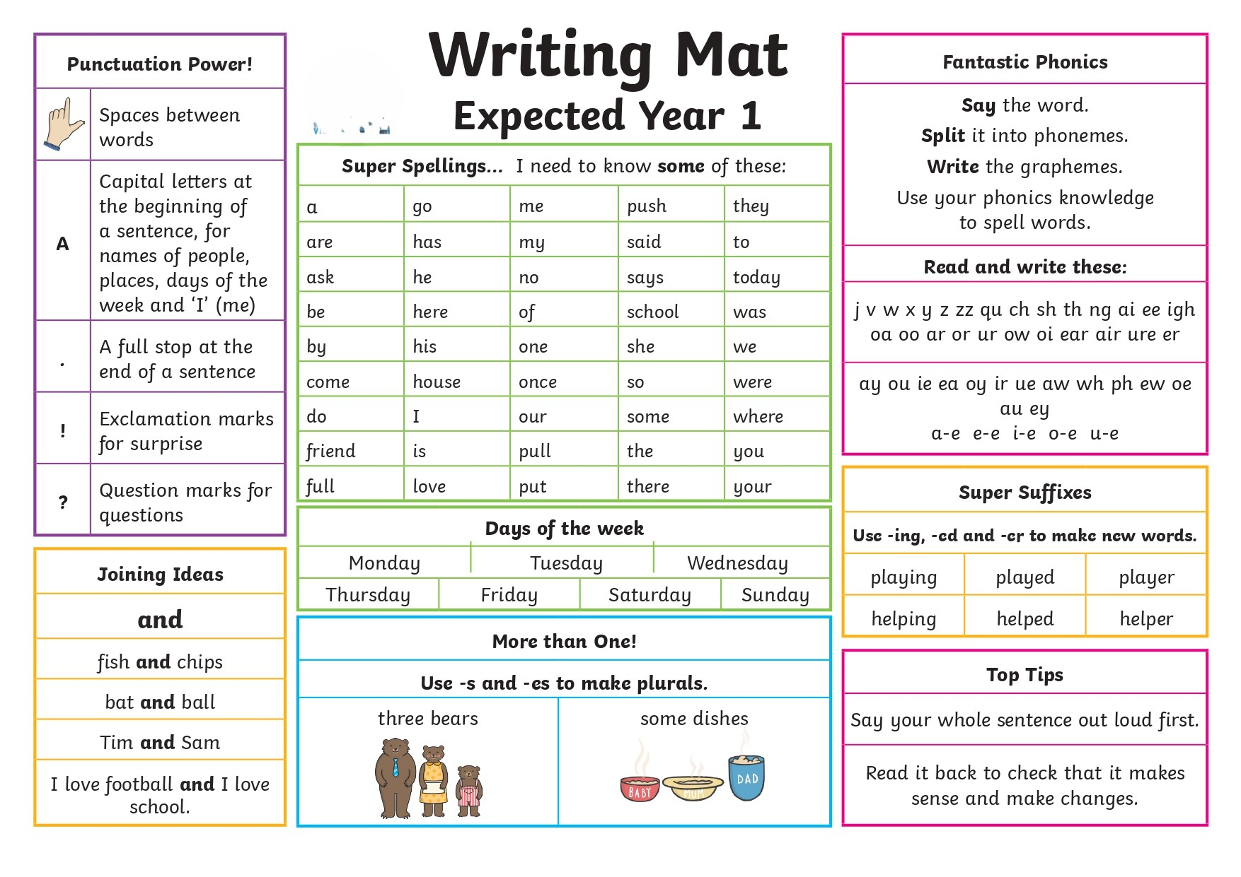
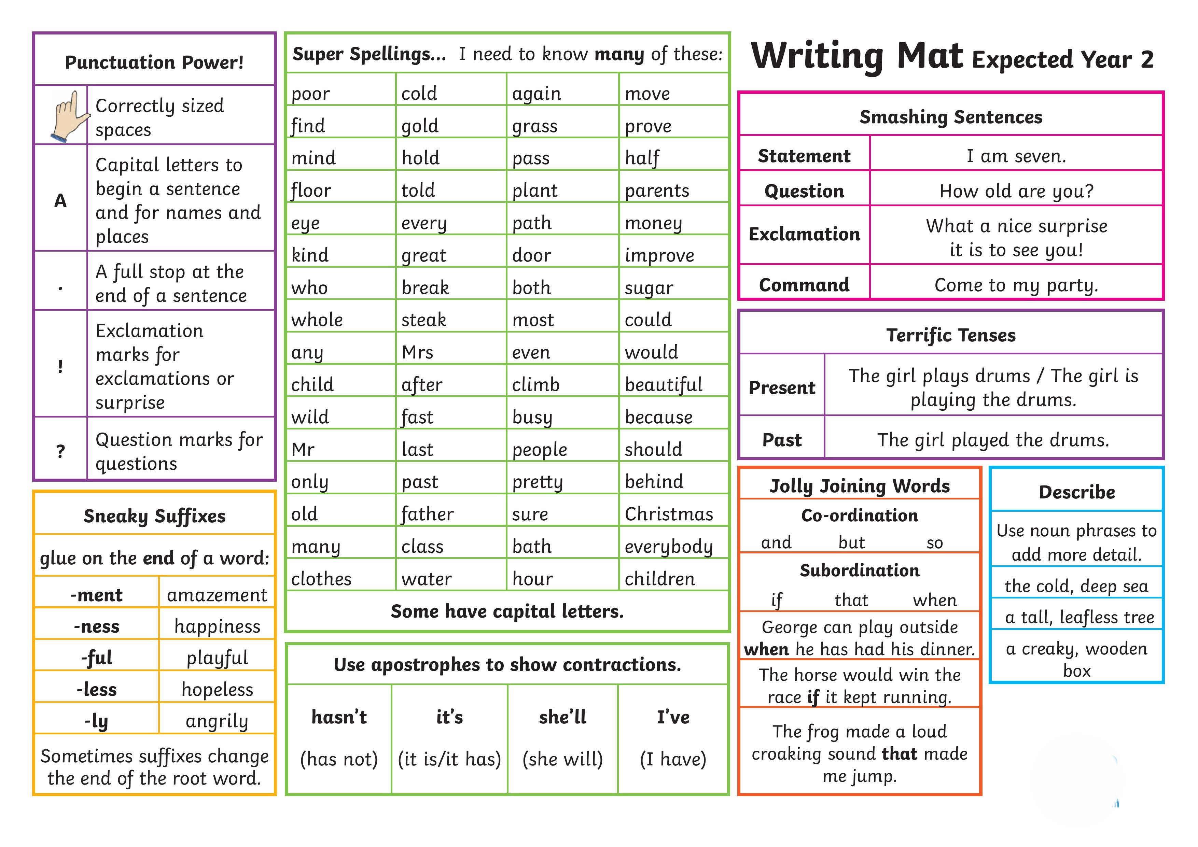
English

Slide 2
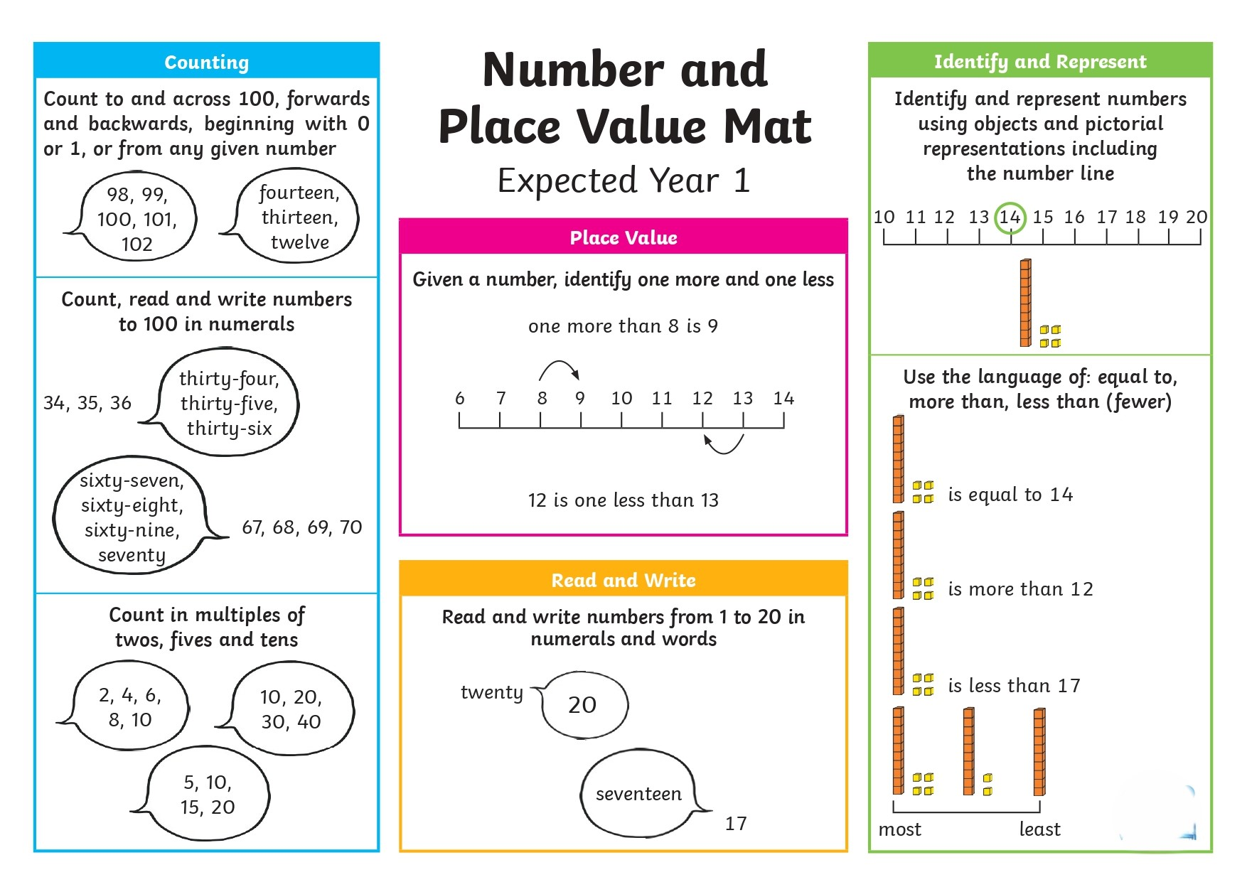
Maths
Number and Place Value – Year 1

Slide 3
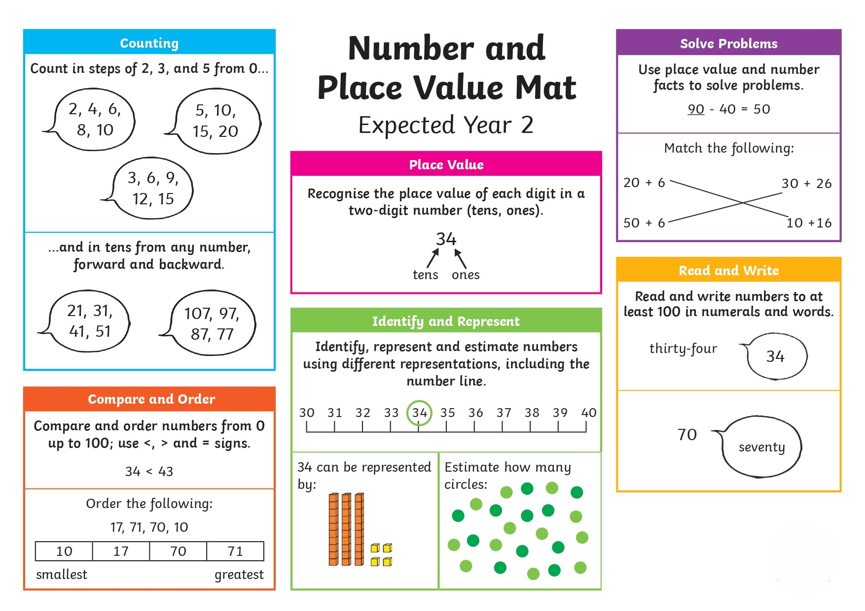
Maths
Number and Place Value – Year 2

Slide 4
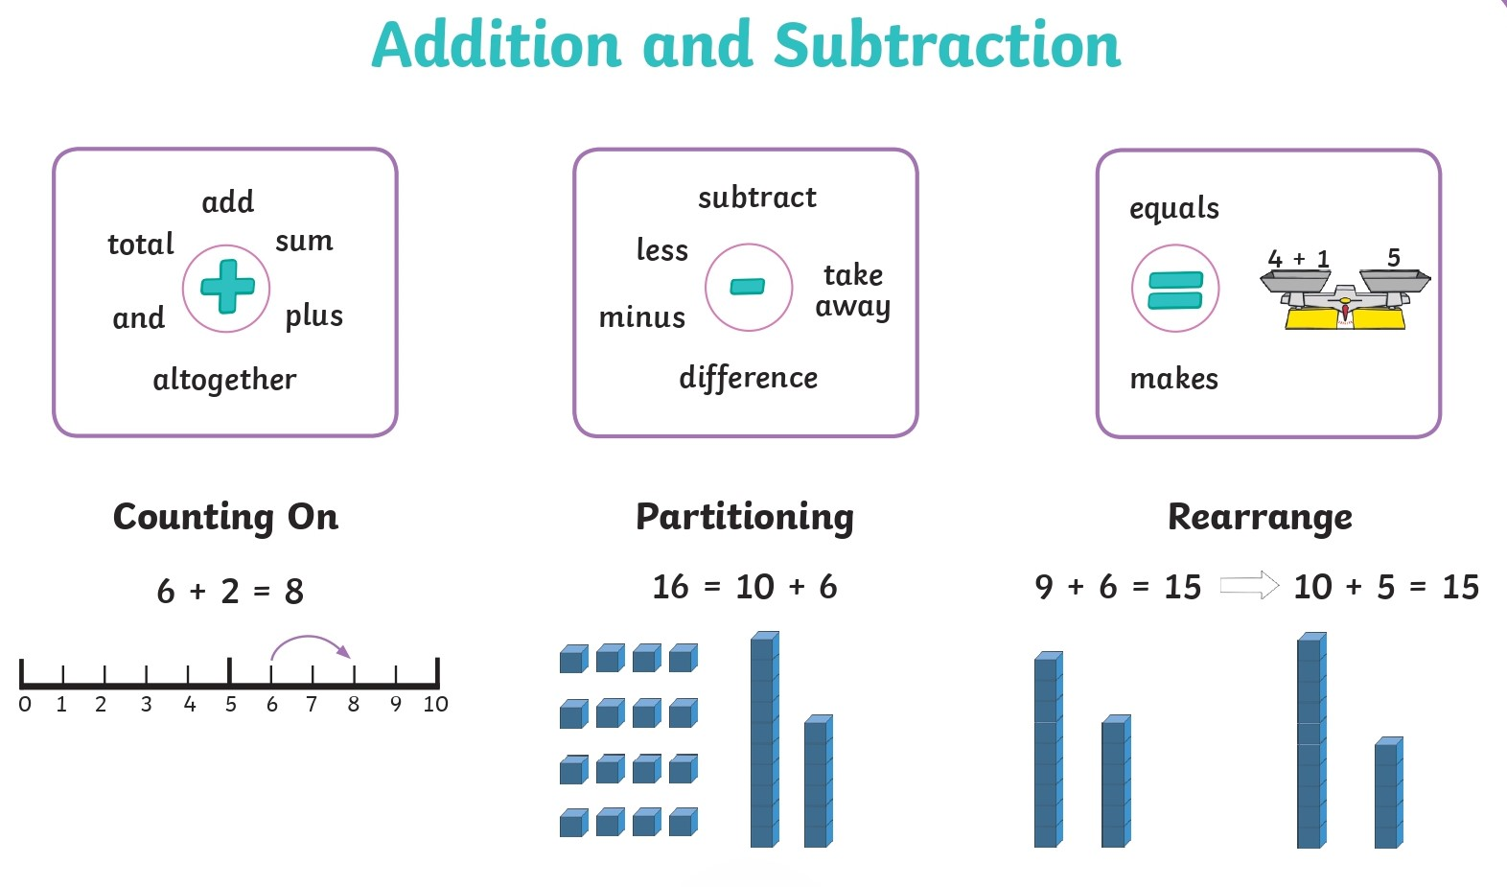
Maths
Addition and Subtraction – Year 1

Slide 5
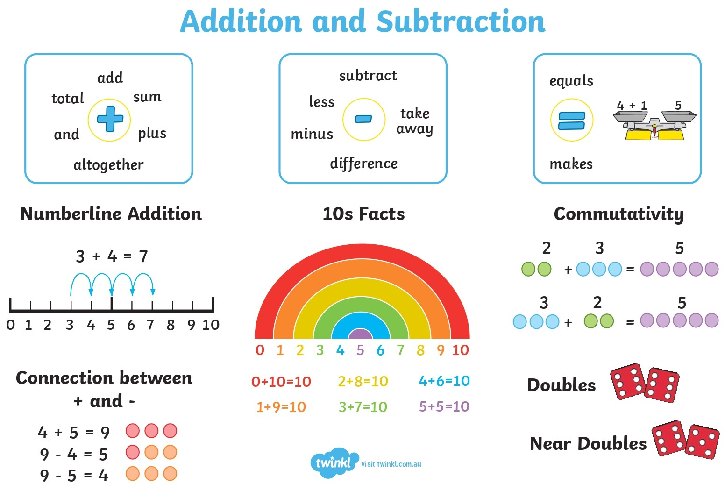
Maths
Addition and Subtraction – Year 2

Slide 6
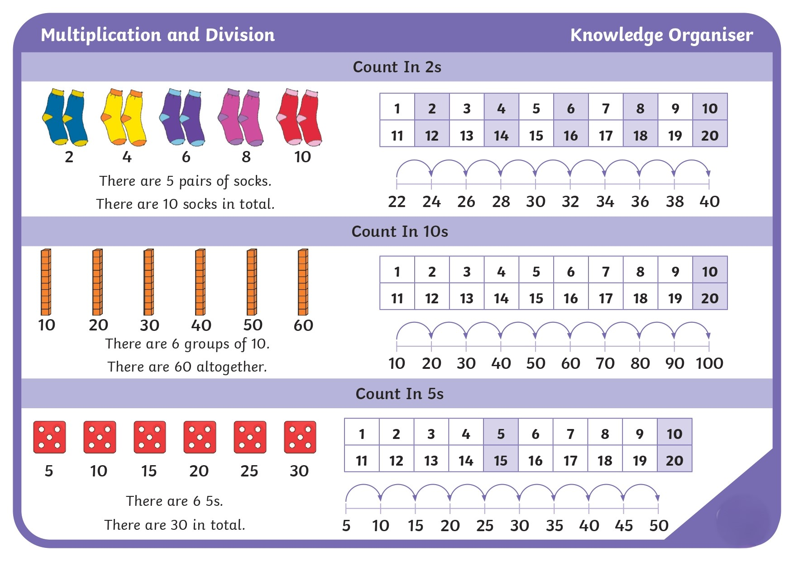
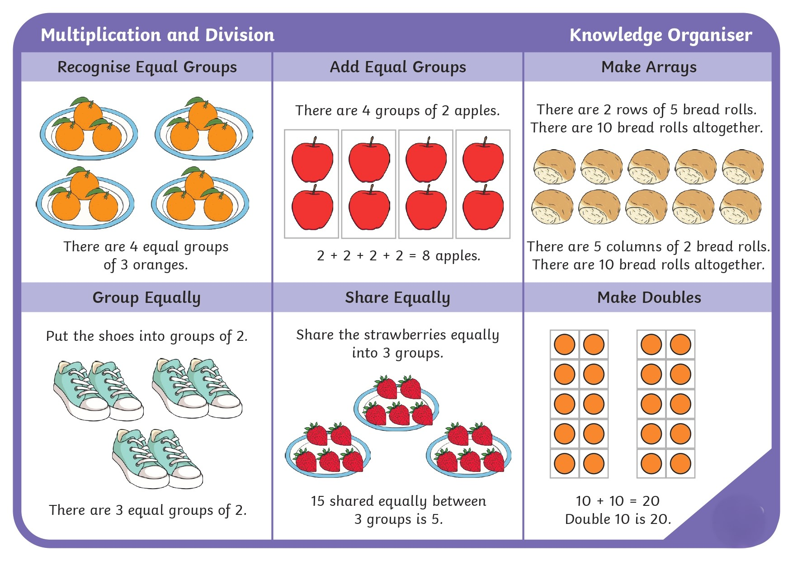
Maths
Multiplication and Division – Year 1

Slide 7
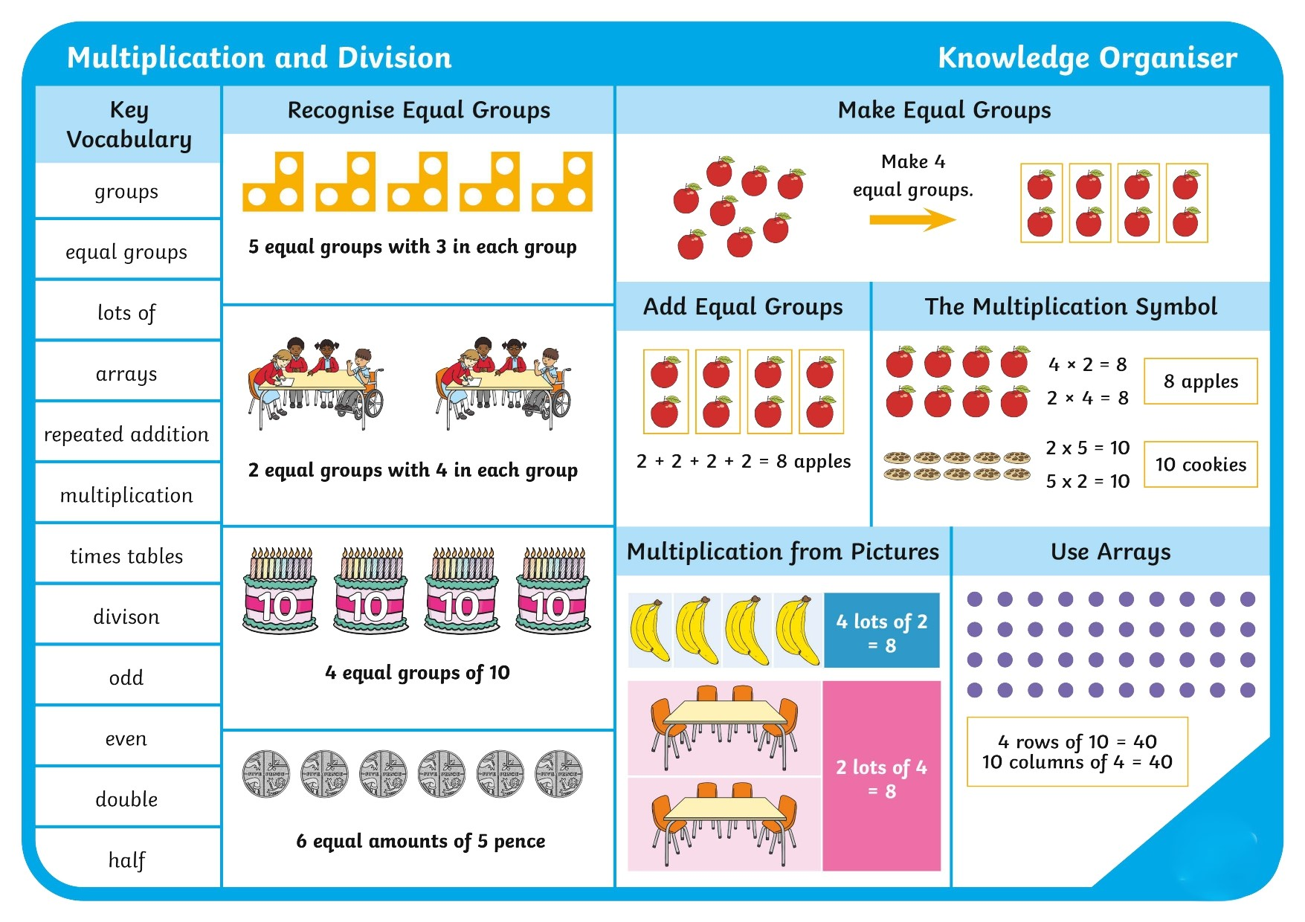
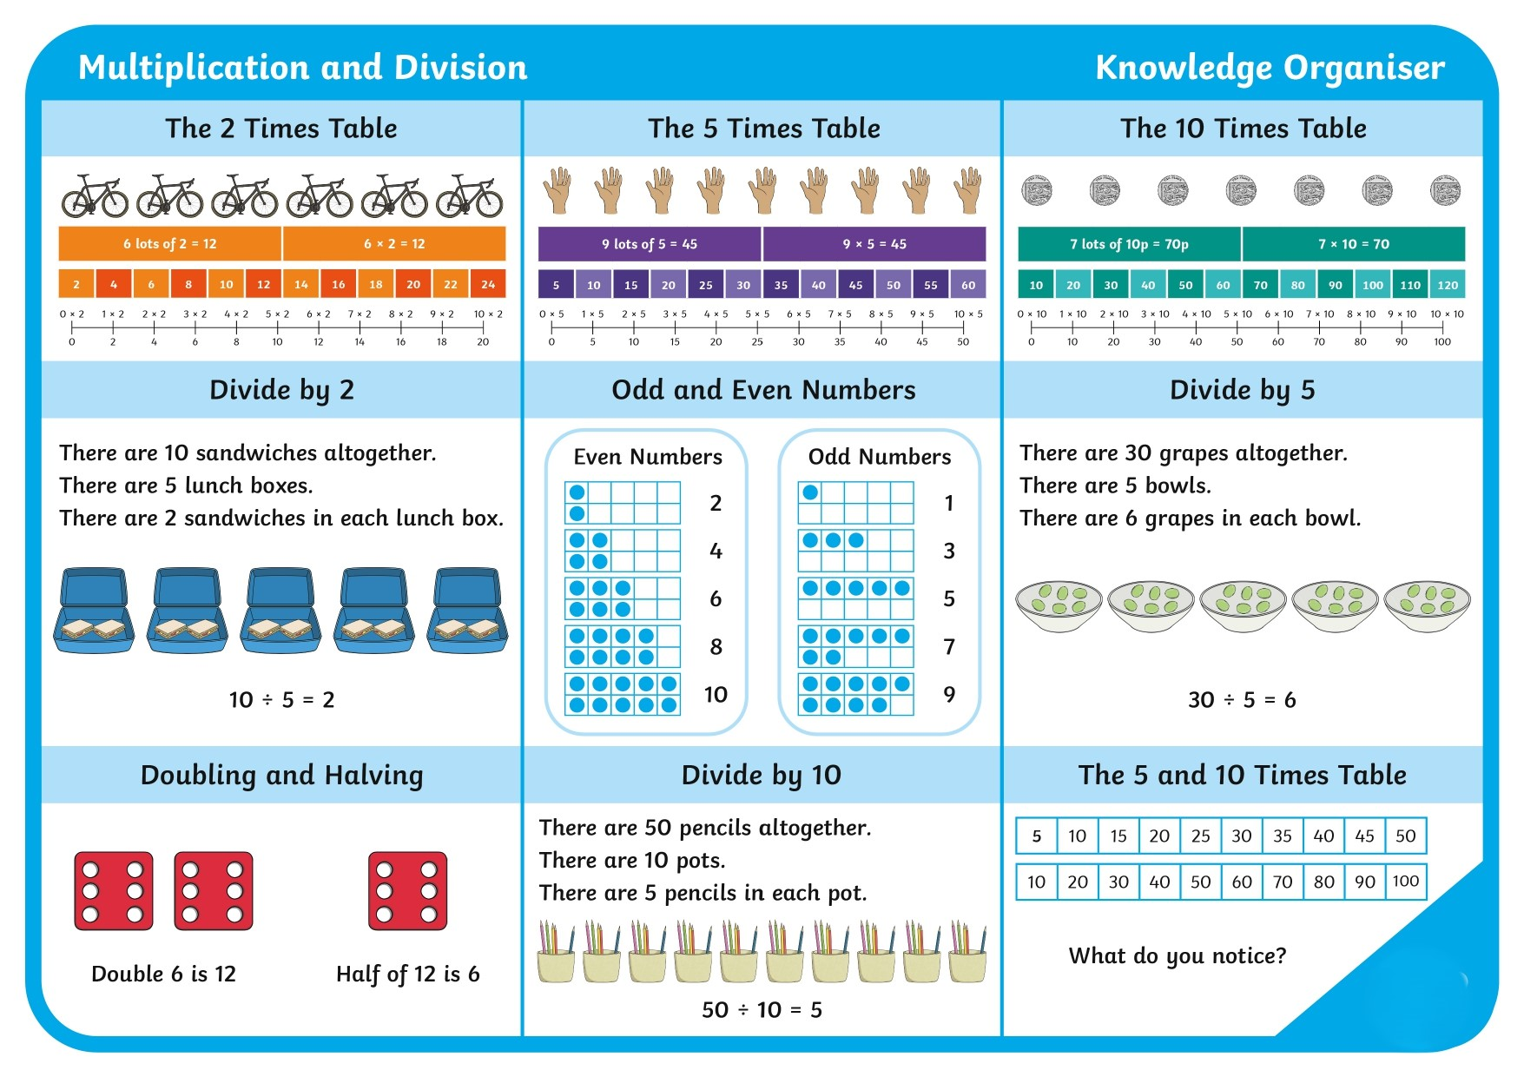
Maths
Multiplication and Division – Year 2

Slide 8
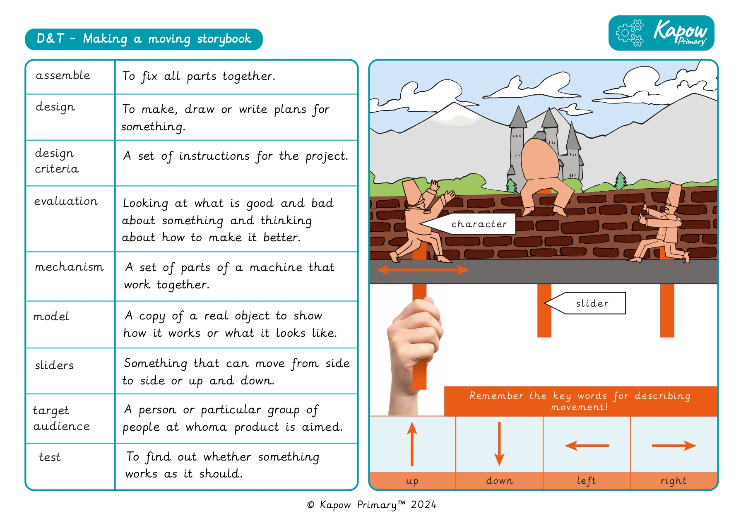
DT
Spring 1 - Making a moving storybook

Slide 9
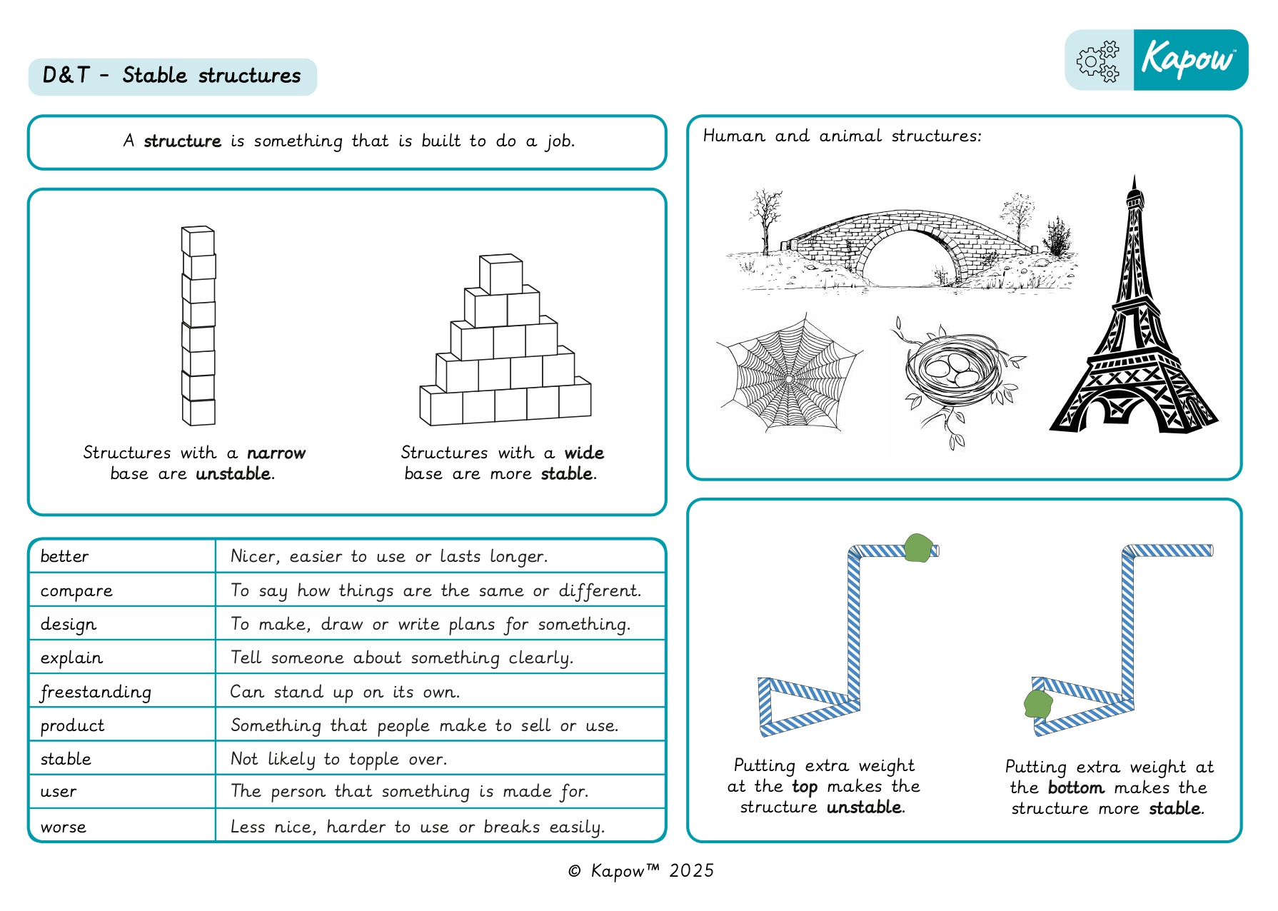
DT
Spring 2 - Stable Structures

Slide 10
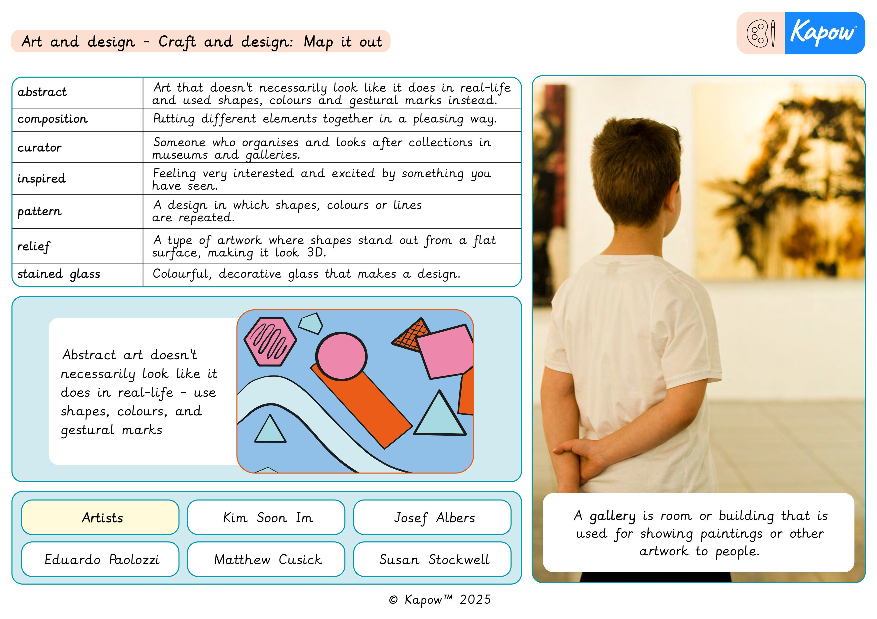
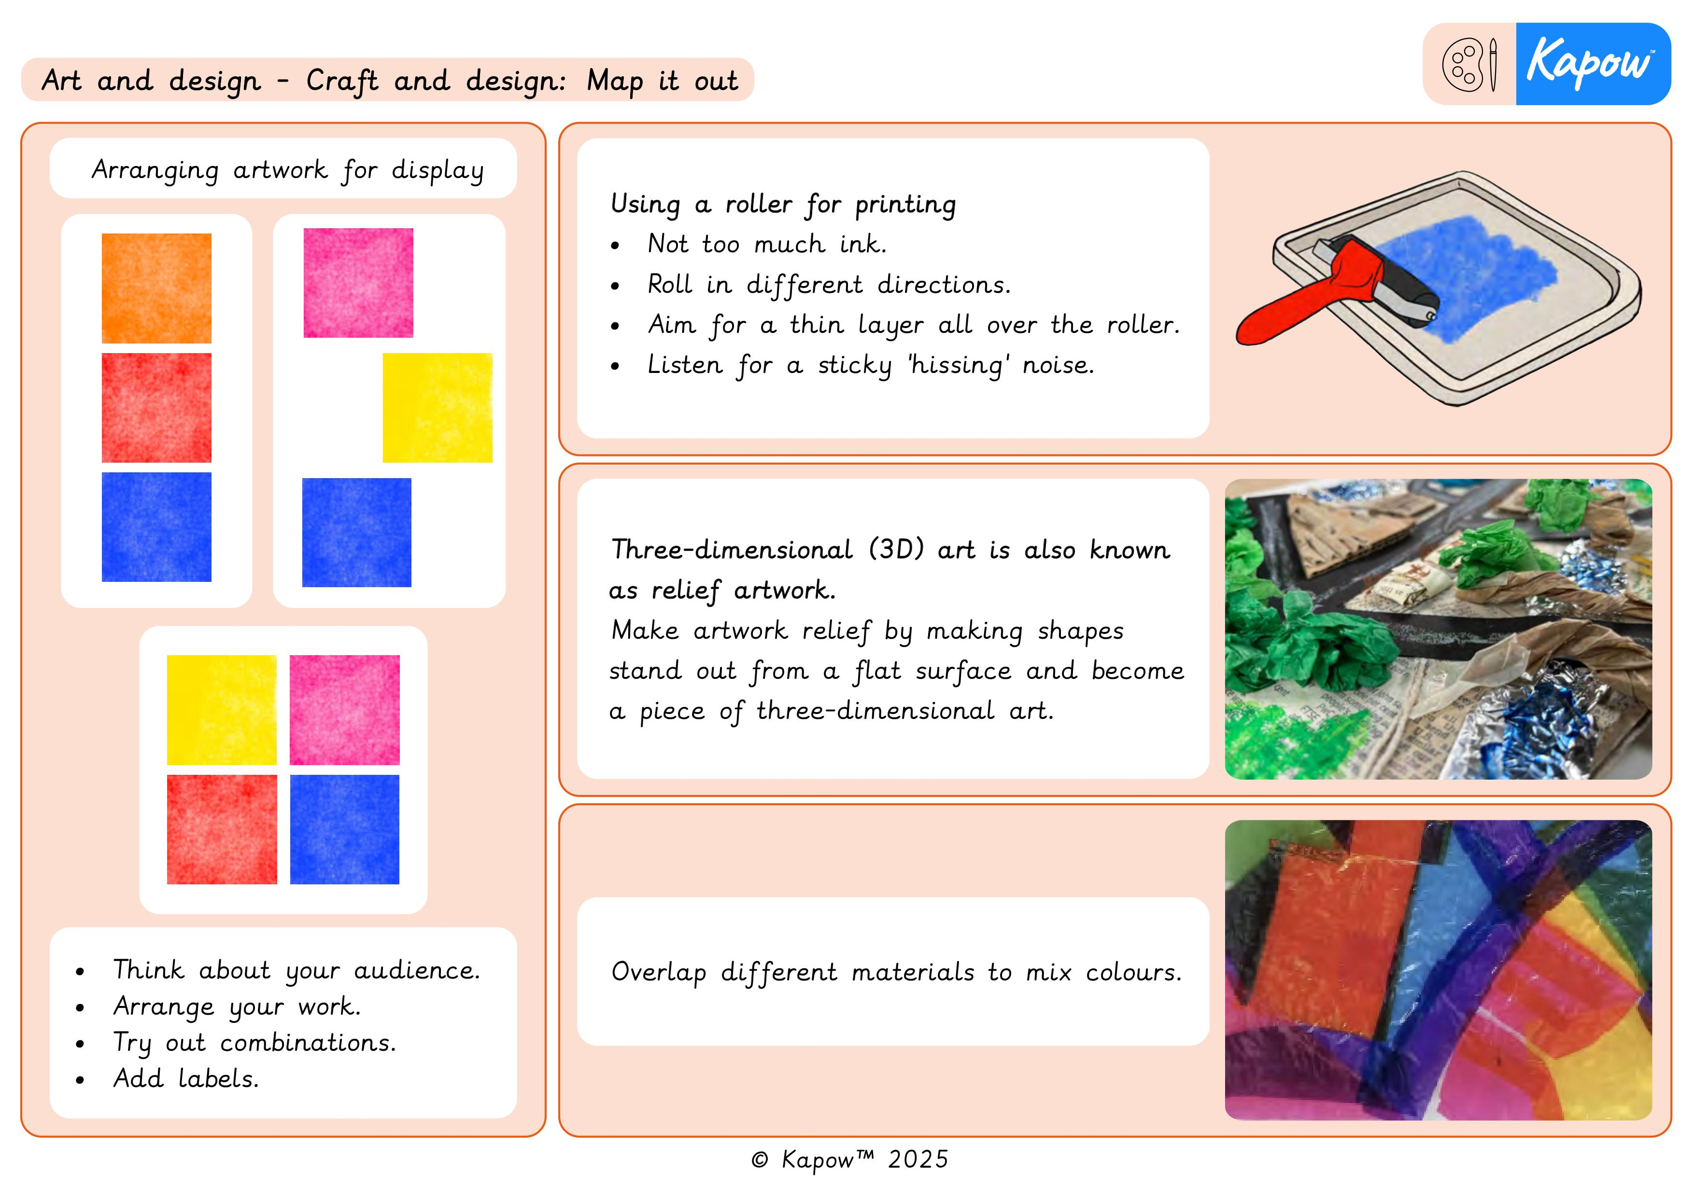
ART
Spring 1 - Map it out

Slide 11
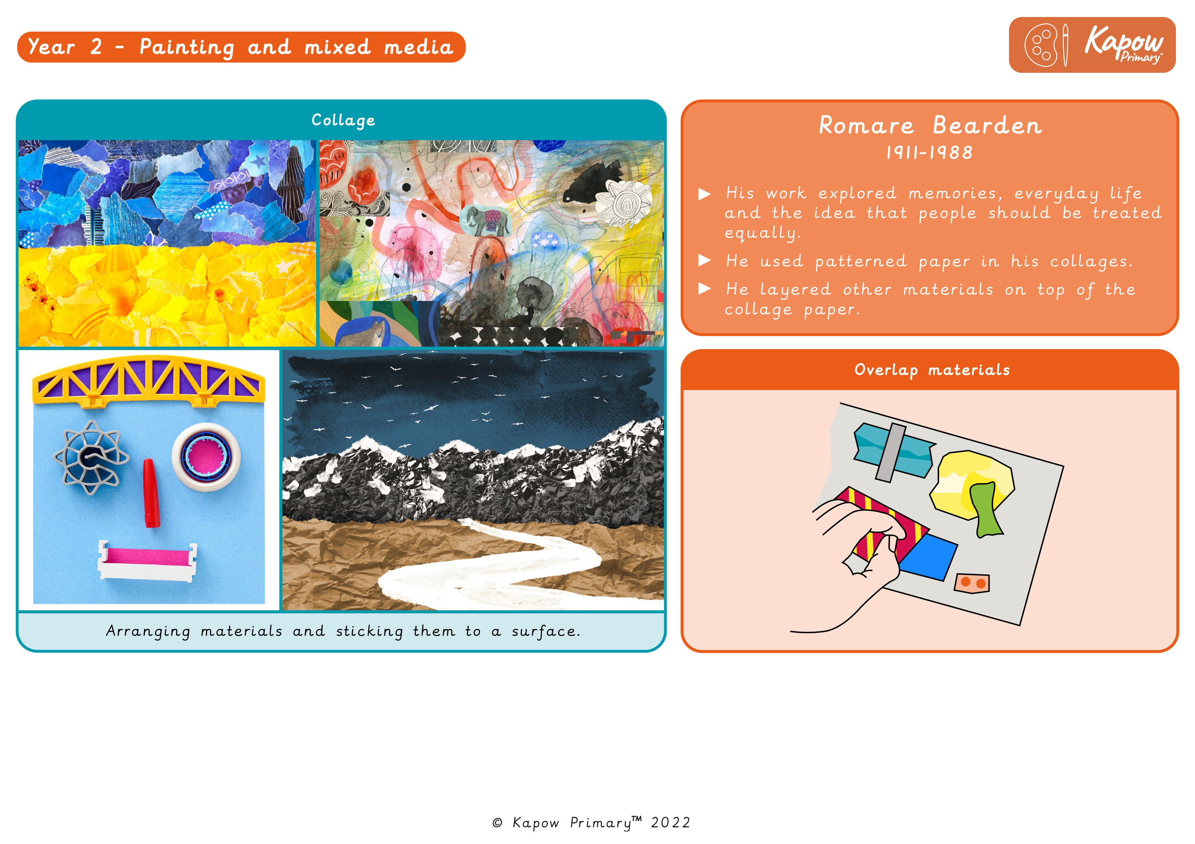
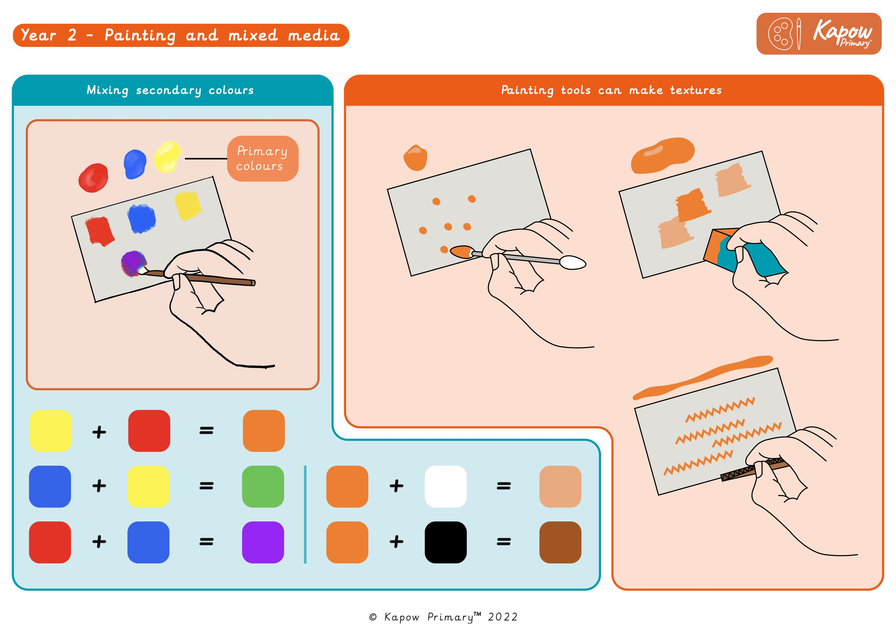
ART
Spring 2 - Life in Colour

Slide 12
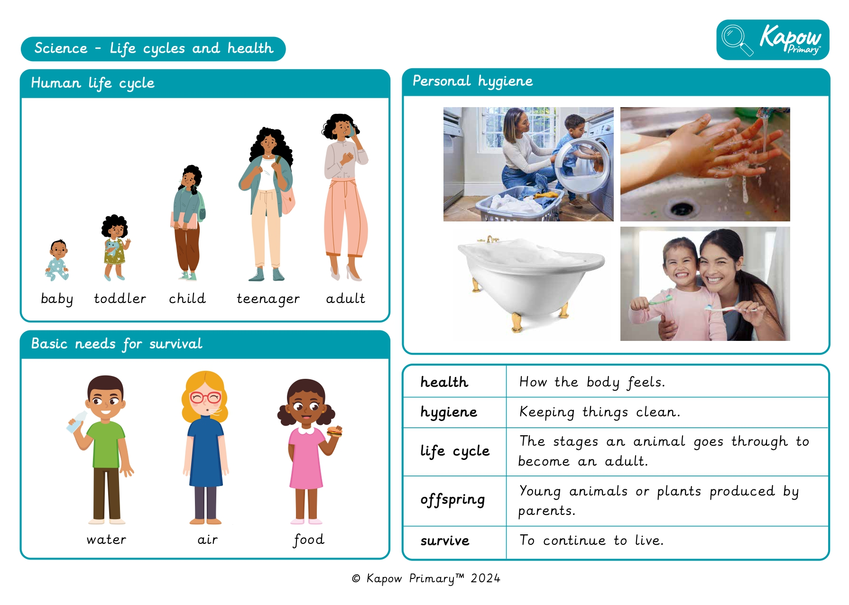
Science
Spring 1 - Lifecycles and Health

Slide 13
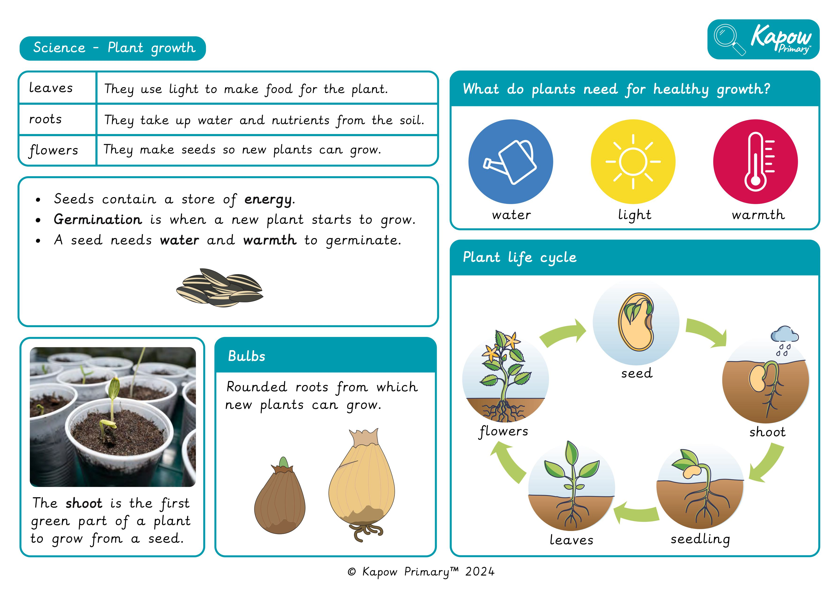
Science
Spring 2 - Plant Growth

Slide 14
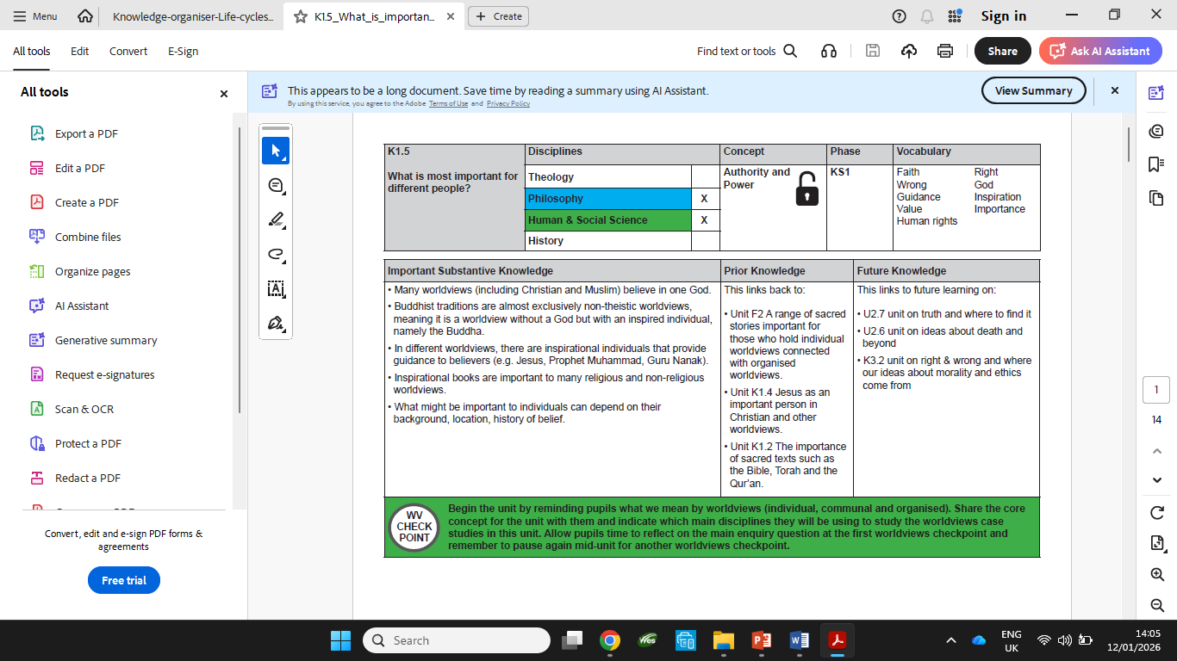
RE
Spring 1 - What is most important for different people?

Slide 15
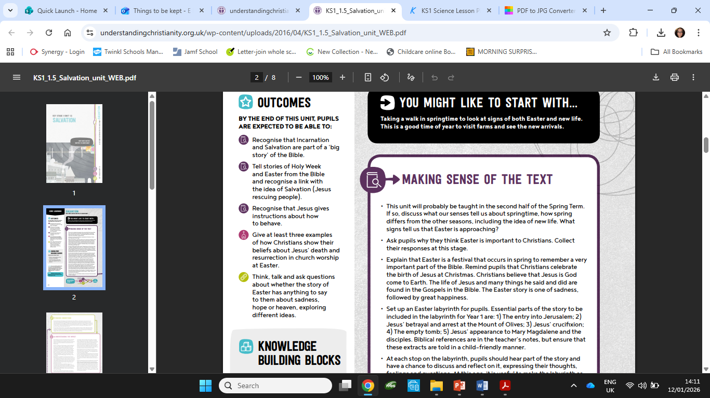
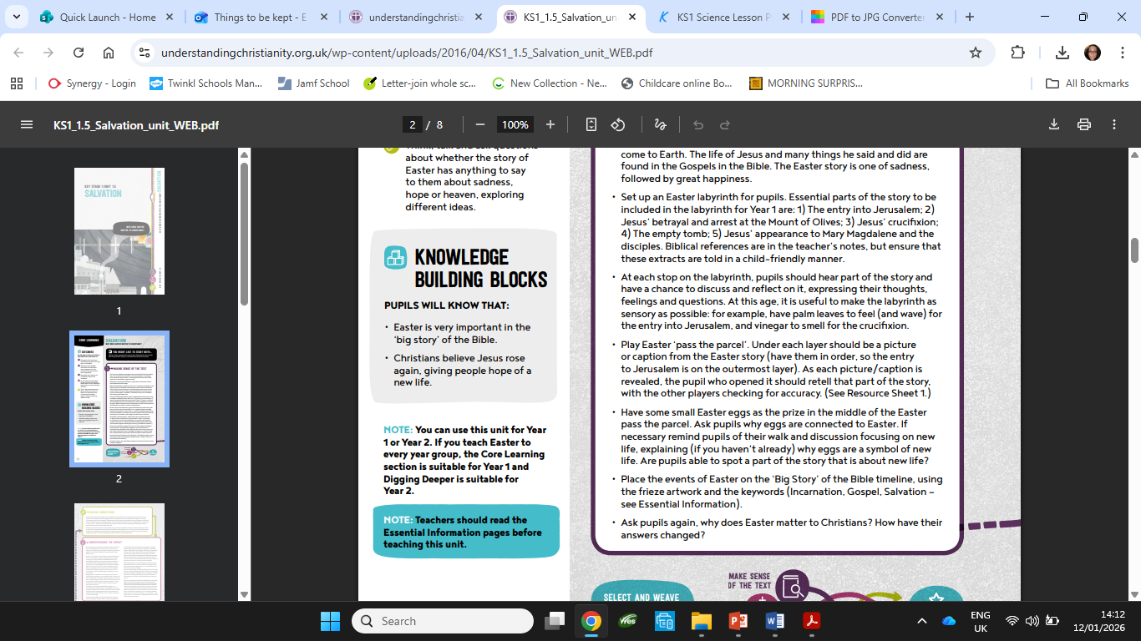
RE
Spring 2 - Why does Easter matter to Christians?

Slide 16
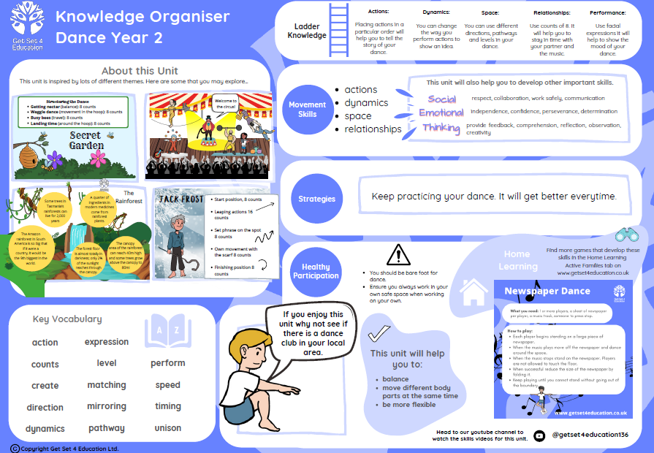
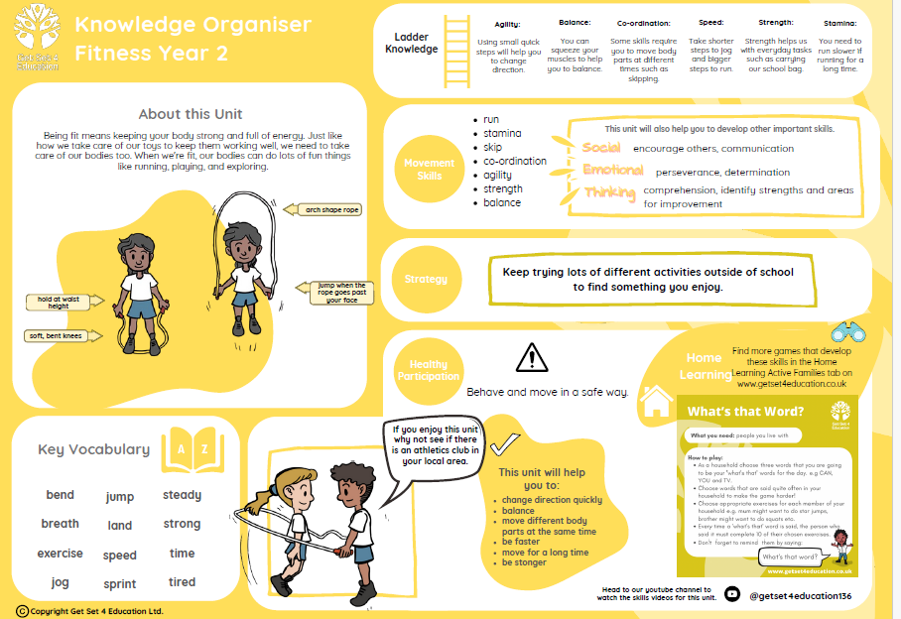
PE – Spring 1
Dance
Fitness

Slide 17
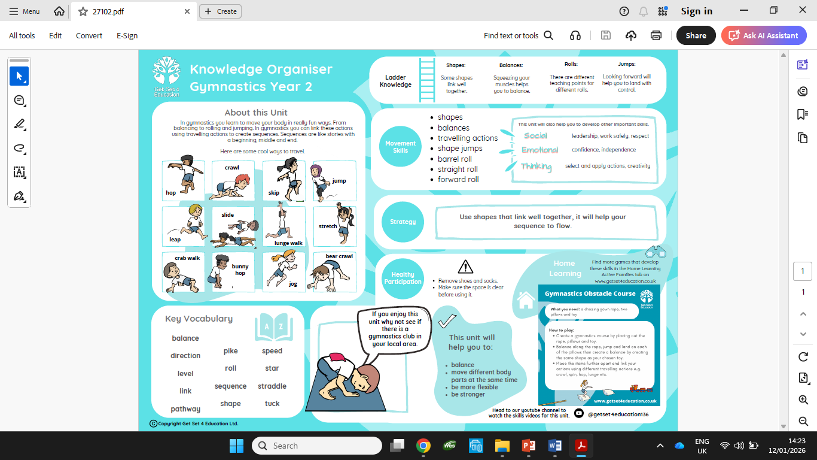
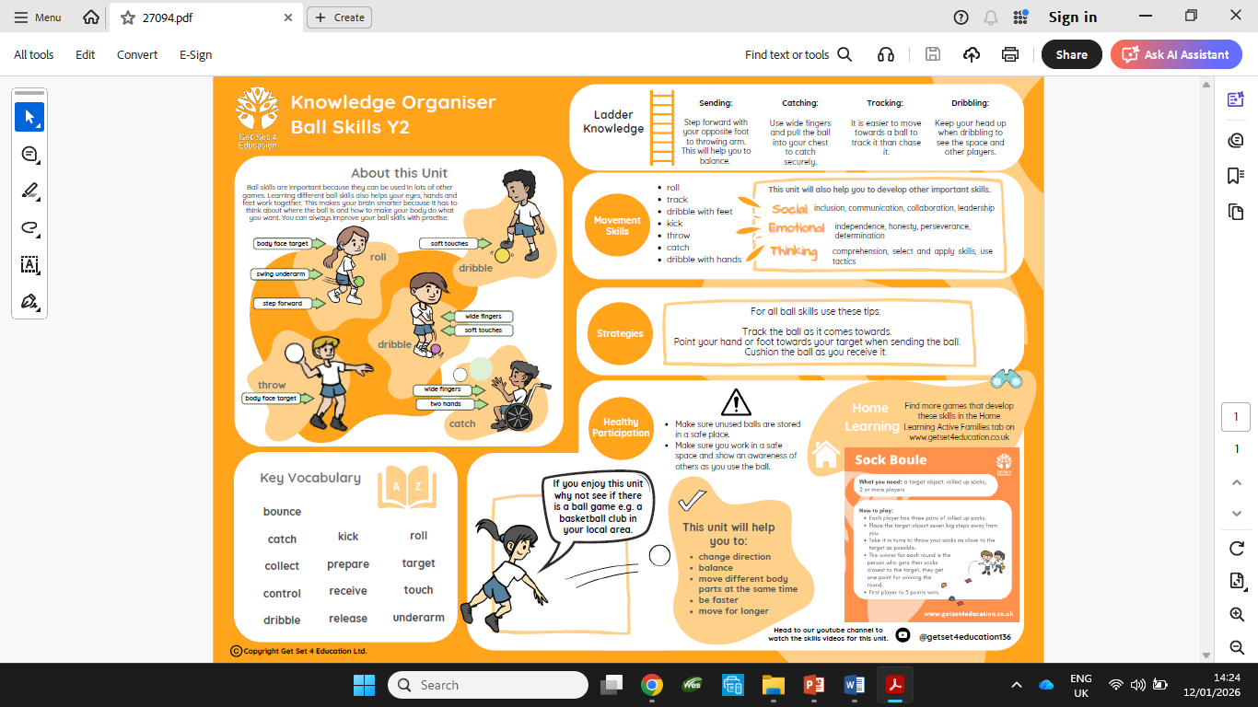
PE – Spring 2
Gymnastics
Ball Skills

Slide 18
History
How can we explore the world around us?
🌍 What is this topic about?
We are learning about explorers who travelled the world a long time ago to find new places.
🕰️ Key Ideas
An explorer travels to new places
Explorers lived in the past
They went on long journeys
Explorers helped people learn about the world
🧠 Key Questions
Who were explorers?
Why did explorers travel?
How did they travel?
What did they discover?
🗣️ Important Vocabulary
Word | Meaning
Explorer | A person who travels to new places
Past | A long time ago
Journey | A long trip
Map | A picture that shows places
Ship | A big boat
Discover | To find something new
🧑‍✈️ Explorers from the Past
Christopher Columbus – sailed across the ocean
Marco Polo – travelled to faraway lands
Ibn Battuta – travelled to many countries
(We will learn about 1 or 2 explorers)

Slide 19
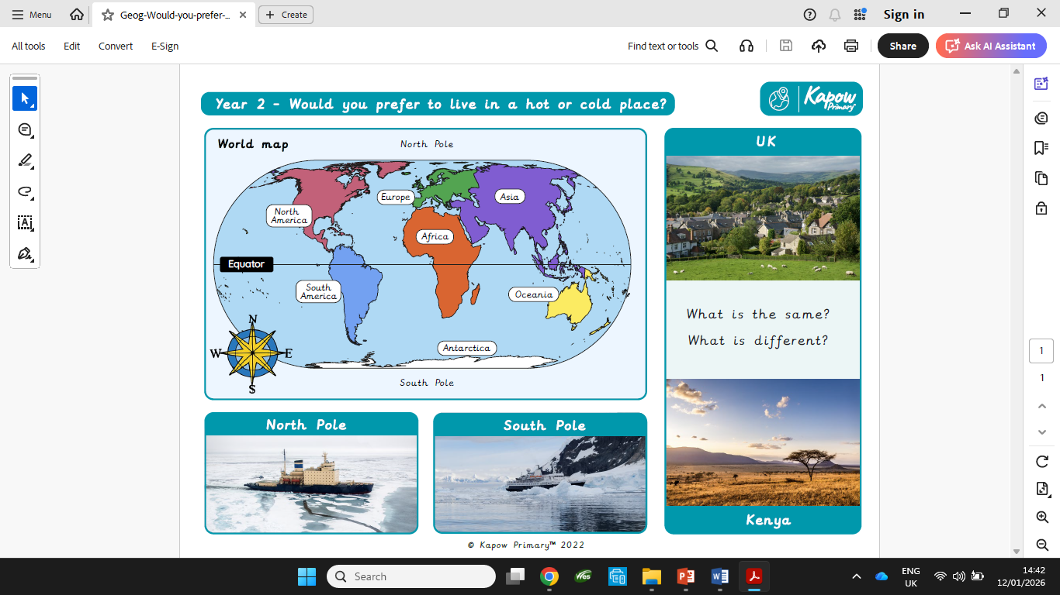
Geography
Would you prefer to live in a hot or cold place?

Slide 20
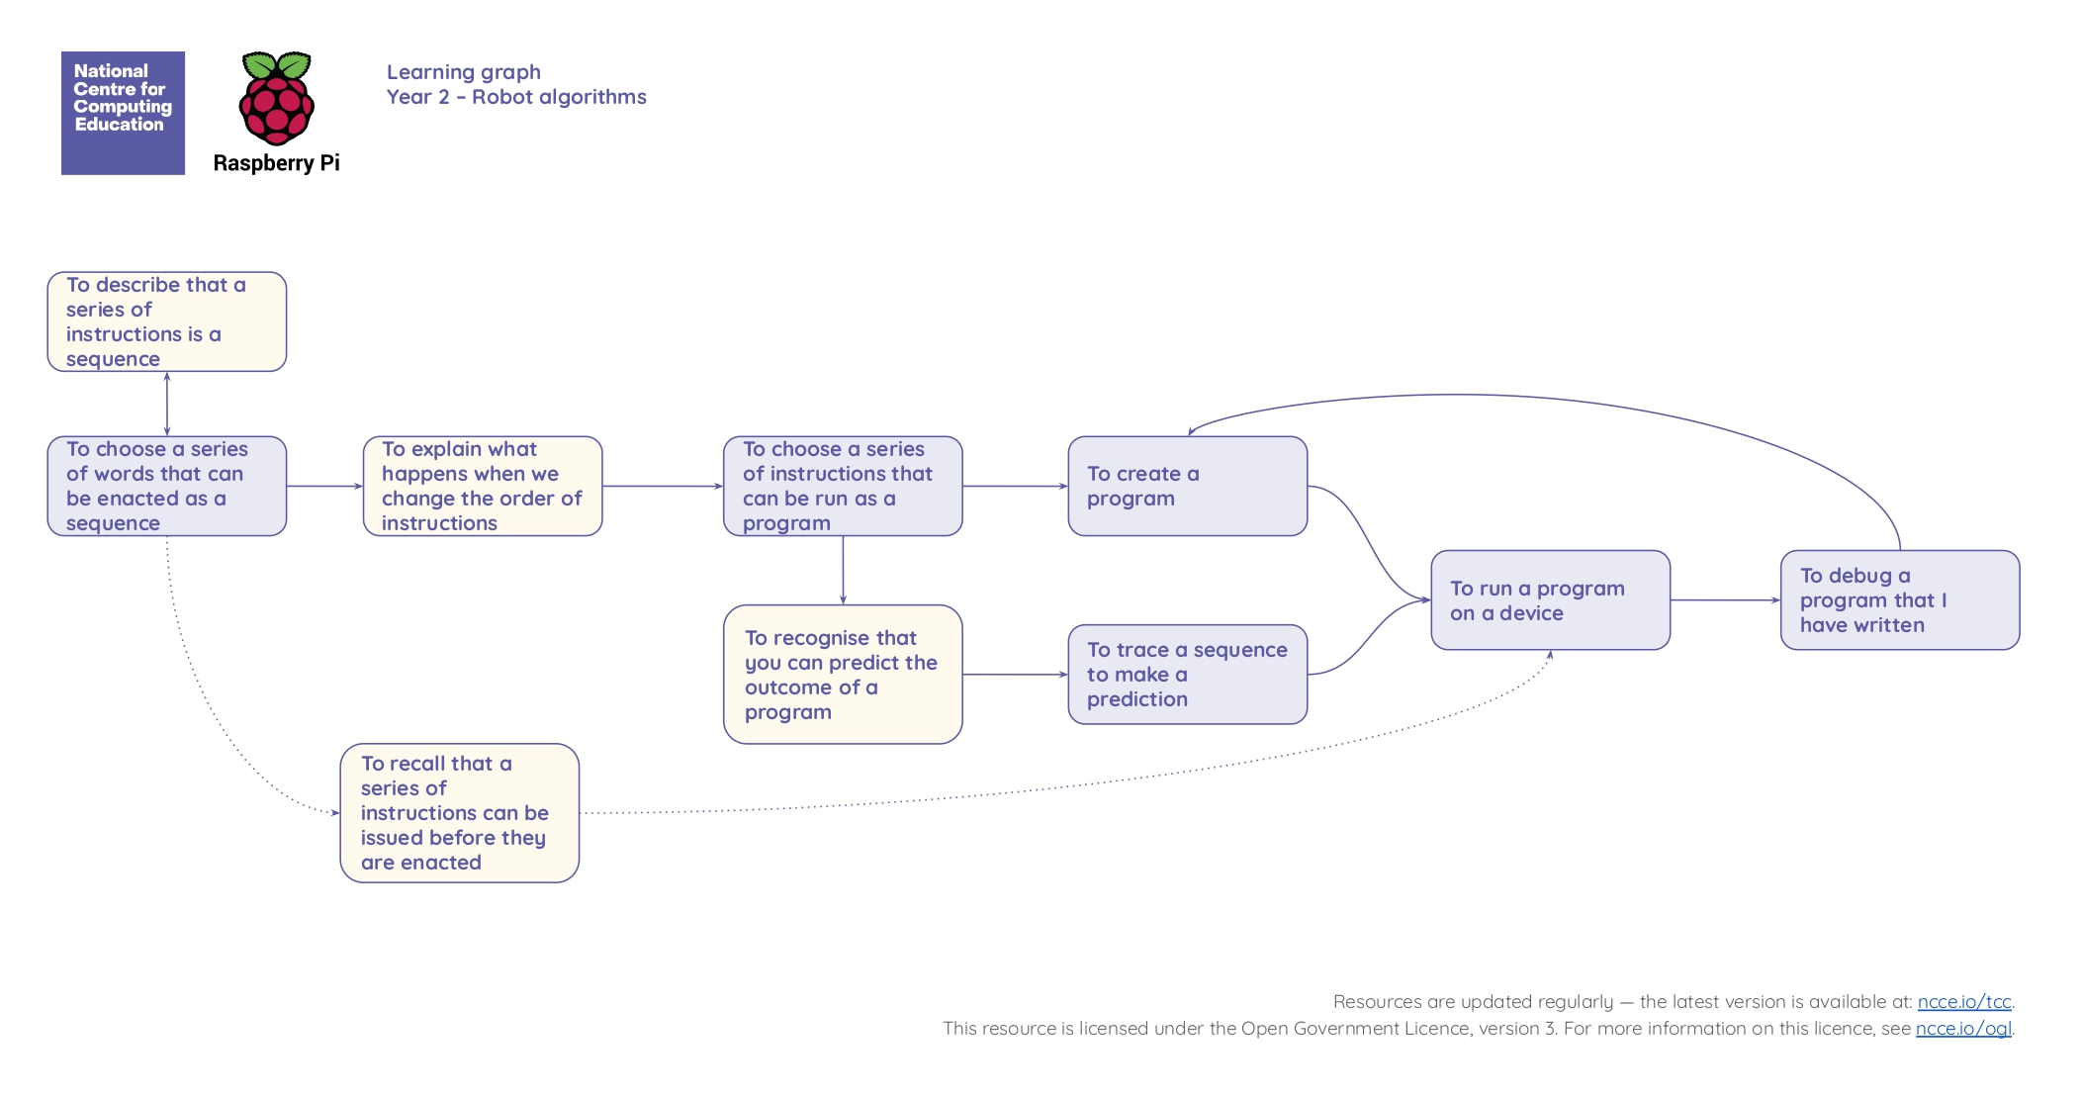
Computing
Spring 1 - Robot Algorithms

Slide 21
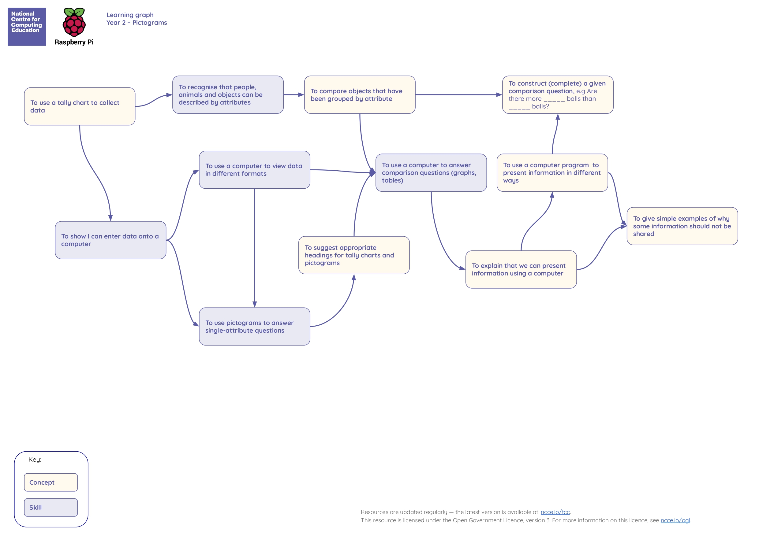
Computing
Spring 2 - Pictograms

Slide 22
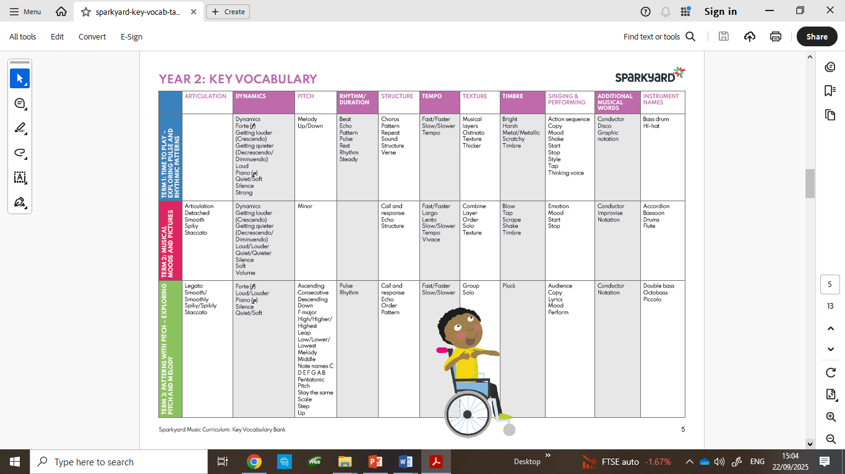
Music
Musical Moods and Pictures

