Slide 1
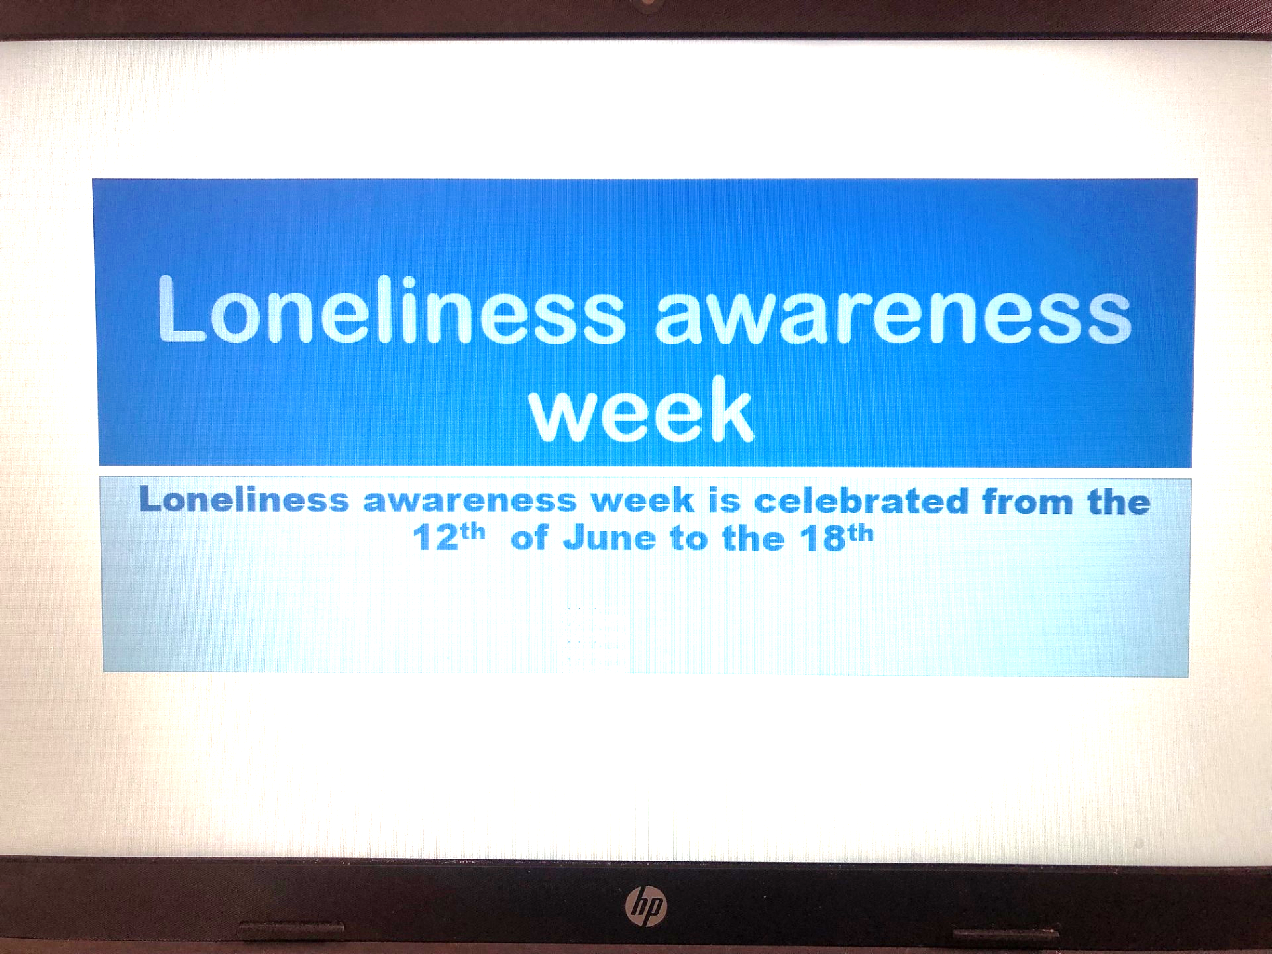

Slide 2
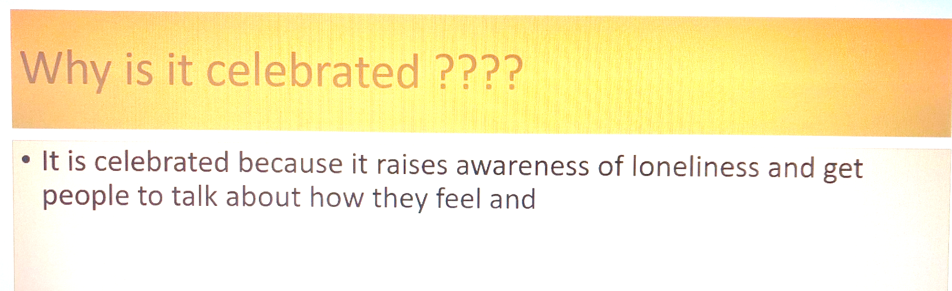

Slide 3

Marmalade Trust
This is leading loneliness charity for all ages and the only charity in the world specifically dedicated to raising awareness of loneliness.
They encourage people to see loneliness as fill their lives with new friends and experiences – and they’re there to help everyone.
Their aim is to reduce the stigma of loneliness and encourage people to talk more openly about it.

Slide 4

If you are feeling lonely what can you do?
What advice would you give to someone who seems lonely or tells you that they are feeling lonely?

Slide 5



If you are feeling lonely or you see someone who may be lonely, what can you do?
Notice!!!
Talk to them, show kindness
Network of friends
Smile at them
Make them laugh
Go for a walk together
Invite them to play with you
Be a good friend

Slide 6

You’ve got a friend in me
https://www.youtube.com/watch?v=zIYOJ_hSs0o

Slide 7
