Slide 1
Welcome
By Head Boy and Head Girl

Slide 2
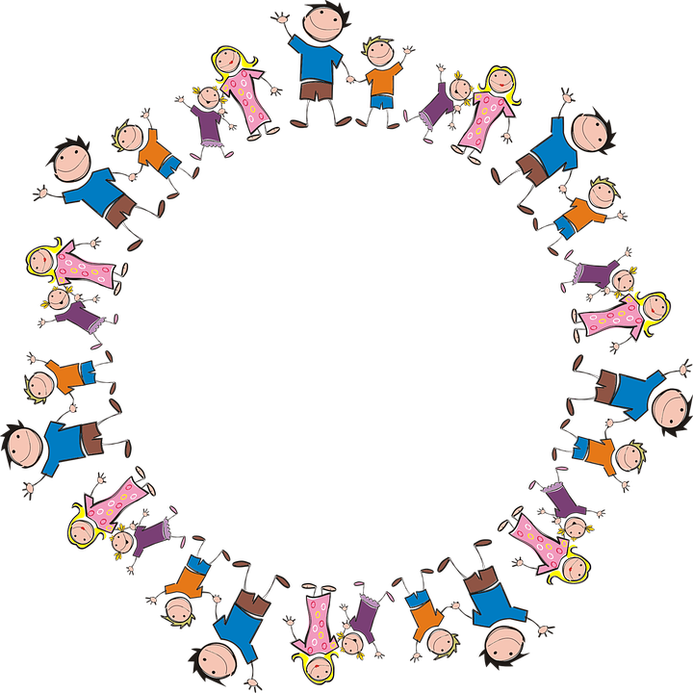
Sophie and Alfie - The Gathering

Slide 3

LIGHTING THE CANDLES
God’s love brings light to the world and we light 3 candles to remember God is Father, Son and Holy Spirit. The Trinity.
Jesus light of the world is here.

Slide 4

We welcome the Bible; it guides us in everything we try to do.
We welcome God’s words.

Slide 5
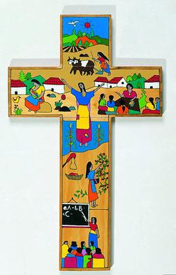
We welcome the cross; it reminds us of what Jesus gave for us.
We thank you Jesus.

Slide 6
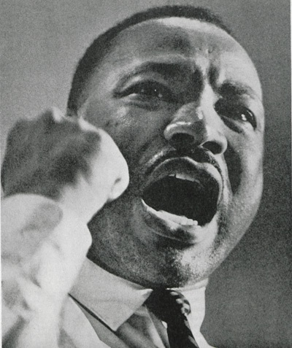
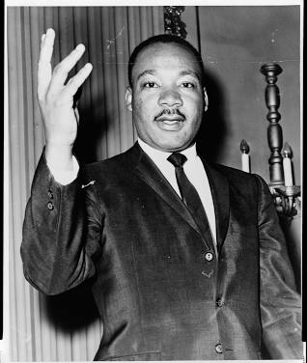
MARTIN
LUTHER
KING!!!
MARTIN
LUTHER
KING!!!

Slide 7
What did martin Luther king do to change the world?
Martin Luther King changed the world using his words.
His speeches motivated generation’s to change their ideas and actions that were deemed unthinkable, moved ideas and thoughts and develop innovative concepts such as the non-violent opposition. His words brought real change.

Slide 8
What did Martin Luther King achieve?
1957 – The founding of the Southern Christian Leadership Conference (SCLC)
1963 – The Birmingham Campaign.
1963 –1964 – Civil Rights Act of 1964.
The Grate game on Washington
1965 – 1965 Voting Rights Act
1964 – Nobel Peace Prize.

Slide 9

About Martin Luther King’s life
Born on the 15 January 1929 and was brute fully assassinated on the 4 April 1968
In this period of time he was an American minister and is such a good role modal to look up to
led the movement to end segregation and counter prejudice in the United States through the means of peaceful protest.
This Photo by Unknown Author is licensed under CC BY-SA-NC

Slide 10
A speech from martin Luther King (7 muinuits)
https://www.youtube.com/watch?v=vP4iY1TtS3s

Slide 11

THE END OF THIS ASSEMBLY HOPE YOU ENJOYED
BY :JOSHUA SIMPSON

Slide 12
Let us pray
Dear Heavenly Father Friend of all children Bless our school at Henley All the children and staff who work here Help us do our best Be kind to one another And to be cheerful all day long Amen

Slide 13
The Blessing

