Slide 1
Welcome
By Head Boy and Head Girl

Slide 2
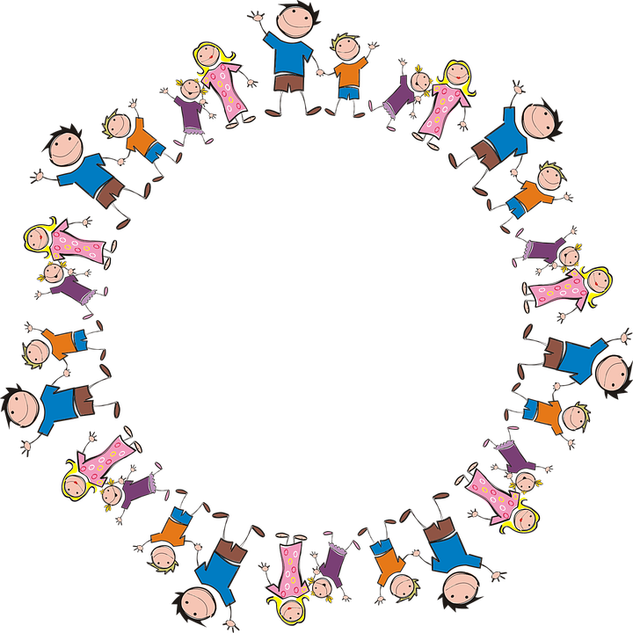
Sophie and Alfie - The Gathering

Slide 3
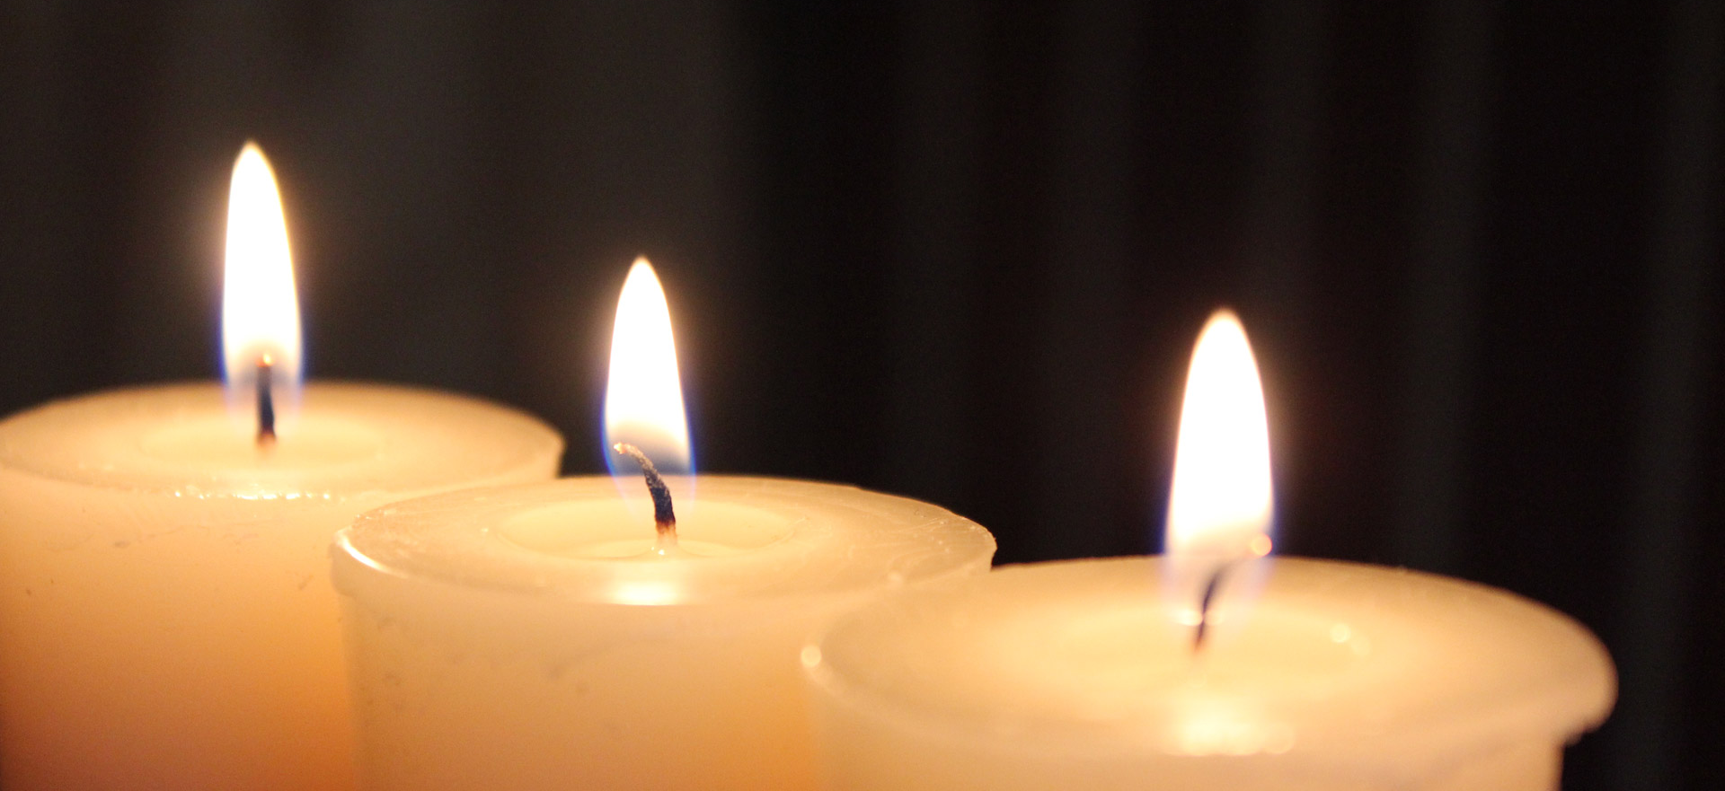
LIGHTING THE CANDLES
God’s love brings light to the world and we light 3 candles to remember God is Father, Son and Holy Spirit. The Trinity.
Jesus light of the world is here.

Slide 4

We welcome the Bible; it guides us in everything we try to do.
We welcome God’s words.

Slide 5
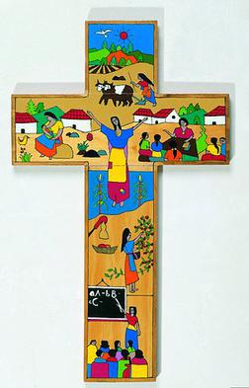
We welcome the cross; it reminds us of what Jesus gave for us.
We thank you Jesus.

Slide 6
Today is National Thank You Day!
By Sophie and Tiffany :]

Slide 7

What is National Thank You day?
A day to celebrate those who have helped us and let us live an amazing life. We try to say thank you to those who have done something good.
Remember to say thank you today and always.

Slide 8
How to get a thank you on thank you day?

Slide 9
How many did you get?
Hold open a door for someone
Include someone if they look lonely
Help someone if they are stuck on a lesson
Just make sure you make people happy.
Yes these things are perfect for today but remember to always be kind to everyone – not just today :]

Slide 10


We will now listen to a thank you song
National Thank You Day Song
This Photo by Unknown Author is licensed under CC BY-NC-ND
This Photo by Unknown Author is licensed under CC BY-SA

Slide 11
Thank you day quiz!
Why is thank you celebrated?
Name on thing that could get you a thank you
Why is thank you day important?
Do you think we should carry on with thank you day to remind us to say thank you?

Slide 12
Let us pray
Dear Heavenly Father Friend of all children Bless our school at Henley All the children and staff who work here Help us do our best Be kind to one another And to be cheerful all day long Amen

Slide 13
The Blessing

