Slide 1
Welcome
By Head Boy and Head Girl

Slide 2
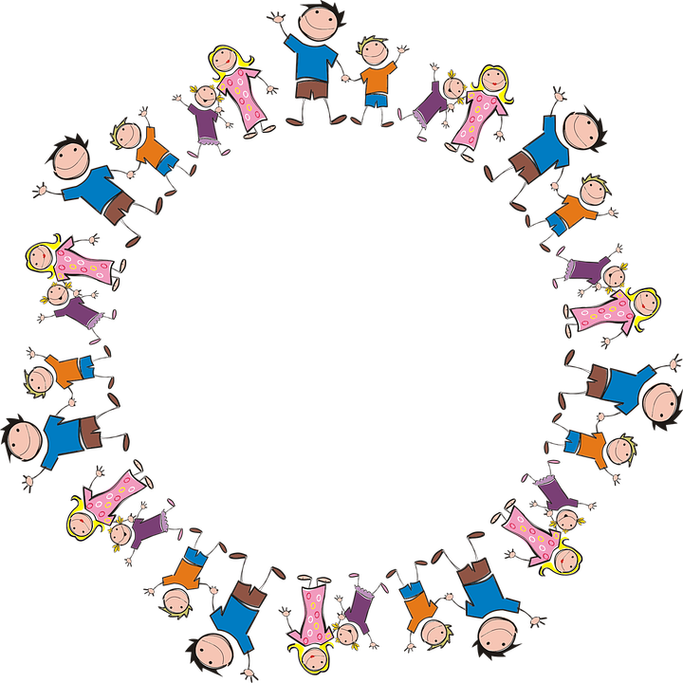
Sophie and Alfie - The Gathering

Slide 3
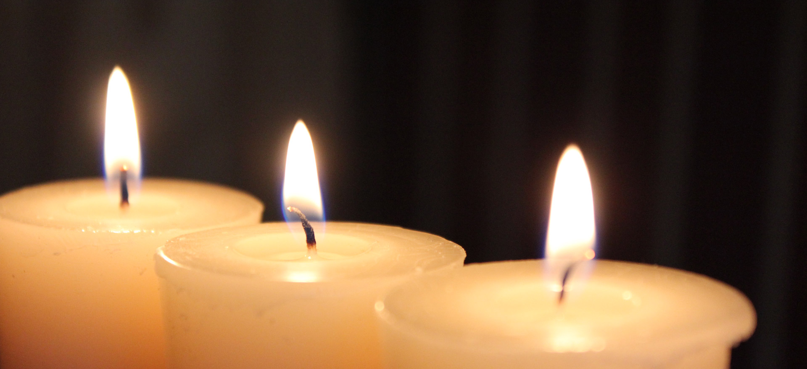
LIGHTING THE CANDLES
God’s love brings light to the world and we light 3 candles to remember God is Father, Son and Holy Spirit. The Trinity.
Jesus light of the world is here.

Slide 4
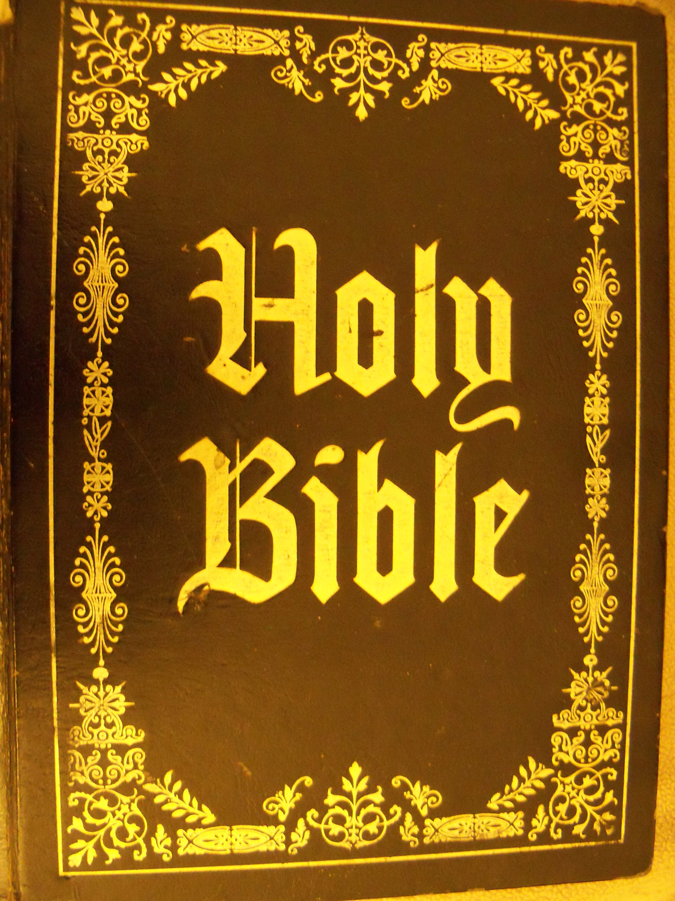
We welcome the Bible; it guides us in everything we try to do.
We welcome God’s words.

Slide 5
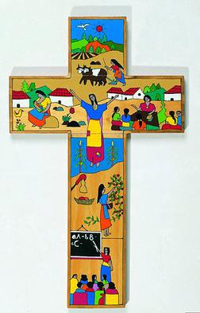
We welcome the cross; it reminds us of what Jesus gave for us.
We thank you Jesus.

Slide 6
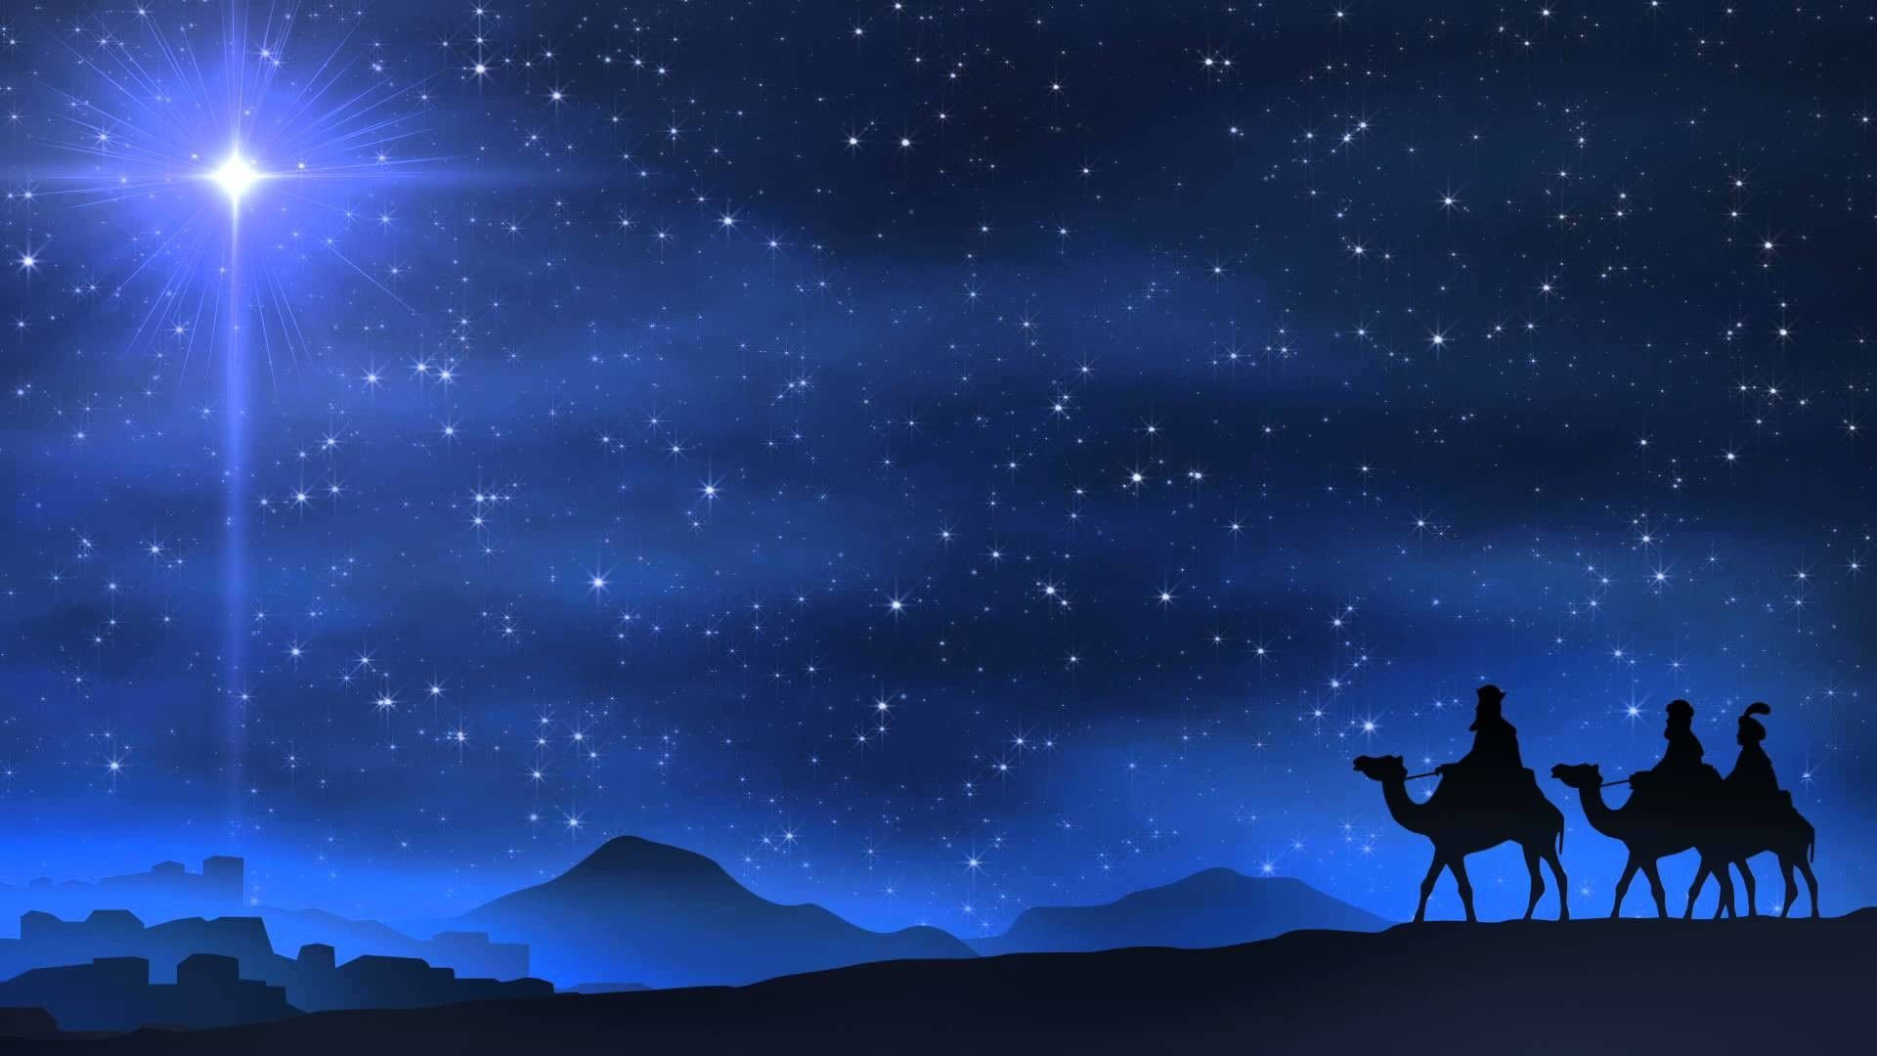
The
Nativity
By Eden Cox and Frankie Attridge!
https://www.youtube.com/watch?v=nwSV-b9vAUQ (FROM 35 SECONDS)

Slide 7
Why is the Nativity called the Nativity?
The Nativity is called the Nativity because in Latin it translates to
‘Born’.

Slide 8
What is the Nativity About?
The Nativity story is about Jesus being born to his mother Mary in a stable surrounded by the three Wise Men, Angel Gabriel and the animals.

Slide 9
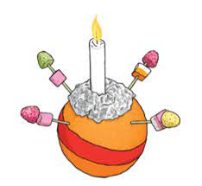
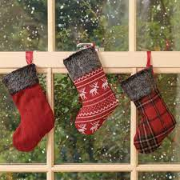
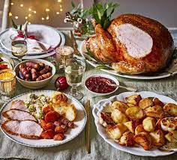
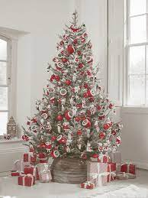
How do we celebrate Jesus’s birth?

Slide 10
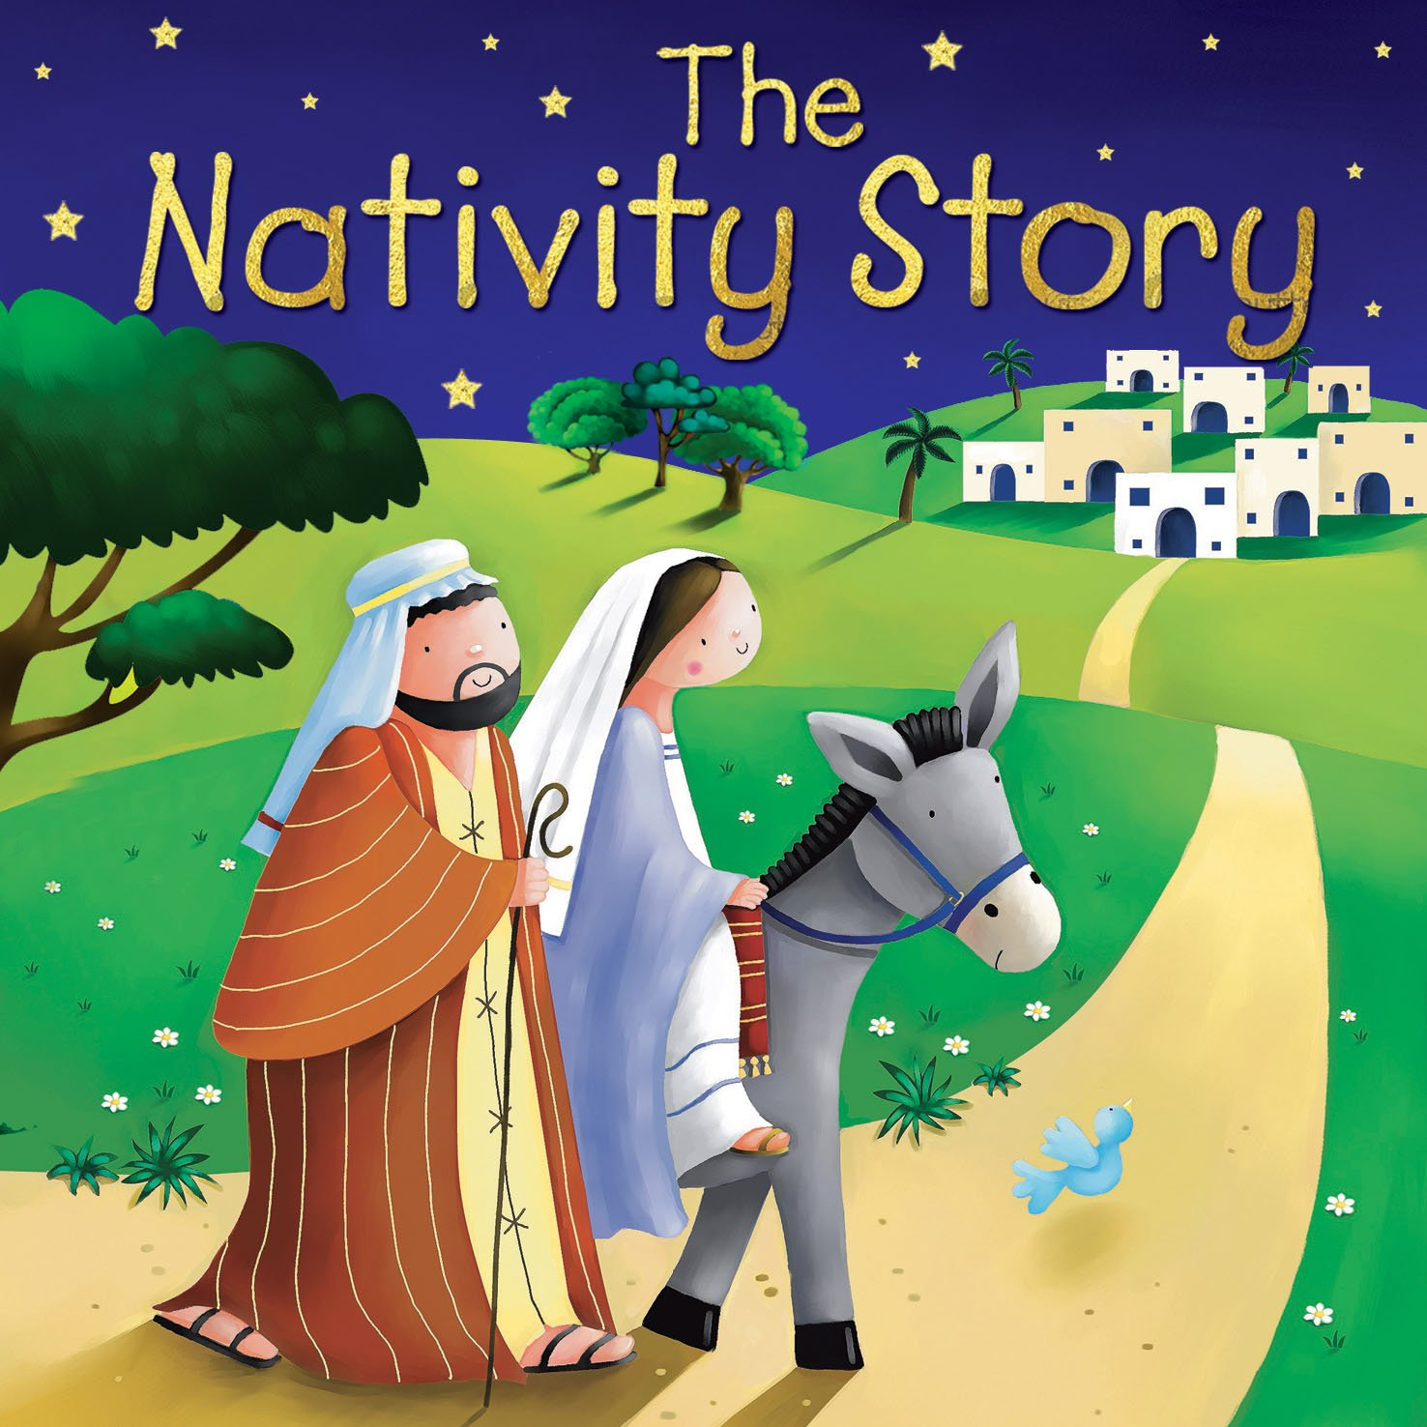
The Nativity Story

Slide 11
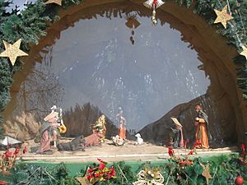
What are the main events of the Nativity?
An angel visits Mary.
Mary visits her relatives, Elizabeth and Zechariah.
An angel of God visits Joseph.
Joseph and Mary travel to Bethlehem.
There’s no room left at the inn.

Slide 12

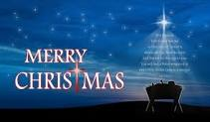

Slide 13
Let us pray
Dear Heavenly Father
Friend of all children
Bless our school at Henley
All the children and staff who work here
Help us do our best
Be kind to one another
And to be cheerful all day long
Amen

Slide 14
The Blessing

