Slide 1
Welcome
By Head Boy and Head Girl

Slide 2
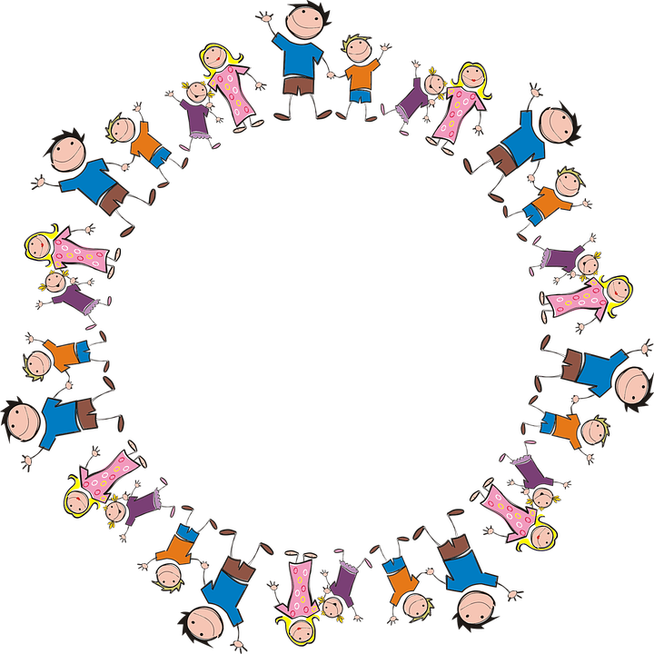
Sophie and Alfie - The Gathering

Slide 3
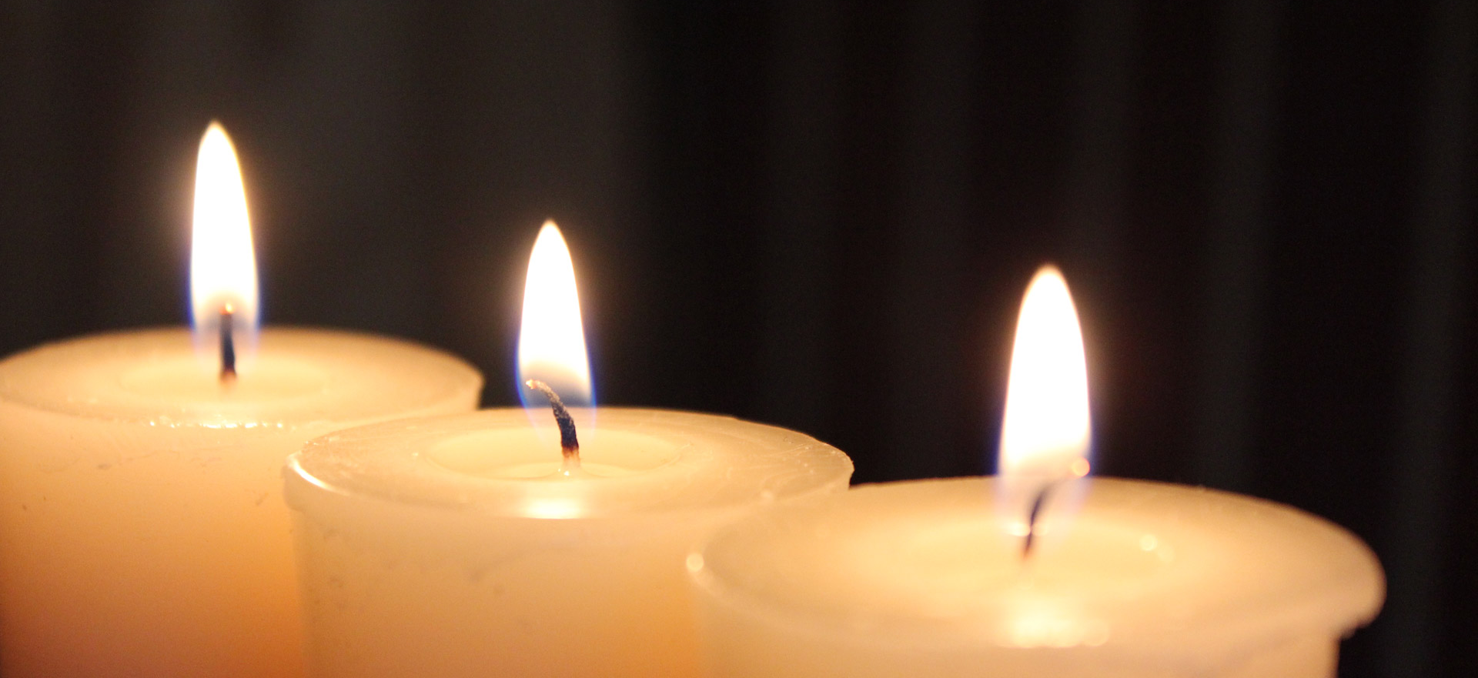
LIGHTING THE CANDLES
God’s love brings light to the world and we light 3 candles to remember God is Father, Son and Holy Spirit. The Trinity.
Jesus light of the world is here.

Slide 4
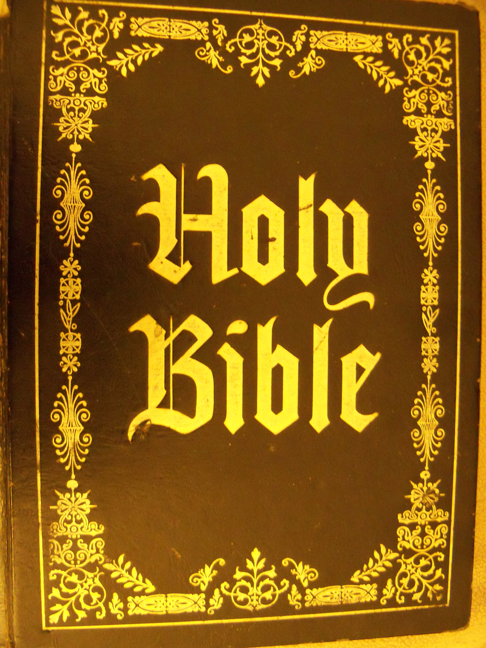
We welcome the Bible; it guides us in everything we try to do.
We welcome God’s words.

Slide 5
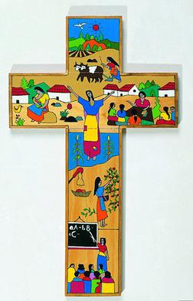
We welcome the cross; it reminds us of what Jesus gave for us.
We thank you Jesus.

Slide 6
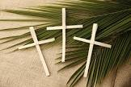
Palm Sunday (SOPHIE B AND GRACE)
SSSSSSSSSSSSSSSSS

Slide 7
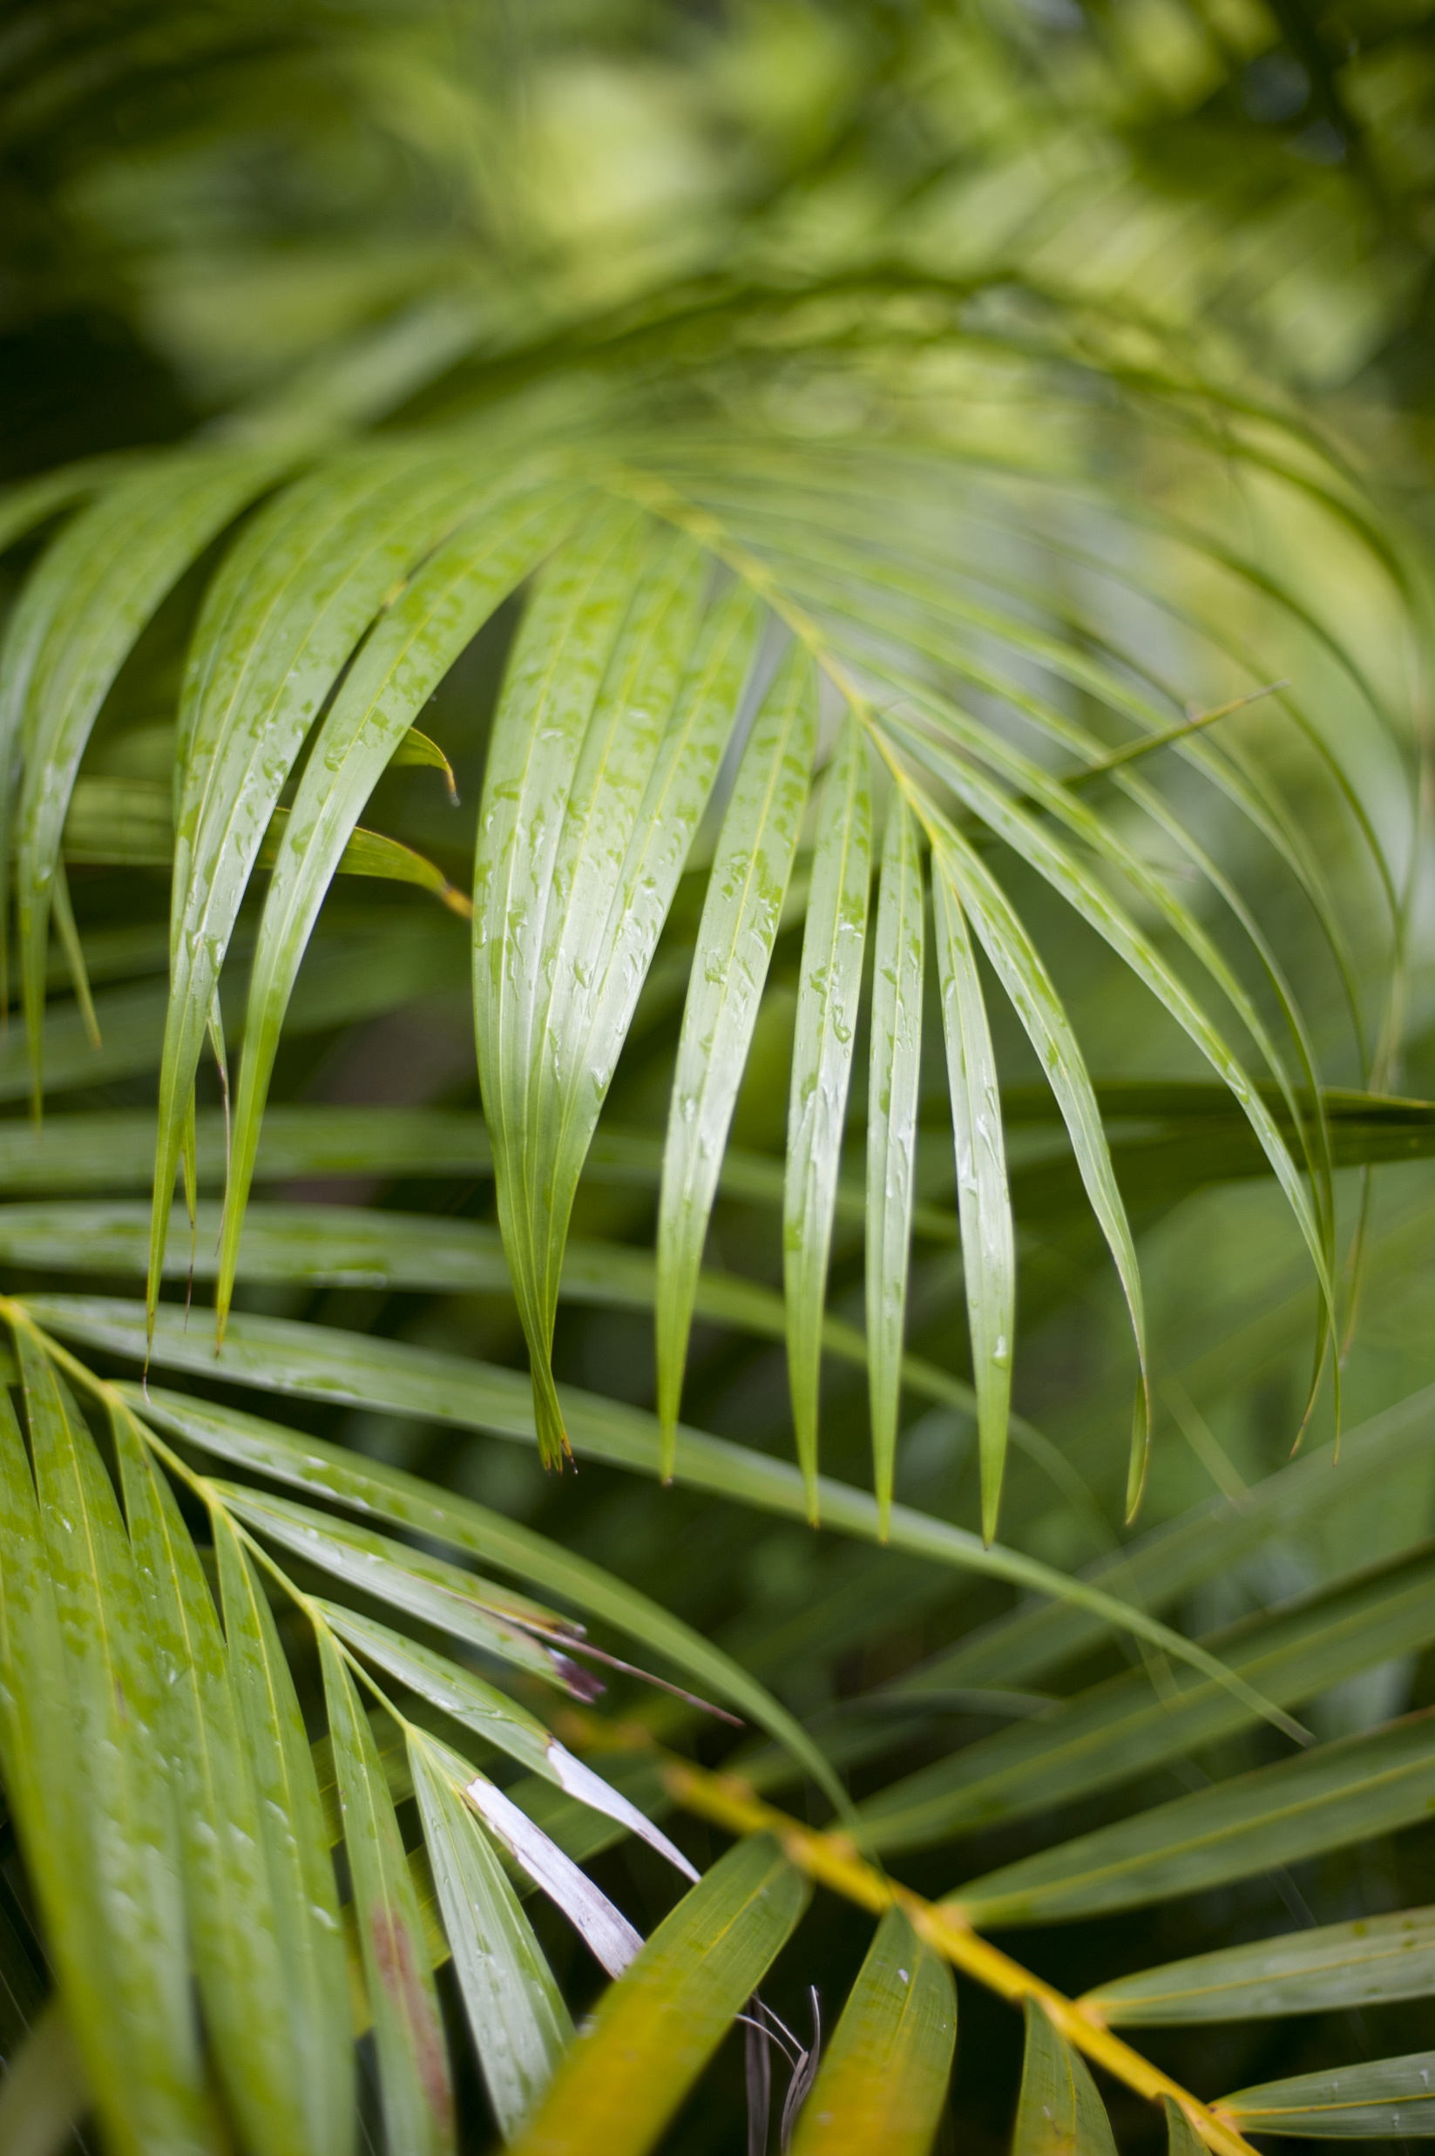
Palm Sunday is the day before easter
It was when people used to wave palm leaves when jesus walked past.

Slide 8
https://youtu.be/lTmbTuutBgg

Slide 9
What is Palm Sunday and why is it celebrated?
Palm Sunday recalls an event in the Christian Scripture (The New Testament) of Jesus entering into Jerusalem and being greeted by the people waving palm branches. For Christians, it is a reminder of the welcoming of Jesus into our hearts and of our willingness to follow him.

Slide 10
What are 2 things you can tell me about Palm Sunday?
Palm Sunday is a Christian moveable feast that falls on the Sunday before Easter. The feast commemorates Christ's triumphal entry into Jerusalem, an event mentioned in each of the four canonical Gospels. Palm Sunday marks the first day of Holy Week.

Slide 11
According to Christians, Palm Sunday is a celebration for honoring Jesus Christ's victorious entry into Jerusalem. While this was a joyful, special occasion for his followers, this event took place towards the end of his days on Earth before being crucified.

Slide 12
Let us pray
Dear Heavenly Father Friend of all children Bless our school at Henley All the children and staff who work here Help us do our best Be kind to one another And to be cheerful all day long Amen

Slide 13
The Blessing

