Slide 1
Welcome
By Head Boy and Head Girl

Slide 2
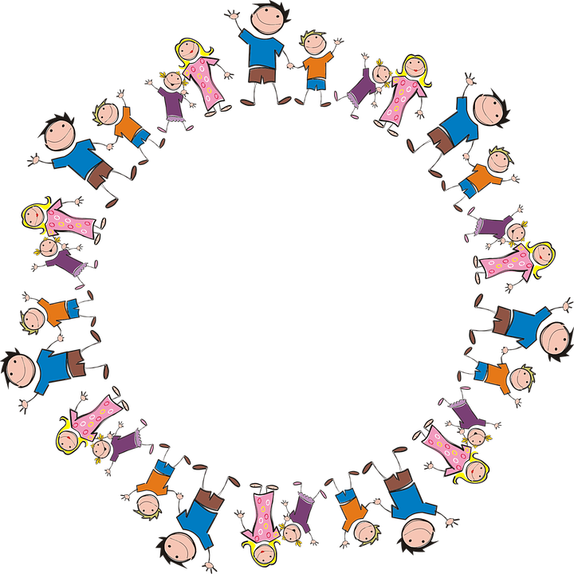
Sophie and Alfie - The Gathering

Slide 3
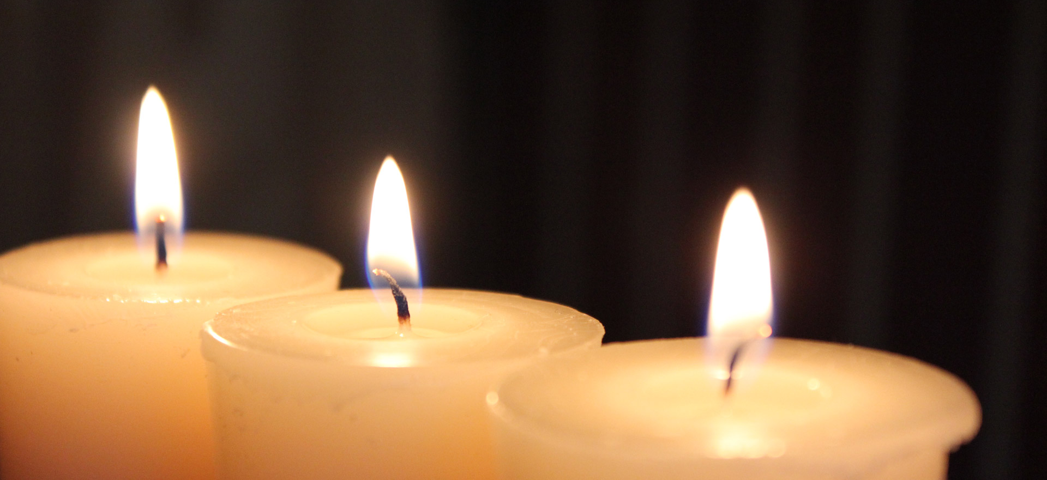
LIGHTING THE CANDLES
God’s love brings light to the world and we light 3 candles to remember God is Father, Son and Holy Spirit. The Trinity.
Jesus light of the world is here.

Slide 4

We welcome the Bible; it guides us in everything we try to do.
We welcome God’s words.

Slide 5
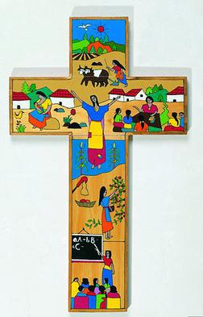
We welcome the cross; it reminds us of what Jesus gave for us.
We thank you Jesus.

Slide 6



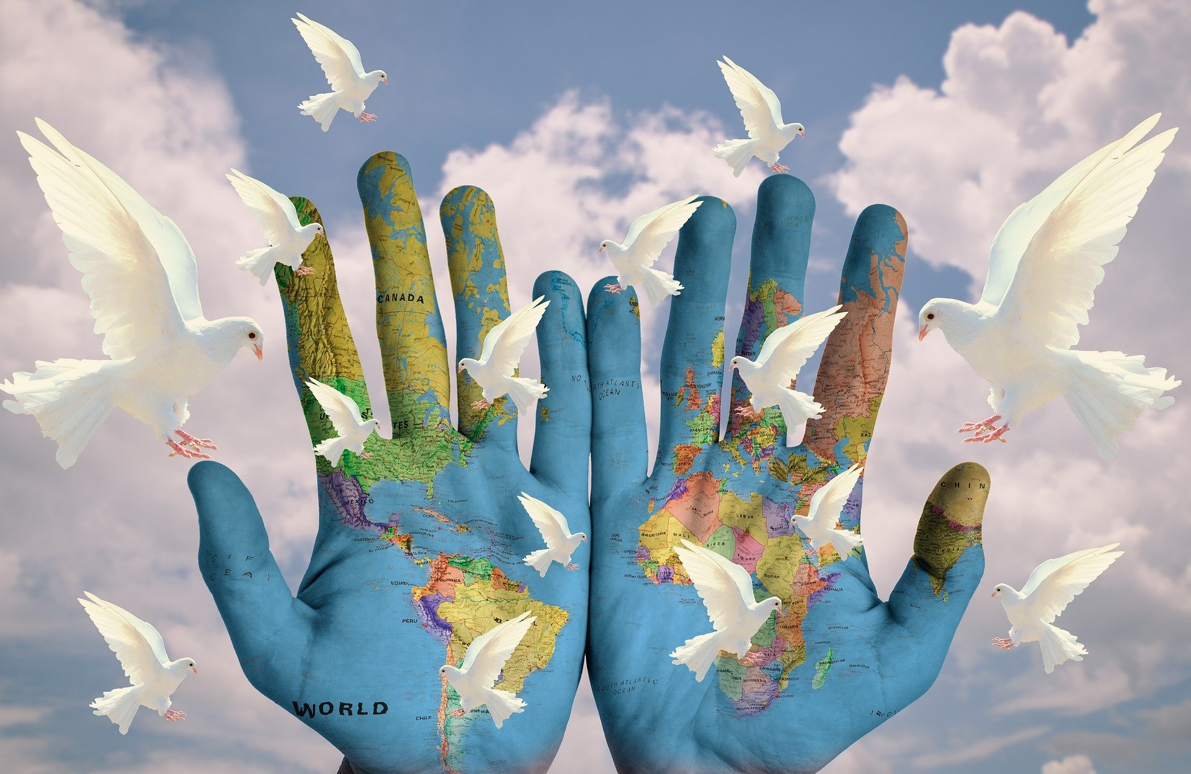
International Peace day
22/9/2022
This Photo by Unknown Author is licensed under CC BY

Slide 7
How can peace be shown?
With friends? At home? Worldwide?

Slide 8
What do you think peace is ?

Slide 9
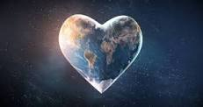
Information about peace
Peace can be shown in many different way
1.No wars
2.Daily life
3.Play ground
4.At home
And many other ways
Peace is shown every day but what is it???

Slide 10
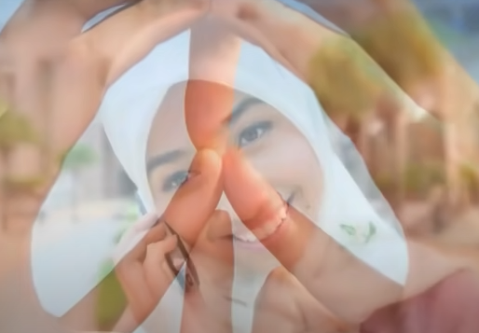
What is World Peace Day?
https://www.youtube.com/watch?v=Osw1_0jMM4M

Slide 11
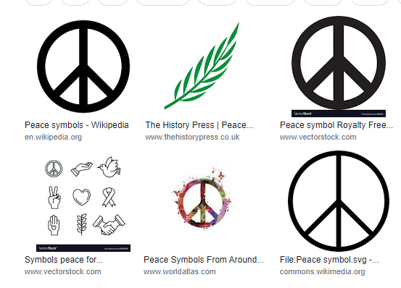
PEACE!
What symbols represent peace?

Slide 12


https://www.youtube.com/watch?v=F62L1TaDIUk
A peace song

Slide 13

Let us say the prayer for our school

Slide 14
Let us pray
Dear Heavenly Father Friend of all children Bless our school at Henley All the children and staff who work here Help us do our best Be kind to one another And to be cheerful all day long Amen

Slide 15
The Blessing

