Slide 1
Welcome
By Head Boy and Head Girl

Slide 2
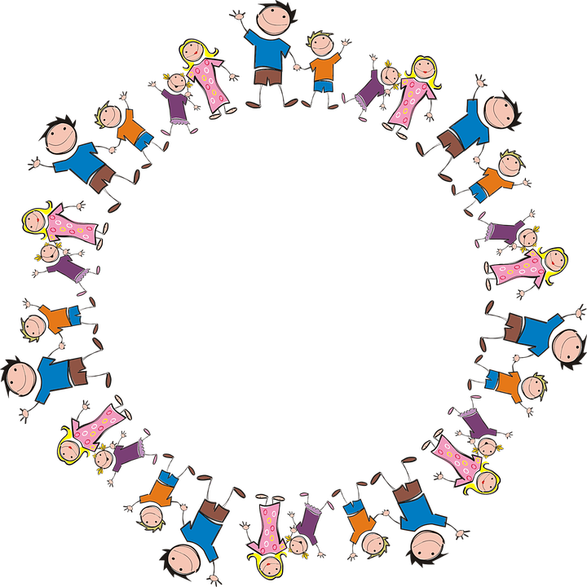
Sophie and Alfie - The Gathering

Slide 3
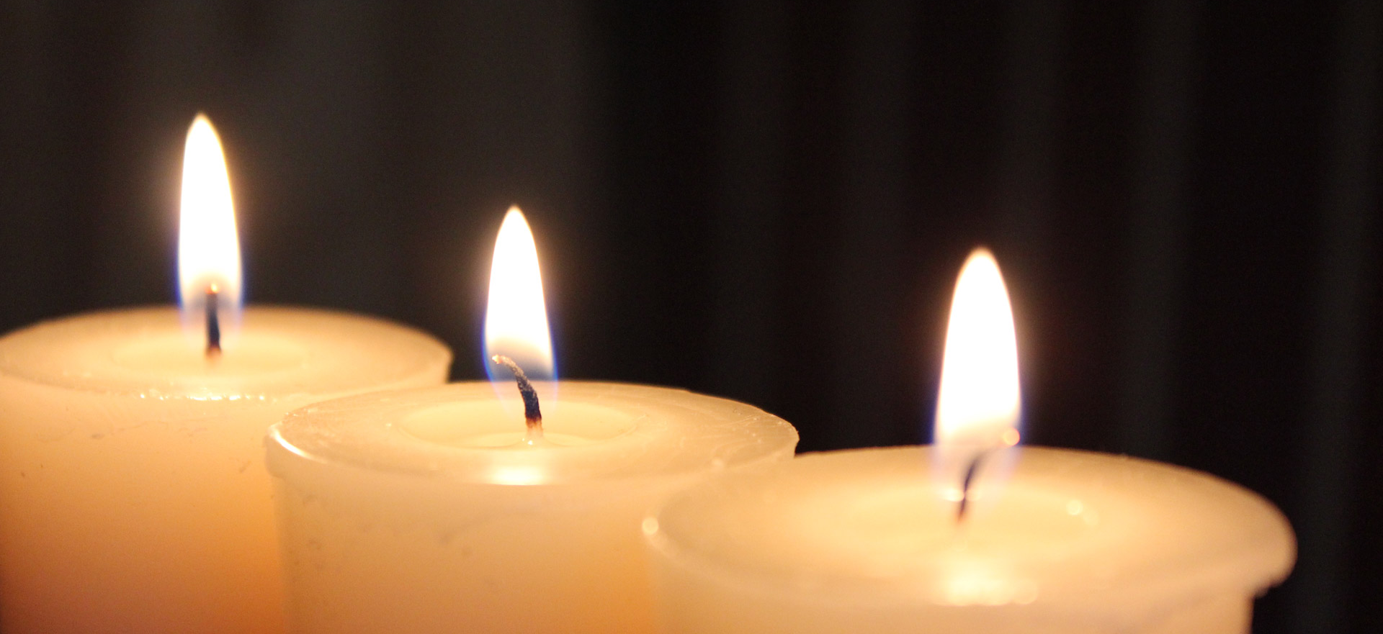
LIGHTING THE CANDLES
God’s love brings light to the world and we light 3 candles to remember God is Father, Son and Holy Spirit. The Trinity.
Jesus light of the world is here.

Slide 4
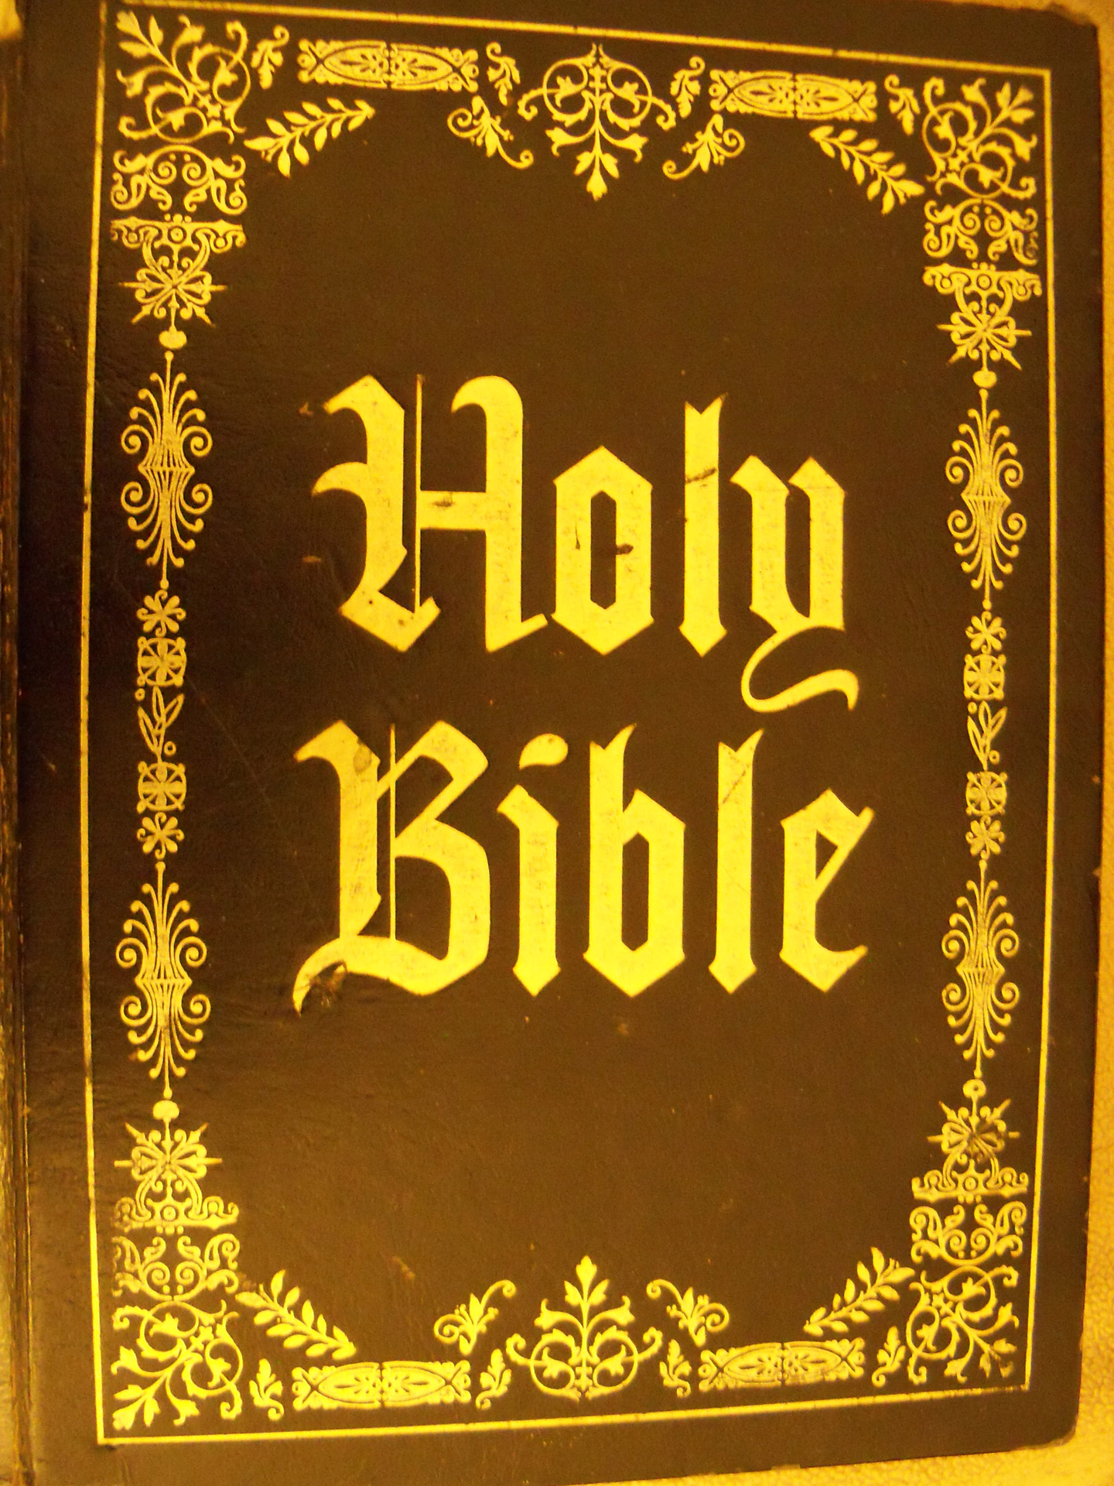
We welcome the Bible; it guides us in everything we try to do.
We welcome God’s words.

Slide 5
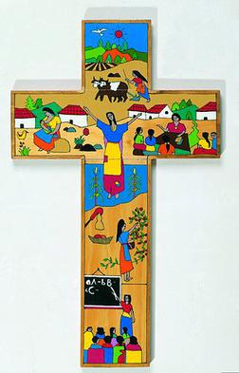
We welcome the cross; it reminds us of what Jesus gave for us.
We thank you Jesus.

Slide 6
St Andrew’s Day
By ethan , Lawson, bobby

Slide 7
What is St Andrew's Day?
St Andrew's Day is the feast day of Andrew the Apostle and is celebrated every year in Scotland on the 30 November.
In 1320, St Andrew officially became the patron saint of Scotland when the country's independence was declared.
BH

Slide 8

It is believed that when Scottish independence was declared in 1320, Andrew became the patron saint of Scotland.
His story went on to shape many different aspects of Scottish culture, including the blue and white flag of Scotland, also known as the St Andrew's Cross.
LH
This Photo by Unknown Author is licensed under CC BY-SA

Slide 9
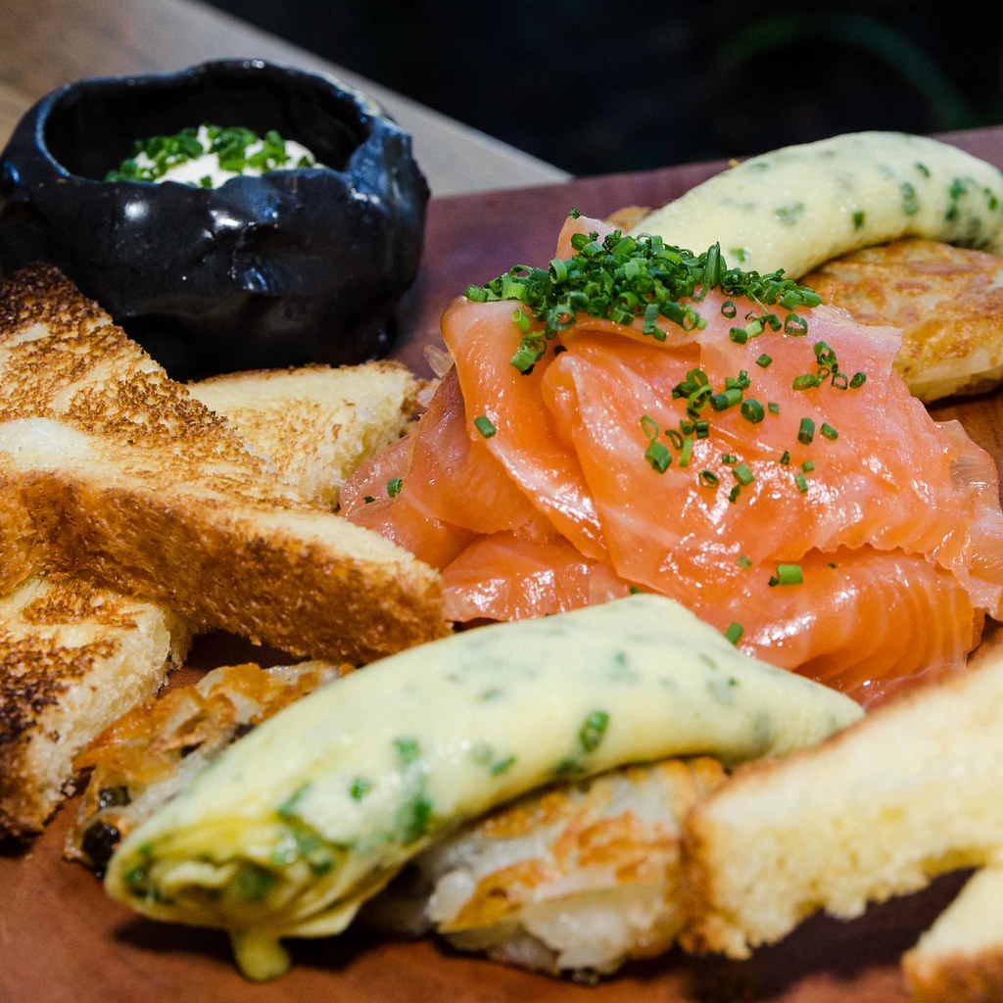
WHAT DO PEOPLE EAT ON ST ANDREW’S DAY
Scottish smoked salmon
Haggis
Black pudding
Stovies
Bridies
Scotch pies
Aberdeenshire Butteries
Beef and Lamb Roast
Fish and chips
Scotch broth
Lorne sausage
Cranachan
Clootie dumpling
Dundee cake
Shortbread
Peppermint creams
Tablet
All
This Photo by Unknown Author is licensed under CC BY

Slide 10
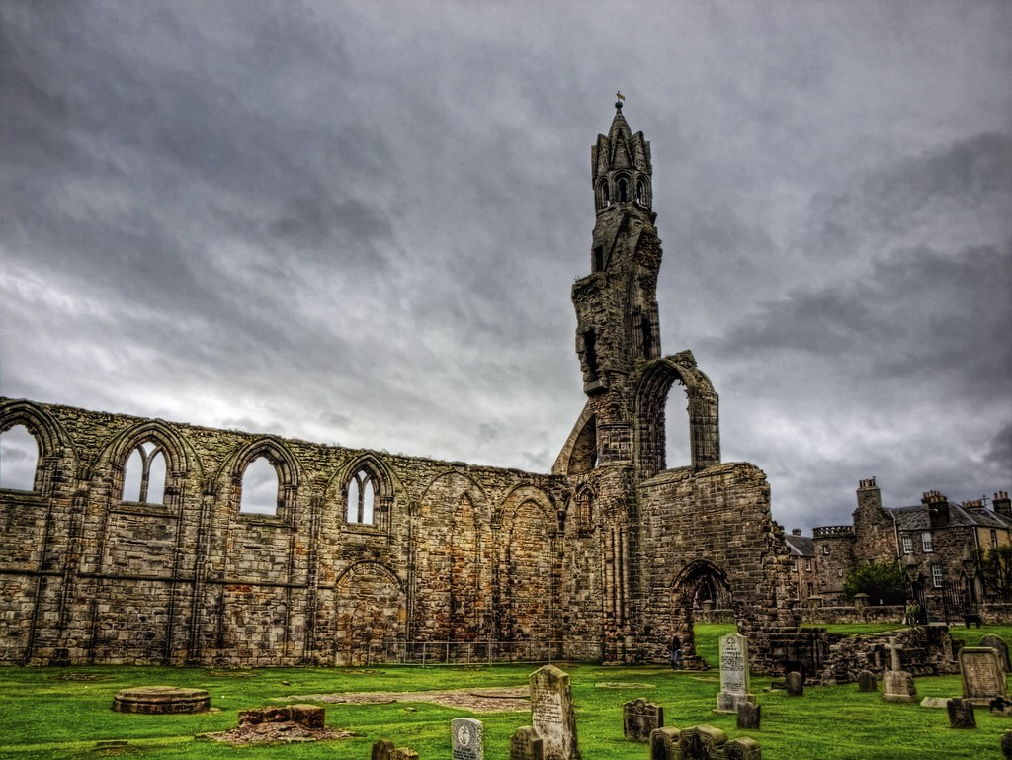
Animated story of St Andrew’s 1 minute only!
https://www.youtube.com/watch?v=AWdBKC7j6kU
This Photo by Unknown Author is licensed under CC BY-NC

Slide 11
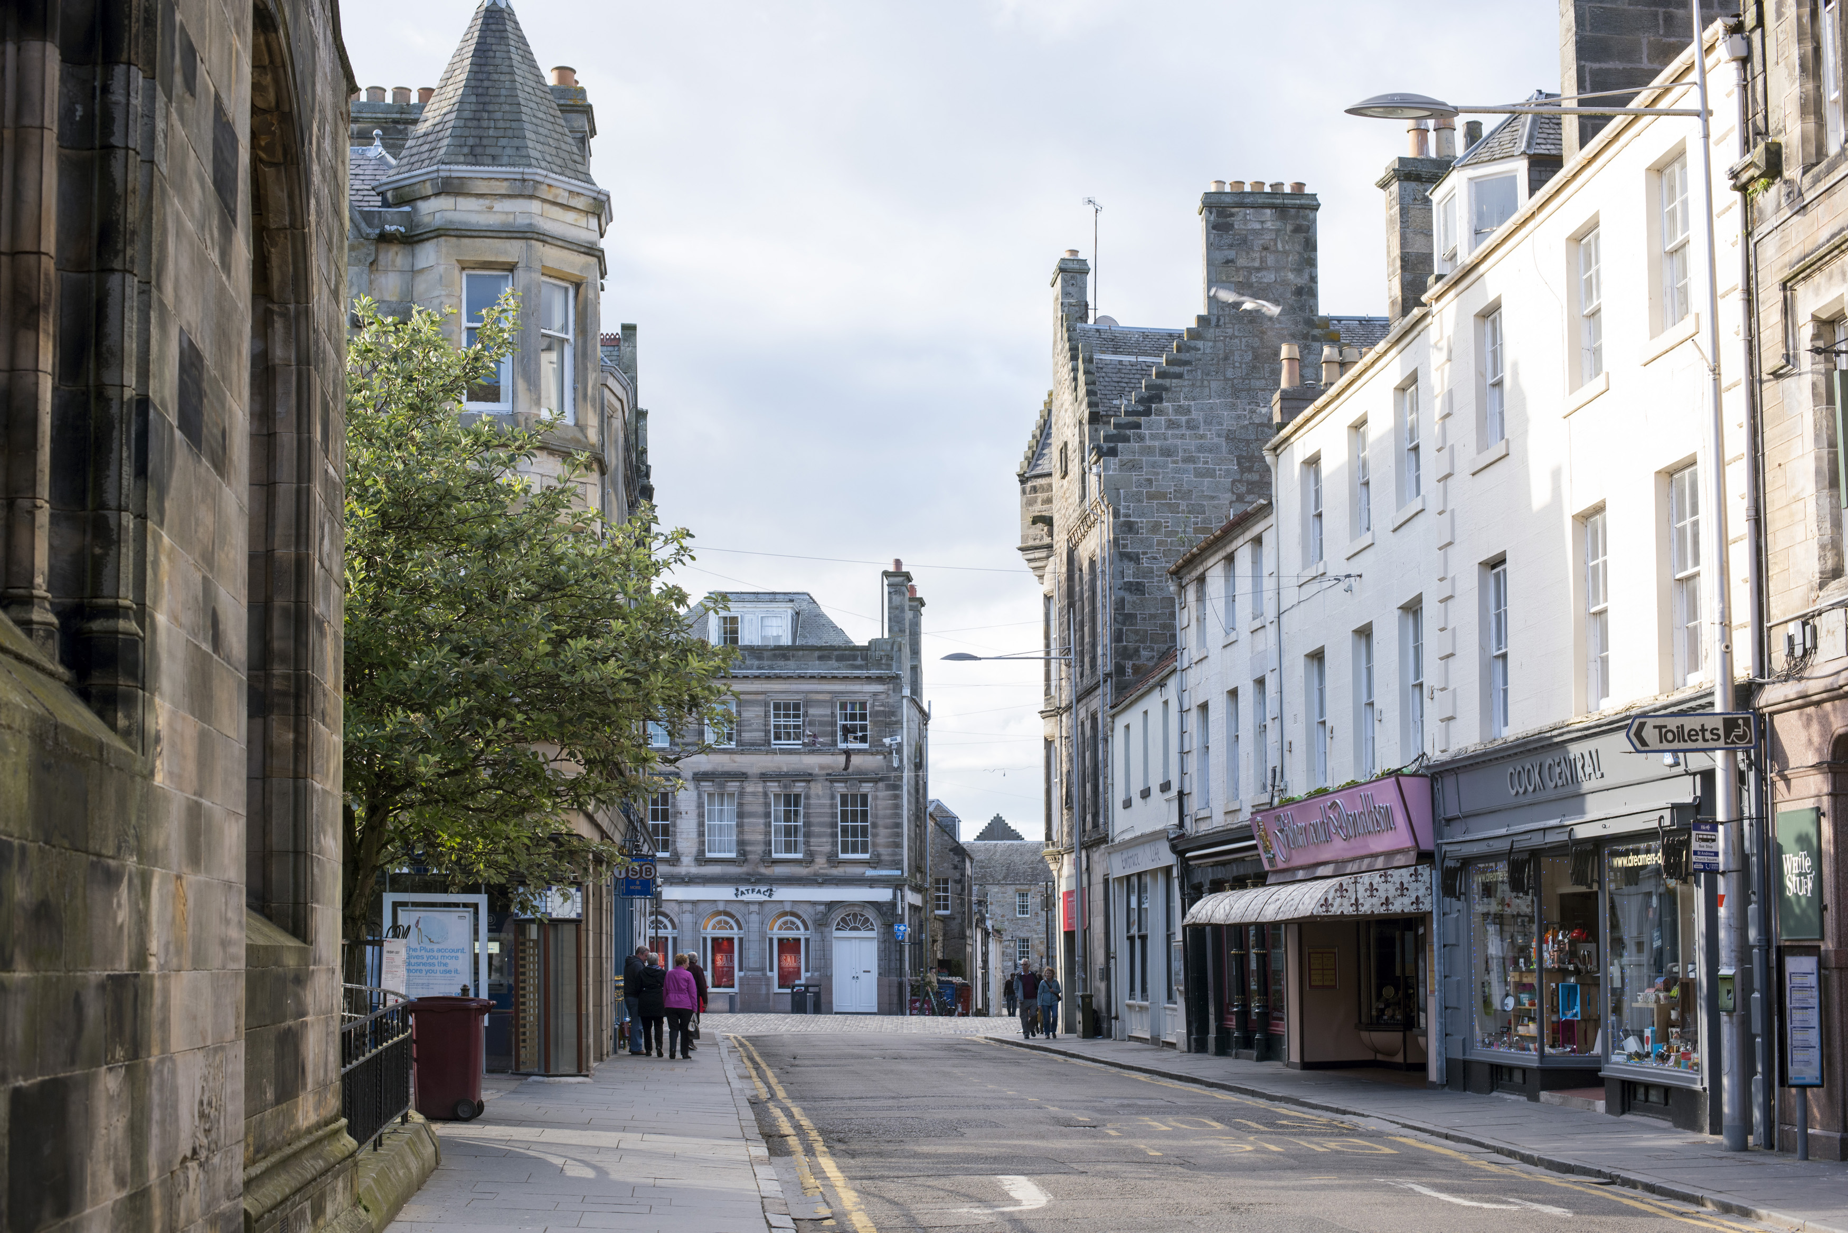
St Andrews is a beautiful Scottish town on the coast of Fife.
Most of all, it's famous for its University (the Duke and Duchess of Cambridge attended here), its golf links and absolutely stunning coastline. Oh, and then there's the architecture here which is worth visiting in and of itself!

Slide 12
Scotland's Winter Festival starts on November 30.
People across the country gather together to celebrate Andrew and share good times.
The day is usually marked with a celebration of Scottish culture, including dancing, music, food, and drink, with parties going on until the early morning hours.
e.l

Slide 13
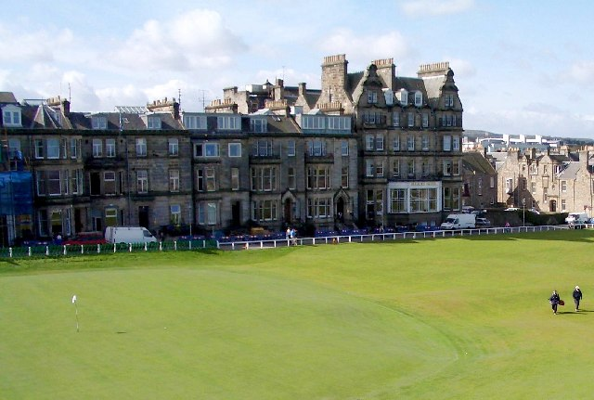
This Photo by Unknown Author is licensed under CC BY-SA

Slide 14
The end. Thank you for listening to Lawson Bobby Ethan

Slide 15
Let us pray
Dear Heavenly Father Friend of all children Bless our school at Henley All the children and staff who work here Help us do our best Be kind to one another And to be cheerful all day long Amen

Slide 16
The Blessing

