Slide 1
Monday 15th May
Piece of paper

Slide 2
As we watch the short video
Every time the boy says there is a wolf, what does he promise?

Slide 3

https://www.youtube.com/watch?v=1axKaW61_78

Slide 4

Responding
Have you ever made a promise that you couldn’t keep?
Have you ever had a promise made to you that wasn’t kept?
How did you feel?
This Photo by Unknown Author is licensed under CC BY-NC

Slide 5
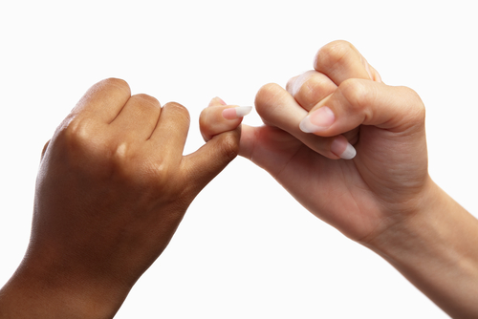
We all want to be able to trust people to tell the truth and to keep their promises.
We particularly expect our families, friends and those who care for us to tell the truth.
However, we are all let down at some point and we all let other people down sometimes.
We are all guilty of breaking promises.

Slide 6


Slide 7
How is this like a broken promise?
This is similar to what happens when we break promises.
We spoil something that was good.
We may say sorry for our mistake, and thereby hope to smooth out the fault, but the paper is never going to be the same again.
Breaking promises has consequences.

Slide 8
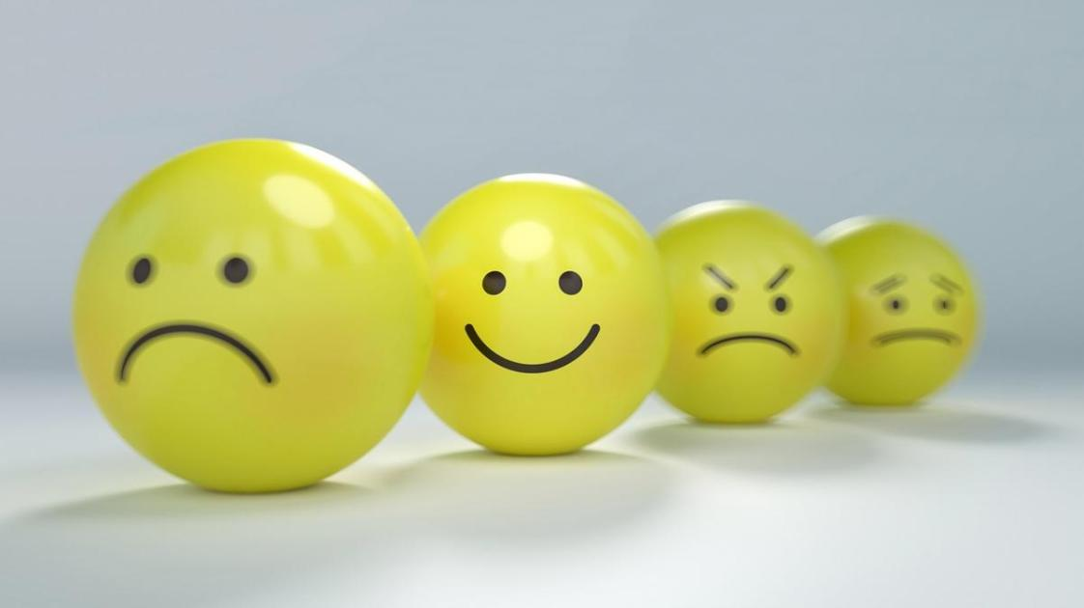
A broken promise can lead to feelings like:
- I can’t trust you - I am disappointed in you - I feel unimportant to you - I don’t respect you any more

Slide 9
It is good to remember -
That the person who breaks a promise never usually means to hurt another.
- Perhaps the promise was made in a rush without really thinking about the consequences.
Perhaps something came up that made it impossible for the person to carry out what they had promised.
If we can tell the promise-breaker how we feel and give them a chance to apologise, this is helpful.
Sometimes, though, we just have to accept that people will let us down, even those closest to us. Then, we can choose to forgive them.

Slide 10
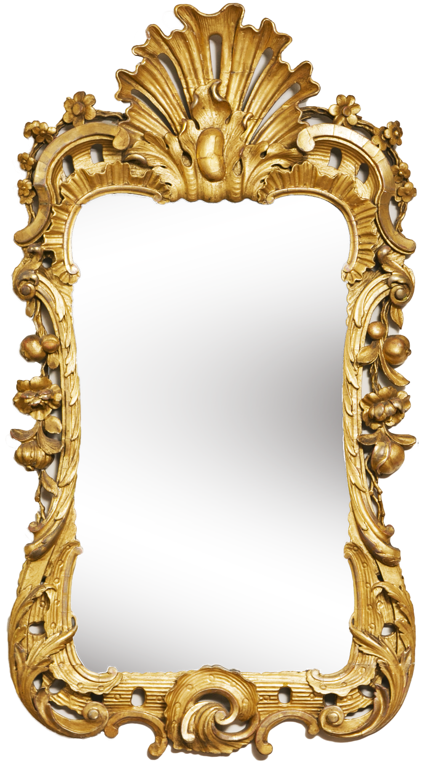
Time for reflection
We all break promises sometimes. However, when we do, it is important to admit that we are wrong and ask for forgiveness.
If anyone ever hurts us, we should always tell someone we trust, no matter whether someone makes us promise not to say anything.
There are some things that we should never keep secret.
This Photo by Unknown Author is licensed under CC BY-NC

Slide 11
Christians believe that God always keeps his promises. Some of the promises that are recorded in the Bible are: - God will always love us - God will never leave us - God cares for us - God will always be with us

Slide 12
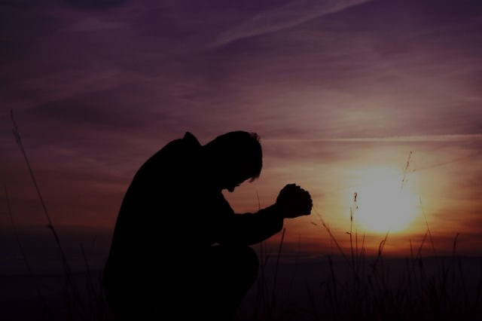
Prayer
Dear God, Please help us to keep our promises. Please help us to be people who tell the truth. Please help us to be people whom others can trust. Help us to forgive people who let us down. Thank you that you keep your promises. Thank you that you will always love us. Amen.
This Photo by Unknown Author is licensed under CC BY-NC-ND

