Slide 1
Welcome
By Head Boy and Head Girl

Slide 2
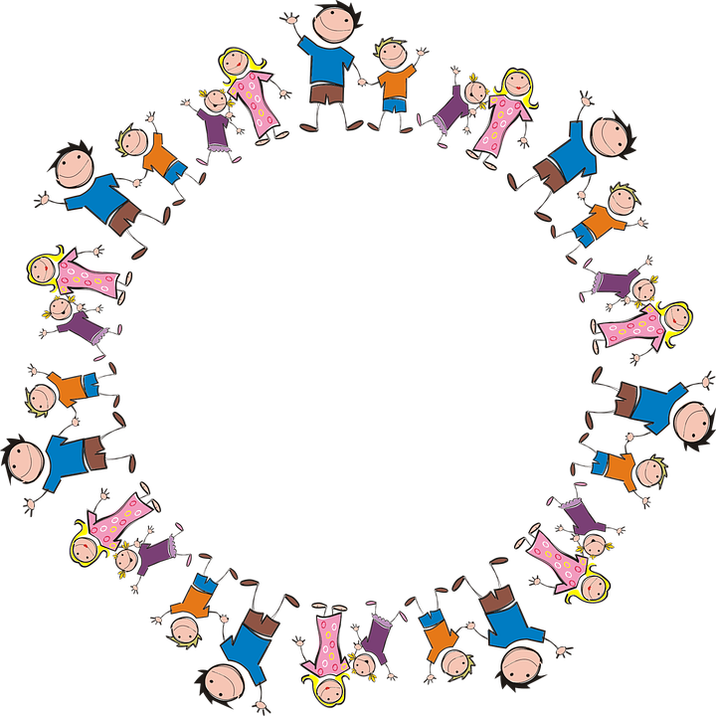
Sophie and Alfie - The Gathering

Slide 3
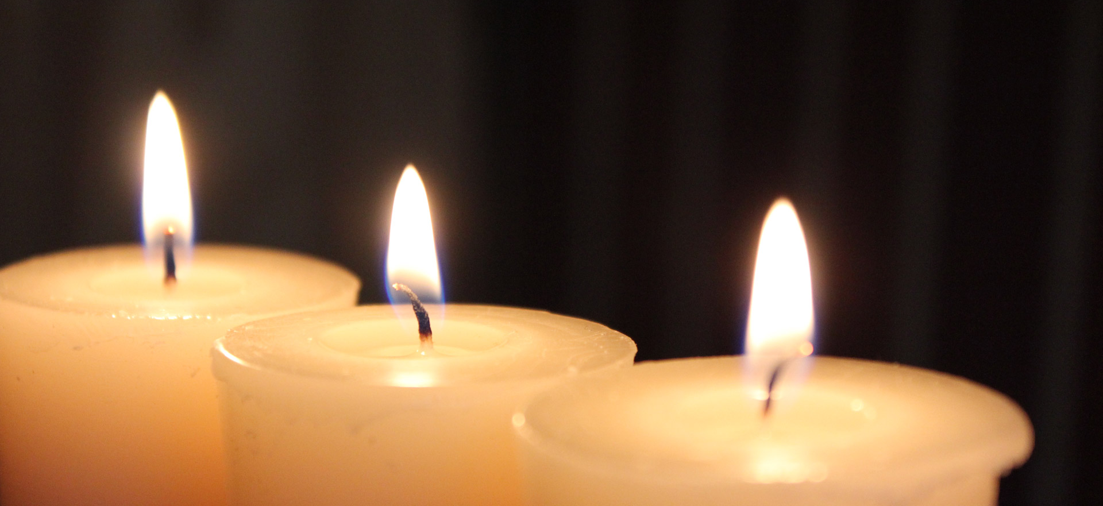
LIGHTING THE CANDLES
God’s love brings light to the world and we light 3 candles to remember God is Father, Son and Holy Spirit. The Trinity.
Jesus light of the world is here.

Slide 4

We welcome the Bible; it guides us in everything we try to do.
We welcome God’s words.

Slide 5
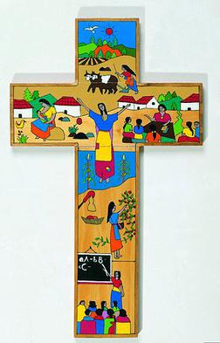
We welcome the cross; it reminds us of what Jesus gave for us.
We thank you Jesus.

Slide 6
The war on plastics!
By Gabe Evans

Slide 7
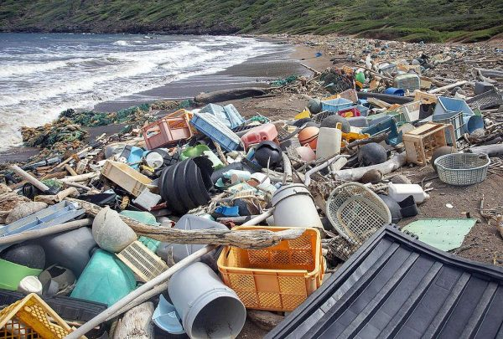
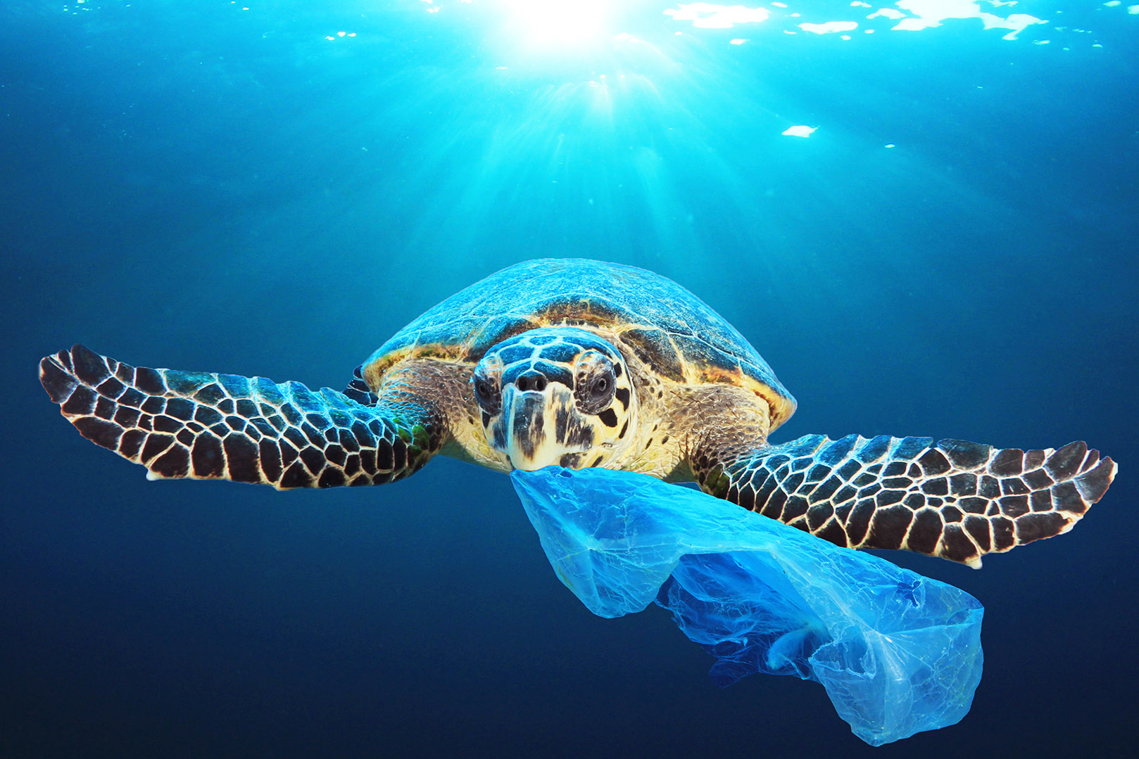
The war on plastics!
The war on plastics is a term used to stop plastic waste around the world and help stop pollution.

Slide 8
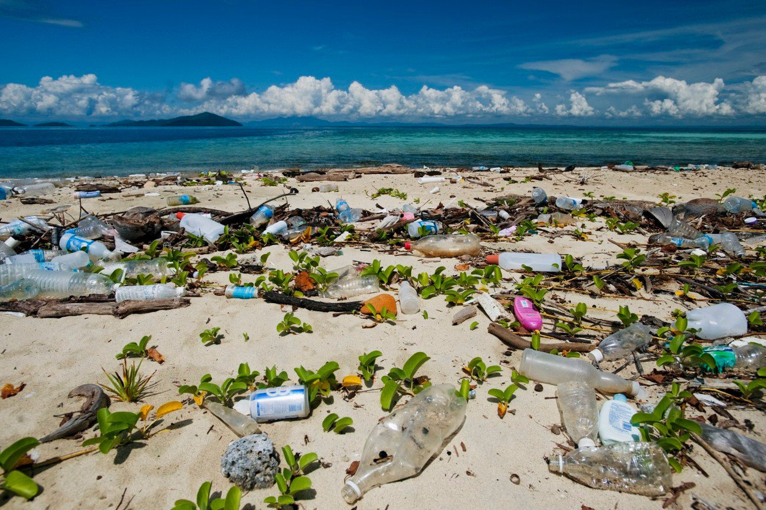
Why is there a war on plastics?
Plastics are filling up our oceans and beaches and we need to stop it and many governments around the world are banning many single use plastics like: plastic straws, plastic cups, plastic cutlery and plastic or paper plates.

Slide 9
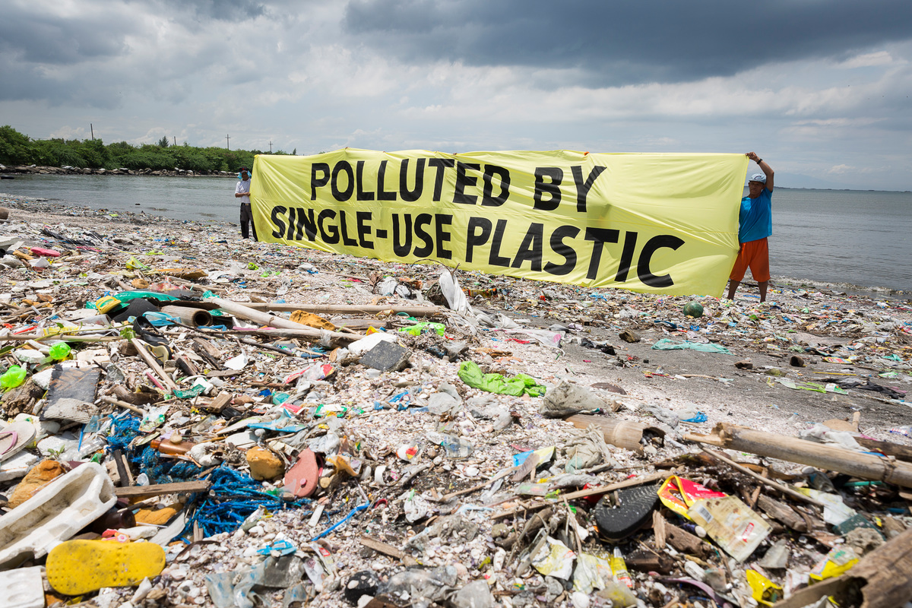
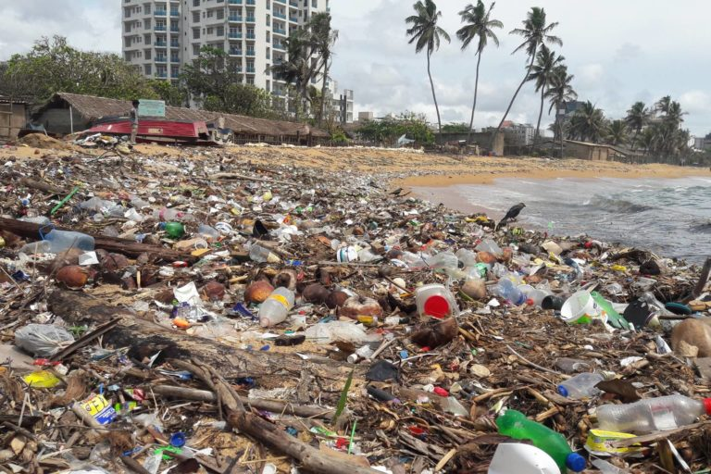
What can I do to help?
You can help stopping plastic pollution by cutting down on single use plastics like paper plates and recycling anything that can be recycled.

Slide 10
Is there any thing else important?
This video will help you understand any questions you have https://youtu.be/_XVUux3boWk

Slide 11
Let us pray
Dear Heavenly Father
Friend of all children
Bless our school at Henley
All the children and staff who work here
Help us do our best
Be kind to one another
And to be cheerful all day long
Amen

Slide 12
The Blessing

