Slide 1
Welcome to
“Meet the Teacher”
Add class name

Slide 2
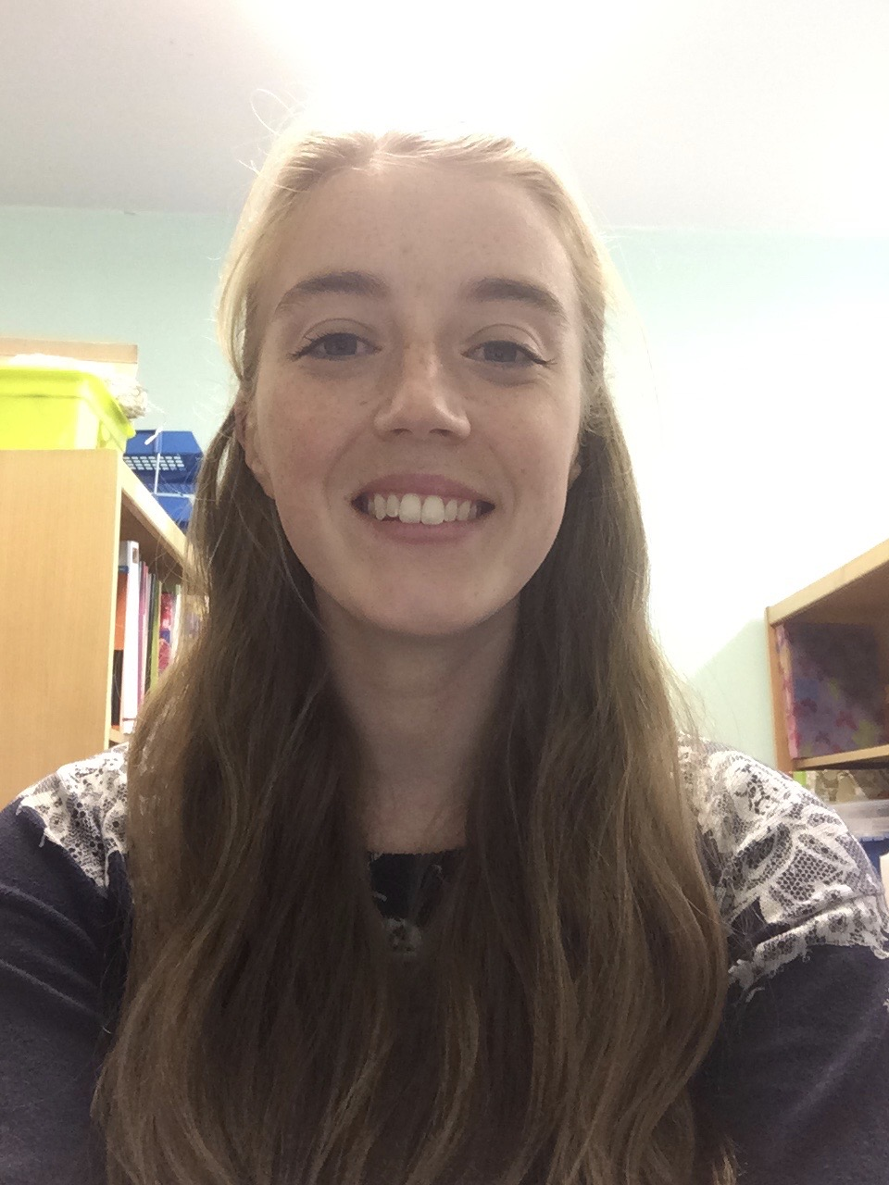
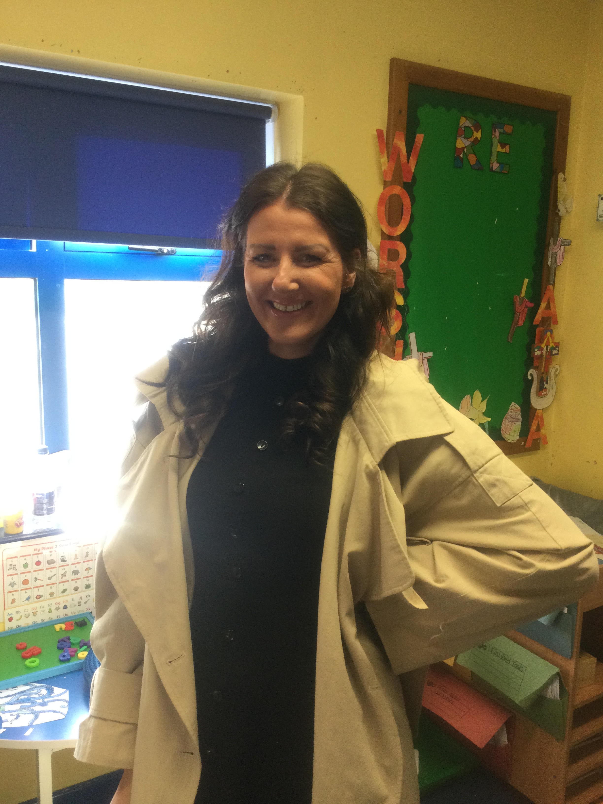
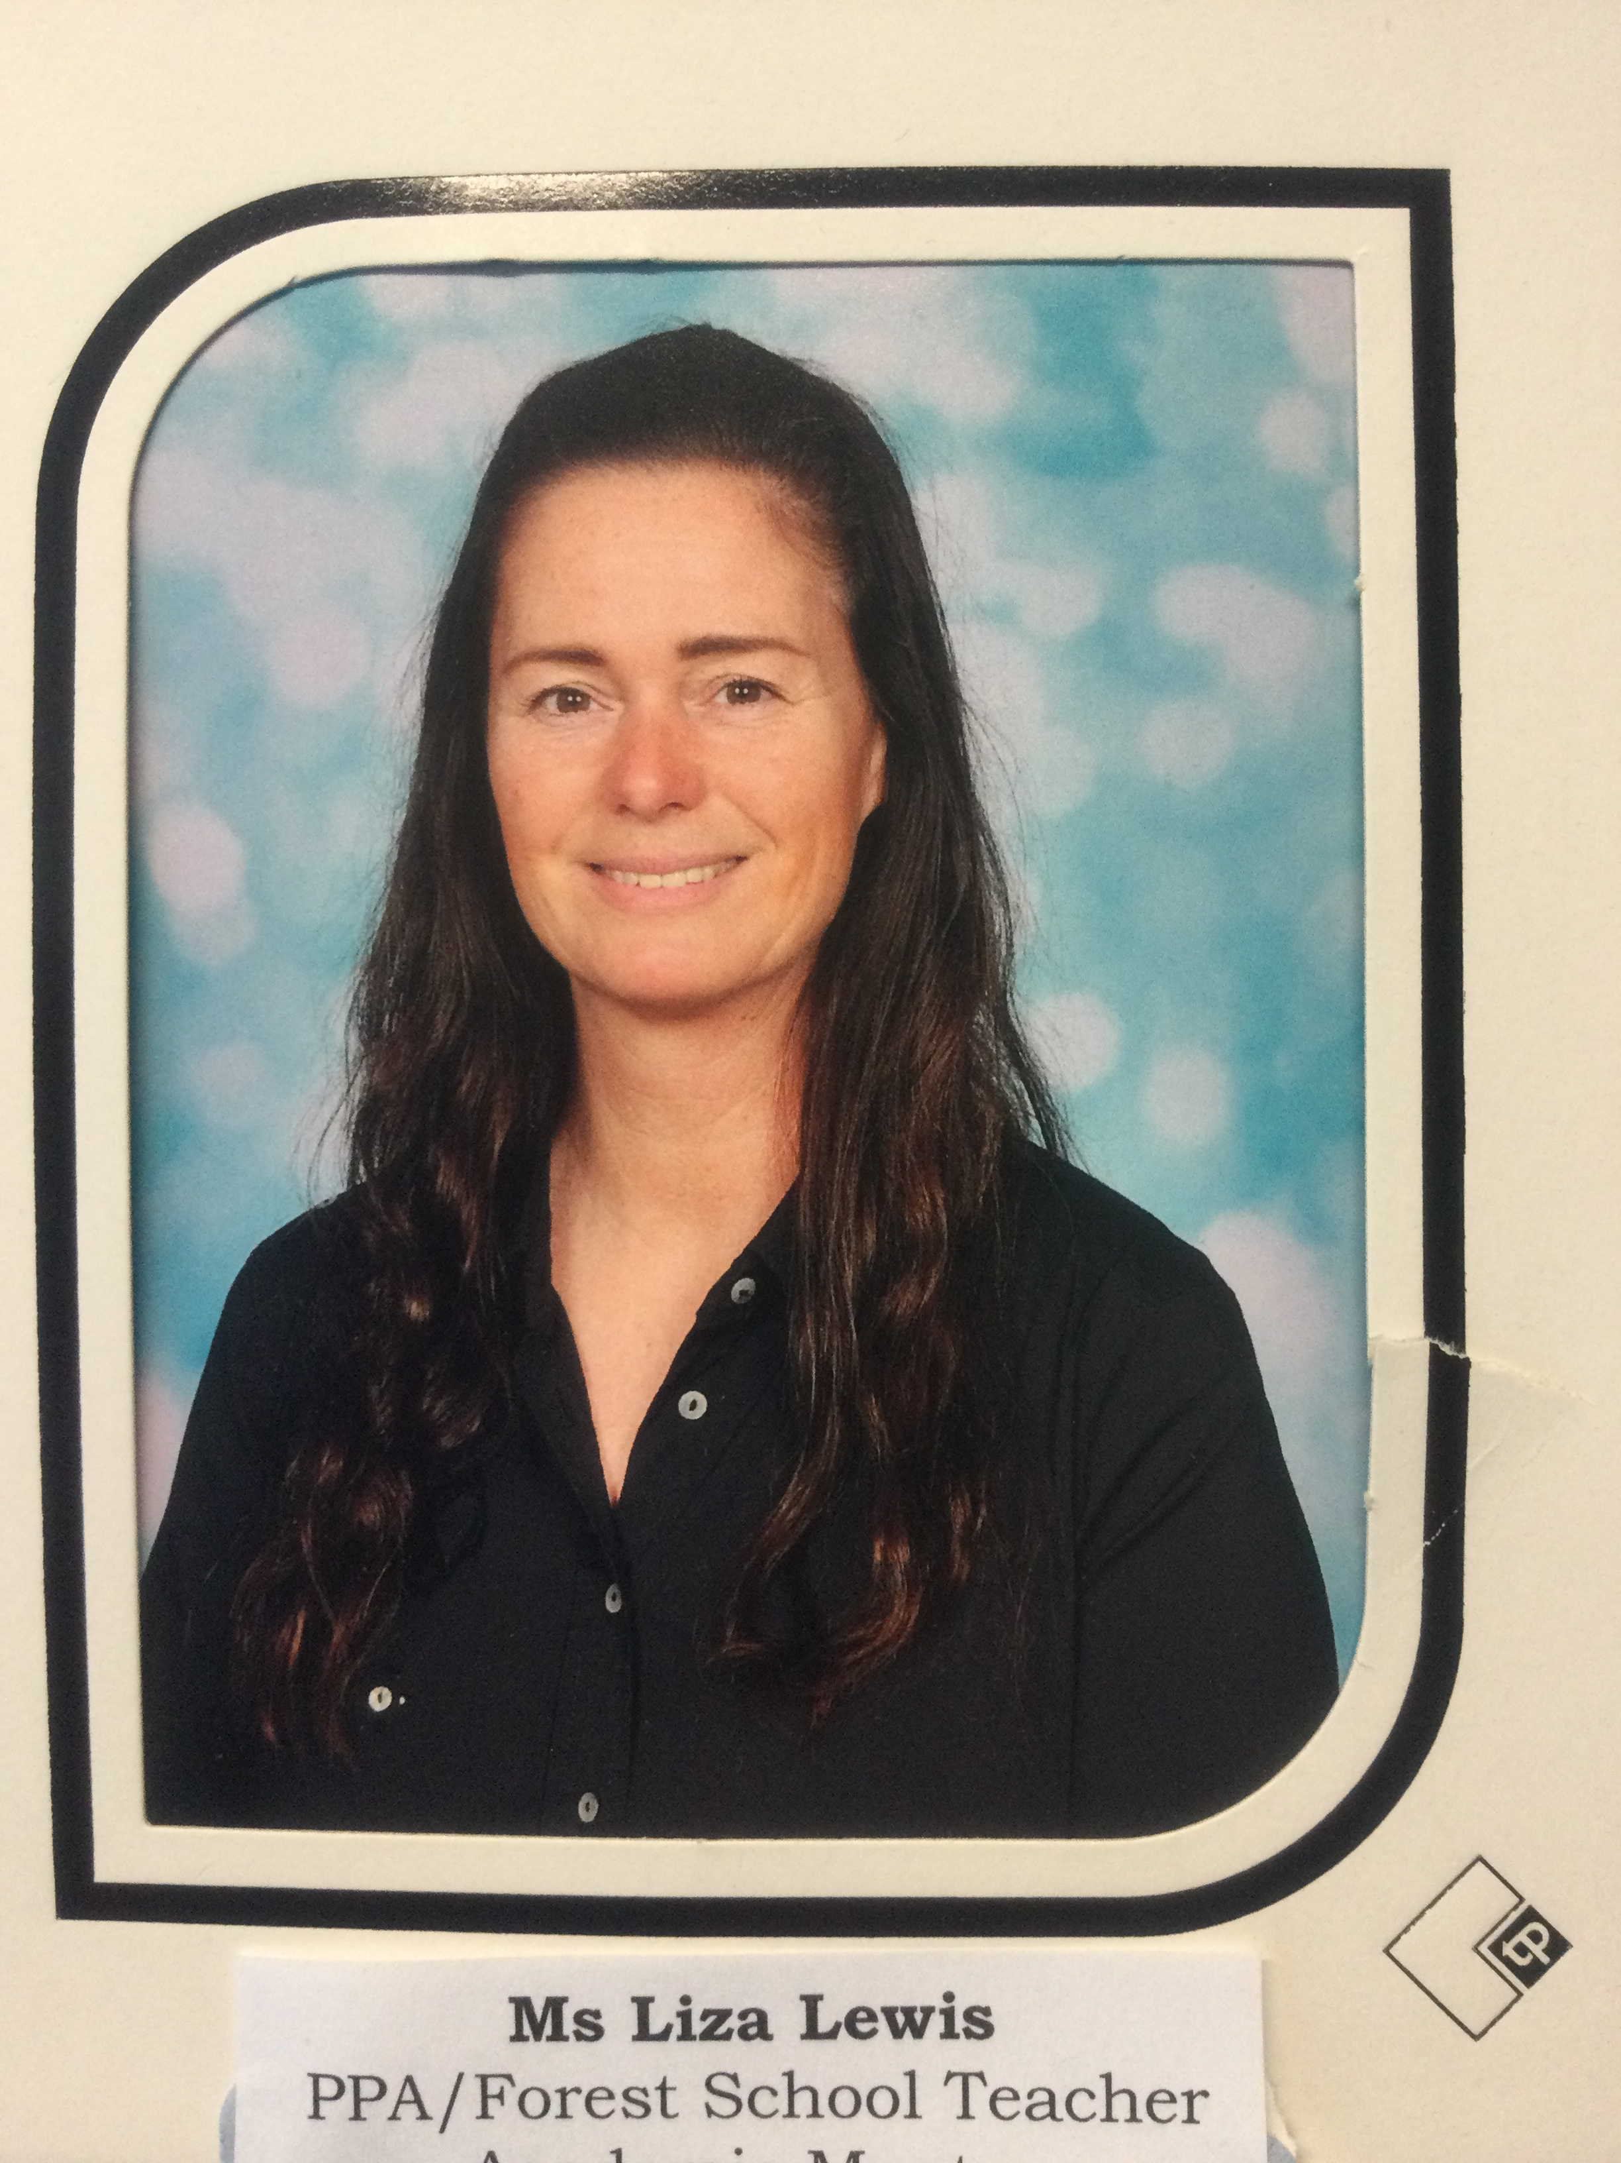
Adults in class
Miss Higson
Mrs Aldwin
Mon-Fri
Mrs Allen
Mon-Wed
Ms Lewis
Wed mornings

Slide 3
Our normal timetable

Slide 4
Our curriculum
This year we have developed our own unique curriculum that is bespoke to our school and its community.
This is our long-term plan for the whole year and the subjects we
will be focussing on each term.

Slide 5
Our Curriculum
On Wednesday mornings the children will be partaking in a forest school session so please make sure they are prepared for the weather.
Each Friday we will have a celebration assembly where a star of the week certificate and a VIP award for showing school values will be awarded.

Slide 6
Reading
Phonics
Children have a twice daily phonics session as a whole class; in which we work on reading and writing skills of the sounds we are learning. This will be linked to spellings each week.
Phonics is also fed through our everyday routines as a whole class.
Reading
The children also get a guided reading session daily in a small group.
Books will be sent home every Wednesday with your child, which is linked to their current learning in phonics.
Reading underpins everything we do in school so it is extremely important that children are supported at home.
Reading also supports and improves your child’s writing skills.
Comprehension is an important aspect to be mindful of so please take the opportunity to talk about the texts.

Slide 7
Our school rules
Ready, respectful, safe
VIP of the week

Slide 8
National tests
Phonics screening test- June
No pressure on the children as it will be a part of our class
Routine by this point in the year.

Slide 9
Homework - Pathfinders
We understand the importance of having time at home for relaxing and extra curricula activities, so we are trying to keep homework as simple as possible.
Reading books will be changed on a Wednesday.
Phonics books are for helping the children to link sounds and words. These will be looked at on a Thursday and a new sound added.
Children are encouraged to use phonics so may not spell correctly.
Parents are asked to support homework by:
Making sure that homework is valued
Encouraging pupils to complete homework and return it on time
Reading regularly with Foundation Stage and Key Stage1 pupils (daily if possible)

Slide 10
Communicating with parents
Parentmail (office)
Seesaw/email (teacher – working hours/ urgent messages for teacher must be through office)
Website/facebook – follow us – for celebrating
Open door - Come to class teacher if any issues so we can sort them together

Slide 11
Attendance
It is incredibly important children arrive to school on time to settle them in to daily routine.
Support – Home school partnership

Slide 12
At school, we will…
Encourage children to do their best at all times.
Encourage children to take care of their surroundings.
Inform you of your child's progress at regular meetings.
Inform you about topics to be covered each term.
Encourage children to demonstrate our values.
Maintain a safe environment for all pupils.

Slide 13
We encourage our children to …
Do their best at all times.
Follow the school rules (ready, respect, safe)
Try their best to put our school values into practice.
Be kind and supportive to others.
Keep themselves and others safe.
Look after our school.

Slide 14
We would like you to help us by …
Making sure your child arrives at school on time (8.50 - 9.00a.m) dressed appropriately and fully equipped for school.
Making sure your child has the best attendance possible and letting us know if they are absent.
Informing us if there are matters outside of school that are likely to affect their performance or behaviour
Attending parents evenings to discuss their progress.
Encouraging them to read regularly at home, and to complete any other homework set.
Supporting us in our policy on behaviour, bullying and uniform.

Slide 15
Uniform
On a Tuesday, Thursday and Friday:
the children are expected to wear full uniform which includes; yellow school T-shirt, grey trousers/skirts etc, blue Jumper/cardigan (Named please!), black shoes
On a Monday and Wednesday:
The children need to come in their PE kits which include; yellow top and jumper/cardigan, blue tracksuit bottoms or shorts and trainers.
We also encourage brining wellies on a Wednesday for forest school.
The children will be going outside everyday so please make sure they have appropriate clothing for the weather- coats etc

Slide 16
Thank you for coming to meet the teacher! I look forward to working together with you this year.

