Slide 1
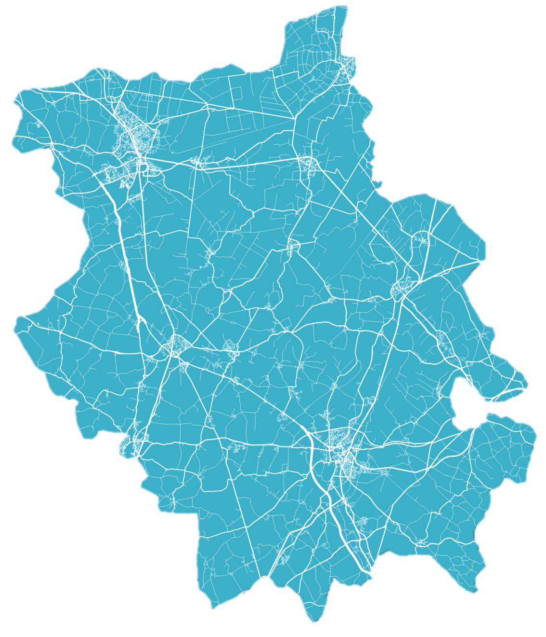
WORK & SKILLS OPPORTUNITIES
IN CAMBRIDGESHIRE AND PETERBOROUGH

Slide 2
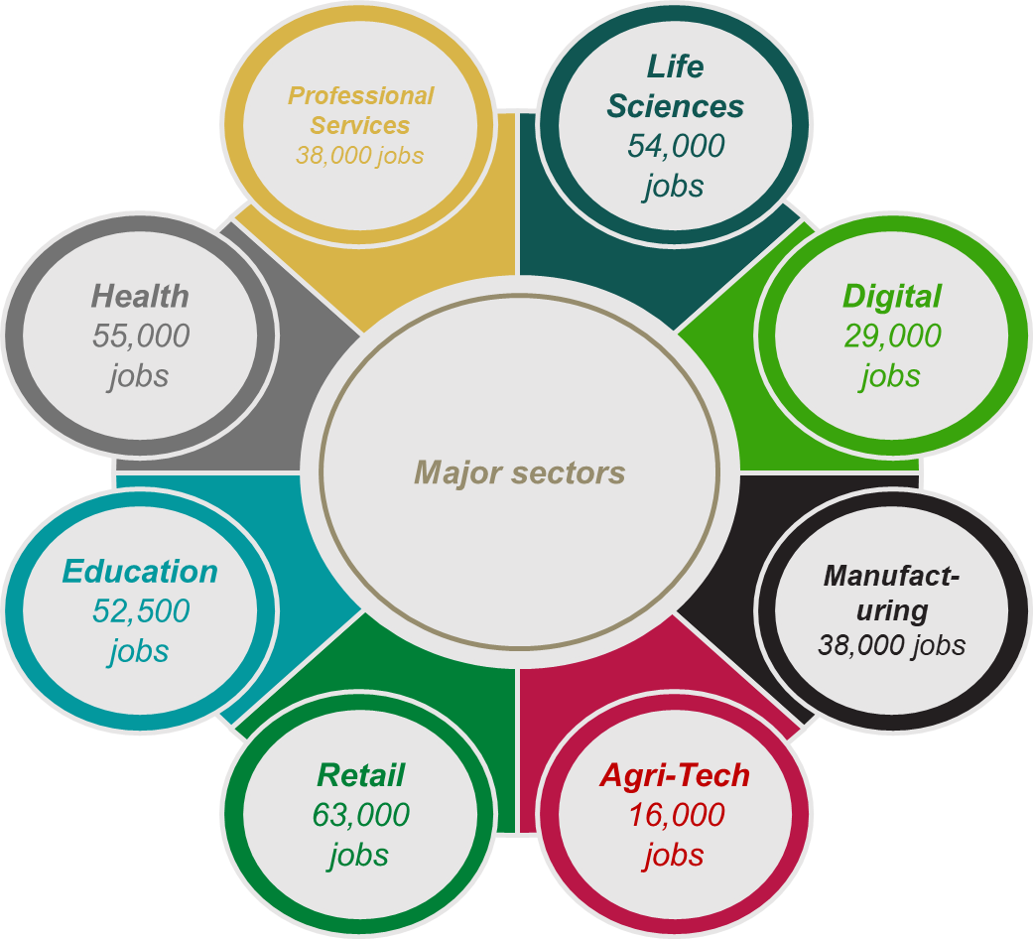
Work & skills today
Cambridgeshire & Peterborough has a huge array of jobs and opportunities on offer. As well as a host of different roles in key sectors including Health, Education and Retail, we also have major opportunities in sectors vital to growing our local economy. These are specialisms within broader sectors, and are: Life Sciences, Digital, Advanced Manufacturing and Agri-Tech.
430,000
44%
Of people have a university level qualification
Number of jobs
£32,000
36,000
Median salary
Businesses

Slide 3
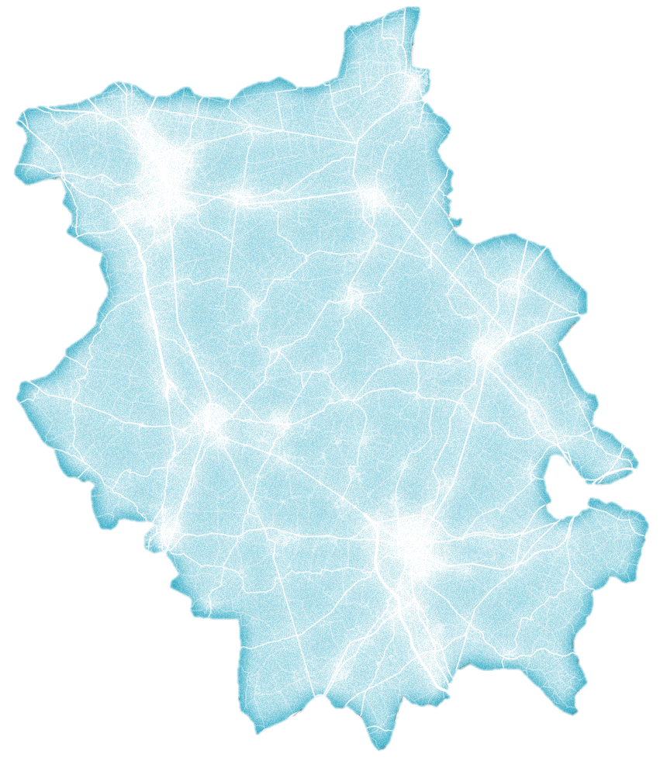
HUBS OF EMPLOYMENT IN CAMBRIDGESHIRE AND PETERBOROUGH
1
Peterborough Advanced Manufacturing Cluster
Close geographical concentration of robotics, metals and machinery businesses
6
WISBECH
6
Fenland Agriculture
Group of Farming, Agri-tech and Agricultural Manufacturing businesses
PETERBOROUGH
1
7
WHITTLESEY
MARCH
2
Huntingdon Retail Park
Cluster of retail and hospitality businesses
7
Peterborough Logistics Cluster
Area of logistics businesses transporting goods along motorway routes
RAMSEY
CHATTERIS
3
Huntingdonshire Manufacturing Cluster
A close geographical concentration of manufacturing businesses in Huntingdonshire
10
ELY
8
Lancaster Way Business Park
Large industrial and commercial cluster of tech manufacturing companies
2
8
3
ST IVES
HUNTINGDON
10
9
4
10
4
Cambourne Business Park
Cluster of Tech and Professional Services offices
5
9
Cambridge Research Park
Cluster of Tech and Life Science research businesses and distributors
CAMBRIDGE
ST NEOTS
5
Cambridge City Centre
Educational, Retail and Hospitality hub
10
Enterprise Zones
Including Northstowe Enterprise Zone, Alconbury Weald and Cambridge Compass Enterprise Zone

Slide 4
What local career opportunities are available to you?
LIFE SCIENCES
AGRI-TECH
HEALTH
Life Sciences is the application of biology and technology to health improvement, and is one of the largest sectors in Cambridgeshire, employing 54,000 people
Agri-Tech is the use of technology to make farming more efficient. It employs 16,000 people in Cambridgeshire & Peterborough.
55,000 people are employed across health and social care in Cambridgeshire & Peterborough, including doctors, nurses, care workers and care assistants.
ADVANCED MANUFACTURING
DIGITAL
RETAIL
Advanced Manufacturing is a modern form of Manufacturing using advanced technology, employing 22,000 people.
Digital involves the trade of goods and services using computer networks and technological infrastructure, employing 27,000 people.
Retail employs 63,000 people in Cambridgeshire & Peterborough, with a wide range of possible career paths including cashiers and store managers.
PROFESSIONAL SERVICES
EDUCATION
TRANSPORT
Professional Services involves the provision of specialist services to businesses, including IT, finance and business advice , and employs 58,000 people.
52,500 people are employed within education in Cambridgeshire & Peterborough, including teachers and teaching assistants.
Transport employs 24,500 people in Cambridgeshire & Peterborough, with a wide range of possible career paths, including drivers, pilots and cabin crew.

Slide 5
Jobs in east Cambridgeshire
Top Sectors in east cambridgeshire
Number of jobs
46,000
35%
5,000
4,000
Of people have a university level qualification
3,000
Jobs
2,000
1,000
0
£25,000
4,000
Admin
Retail
Education
Manufacturing
Transport
Median Salary
Businesses
MAJOR EMPLOYERS
RETAIL
Including: sales, merchandising, logistics, customer service
ADMIN
Including: secretary, receptionist, administration support
ELYSIUM HEALTHCARE
is a health and social care provider, specialising in neurological and children's services
MANUFACTURING
Including: engineering, distribution, farming
is a global optical technologies company with a base in Ely, specialising in the design and manufacture of innovative photonics products for manufacturing and research.
EDUCATION
Including: teaching, teaching assistants
THORLABS
Including: haulage, distribution, delivery driver
TRANSPORT

Slide 6
Jobs in fenland
Top Sectors in fenland
Number of jobs
48,500
17%
6,000
Of people have a university level qualification
4,000
Jobs
2,000
0
£20,600
3,700
Admin
Retail
Health
Manufacturing
Transport
Median Salary
Businesses
MAJOR EMPLOYERS
MANUFACTURING
Including: engineering, distribution, farming
RETAIL
Including: sales, merchandising, logistics, customer service
Is one of Europe’s largest food and drink groups. They source and manufacture products, and supply food and drink to suppliers across Europe.
PRINCES GROUP
ADMIN
Including: secretary, receptionist, administration support
Is a major global food supplier with a significant presence in Fenland, with opportunities in agri-tech, manufacturing and retail distribution.
HEALTH
Including: nursing, social care, medical practitioners
MCCAINS FOOD
TRANSPORT
Including: haulage, distribution, delivery driver

Slide 7
FURTHER STUDY
Pathways from school into employment
university
apprenticeships
ON THE JOB TRAINING
University degrees usually last a minimum of 3 years and involve studying through a mix of lectures and tutorials, and completing coursework and exams, and can provide pathways into many different careers.
Apprenticeships provide a route into industry, available across a wide range of industries. Apprenticeships allow you to 'work whilst you learn' and you will usually spend a set amount of time studying for a professional qualification, or possibly a degree, whilst you work for a particular company.
On the job training is training or education that takes place whilst in a job. This might be informal learning from a manager or mentor, but may also be formal learning for a professional qualification that is needed to progress in the job.
TECHNICAL EDUCATION
WORK EXPERIENCE
ROUTES TO FURTHER STUDY
Technical education is a career focused option, with T Levels a technical alternative to A Levels, and Higher Technical Qualifications (HTQ) an alternative to degree, developed with businesses, with specific skill requirements in mind.
Work experience is where you gain experience of what it is like to work within a particular job or company. It is usually short and runs for one or two weeks, and is usually unpaid. Work experience is often organised by schools and usually takes place whilst you are still in education.
GCSEs remain a compulsory qualification in the UK, and moving into some forms of further study will require five passes at GCSE, including Maths and English. Resitting these qualifications is an option in order to progress to further study or work. Alternatively, Level 2 BTECs, NVQs, and Functional Skills are also a pathway into further education.

Slide 8
FURTHER STUDY
Local education providers in Cambridgeshire & Peterborough
COLLEGES
HIGHER EDUCATION
ADULT LEARNING
Local colleges include:
Inspire Education Group – Peterborough College and Stamford College
Cambridge Regional College
College of West Anglia
Bedford College
West Suffolk College
North Hertfordshire College
North Cambridgeshire Training Centre
In addition, a large proportion of our secondary schools offer Sixth Form colleges, where students can study A Levels, T Levels, BTECs and wider curriculum offers.
Local Higher Education providers include:
University of Cambridge
Anglia Ruskin University Cambridge
ARU Peterborough
University Centre Peterborough
Cambridge Regional College
Inspire Education Group - Peterborough
Local training providers include:
The Skills Network
Purple Beard
Capita Public Service
Construction Skills People Ltd
Duplex Business Services
Imeta Training Ltd
Retrofit Academy
Steadfast Training
Back to Work
NACRO
SERCO
Ixion
New Meaning Foundation
Cambridgeshire Skills

Slide 9
LOCAL CAREERS SERVICES
local careers services available include
Career Focus Cambridge
University of Cambridge Careers Service
Cambridgeshire Skills
Cambridgeshire & Peterborough Careers Hub
National Careers Service
JobCentrePlus
Form The Future
Peterborough Online Careers Service

