Slide 1
Highfield Schools
Medical Awareness Training

Slide 2
Allergy & Anaphylaxis Awareness
Aims:
To recognise common allergens
To understand what happens in an anaphylactic reaction and recognise the signs and symptoms
To have a greater understanding of how and when to use adrenaline injectors and ow to care for these devices
To gain knowledge of the long term management of anaphylaxis and how to lessen the risk of a severe allergic reaction

Slide 3
Allergic Reaction
Any allergic reaction (or the most extreme form anaphylactic shock) occurs because the body’s immune system reacts inappropriately in response to substances that it perceives as a threat
A reaction is caused by the sudden release of chemical substances including histamine from cells into the tissues.
You can be exposed to the allergen on a previous occasion and not have been aware of the reaction at the time. The next time a severe reaction may occur (Triggering event).
This is so sensitive that even a minute quantity of an allergen can cause a reaction
Chemicals cause swelling in the mouth and anywhere on the skin. There is a fall in blood pressure and for people with asthma the effect is mainly on the lungs

Slide 4
Types of Reaction
There are two different types of reaction which could occur:
Uniphasic – fast onset and rapid progressive symptoms. One treated symptoms go
Bi-phasic – mile or severe to start with followed by a symptom-free period then increasing symptoms which could occur hours later (less common)
As a general rule people who have had a severe reaction should be monitored for 6-12 hours because of the risk of a bi-phasic reaction

Slide 5
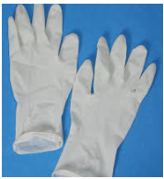
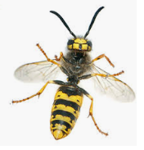
Common Causes of Anaphylaxis
Food allergens are the most common cause of severe allergies but some people will have severe reactions to other allergens including pollen, animals, stinging insects and even from unknown causes

Slide 6
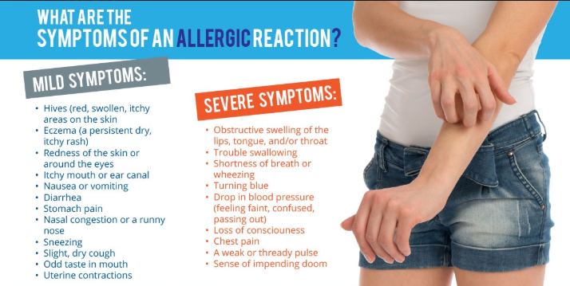
Common Anaphylactic Symptoms
Redness, swelling or itching of the lips, tongue, inside of mouth, soft palate and ears
Itching and swelling affecting the throat
Symptoms in the oesophagus or stomach including pain, discomfort, nausea or even vomiting
Sneezing, runny nose or eye symptoms including itching, redness, puffiness or watering
Skin rashes/hives

Slide 7
Treatment
Antihistamines – these are useful for less severe reactions. They work within 15-20 minutes
Cetirizine (Benadryl, Zirtek, Clarityn) are non sedating anti histamines, meaning they are unlikely to make you feel drowsy
Chrlorophenamine (Piriton) is an old school antihistamine which can make you sleepy
Asthma Inhalers – asthma medication may be used in addition to adrenaline in the case of severe asthma
Prednisolone – is a cortico-steroid drug. It helps to calm the inflammation caused by a severe allergic reaction. It can shorten reactions particularly where asthma is involved
ENSURE YOU CHECK THE STUDENTS PROTOCOL OR HEALTH CARE PLAN FOR INFORMATION AND MANAGEMENT

Slide 8
Treatment with Adrenaline
For severe allergic reactions and those that develop rapidly adrenaline begins to work in seconds
It should be administered by an injection into the muscle
Adrenaline is the name we use for the drug in the UK, Epinephrine is the internationally recognised name
What does adrenaline do?
- Opens up the airways
- Stops swelling
- Raises the blood pressure
It should be administered with the minimum of delay as it is more effective in preventing an allergic reaction from progressing than reversing it once the symptoms have become severe

Slide 9
Administering Adrenaline
Intramuscular administration is the preferred and safest route
Adrenaline injectors are designed for use in the upper, outer thigh muscle of the leg
These can be administered through clothing although it is advisable to avoid the seams of any clothing
As a general rule patients who have had significant allergic reactions affecting breathing or circulation, or have an acknowledged risk of anaphylaxis alongside asthma are likely to be given an adrenaline injector

Slide 10
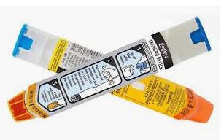
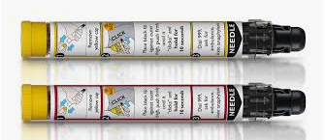
Adrenaline Injectors
There are currently 3 devices licenced in the UK
Emerade www.emerade.co.uk
EpiPen www.epipen.co.uk
Jext www.jext.co.uk
Always check the expiry date on the injector and if the liquid appears cloudy or discoloured do not use it.
It is not always immediately obvious how to use the devices so training is vital. It is vital to train family, friends and anyone who needs to know how to help in an emergency. If you suspect a reaction is serious use the injector immediately. Dial 999 and ensure medical help is sought.
Ensure the auto injector is available at all times and stored correctly.

Slide 11
Using an Adrenaline Injector *Only use an adrenaline injector if it is prescribed to that person*
Determine where to inject – it should always be given into the muscle in the outer thigh
Preparing to inject – grasp the auto injector in your dominant hand with needle tip facing down. Remove the safety cap (EpiPen & Jext)
Inject and hold in place – If using EpiPen hold the injector a few cm away from the leg and jab firmly. If using Emerade or Jext press the injector against the thigh and push firmly. You will hear a click when the injector fires. Hold in place for the amount of time according to the instructions (10 seconds for Jext, 5 seconds for Emerade, 3 seconds for Epipen). Some of the older Epipen models may still be in circulation so ensure this is held in place for 10 seconds
Rub – remove the auto injector and gently rub the injection site for a few seconds. Store the used auto injector safely and give to the emergency services when they arrive
Call an ambulance – make a note of the time you administered the injector to tell the paramedics when they arrive. All patients must go to hospital after using their auto-injector

Slide 12
Patient Positioning
Positioning will depend upon the symptoms they are experiencing:
Symptoms only affecting breathing – sit up or in a semi-recumbent position
Symptoms of low blood pressure – (cold, clammy, sweaty, dizzy or feeling weak) they should lie down with their legs raised to ensure the heart is the lowest part of the body. If they are also having breathing problems position them semi-recumbent with legs propped up on a cushion. Do not allow them to sit up or stand after getting adrenaline as this may lower blood pressure drastically and worsen their condition.
Unconscious patient – the patient should be placed in the recovery position

Slide 13
Management in Schools
It is essential to understand three key issues in schools:
1) Allergen avoidance – in order to prevent those coming into contact with their allergen
2) Early recognition of symptoms – how to spot signs early
3) Crisis management – understand care plans and protocols and know how to use an auto injector
Cookery – ensure surfaces are wiped down, wash carefully, separate cookery and general teaching areas, now pupils specific allergens and avoid them
School dinners – allergen free, identify students with allergies to all staff, clean tables thoroughly, understand risks posed to friends
Conduct a risk assessment to ensure all allergen exposure is accounted for (eg bird tables/seeds, bake sale ingredients etc)

Slide 14
Links to Further Resources
Health Conditions in School Alliance – published a guide to the laws of looking after children with medical conditions in school www.medicalconditionsatschool.org.uk
Anaphylaxis Campaign has a School and Education Providers webpage www.anaphylaxis.org.uk
Jext Auto Injector training video www.jext.co.uk
EpiPen Auto Injector training video www.epipen.co.uk
Emirade Auto Injector training video www.emirade.co.uk

