Slide 1
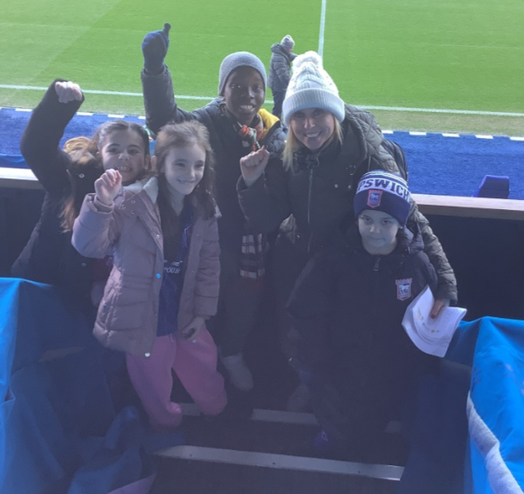
Dear Parents and Carers,
Achieving Greatness Together'
Hillside ITFC Mascots lead the way!
Wow, what an incredible experience for our children. On Sunday, Miss Baker, Mrs Curry, Mrs Canham, Miss Cantin, Mr Liew, Miss Drechny and I supported a group of children as they walked onto the pitch as Mascots in front of approximately 30,000 supporters during the FA cup Ipswich Town game. They also experienced a tour of the stadium, met with their favourite players and even took part in a penalty shoot-out against Bluey the team mascot( please refer to page 2 and 3 for more photos). The experience has really inspired them and given us all memories to last a lifetime. Thank you to everyone at ITFC!
Thank you to all the parents for attending our ' New Year, New opportunities' meetings. We really value working in partnership with you.
We also had a parent council meetings this week. Your ongoing views are really important to us. Please refer to page 8 for more details.
Thank you for all your ongoing support!
It is greatly appreciated.
Best wishes,
Mrs Wass

Slide 2
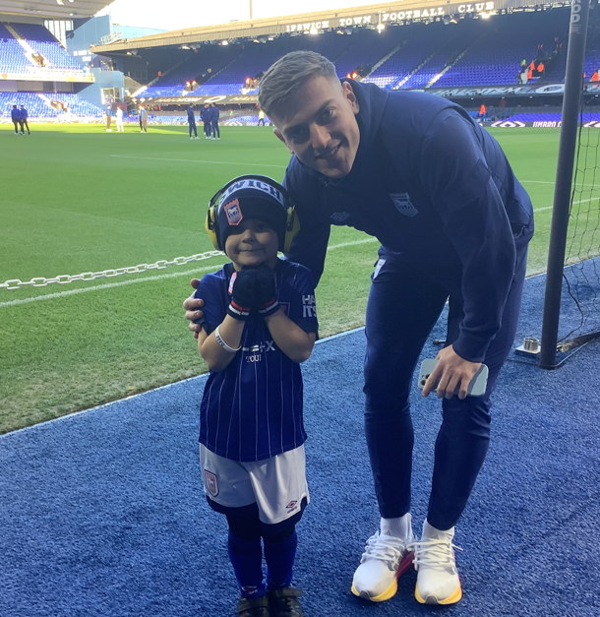
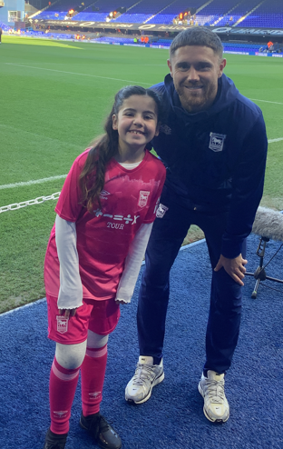
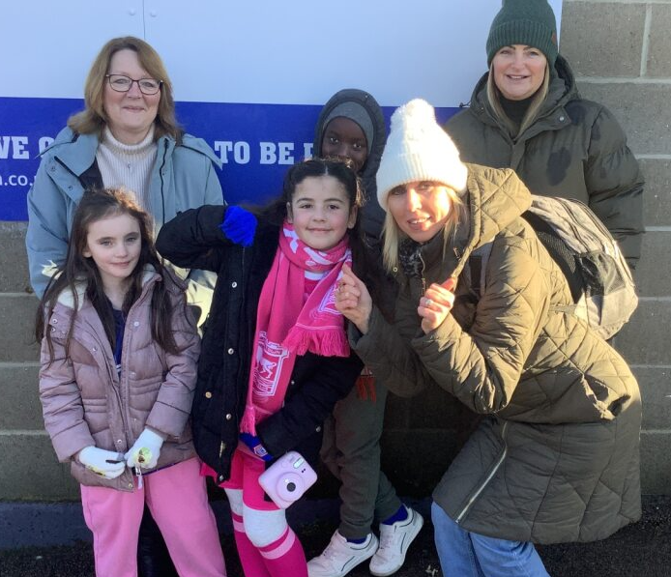
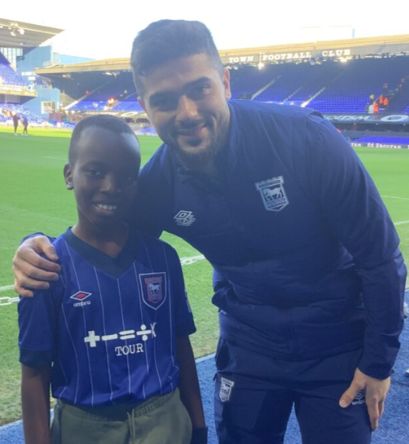
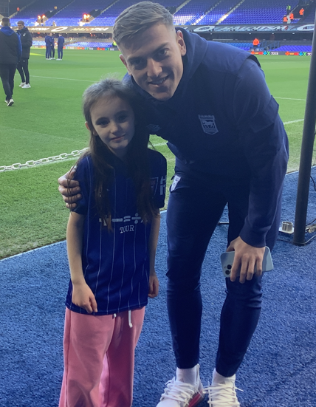

Slide 3
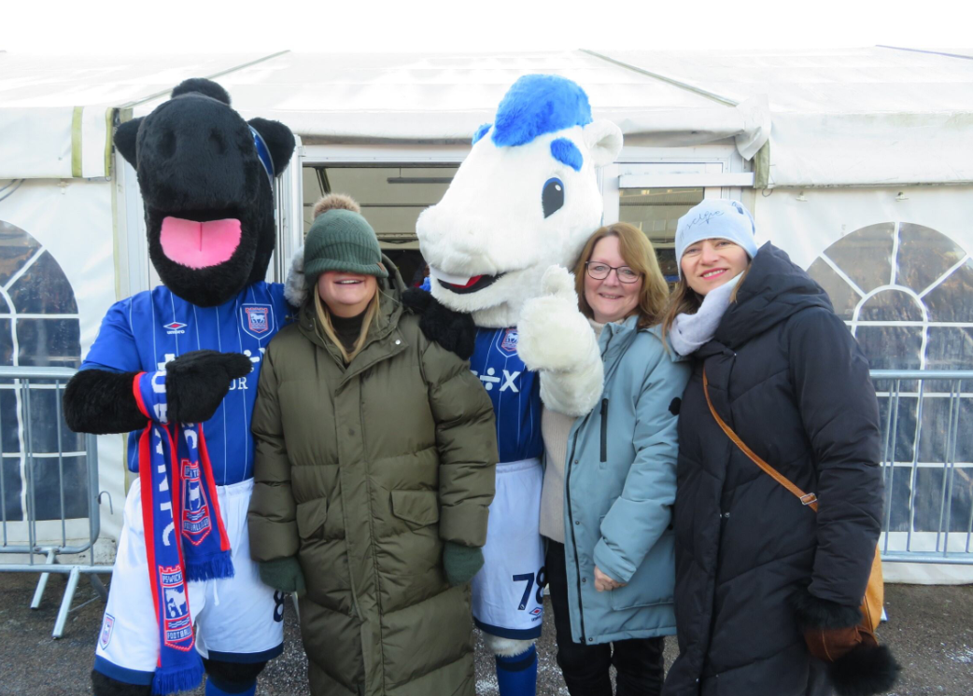
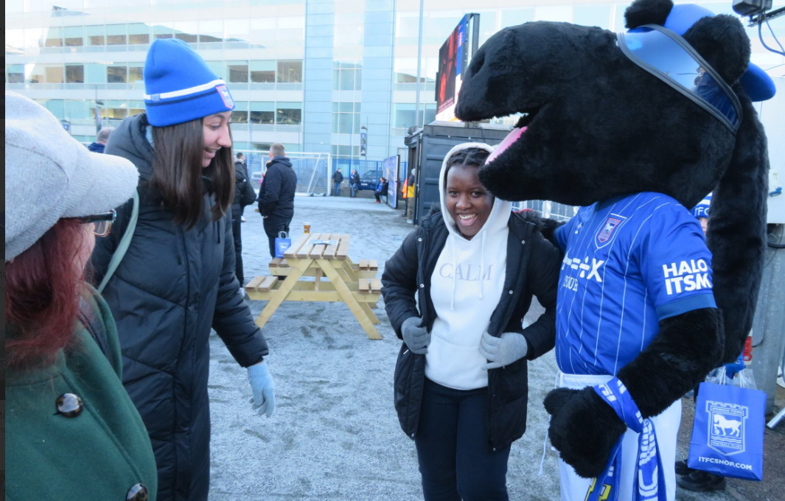
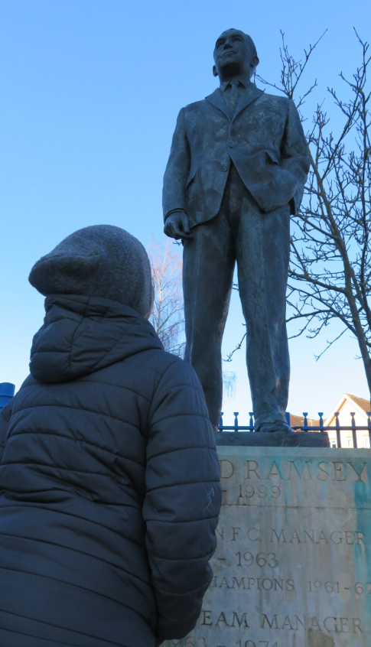
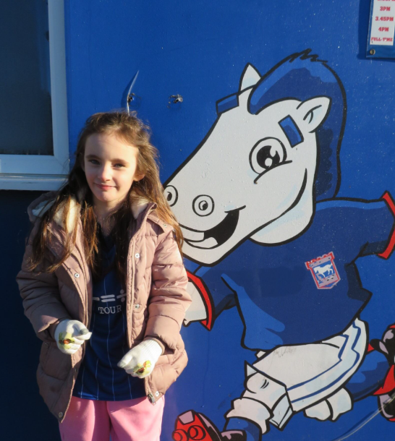

Slide 4
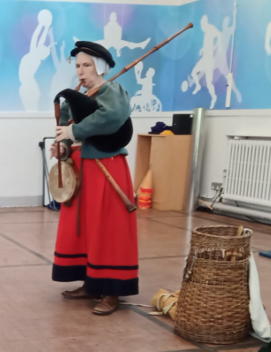
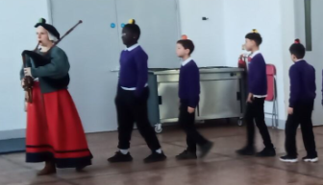
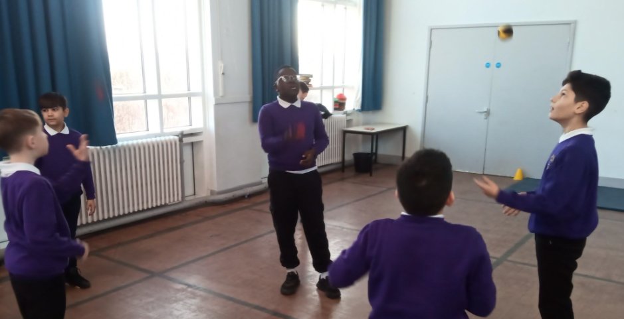
The Travelling Entertainer
Wolsey 550 Theatre
Year 6 Enrichment
Having just learnt about Monarchs in History, children in year 6 had a visitor from the Tudor era show us about her lifestyle as a travelling entertainer. We learnt about life as a Tudor, listened to music performed with different instruments simultaneously and even juggled. We were taught how to juggle too, and it was a fantastic experience for all.
"We were amazed at how instrument skills."
Christiane
"I really liked it when she played the bag pipes."
Dakota
"If you want to know how to juggle... this was amazing!"
Ionut

Slide 7
Diary Dates for Spring Term
WB 20th January – Year 6 Mock SATS week
WB 3rd February – Children's Mental Health Week
10th February – Reading Week at Hillside
11th February – Safer Internet Day
Thursday 13th February – KS1 bedtime story session( more information to follow)
Friday 14th February – Last day of the half term
Monday 24th February – Return to school
Monday 3rd March- 2.15pm Parent Council
Monday 3rd March – Year 2 History Parent event at 2pm
Friday 28th March – Year 2 local area walk
Friday 4th April –Last day of the term
Tuesday 22nd April – Return to school
WB 12th May – Year 6 SATS week
P.E days
Monday – Nursery & Year 2
Tuesday – Reception, Year 2 and Year 3
Wednesday – Year 1, Year 3, Year 4, Year 5
Thursday – Year 4 and Year 6
Friday – Year 1 and Year 6 plus Year 5 swimming
Parent engagement meetings
Monday 20th January – Year 1 Parent meetings ( arrival via classroom door at 8.30am)
Wednesday 22nd January – Year 3 Parent meeting ( arrival via classroom door at 8.30am)

Slide 8
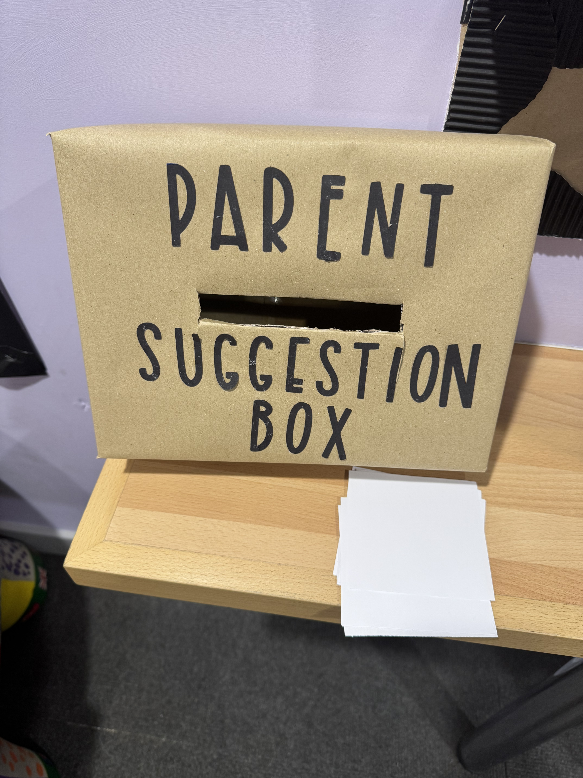
Parent Partnership
Parent Council
We are keen for all classes and communities to be represented. We still have vacancies in R1, R2, 1A, 3R, 4G, 4C, 6H, 6C. Please let the office team know if you are interested.
Please refer to our minutes here:
Parent Partnership | Hillside Primary School
PE Kit
Following our recent parent survey, we will be changing the PE kit expectations from a white T shirt to a purple T Shirt from September 25. More details to follow including how to purchase a reduced cost branded and non branded option.
Photo of suggestion box
We are keen for your
suggestions!

Slide 9
Remembering more and doing more at
Hillside Primary School!

Slide 10
Success really does start with attendance
We support first!
We want every single one of our children to be an Attendance Hero:
Here
Everyday
Ready
On time
Target 24-25 96%
Whole School 93.06%
Every day counts!
2M 98.21%, 3B 97.33%, 4C 96.67%, 6H 96.15%, 5C1 95.48%, 4G 95.45%, 3R 94.29%, 1D 94%, R2 93.89%, 1A 93.33%, 4T 93.18%, 6C 93.1%, 2D 90.36%, R1 89.52%, 5C2 84.14%
If your child is not well enough to attend school please report this by phoning the Office on 01473 601402 option 1 from 7.30am. We MUST receive this information by 8.45am
Please support us in reducing the number of school days lost.
A day off school means a day where learning is lost.
Notes:
Colour hex code is: #800080

Slide 12
