Slide 1
Welcome to...

Slide 2
Our Team...
Mrs Malik – 1M
Year Group Leader
Miss Kauser
- 1K
Class Teacher
Pupil Support Assistants:
Mrs F.Bibi
Mrs S.Bibi
Mrs. O’Rourke
Phase Leader
Pastoral Support
Mr Clayton
Mrs Hussain and Miss Roach
- 1HR
Class Teacher

Slide 3
02
01
03
04
Our Curriculum
Reading and Maths
Assessment and Intervention
Other areas of learning

Slide 4
01
We have a broad curriculum which covers all areas of learning. Please use the parents’ overview to talk to your child about what they will be learning this year.

Slide 5
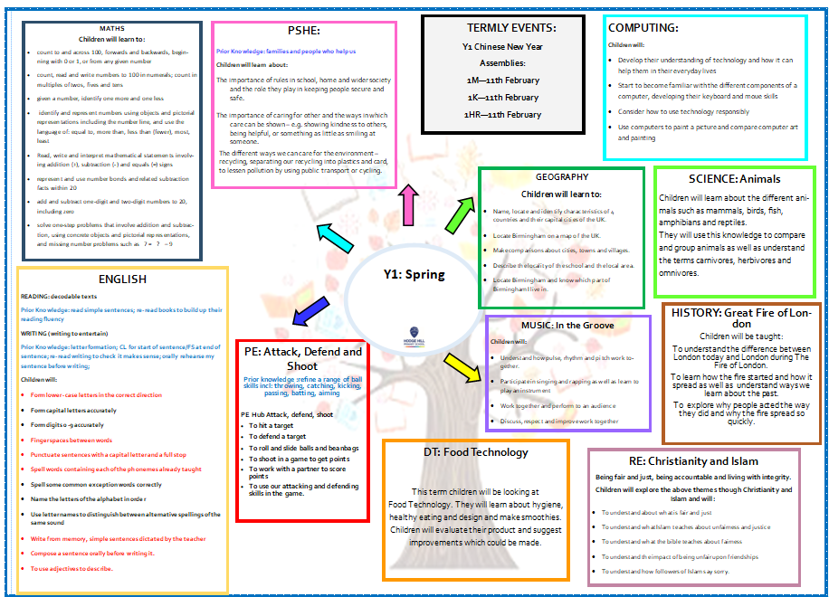
Curriculum Overview

Slide 6
Oracy
Speaking in full sentences about their work and things that they like to tell each other.

Slide 7
02
Reading and Maths

Slide 8
Reading
Focus on:
Phonics
Blending to read
Reading fluency
Comprehension
Decodable Texts
Sharing Books

Slide 9
Reading at Home
Expectation:
Read at home 5x week
Books and reading records must be in school every day.
Decodable books will be sent home each Thursday and must be returned on Monday
Sharing books will be sent home on Monday and must be returned each Thursday

Slide 10
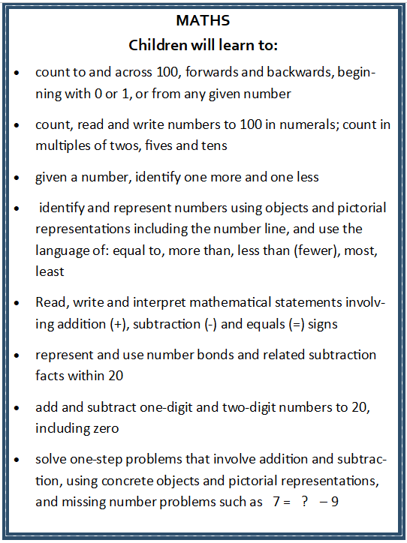
Maths
Focus on:
Times table: x2, x5, x10
Times table rockstars
Place value to 20
Addition and subtraction up to 20
Multiplication and Division

Slide 11
03
Assessments and Interventions

Slide 12
Assessments
Your child will have Maths, Reading and Phonics assessments. We will use teacher assessment to check their understanding of writing.
Your child will have regular phonics assessments and keep-up intervention where it is needed.
You will get mini reports to keep you updated with your childs progress.

Slide 13
Additional Support
Children who need extra support will have an additional intervention session to help them catch up on the day’s learning.
These groups are constantly reviewed according to the need of the children and ongoing assessment.
Details on how you can support your child at home are on the school’s website.

Slide 14
04
Other areas of learning

Slide 15
It is important that the children bring in their PE kit:
1HR – Wednesday & Friday
1K – Monday & Friday
1M – Tuesday & Friday
Children are expected to come to school in their uniform and change into their PE kits at school.
White T shirt or polo shirt
Black shorts or leggings.
During colder weather, a plain tracksuit or jogging suit-either black, dark blue or grey coloured clothing.
Football shirts/boots cannot be worn.
Trainers may be worn for outdoor games.

Slide 16
PSHE including relationships education
We follow the PSHE Association scheme of work.
This half term children will cover the topics:
Belonging to a community:
What rules are
Caring for others needs
Looking after the environment
Internet Safety:
Using the internet safely
Digit devices and how they can be used
Communicating online safely

Slide 17
Homework
Reading 5 times a week with reading diaries updated after every read.
Times Tables Rockstars should be played 5 times a week.
Please can an adult at home sign the child’s reading diary every time the child reads. This is invaluable support for the teacher and each child earns a dojo point for their House every time this happens.

Slide 18
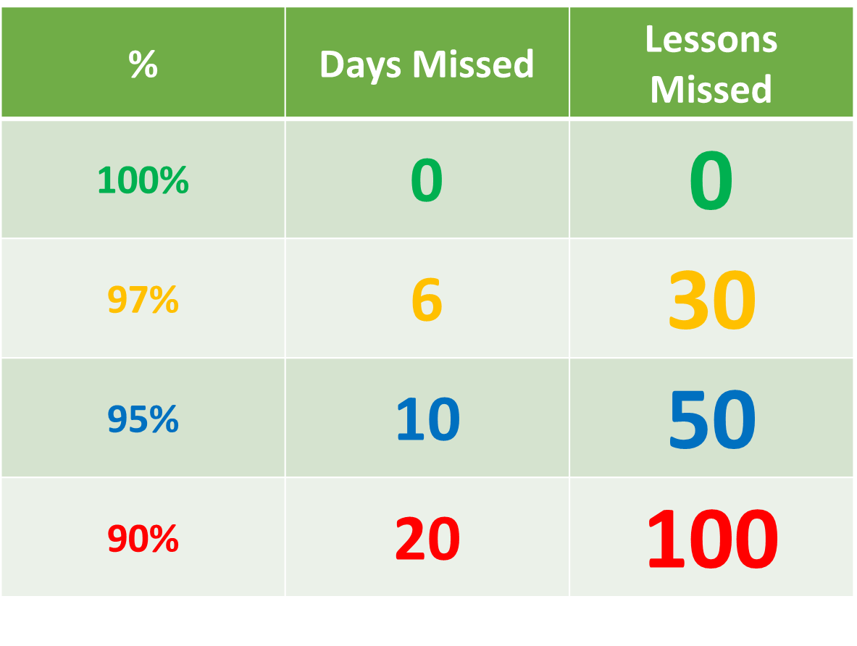
Attendance
Being in school every day that it is open, is important to your child’s achievement, wellbeing, and their wider development. Evidence shows that the students with the highest attendance throughout their time in school gain the best GCSE and A Level results.
Regular attendance:
Teaches and embeds good routines which are easily transferred into the working life as young people leave education and enter the world of work.
During school time we believe pupils should be in class with their teachers and peers and enjoying all the benefits that brings.
Parents or carers of a child have a legal responsibility to ensure their child receives a suitable education. This is usually achieved through regular attendance at school.

Slide 19
Class Assemblies
1M - Tuesday 11th February at 9:00am
1K - Tuesday 11th February at 9:00am
1HR-Tuesday 11th February at 2:45am

Slide 20
Thank you for listening, any questions?

