Slide 1

Welcome to...

Slide 2

Our Team...
Pupil Support Assistants:
Mrs Ali
Miss Brandon
Phase Leader
2A
Miss Ahmed
(YGL)
Pastoral Support
Mr Clayton
2M
Mr Moughal
Class Teacher
2F
Miss
Fiaz
Class Teacher

Slide 3

02
01
03
04
Our Curriculum
Reading, Writing and Maths
Assessment and Intervention
Other areas of learning

Slide 4
01
We have a broad curriculum which covers all areas of learning. Please use the parents’ overview to talk to your child about what they will be learning this term.

Slide 5
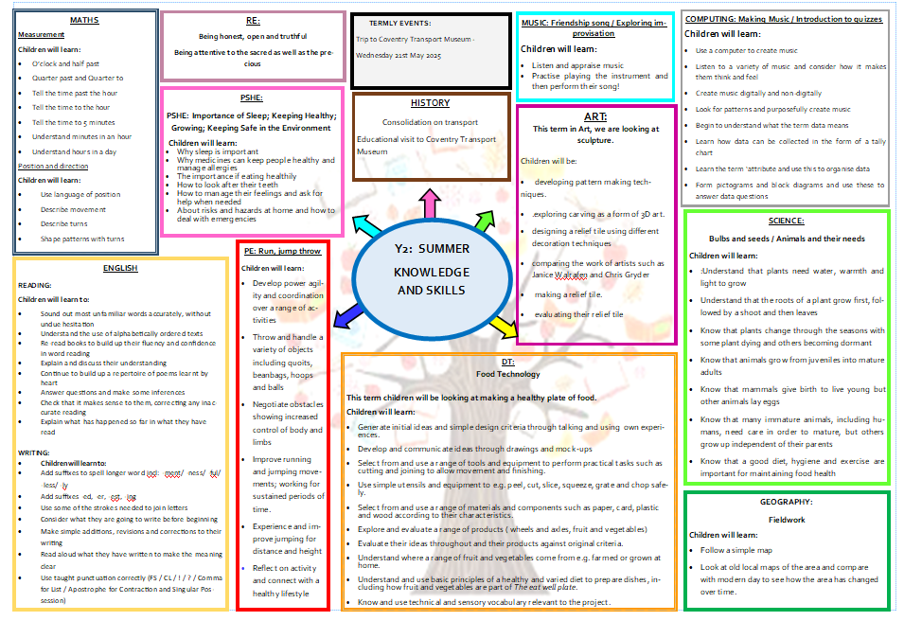

Slide 6
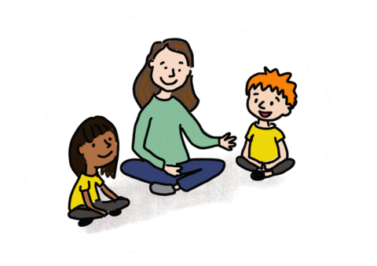
Oracy
Speaking in full sentences about their work and things that they like to tell each other.

Slide 7
02
Reading, Writing and Maths

Slide 8

Reading – whole class
Focus on:
Poetry
Reading fluency
Comprehension
Word meaning
Inference
Deduction

Slide 9
Reading at Home
Expectation:
Read at home 5x week
Book bags must be in school every day.
Reading records will be checked Monday/ Thursday
Each week your child will bring home one book that they can read to you and one book that you can share with your child.

Slide 10
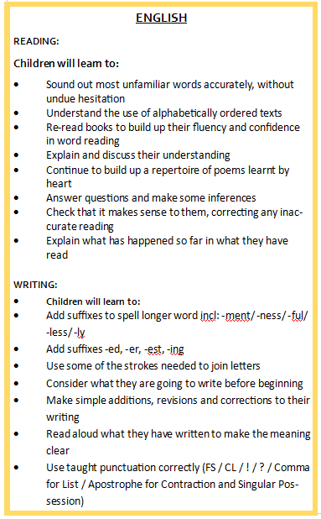
Writing

Slide 11
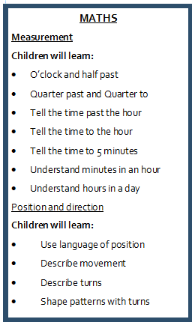

Maths
Focus on:
Telling the time –
-How many minutes past the hour?
-How many minutes to the hour?
O’ clock, half past, quarter past, quarter to

Slide 12
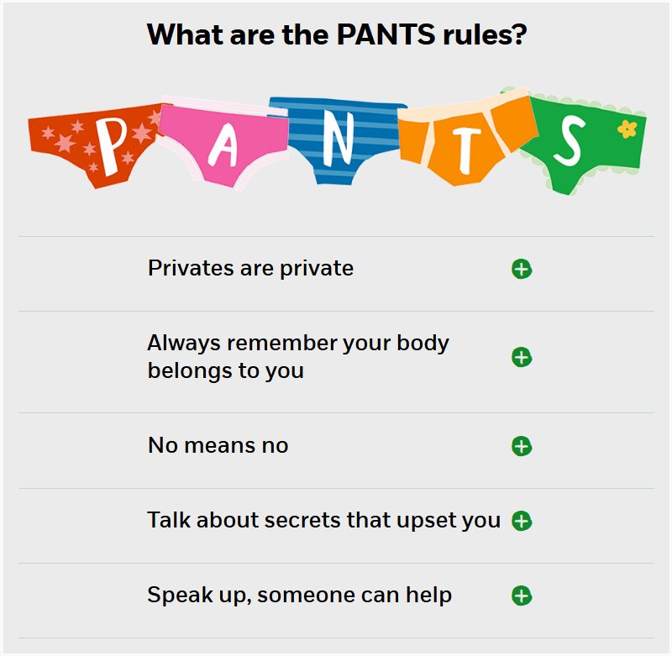

PSHE
Let's talk PANTS with Pantosaurus! | NSPCC

Slide 13
03
Assessments and Interventions

Slide 14

Assessments
Your child will be assessed every term in Reading, Writing and Maths. These assessment will inform next steps and provide targets for you to work with at home.
We will also assess key pieces of work at the end of units in other broader curriculum areas.

Slide 15
Additional Support
Children who need extra support will have an additional intervention session to help them catch up on the day’s learning.
These groups are constantly reviewed according to the need of the children and ongoing assessment.
Details on how you can support your child at home are on the school’s website.

Slide 16
04
Other areas of learning

Slide 17

It is important that the children bring in their PE kit:
2A – Wednesday and Thursday
2F - Tuesday and Friday
2M – Wednesday and Friday

Slide 18
Homework
Children are expected to read at home 5 times a week. Diaries will be checked x2 weekly.
Children will bring home a library book.
Children will bring home every Friday spellings homework. Please practise these with your children ready for the spelling test on the following Friday.
TTRS – competition will be set up weekly.

Slide 19
Attendance
Being in school every day that it is open, is important to your child’s achievement, wellbeing, and their wider development. Evidence shows that the students with the highest attendance throughout their time in school gain the best GCSE and A Level results. Regular attendance at school also teaches and embeds good routines which are easily transferred into the working life as young people leave education and enter the world of work.

Slide 20


...putting children at the heart of all we think, say and do
% | Days Missed | Lessons Missed
100% | 0 | 0
97% | 6 | 30
95% | 10 | 50
90% | 20 | 100
Attendance: 97%

Slide 21
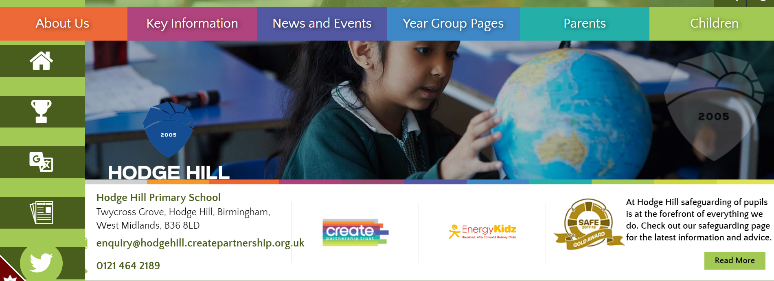
All of this meeting’s information and more can be found on the Y2 Year Group Page on the school’s website

Slide 22

Thank you for listening, any questions?

