Slide 1

Welcome to...

Slide 2

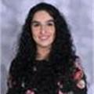
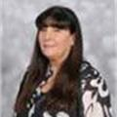
Our Team... Year 3
Miss Brandon
Phase Leader
3A
Miss Arif
(YGL)
Pupil Support Assistants:
Mrs S Ali
Mrs A Ali
Pastoral Support
Mrs Hemmings
3K
Miss Kauser
Class Teacher
3W
Miss Wiffen
Class teacher

Slide 3

02
01
03
04
Our Curriculum
Reading and Maths
Assessment and Intervention
Other areas of learning

Slide 4
01
We have a broad curriculum which covers all areas of learning. Please use the parents’ overview to talk to your child about what they will be learning this year.

Slide 5
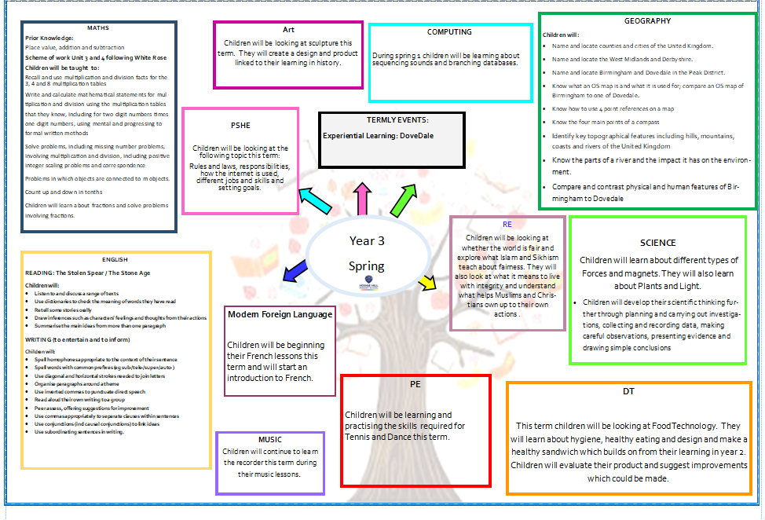
Curriculum Overview

Slide 6
Homework
Reading 5 times a week with reading diaries updated after every read.
Times Tables Rockstars should be played 5 times a week.
Musical instruments, once taken home should be practiced as often as possible.
This year we are focusing on vocabulary and in particular subject specific vocabulary. An activity will be sent home from Year 1- 6 every Tuesday to be returned for marking on Friday.
Please can an adult at home sign the child’s reading diary every time the child reads. This is invaluable support for the teacher and each child earns a dojo point for their House every time this happens.

Slide 7
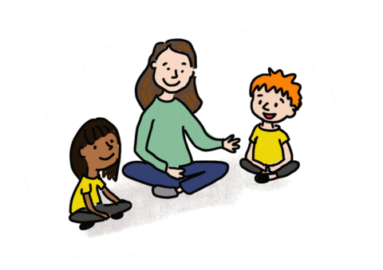
Oracy
Speaking in full sentences about their work and things that they like to tell each other.

Slide 8
RSE Curriculum:
Learning for this term – Living in the Wider World
Children will explore belonging to a community, Media literacy and Digital resilience as well as money and work.
Children will understand:
-rules and laws in society and the importance of abiding by the law
-rights and responsibilities
-how the internet can be use positively for leisure, for school and for work
-Strategies to recognise whether something they see online is true or accurate.
-Making safe and reliable choices online
-Different types of jobs from different sectors
-common myths and stereotypes related to work
-how to set goals that they would like to achieve this year

Slide 9
02
Reading and Maths

Slide 10

Reading
Focus on:
Reading fluency
Comprehension
The Stolen Spear
The Stone Age

Slide 11
Reading at Home
Expectation:
Read at home 5x week
Books and reading records must be in school every day.
Books will be changed on Wednesdays with class teacher.

Slide 12
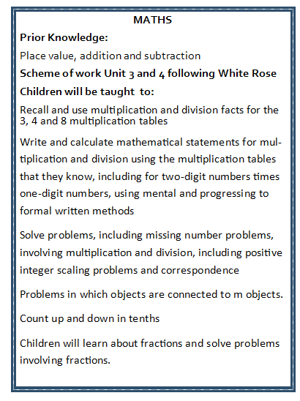
Maths
Focus on:
Times table and related facts
Times table rockstars
Multiplication and division
Fractions

Slide 13
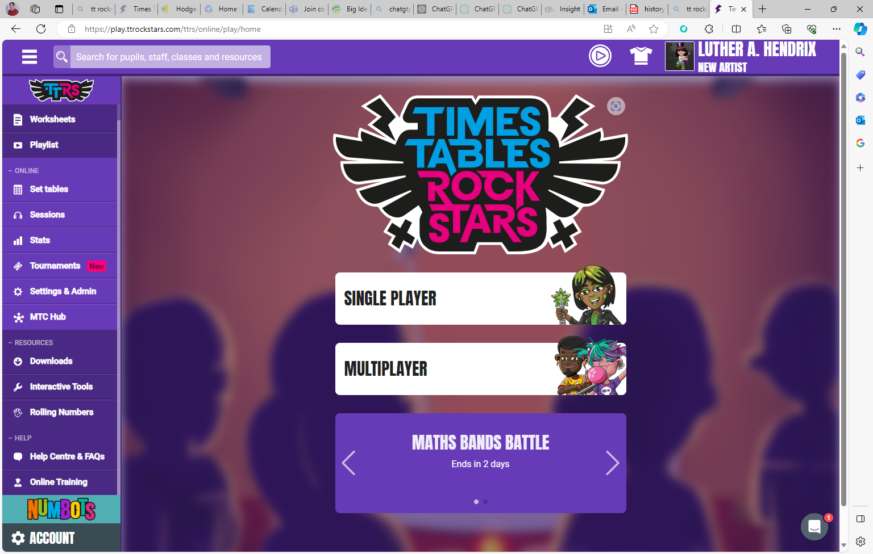

Slide 14
03
Assessments and Interventions

Slide 15

Assessments
Your child will have Maths, Reading and SPaG assessments. We will use teacher assessment to check their understanding of writing.

Slide 16
Additional Support
Children who need extra support will have an additional intervention session to help them catch up on the day’s learning.
These groups are constantly reviewed according to the need of the children and ongoing assessment.
Details on how you can support your child at home are on the school’s website.

Slide 17
04
Other areas of learning

Slide 18

It is important that the children bring in their PE kit:
– Monday & Wednesday 3K
– Tuesday & Thursday 3A
– Wednesday & Friday 3W

Slide 19
Attendance:
Face-to-face education is important in helping pupils to fulfil their potential.
During school time we believe pupils should be in class with their teachers and peers and enjoying all the benefits that brings.
Parents or carers of a child have a legal responsibility to ensure their child
receives a suitable education.
This is usually achieved through regular attendance at school.
Being in school every day that it is open, is important to your child’s achievement, wellbeing, and their wider development.
Evidence shows that the students with the highest attendance throughout their time in school gain the best GCSE and A Level results. Regular attendance at school also teaches and embeds good routines which are easily transferred into the working life as young people leave education and enter the world of work.

Slide 20

Thank you for listening, any questions?

Slide 21
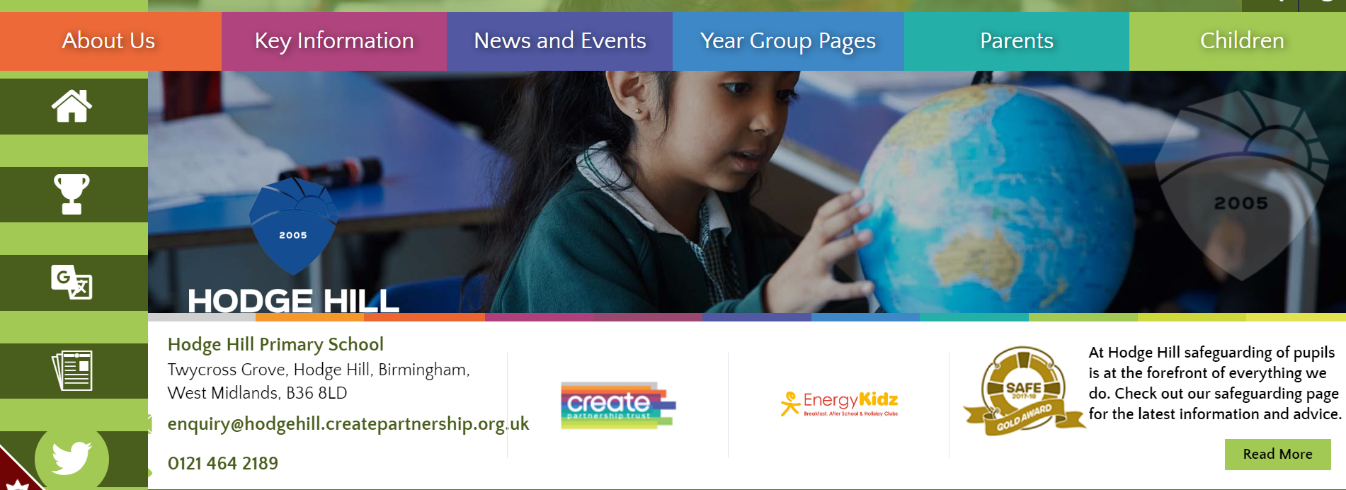
All of this meeting’s information and more can be found on the Y3 Year Group Page on the school’s website

