Slide 1
Welcome to...

Slide 2
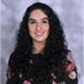
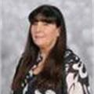
Our Team... Year 3
Miss Brandon
Phase Leader
3A
Miss Arif
(YGL)
Pupil Support Assistants:
Mrs S Ali
Mrs A Ali
Pastoral Support
Mrs Hemmings
3K
Miss Kauser
Class Teacher
3W
Miss Wiffen
Class teacher

Slide 3
02
01
03
04
Our Curriculum
Reading and Maths
Assessment and Intervention
Other areas of learning

Slide 4
01
We have a broad curriculum which covers all areas of learning. Please use the parents’ overview to talk to your child about what they will be learning this year.

Slide 5
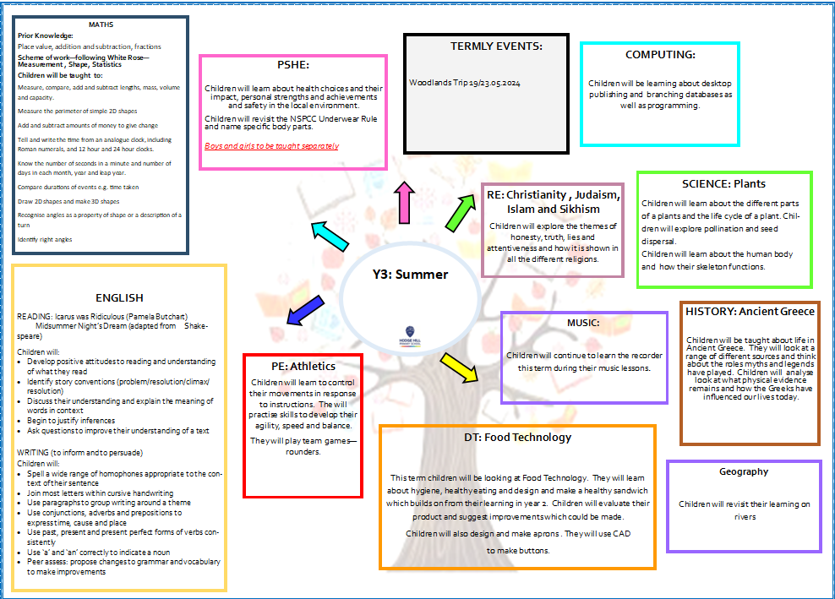
Curriculum Overview

Slide 6
Homework
Reading 5 times a week with reading diaries updated after every read.
Times Tables Rockstars should be played 5 times a week.
Musical instruments, once taken home should be practiced as often as possible.
This year we are focusing on vocabulary and in particular subject specific vocabulary. An activity will be sent home from Year 1- 6 every Tuesday to be returned for marking on Friday.
Please can an adult at home sign the child’s reading diary every time the child reads. This is invaluable support for the teacher and each child earns a dojo point for their House every time this happens.

Slide 7
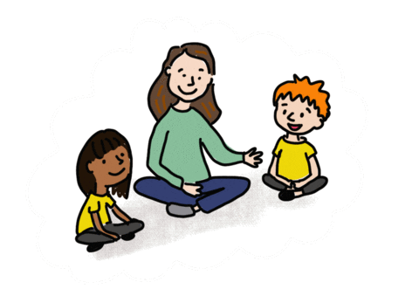
Oracy
Speaking in full sentences about their work and things that they like to tell each other.

Slide 8
RSE Curriculum:
Learning for this term – Health and Wellbeing
Children will explore Physical health and Mental wellbeing, Growing and changing and Keeping Safe
Children will understand:
-Health choices and habits, what affects feelings and expressing feelings
-Growing older; naming external body parts (single gender classes)
-Personal strengths and achievements, managing and reframing setbacks
-Risks and hazards, safety in the local environment and unfamiliar places

Slide 9
RSE Curriculum:
In single gender classes children will be taught the names of their personal and private parts. This will be explored through an interactive child-friendly source.
My personal and private body parts and keeping safe - Family Planning Association (fpa.org.uk)
Children will understand the importance of ‘Keeping what's in your pants private’ through the pants song which was also covered in Y2.
Let's talk PANTS with Pantosaurus! | NSPCC
Children will be taught what to do if they feel unsafe or uncomfortable and trusted adults will be recapped.

Slide 10
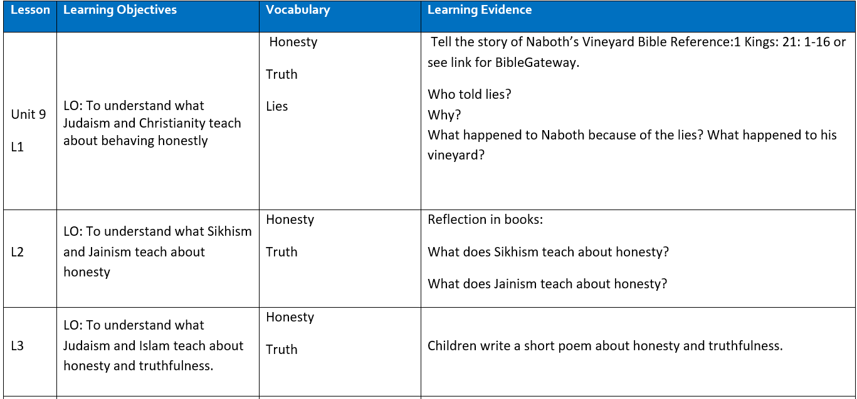
RE:
New Birmingham Agreed Syllabus

Slide 11
02
Reading and Maths

Slide 12
Reading
Focus on:
Reading fluency
Comprehension
Class Texts:
Icarus was Ridiculous
Midsummer Night's Dream

Slide 13
Reading at Home
Expectation:
Read at home 5x week
Books and reading records must be in school every day.
Books will be changed on Fridays with class teacher.

Slide 14
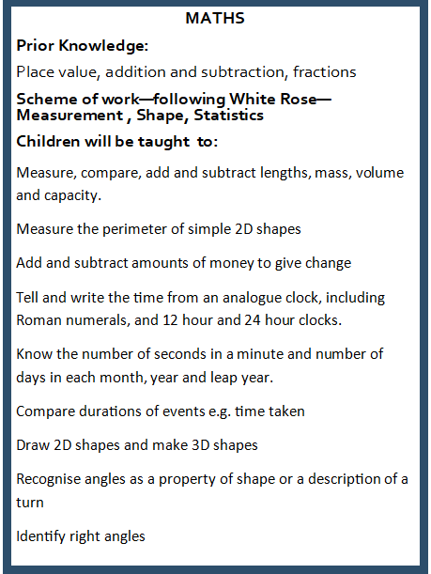
Maths
Focus on:
Times table and related facts
Times table rockstars (TTRS
Measure
Shape
Statistics

Slide 15
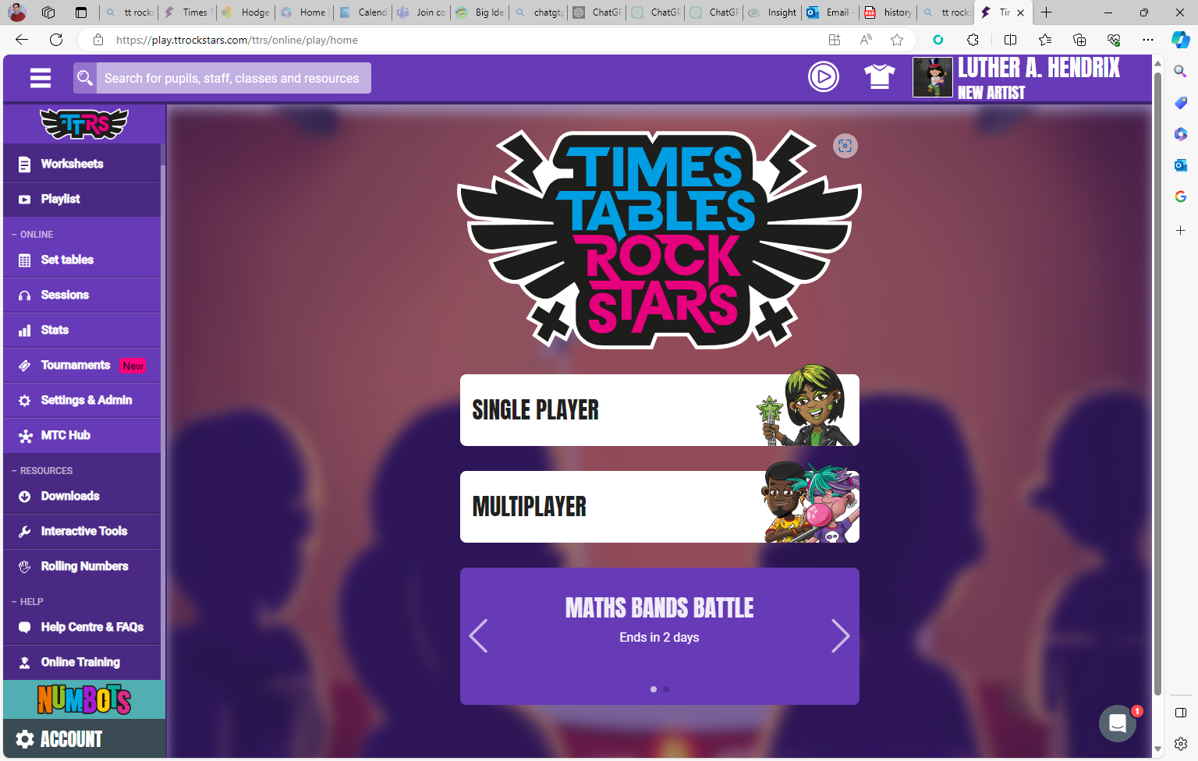

Slide 16
03
Assessments and Interventions

Slide 17
Assessments
Your child will have Maths, Reading and SPaG assessments. We will use teacher assessment to check their understanding of writing.

Slide 18
Additional Support
Children who need extra support will have an additional intervention session to help them catch up on the day’s learning.
These groups are constantly reviewed according to the need of the children and ongoing assessment.
Details on how you can support your child at home are on the school’s website.

Slide 19
04
Other areas of learning

Slide 20
It is important that the children bring in their PE kit:
– Monday & Wednesday 3K
– Tuesday & Thursday 3A
– Wednesday & Friday 3W

Slide 21
Attendance:
Face-to-face education is important in helping pupils to fulfil their potential.
During school time we believe pupils should be in class with their teachers and peers and enjoying all the benefits that brings.
Parents or carers of a child have a legal responsibility to ensure their child
receives a suitable education.
This is usually achieved through regular attendance at school.
Being in school every day that it is open, is important to your child’s achievement, wellbeing, and their wider development.
Evidence shows that the students with the highest attendance throughout their time in school gain the best GCSE and A Level results. Regular attendance at school also teaches and embeds good routines which are easily transferred into the working life as young people leave education and enter the world of work.

Slide 22
Thank you for listening, any questions?

Slide 23
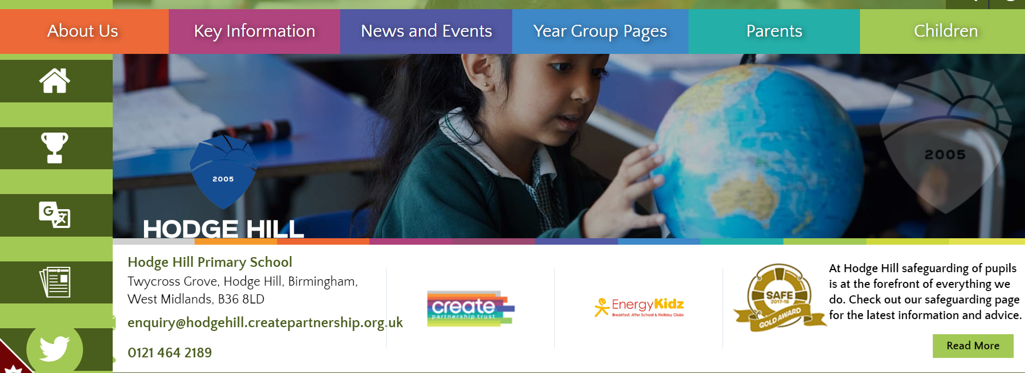
All of this meeting’s information and more can be found on the Y3 Year Group Page on the school’s website

