Slide 1
Welcome to...

Slide 2
Our Team... Year 4
4S
Mr. Sperry
Class Teacher
4M
Miss Mehmood
Class Teacher
Pupil Support Assistants:
Mrs Khanum
Mrs Ali
4H
Miss Hussain
Class Teacher
Pastoral Support
Mrs Hemmings
4T
Mrs. Tarpey
YGL
Mrs Povall
Phase Leader

Slide 3
02
01
03
04
Our Curriculum
Reading and Maths
Assessment and Intervention
Other areas of learning

Slide 4
Oracy
Speaking in full sentences about their work and things that they like to tell each other.

Slide 5
01
We have a broad curriculum which covers all areas of learning. Please use the parents’ overview to talk to your child about what they will be learning this year.

Slide 6
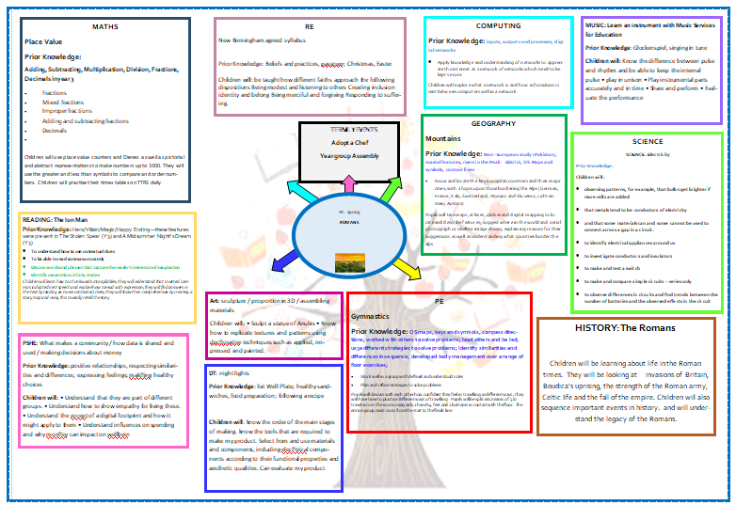

Slide 7
Homework
Reading 5 times a week with reading diaries updated after every read.
Times Tables Rockstars should be played 5 times a week.
Musical instruments, once taken home should be practiced as often as possible.
This year we are focusing on vocabulary and in particular subject specific vocabulary. An activity will be sent home from Year 1- 6 every Tuesday to be returned for marking on Friday.
Please can an adult at home sign the child’s reading diary every time the child reads. This is invaluable support for the teacher and each child earns a dojo point for their House every time this happens.

Slide 8
02
Reading and Maths

Slide 9
Reading
Focus on:
Reading fluency
Comprehension

Slide 10
Reading at Home
Expectation:
Read at home 5x week
Books and reading records must be in school every day.
Books will be changed with class teacher

Slide 11
Maths
Focus on:
Times table and related facts
Times Table Rockstars
Multiplication and Division
Fractions
Decimals

Slide 12
Multiplication Check
During June 2024, your child will be assessed on their times table knowledge, which is a government assessment designed to check that the majority of children know their times tables to prepare them for the increased demands of KS2.
Your child will have Maths and Reading assessments. We will use teacher assessment to check their understanding of writing.

Slide 13
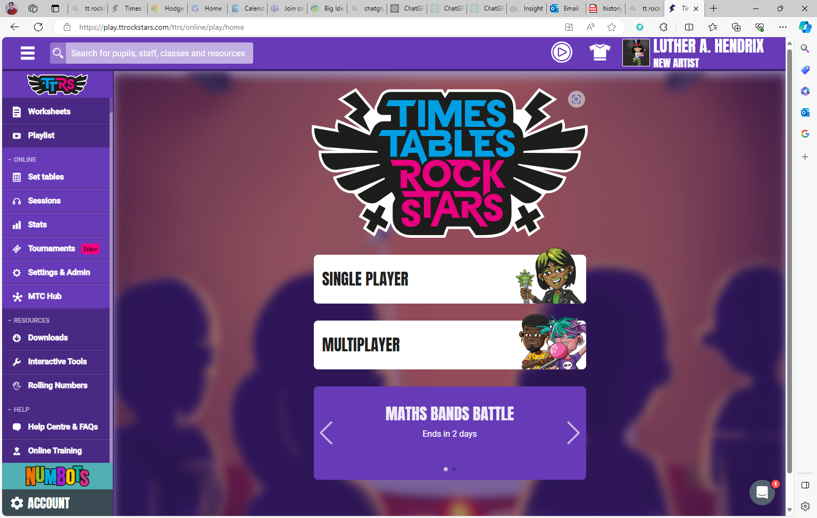

Slide 14
03
Assessments and Interventions

Slide 15
Additional Support
Children who need extra support will have an additional intervention session to help them catch up on the day’s learning.
These groups are constantly reviewed according to the need of the children and ongoing assessment.
Details on how you can support your child at home are on the school’s website.

Slide 16
04
Other areas of learning

Slide 17
It is important that the children bring in their PE kit:
4H- Thursday
4S- Thursday and Tuesday
4T- Monday and Friday
4M- Thursday and Tuesday
Swimming in Spring 2
(Swimming costume, towel and a plastic bag needed)

Slide 18
Thank you for listening, any questions?

Slide 19
All of this meeting’s information and more can be found on the Y4 Year Group Page on the school’s website

