Slide 1

Welcome to...

Slide 2


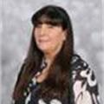
Our Team... Year 4
4S
Mr. Sperry
Class Teacher
4M
Miss Mehmood
Class Teacher
Pupil Support Assistants:
Mrs. Mohsin
4H
Miss Hussain
Class Teacher
Pastoral Support
Mrs Hemmings
4T
Mrs. Tarpey
YGL
Mrs Povall
Phase Leader

Slide 3

Oracy
Speaking in full sentences about their work and things that they like to tell each other.

Slide 4
01
We have a broad curriculum which covers all areas of learning. Please use the parents’ overview to talk to your child about what they will be learning this year.

Slide 5
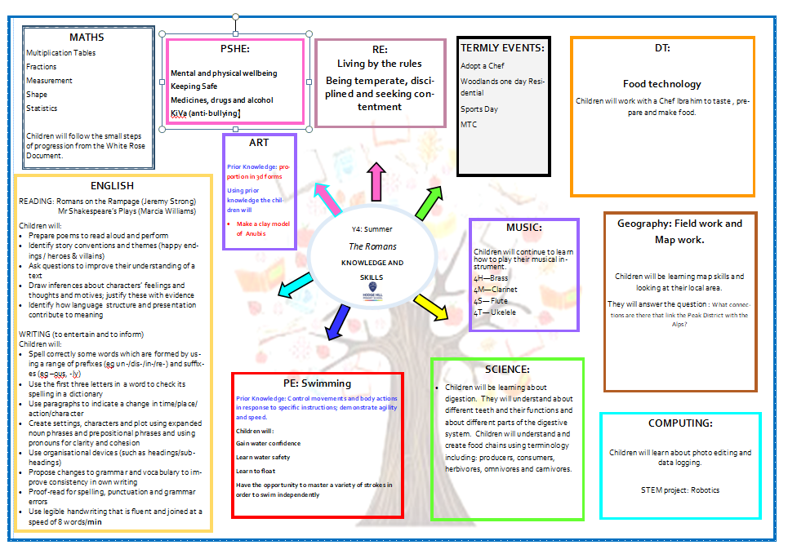

Slide 6
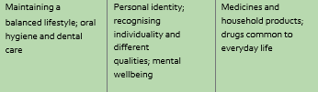
PSHE (Summer Term)

Slide 7
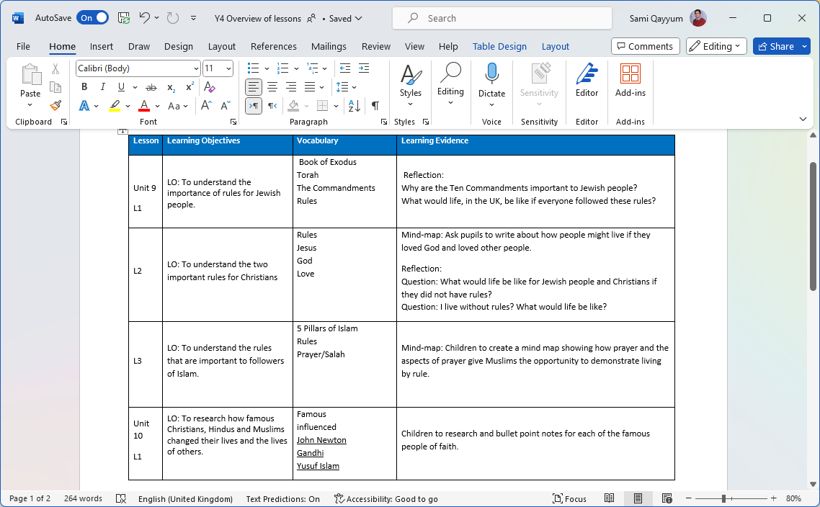
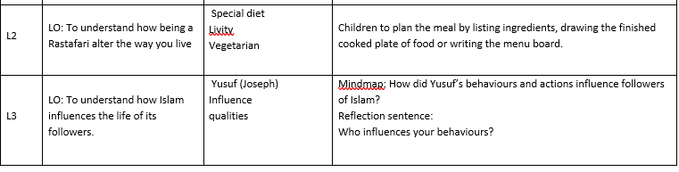
RE
New Birmingham Agreed Syllabus

Slide 8
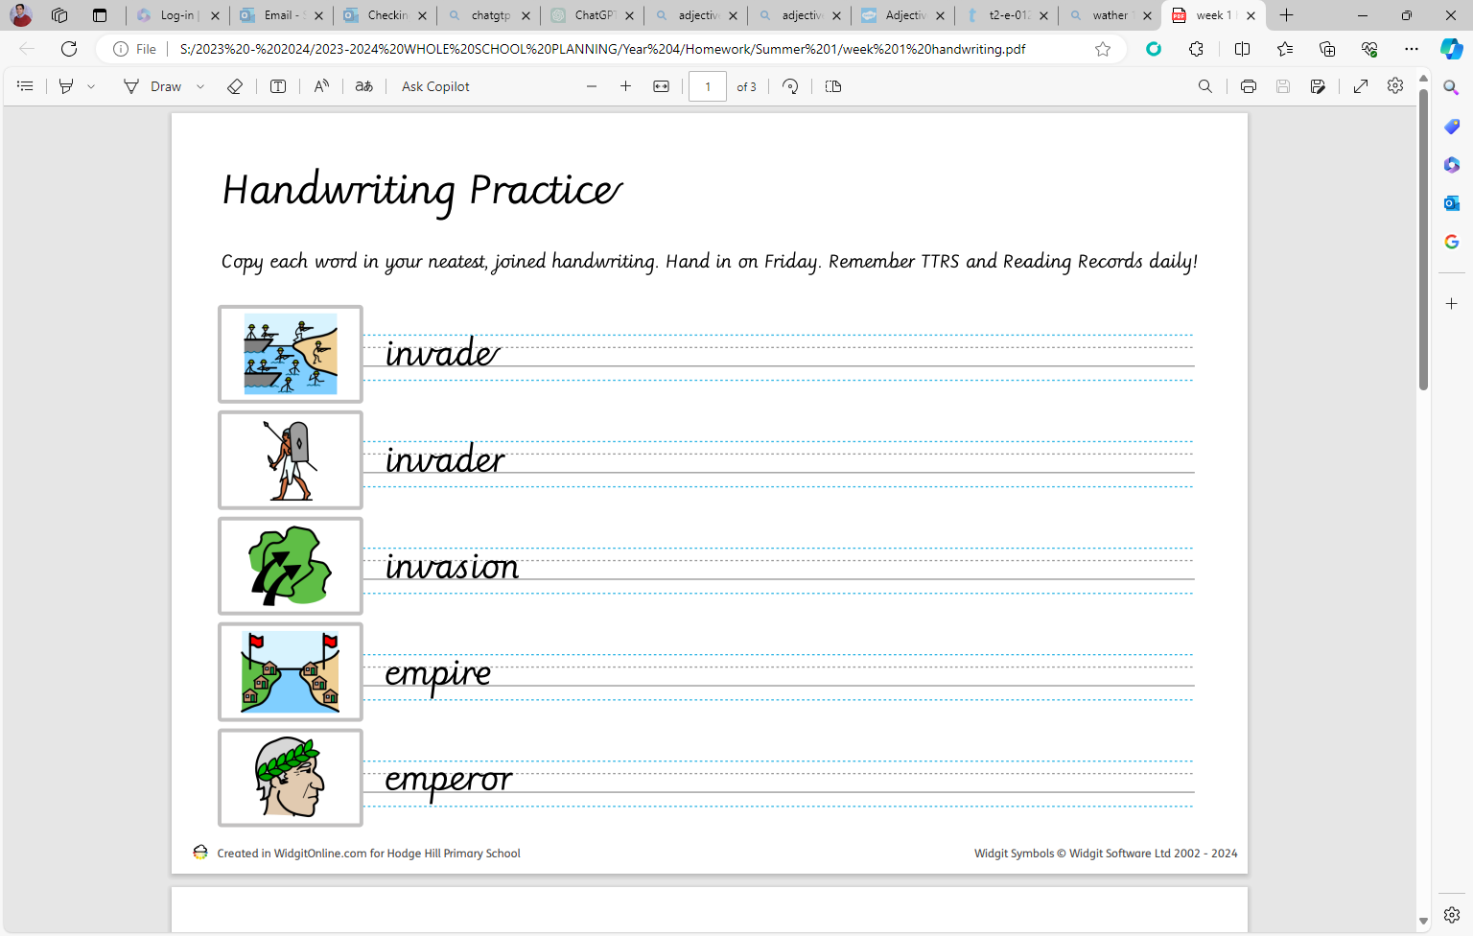
Homework
Reading 5 times a week with reading diaries updated after every read.
Times Tables Rockstars should be played 5 times a week.
Musical instruments, once taken home should be practiced as often as possible.
This year we are focusing on vocabulary and in particular subject specific vocabulary. An activity will be sent home from Year 1- 6 every Tuesday to be returned for marking on Friday.
Please can an adult at home sign the child’s reading diary every time the child reads. This is invaluable support for the teacher and each child earns a dojo point for their House every time this happens.

Slide 9
02
Reading and Maths

Slide 10


Reading
Focus on:
Reading fluency
Comprehension
Class Texts
Romans on the Rampage
Jeremy Strong
Mr Shakespeare's Plays Marcia Williams

Slide 11

Reading at Home
Expectation:
Read at home 5x week
Books and reading records must be in school every day.
Books will be changed with class teacher

Slide 12
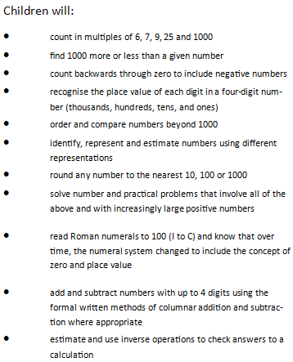
Maths
Focus on:
Measures
Shape
Statistics
MTC (Times Table Rockstars)

Slide 13

Multiplication Check
During June 2024, your child will be assessed on their times table knowledge, which is a government assessment designed to check that the majority of children know their times tables to prepare them for the increased demands of KS2.

Slide 14
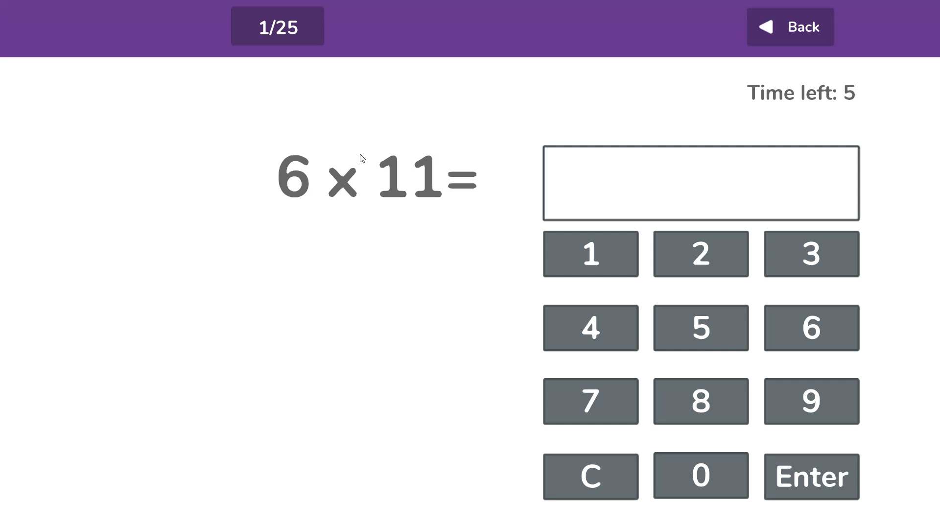

Slide 15
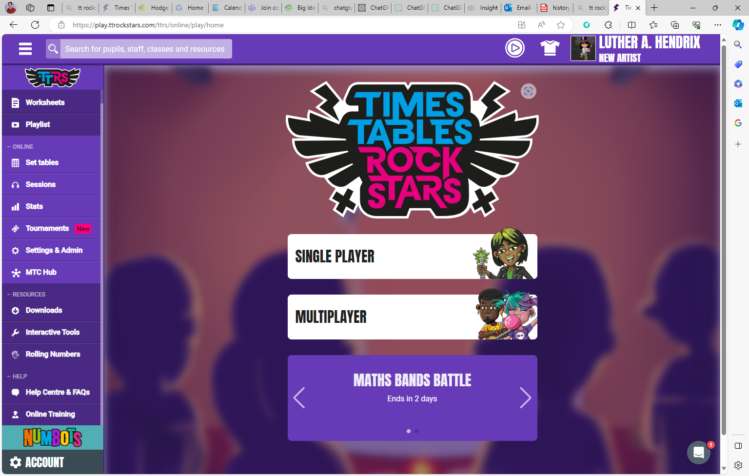

Slide 16
03
Assessments and Interventions

Slide 17
Additional Support
Children who need extra support will have an additional intervention session to help them catch up on the day’s learning.
These groups are constantly reviewed according to the need of the children and ongoing assessment.
Details on how you can support your child at home are on the school’s website.

Slide 18
04
Other areas of learning

Slide 19

It is important that the children bring in their swimming kit:
4T– Monday
4H, 4S, 4M – Thursday
Please remember long hair needs to be tied back and no jewellery.

Slide 20

Woodlands
19th May

Slide 21

Thank you for listening, any questions?

