Slide 1

Welcome to...
Notes:
Drinks and coffees

Slide 2
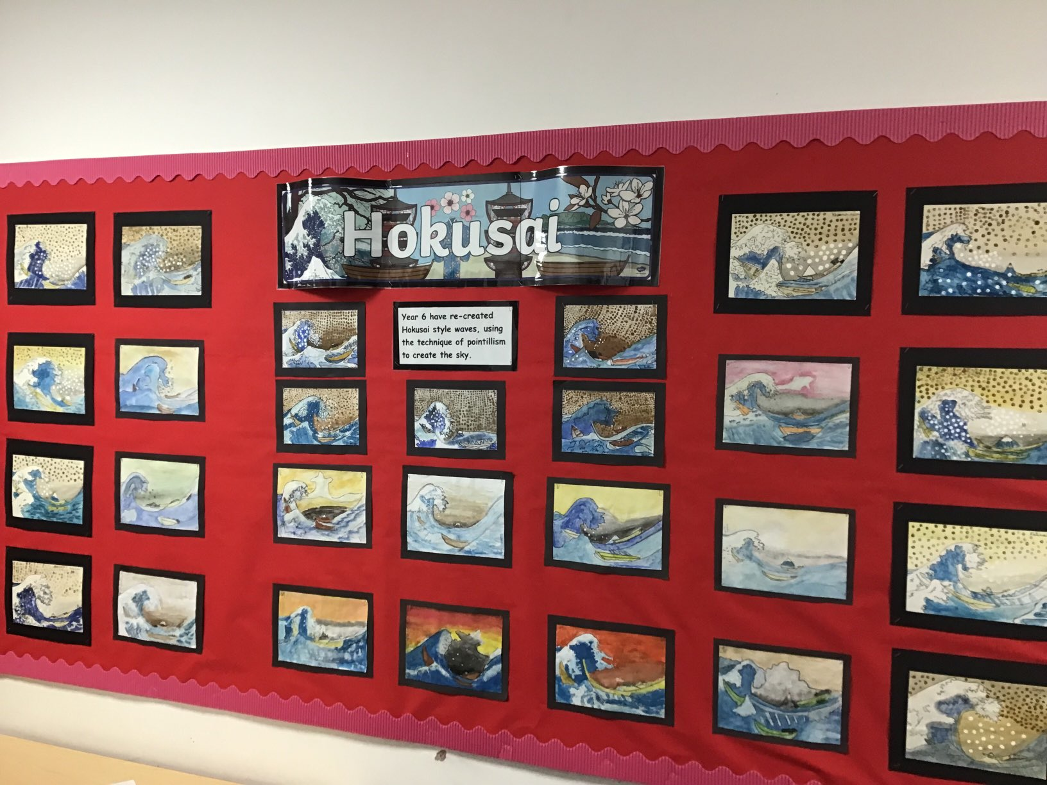

Slide 3
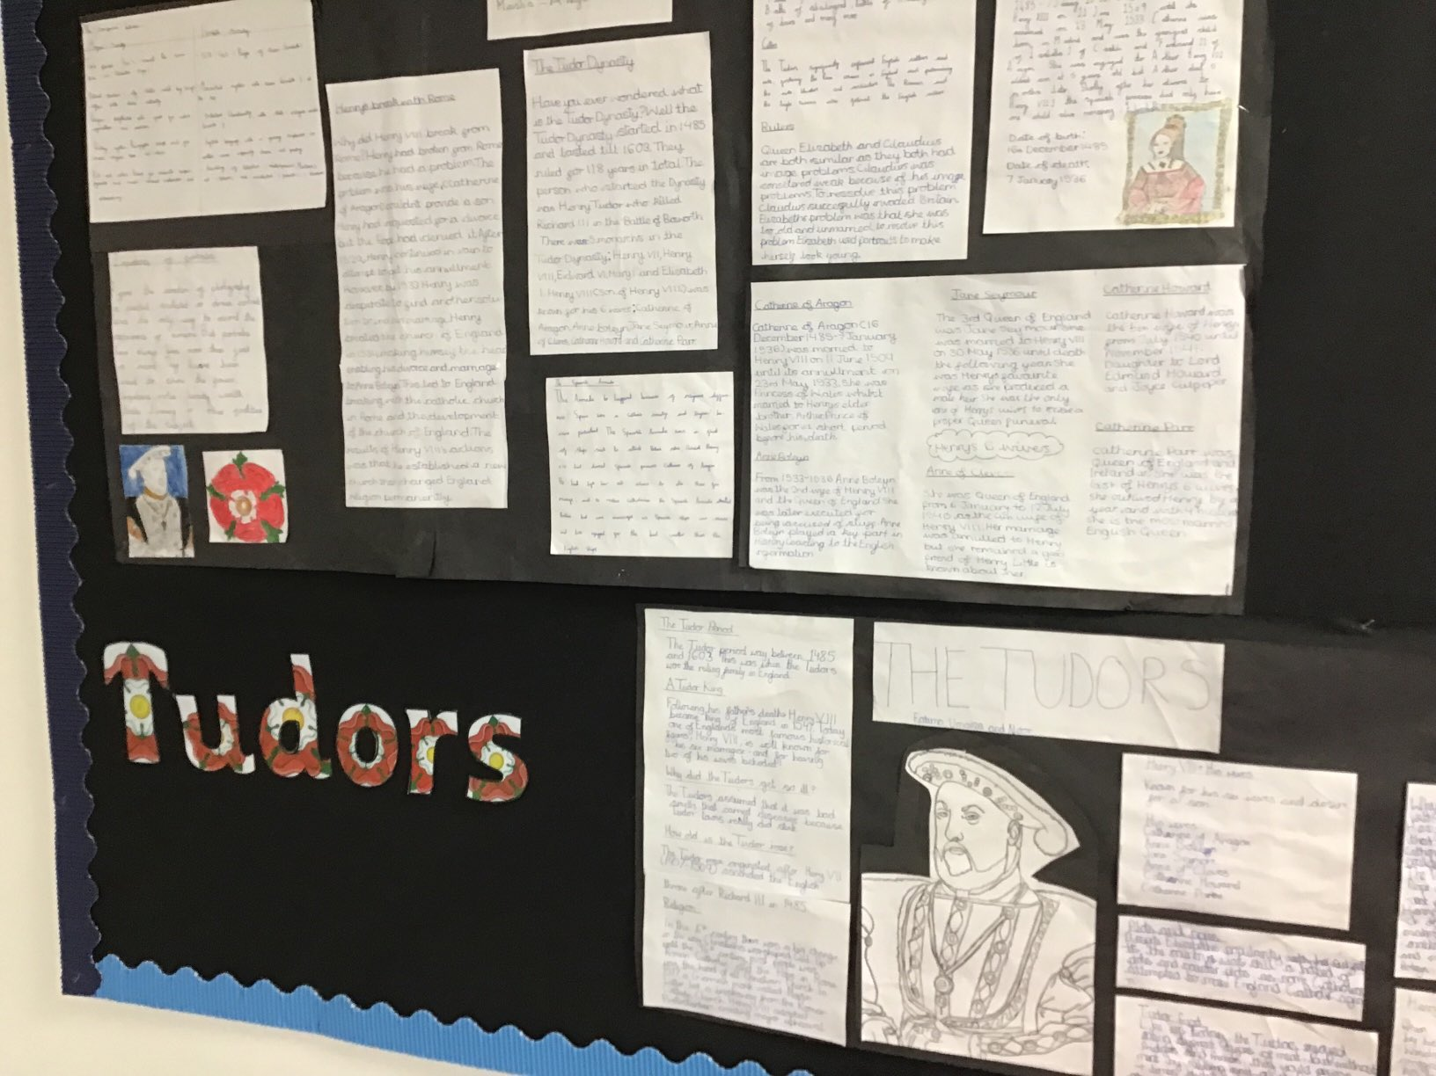

Slide 4
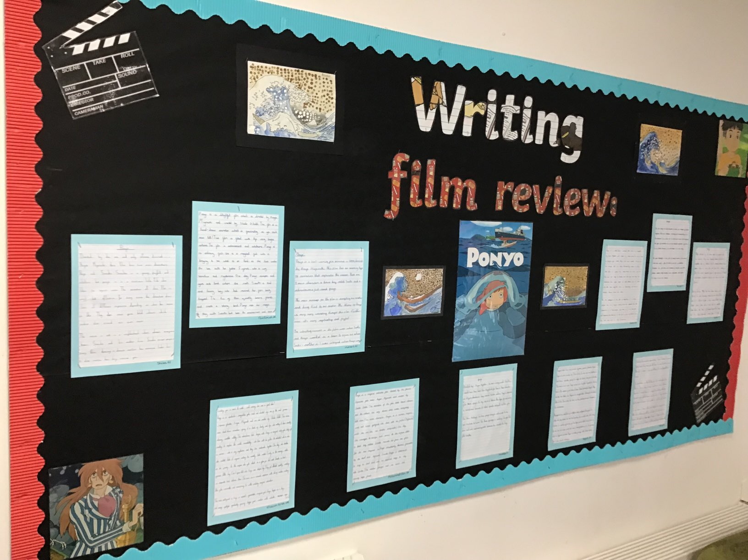
Year 6 Learning:

Slide 5
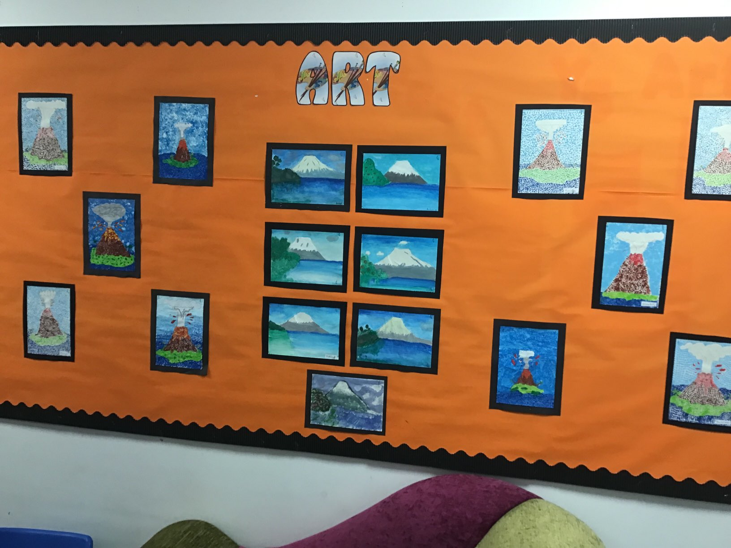

Slide 6
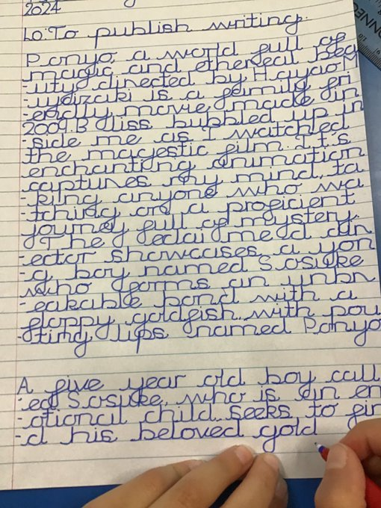
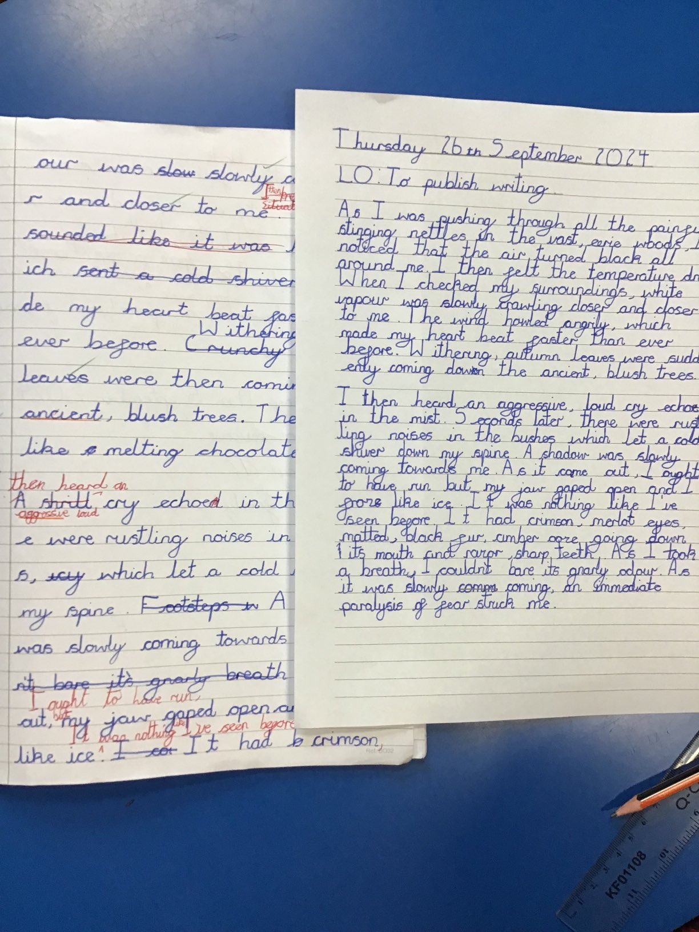
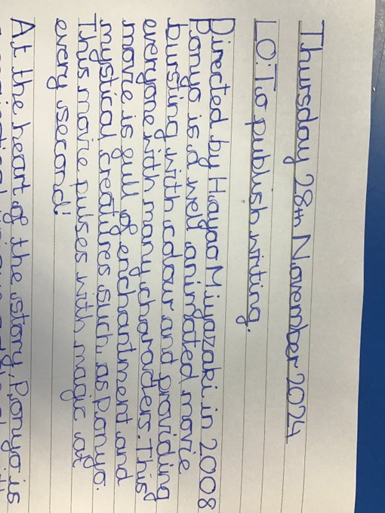

Slide 7
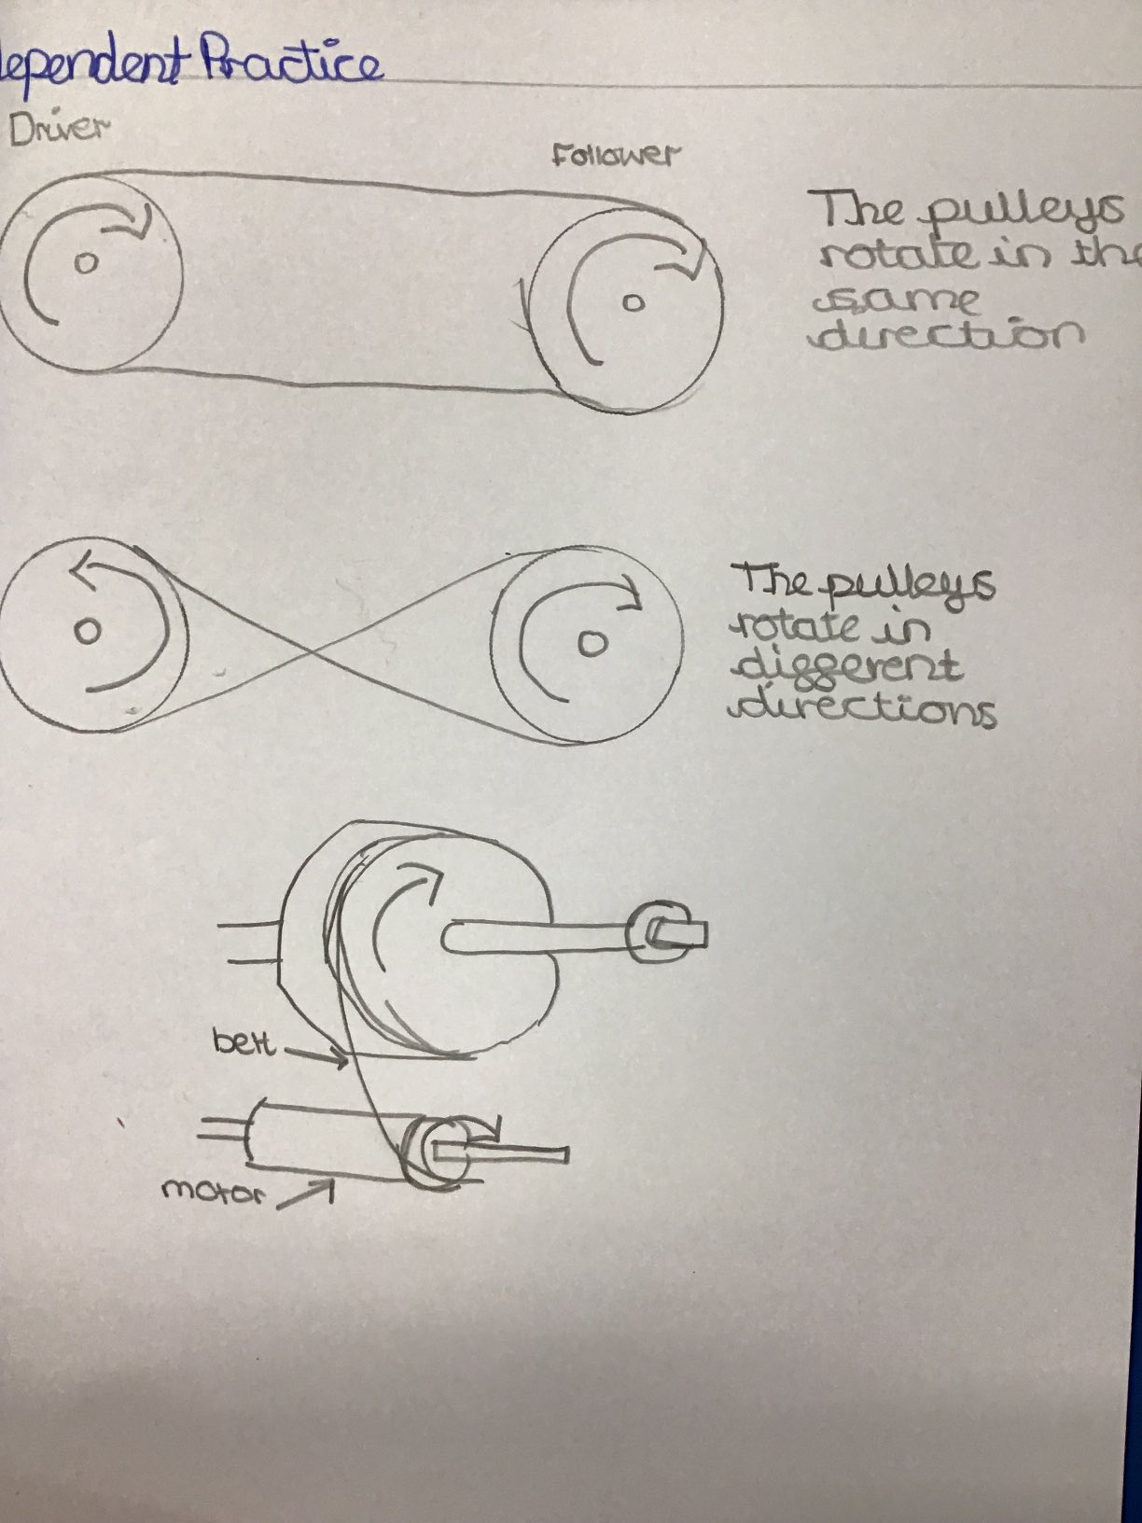
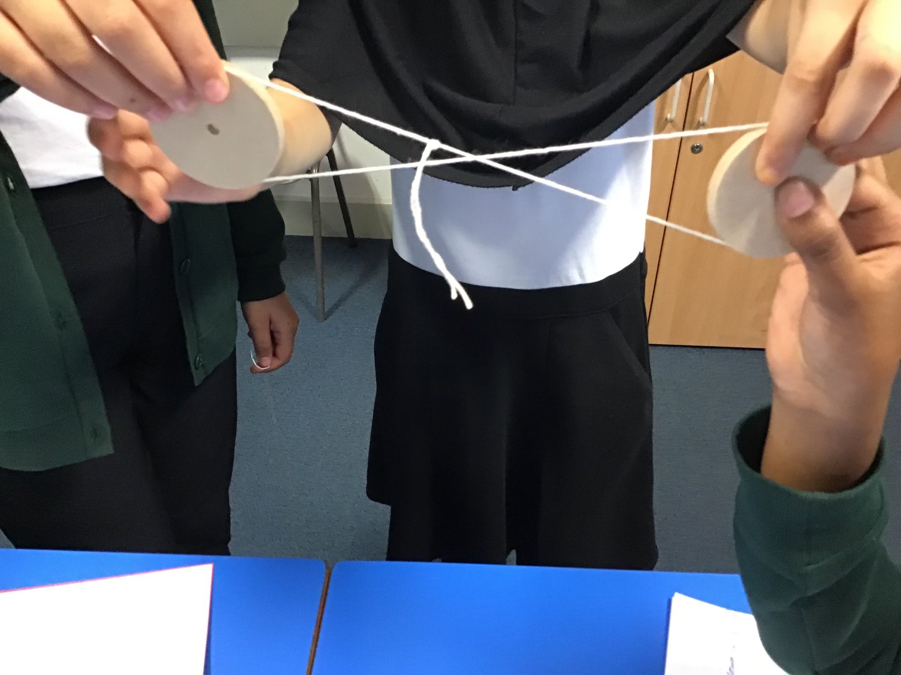
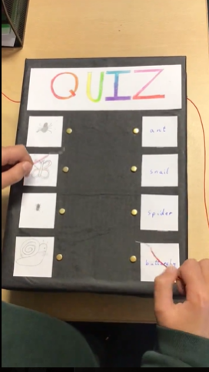

Slide 8
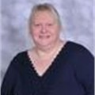
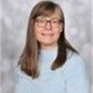
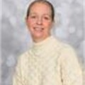
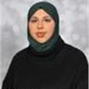
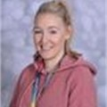
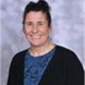
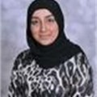
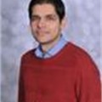
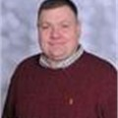
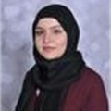
Our Team...
Intervention teachers:
Mrs Darnley
Miss Brandon
Mrs Povall
Miss Sadiq
Additional teachers:
Miss Mahmood (6SH Fridays) and PPA cover for all classes during the week
Mrs Darnley
Phase Leader
Pastoral Support
Mr I Rose
6I
Mrs Ilsley
Class Teacher
6SH
Miss Harris
Class Teacher
6R
Miss Rasif
Class Teacher
6Q
Mr Qayyum
(YGL)
Miss Sadiq
PSA

Slide 9
01
We have a broad curriculum, which covers all areas of learning. Please use the parents’ overview to talk to your child about what they will be learning this year.

Slide 10
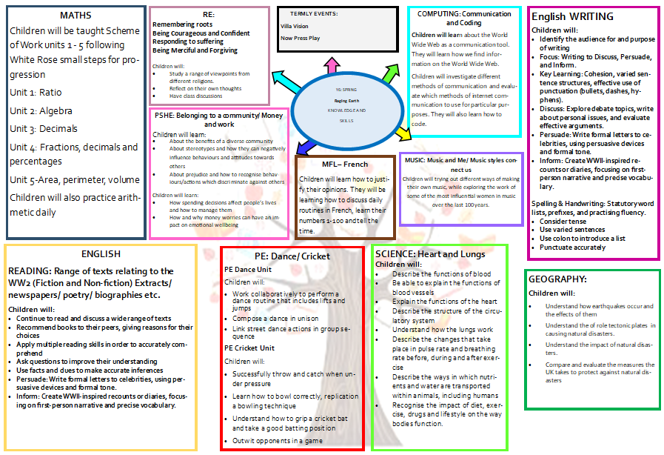
Add in curriculum map

Slide 11

Geography

Slide 12
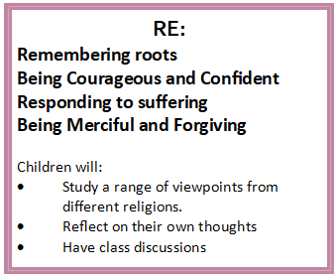
RE
Remembering roots
-Retelling of important stories – Islam
-Understand how statues preserve stories – Christianity and Sikhism
Being Courageous and Confident
-What is courage? - Judaism
-Showing bravery- Sikhism
-How do people show bravery today? - Buddhism
Responding to suffering
-Recognising when others are hurt- Islam and Christianity
-Handling suffering- Buddhism
Being Merciful and Forgiving
-How do Christians show forgiveness and mercy?- Christianity

Slide 13
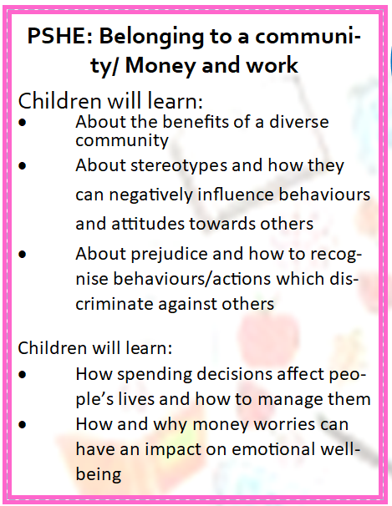
PSHE

Slide 14
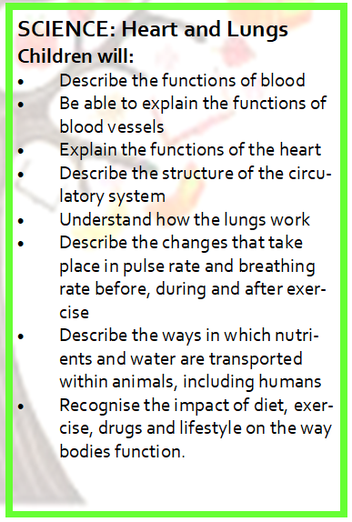
SCIENCE

Slide 15
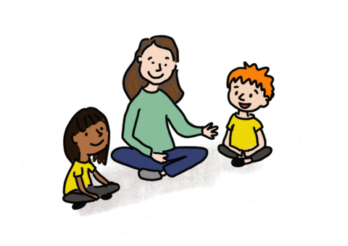
Oracy
Speaking in full sentences about their work and things that they like to tell each other.

Slide 16
02
Reading and Maths

Slide 17
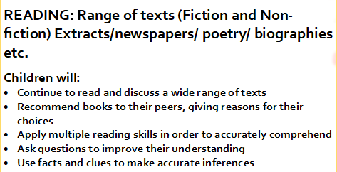

Reading
Focus on reading skills:
Fact retrieval
Inference
Vocabulary
Author’s intent
Summarising
Predicting

Slide 18
Reading at Home
Expectation:
Read at home 5x week
Each week your child will bring home a home reader and their reading record.
Reading record must be filled in every day.
Put subtitles on.

Slide 19
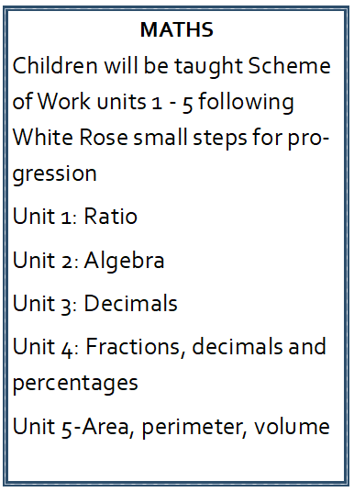

Maths
5 lessons a week
Daily arithmetic

Slide 20

Times tables
We use Times tables Rockstars to develop our multiplication tables.
Develop confident mathematicians.

Slide 21
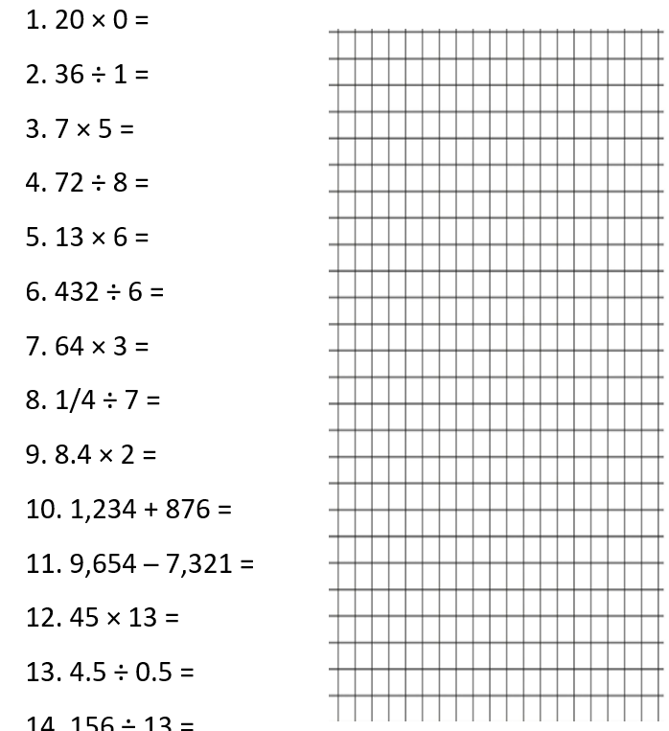
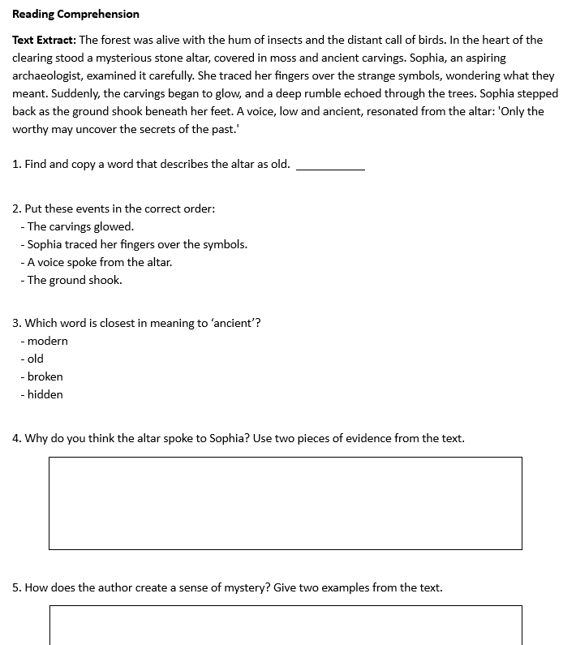
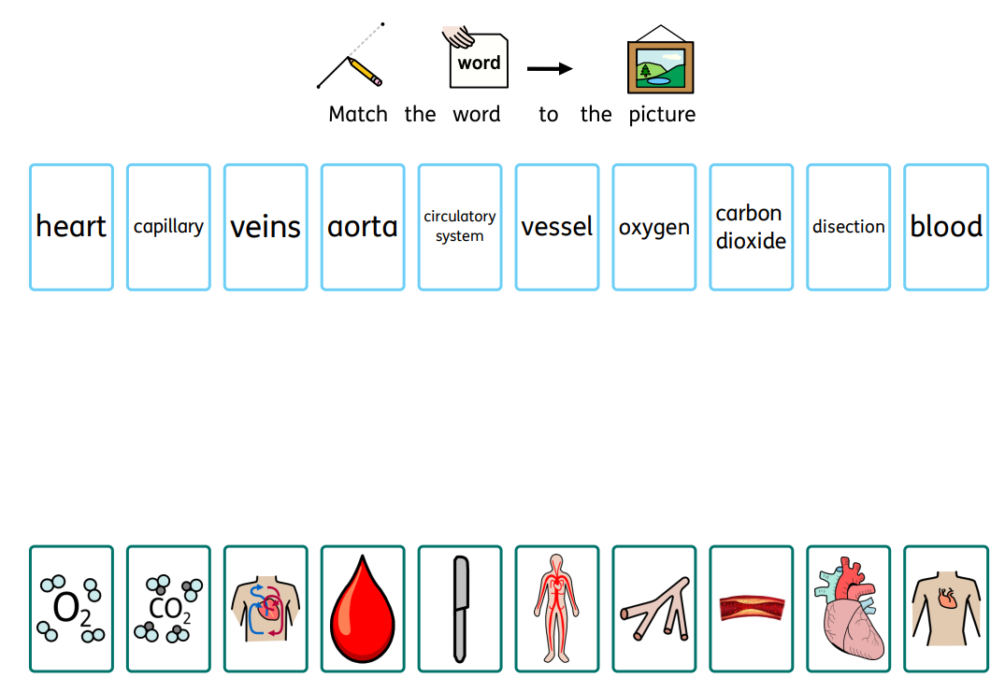
HOMEWORK
In addition to reading/TT rockstars:
Vocabulary- we are focusing on vocabulary and in particular subject specific vocabulary.
Arithmetic and vocabulary homework.

Slide 22
03
Assessments and Interventions

Slide 23
Assessments:
-Carried out after half term
-Mini reports

Slide 24

KS2 SATs
During May 2025, your child will be assessed using the Key Stage 2 SATs, which are a government funded assessment program designed to check that the majority of children are making progress that prepares them for the increased demands of KS3.
Your child will have Maths, Reading and SPaG assessments. We will use teacher assessment to check their understanding of writing.

Slide 25
Year 6 assessments
Each term, your child will be assessed using previous SATs assessments, which are an assessment program designed to check that the majority of children are making progress that prepares them for the increased demands of KS3.
Your child will have Maths, Reading and SPaG assessments. We will use teacher assessment to check their understanding of writing.

Slide 26
Additional Support
Children who need extra support will have additional interventions
These groups are constantly reviewed according to the need of the children and ongoing assessment.
Details on how you can support your child at home are on the school’s website.

Slide 27
04
Other areas of learning

Slide 28

It is important that the children bring in their PE kit:
6R Tuesday
6I – Wednesday
6SH + 6Q– Thursday
White T shirt or polo shirt
Black shorts or leggings.
During colder weather, a plain tracksuit or jogging suit-either black, dark blue or grey coloured clothing.
Football shirts/boots cannot be worn.
Trainers may be worn for outdoor games.

Slide 29
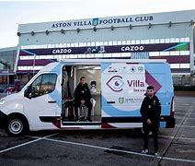
Educational Visits and other
Villa Vision
Parent meeting

Slide 30
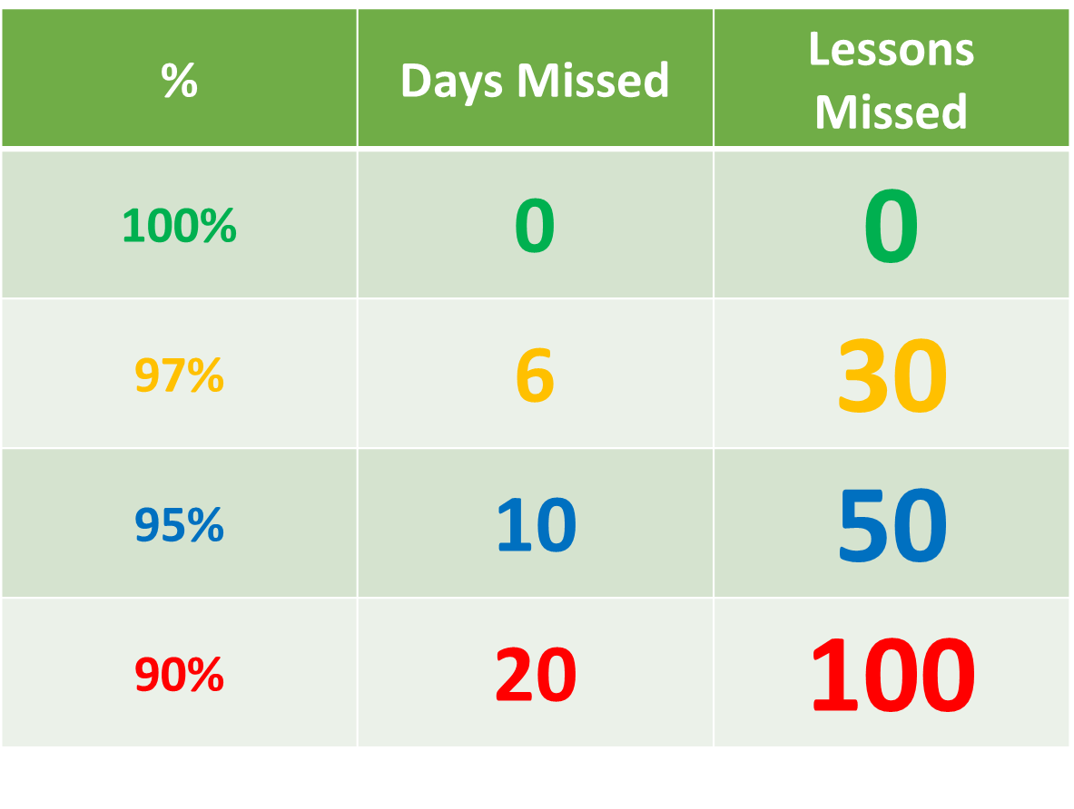
Attendance
Being in school every day that it is open, is important to your child’s achievement, wellbeing, and their wider development. Evidence shows that the students with the highest attendance throughout their time in school gain the best GCSE and A Level results.
Regular attendance:
Teaches and embeds good routines which are easily transferred into the working life as young people leave education and enter the world of work.
During school time we believe pupils should be in class with their teachers and peers and enjoying all the benefits that brings.
Parents or carers of a child have a legal responsibility to ensure their child receives a suitable education. This is usually achieved through regular attendance at school.

Slide 31

Thank you for listening, any questions?

