Slide 1
Welcome to...
Notes:
Drinks and coffees

Slide 2
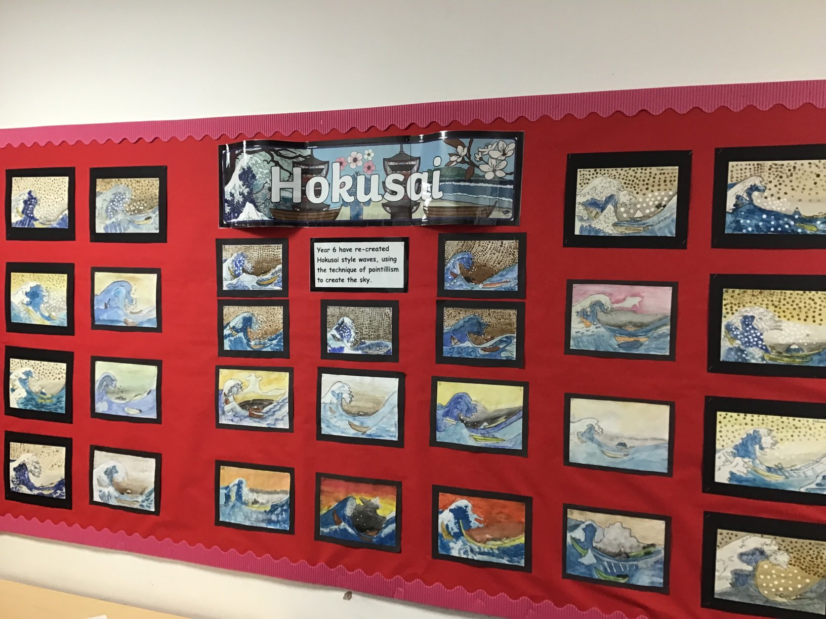

Slide 3
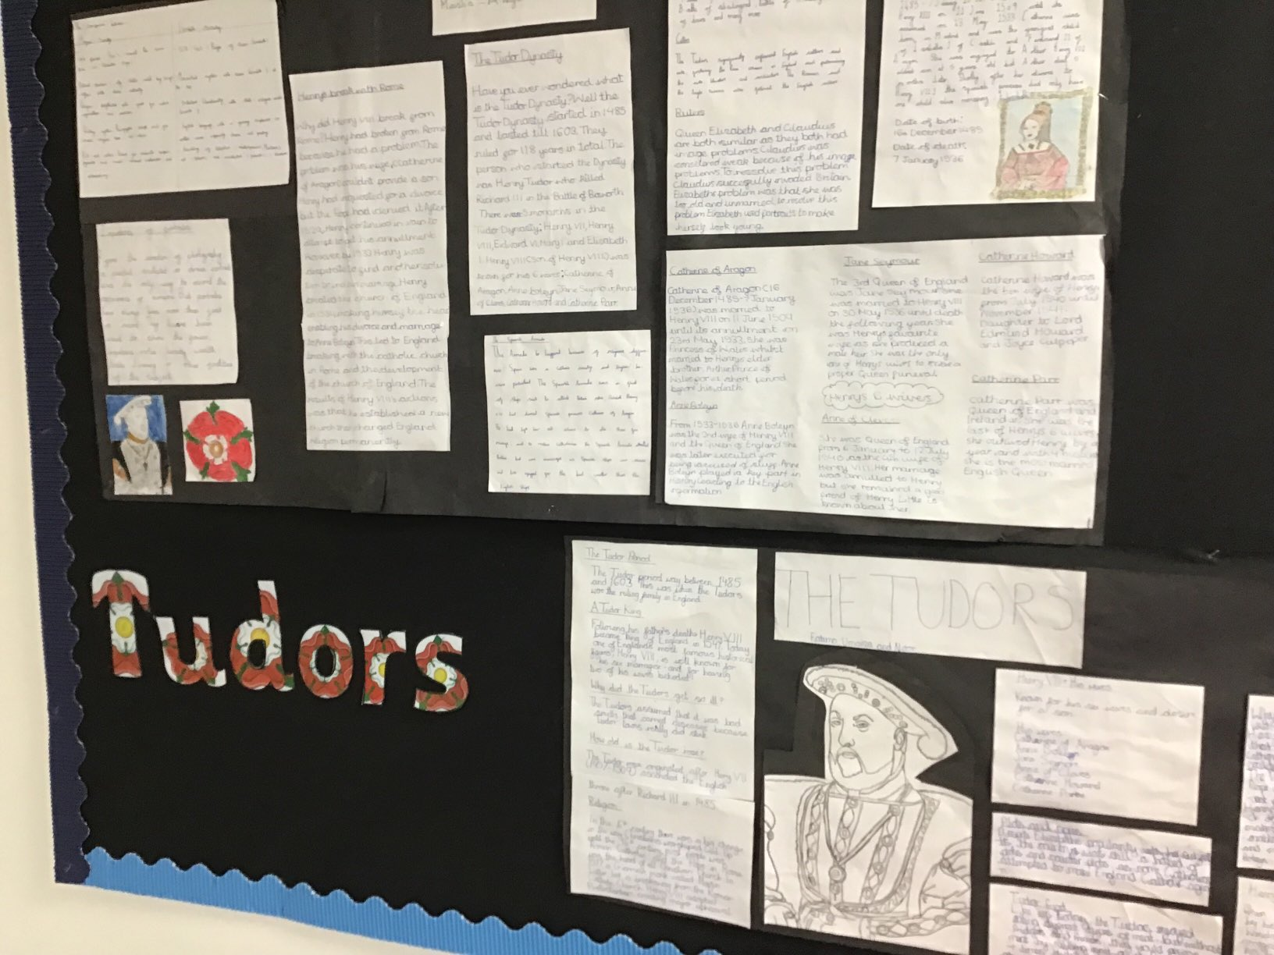

Slide 4
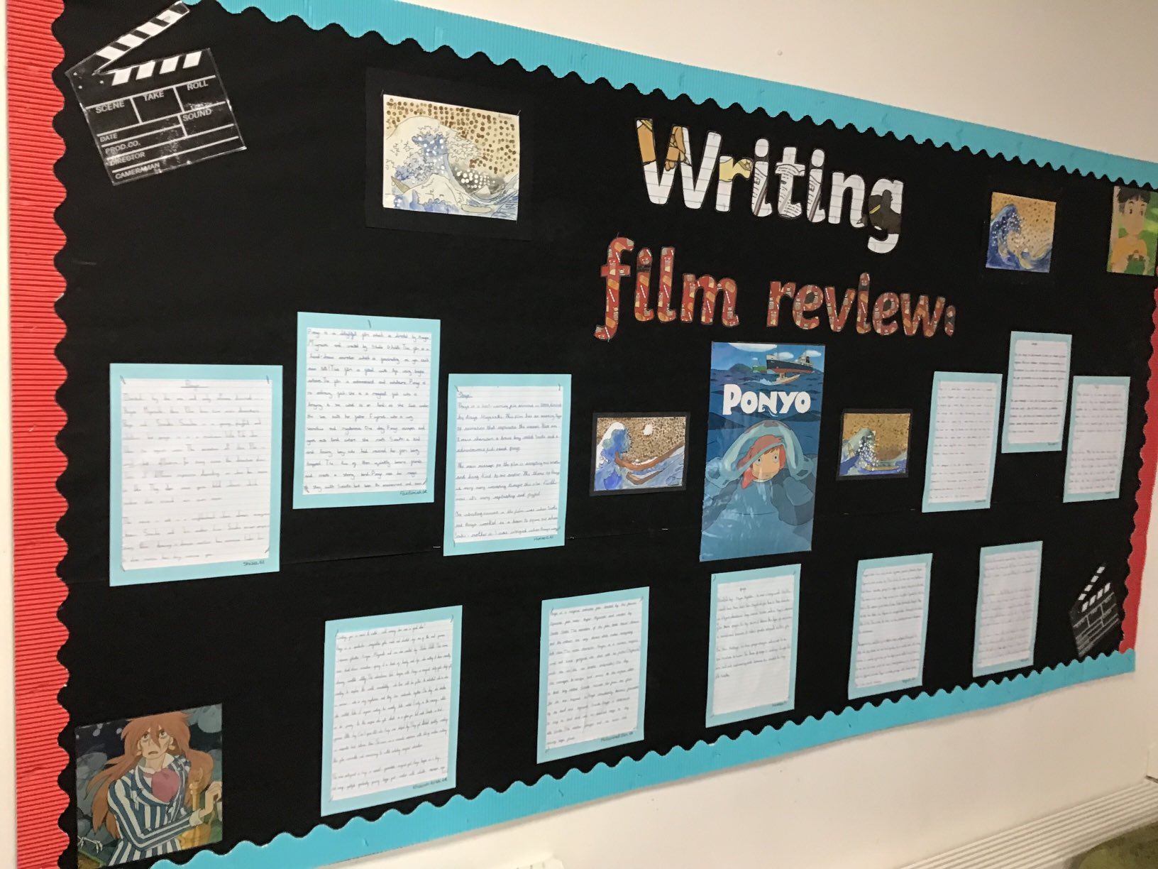
Year 6 Learning:

Slide 5
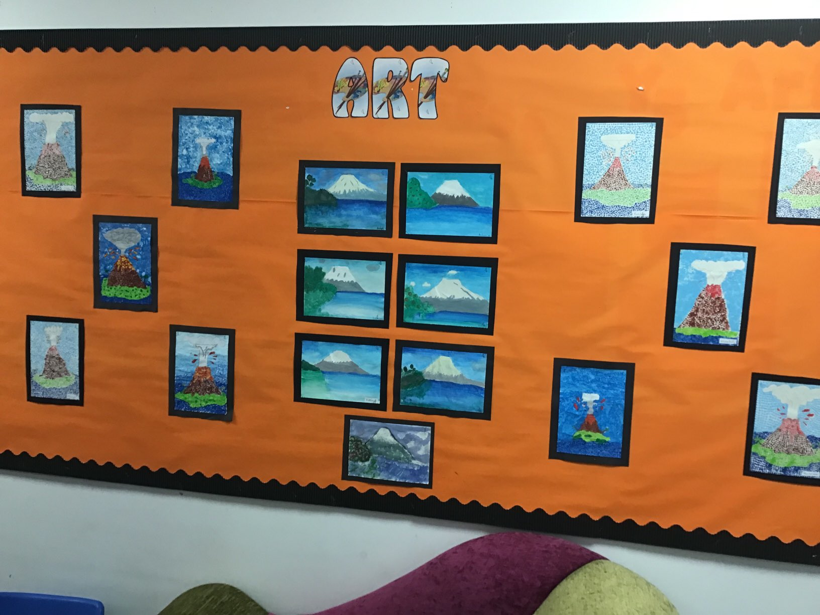

Slide 6
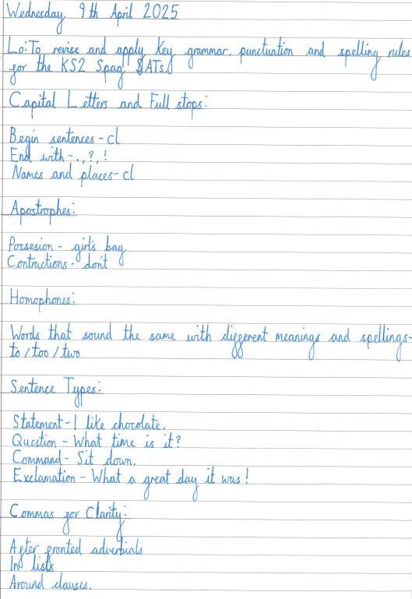
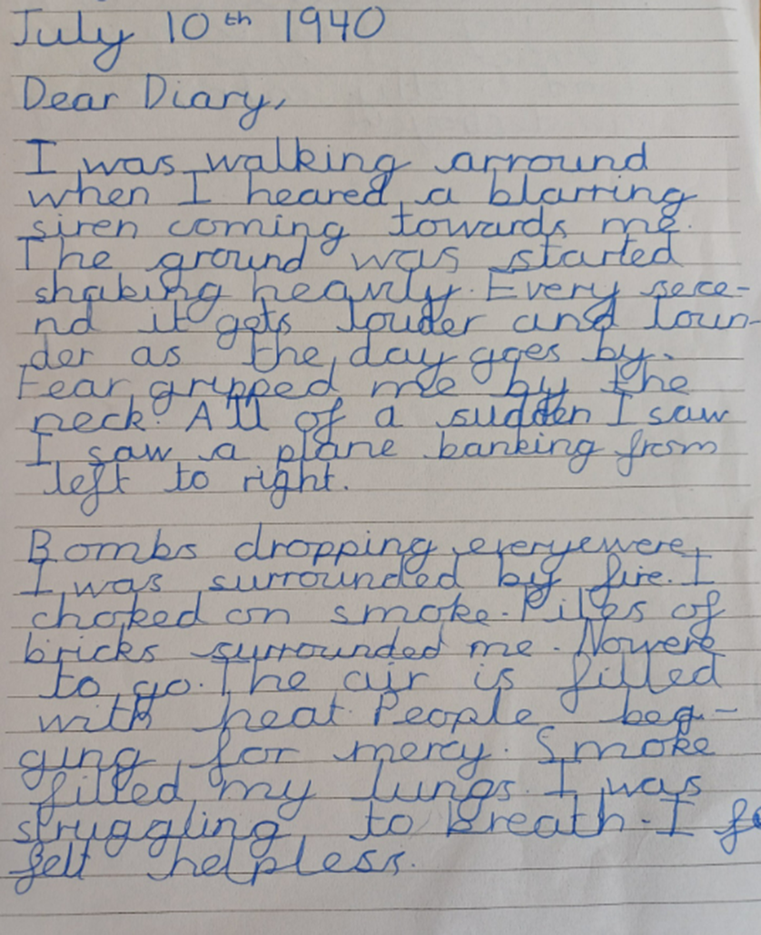
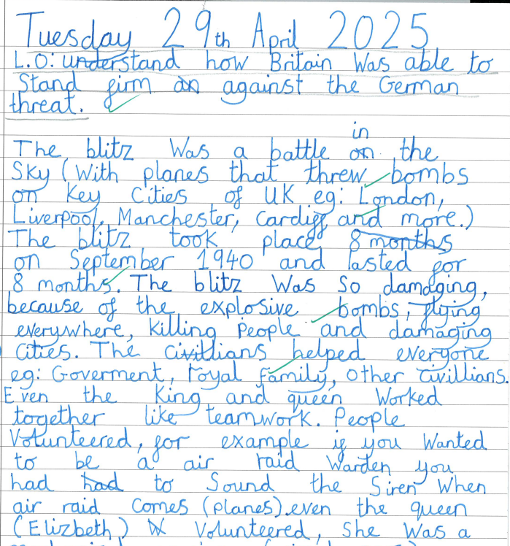
Notes:
6R Khairun -Nisa

Slide 7
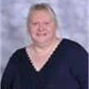
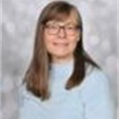
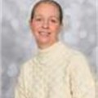
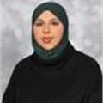
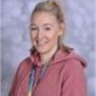
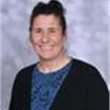
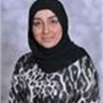
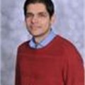
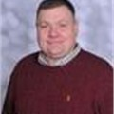
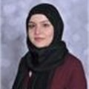
Our Team...
Intervention teachers:
Mrs Darnley
Miss Brandon
Mrs Povall
Miss Sadiq
Additional teachers:
Miss Mahmood (6SH Fridays) and PPA cover for all classes during the week
Mrs Darnley
Phase Leader
Pastoral Support
Mr I Rose
6I
Mrs Ilsley
Class Teacher
6SH
Miss Harris
Class Teacher
6R
Miss Rasif
Class Teacher
6Q
Mr Qayyum
(YGL)
Miss Sadiq
PSA

Slide 8
01
We have a broad curriculum, which covers all areas of learning. Please use the parents’ overview to talk to your child about what they will be learning this year.

Slide 9
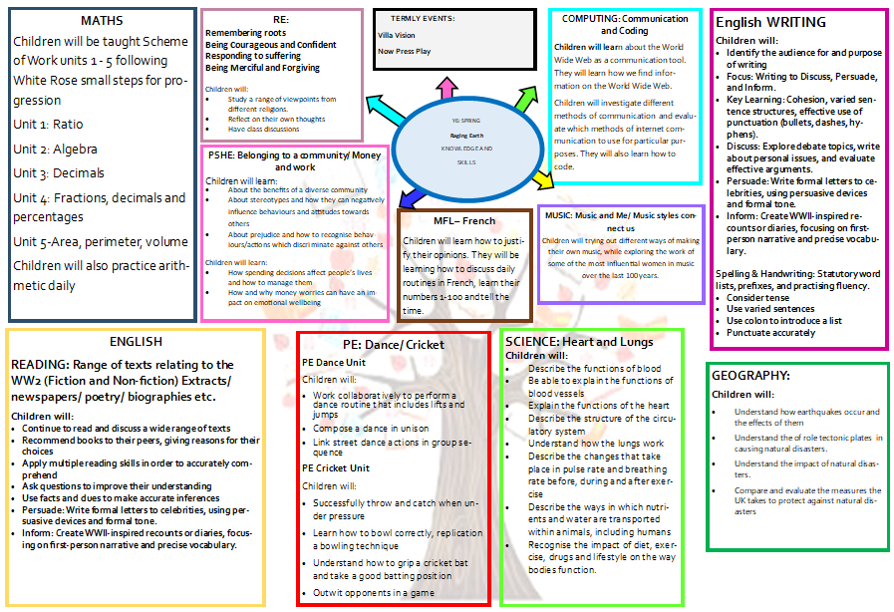
Add in curriculum map

Slide 10
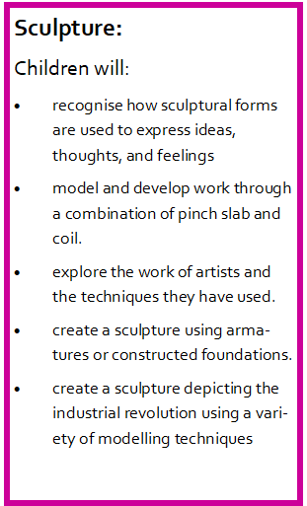
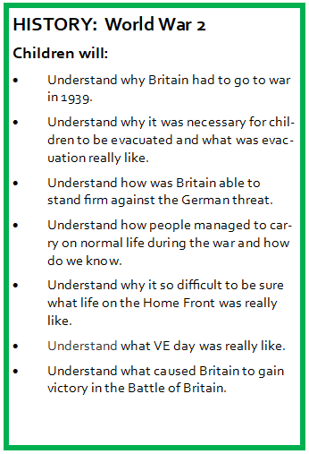
Sculpture and History

Slide 11
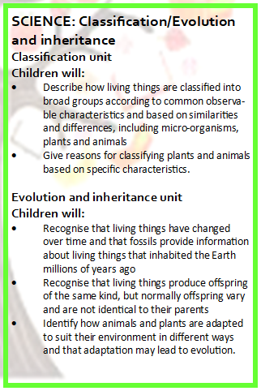
SCIENCE

Slide 12
RE

Slide 13
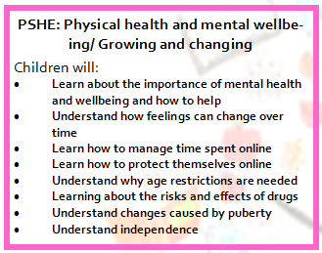
PSHE
Single gender classes
We teach the scientific terminology
Part of safeguarding
how to identify external genitalia and reproductive organs
about the physical and emotional changes during puberty
key facts about the menstrual cycle and menstrual wellbeing, strategies to manage the changes during puberty including menstruation
the importance of personal hygiene routines during puberty including washing regularly and using deodorant
how to discuss the challenges of puberty with a trusted adult –parent
Pupils are told to direct questions to parents

Slide 14
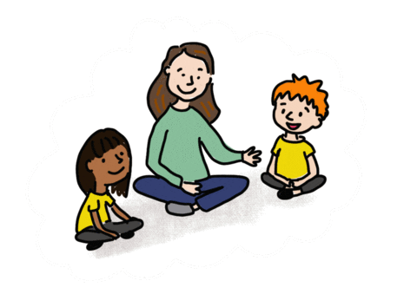
Oracy
Speaking in full sentences about their work and things that they like to tell each other.

Slide 15
02
Reading and Maths

Slide 16
Reading
Focus on reading skills:
Fact retrieval
Inference
Vocabulary
Author’s intent
Summarising
Predicting

Slide 17
Reading at Home
Expectation:
Read at home 5x week
Each week your child will bring home a home reader and their reading record.
Reading record must be filled in every day.
Put subtitles on.

Slide 18
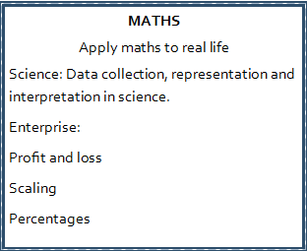
Maths
TT Rockstars
Homework

Slide 19
Times tables
We use Times tables Rockstars to develop our multiplication tables.
Develop confident mathematicians.

Slide 20
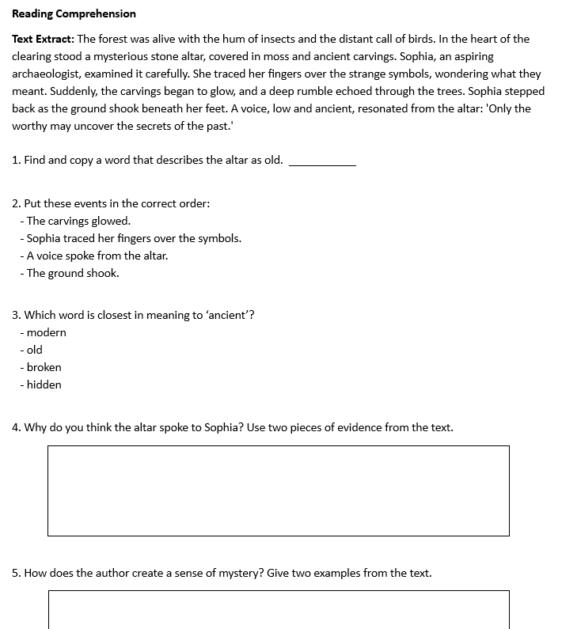
HOMEWORK
In addition to reading/TT rockstars:
We will continue to give children weekly homework

Slide 21
03
Assessments and Interventions

Slide 22
Assessments: -Carried out after half term -Mini reports

Slide 23
KS2 SATs
During May 2025, your child will be assessed using the Key Stage 2 SATs, which are a government funded assessment program designed to check that the majority of children are making progress that prepares them for the increased demands of KS3.
Your child will have Maths, Reading and SPaG assessments. We will use teacher assessment to check their understanding of writing.

Slide 24
Year 6 assessments
Children have completed their SATS papers!!! A massive well done to them and a thank you for your support.
We will continue to assess children’s independent writing.

Slide 25
Additional Support
Children who need extra support will have additional interventions
These groups are constantly reviewed according to the need of the children and ongoing assessment.
Details on how you can support your child at home are on the school’s website.

Slide 26
04
Other areas of learning

Slide 27
It is important that the children bring in their PE kit:
6I Tuesday
6R – Wednesday
6SH + 6Q– Thursday
White T shirt or polo shirt
Black shorts or leggings.
During colder weather, a plain tracksuit or jogging suit-either black, dark blue or grey coloured clothing.
Football shirts/boots cannot be worn.
Trainers may be worn for outdoor games.

Slide 28
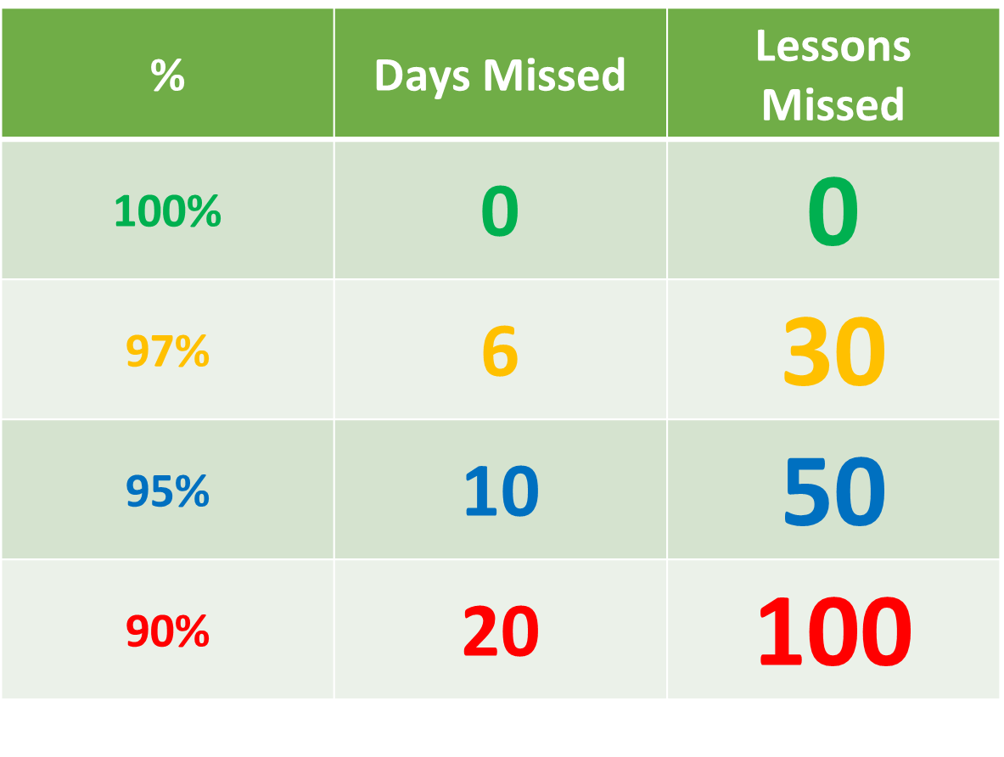
Attendance
Being in school every day that it is open, is important to your child’s achievement, wellbeing, and their wider development. Evidence shows that the students with the highest attendance throughout their time in school gain the best GCSE and A Level results.
Regular attendance:
Teaches and embeds good routines which are easily transferred into the working life as young people leave education and enter the world of work.
During school time we believe pupils should be in class with their teachers and peers and enjoying all the benefits that brings.
Parents or carers of a child have a legal responsibility to ensure their child receives a suitable education. This is usually achieved through regular attendance at school.

Slide 29
Thank you for listening, any questions?

