Slide 1
Online SAFETY
ADVICE AND GUIDANCE FOR PARENTS AND CARERS
…..putting children at the heart of everything we think, say and do.

Slide 2
Safeguarding Statement
We recognise the importance of providing an ethos and environment within our school – and will help children, all staff and wider community to feel safe, secure and respected.
We are committed to safeguarding and promoting the welfare and wellbeing of our school community, and expect all of the staff, parents and volunteers to share this commitment.
We aim to ensure a safe learning and working environment for all of our children so that they reach their full learning potential, develop positive self confidence, and understand how to keep safe within the school and wider community.
……..putting children at the heart of everything we think, say and do.

Slide 3
What are we learning today?
Theme for online safety day-: An internet we trust: exploring reliability in the online world
Digital Resilience Toolkit – Introduction about children being online – please watch link
Set up Safely
Make an agreement about when everyone can go online in the home and what is suitable or not suitable
What help is out there, its so difficult to keep up?
Further Information for parents to access

Slide 4
theme for online safety day-: An internet we trust: exploring reliability in the online world
Click the image below to launch the video

Slide 5
Digital Resilience Toolkit: Supporting 6 - 10 year olds | Internet Matters
Click the image below to launch the video

Slide 6
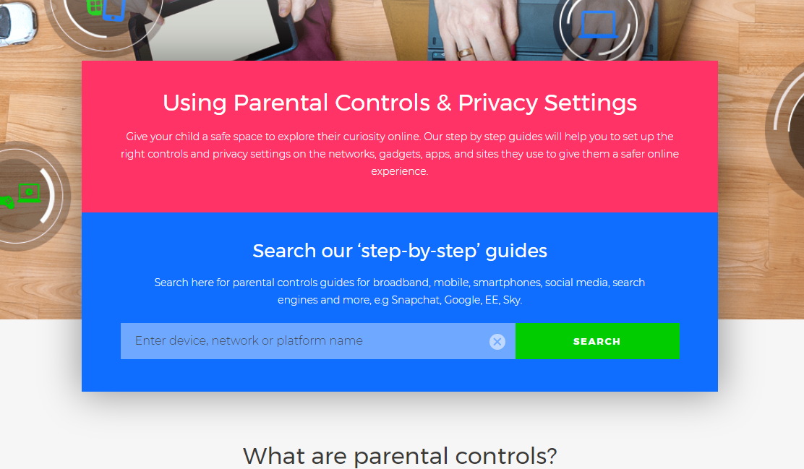
Set up safely
As a parent you have some decisions to make about how you want your child to engage online and on social media and what measures you want to put in place to help protect them:
Set up their device
Whatever device you choose, there are free controls you can use to stop your child from purchasing and using certain apps, seeing certain content, or limiting what they can share with others, like their location for example.
https://www.internetmatters.org/parental-controls/
More than 9 in 10 parent and carers of 5-15s who use parental control software consider it useful

Slide 7
Socialising online (safely)
Getting the low down on sites, games and apps
You will probably use social networks yourself, but you might want to know about new ones that your child is using, or wants to use. Use them yourself and set up your own account so you can experience what your child might see. There are also a number of child-friendly social networks they could use while they get ready for the likes of Snapchat and Instagram.
Privacy settings
Spend time together looking at the privacy settings. It’s always best to assume that default settings are public and should be changed accordingly.
Advice on using privacy settings on the most popular social apps.
https://www.internetmatters.org/resources/social-media-advice-on-popular-apps/

Slide 8
Share aware
Your child should not have their location on when using any device.
Make sure that your children do not have school uniform on when uploading videos, film in their bedroom or share personal details.
Check what you child wants to upload is safe first.
Make sure you check who your child is talking to, and speak with them to check they feel safe and the conversations online are safe.

Slide 9
Set up safely
Blocking software
There are a range of new apps and software that block, filter and monitor online behaviour. You’ll need to decide as a family whether this is the right approach for you, taking into consideration your child’s age and maturity, and their need for privacy.
Negotiating the gaming world
In some games like Minecraft people deliberately try to intimidate other players. In multi-player games where gamers talk to one another – you might find abusive language, harassment and there have been instances of grooming. It’s vital therefore that your child knows how to report abuse and talks to you if something is causing them concern.
FACTS- (30th May, 2016- Internet Matters Team)
1/3 of teens who have made new friends online have met their new friends while online gaming
25% of online games players aged 12-15 chat through the game to players they don’t know
1 in 7 of all 3-4s and half of 5-15s play games online

Slide 10
A Family agreement
How we keep safe online

Slide 11
Family agreement-Things to consider
Keeping Safe:
The Do’s and Don’ts while online, different ages means you may want to have different access to more grown up sites (once you know how to be safe)
Social Networking- Do you as the parent/carer agree with the sites? What are you happy for your child to access?
Games and Toys- Are they age appropriate? Does your child need to let you hear what they and others online are saying, or are you confident its safe that they use headphone?
Positive behaviour- How do we behave online and what to we do if someone behaves poorly towards us?
Healthy Lifestyle-How long are we using it daily, when and where do we use it?

Slide 12
Family agreement
Agree a time and day that everyone is available
Prepare some snacks or organise a treat for afterwards
Be clear that parents have the final say.

Slide 13
For parents and carers information and guidance on how to keep everyone online safe in the home (please copy and paste the web links into your browser and access everything you need
Understanding what it means to be online and how to make sure we are all safe
https://www.thinkuknow.co.uk/parents/Support-tools/home-activity-worksheets/
https://www.thinkuknow.co.uk/parents/Listing/?cat=72,70,69,68,67,66,74&ref=4765&keyWord=
https://www.nspcc.org.uk/keeping-children-safe/online-safety/
How to report to the police and agencies when we have been exposed to inappropriate material or activity
Reporting when my child has been exposed to inappropriate online material and activity
https://www.ceop.police.uk/safety-centre/
How to keep devices in the home safe, and information about the internet
https://www.saferinternet.org.uk/advice-centre/parents-and-carers
https://www.internetmatters.org/

