Slide 1

Welcome to Year 5...

Slide 2

Our Team... Year 5
5R
Miss Richards
Class teacher
(YGL)
5F
Miss Foissey
Class Teacher
Pupil Support Assistants
Ms Javed
5E
Mr Elahi
Class Teacher
Mrs Povall
Phase Leader
Pastoral Support
Mrs Hemming

Slide 3

02
01
03
04
Our Curriculum
Reading, Maths and spellings
Assessment and Intervention
Other areas of learning

Slide 4
01
We have a broad curriculum which covers all areas of learning. Please use the parents’ overview to talk to your child about what they will be learning this year.

Slide 5
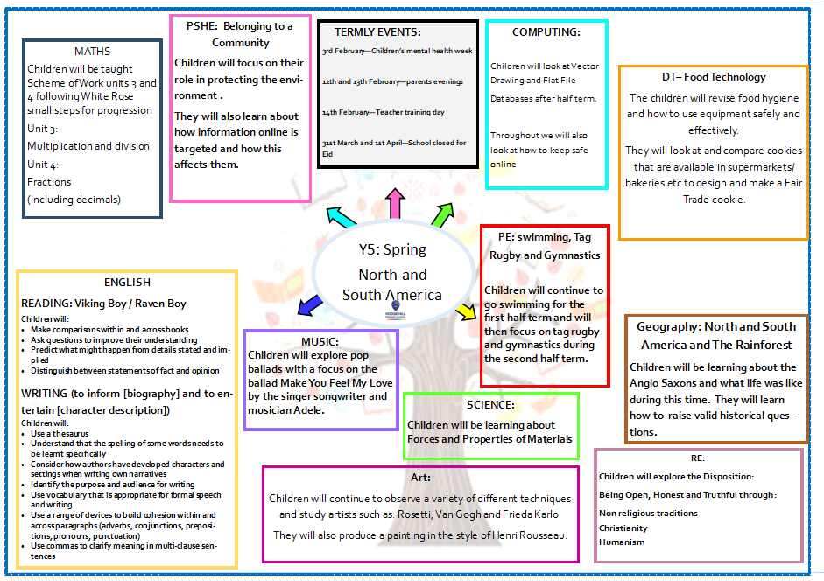

Slide 6
PSHE Curriculum:
Learning for Spring term –
Protecting the environment
Compassion towards others
How information online is targeted
Different media types, their role and impact
Identifying job interests and aspirations
What influences career choices
Workplace stereo-types

Slide 7

Oracy
Speaking in full sentences about their work and things that they like to tell each other.

Slide 8
02
Reading, Maths and spellings

Slide 9

Reading
Focus on:
Reading fluency
Comprehension
A love of reading
There is also the school library that children can borrow books from.
The library is open after school on a Monday and a Thursday.

Slide 10
Reading at Home
Expectation:
Read at home 5x week.
Books and reading records must be in school every day.
Books will be changed with class teacher.

Slide 11
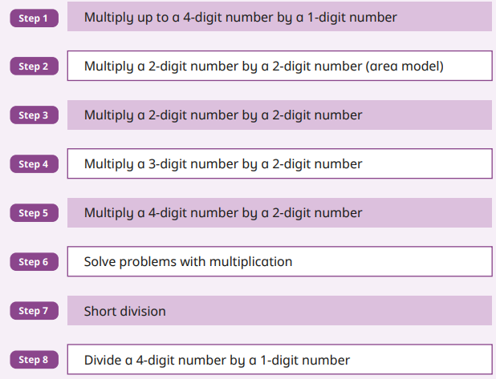
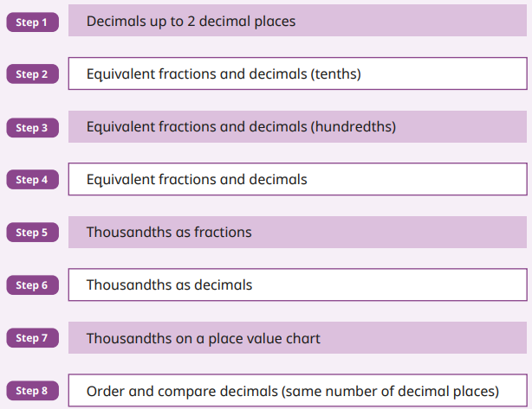
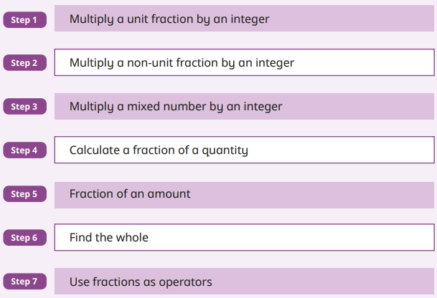
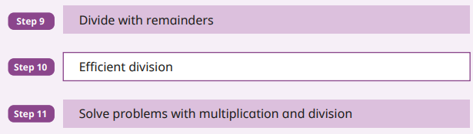
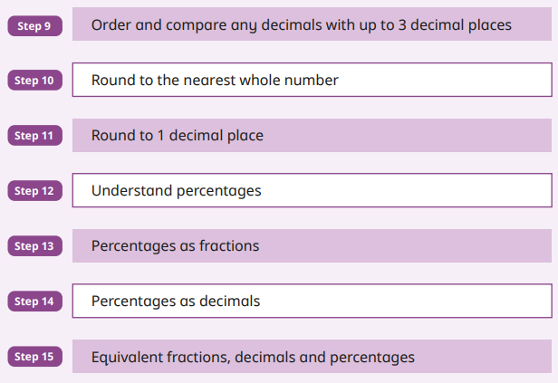
Maths
We follow the White Rose Small Steps for progression.
Focus on:
Fractions and decimals
Focus on:
Multiplication

Slide 12

Maths at Home
Expectation:
Play at home 5x week.
Weekly competitions between classes in Year 5 and 6.

Slide 13

Spellings at Home
This year we are focusing on vocabulary and in particular subject specific vocabulary.
An activity will be sent home every Tuesday to be returned for marking on Friday.

Slide 14
Homework
Reading 5 times a week with reading diaries updated after every read.
Times Tables Rockstars should be played 5 times a week.
Musical instruments (if participating), once taken home should be practiced as often as possible.
This year we are focusing on vocabulary and in particular subject specific vocabulary. An activity will be sent home from Year 1- 6 every Tuesday to be returned for marking on Friday.
Please can an adult at home sign your child’s reading diary every time they read. This is invaluable support for the teacher and each child earns a dojo point for their House every time this happens.

Slide 15
03
Assessments and Interventions

Slide 16

Year 5 assessments
Each term, your child will be assessed using summative assessments.
Your child will have Maths and Reading assessments. We will use teacher assessment to check their understanding of writing.

Slide 17
Additional Support
Children who need extra support will have an additional intervention session to help them catch up on the day’s learning.
These groups are constantly reviewed according to the need of the children and ongoing assessment.
Details on how you can support your child at home are on the school’s website.

Slide 18
04
Other areas of learning

Slide 19

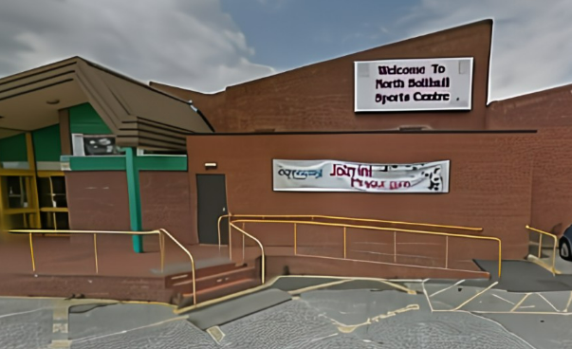
It is important that the children
bring in their Swimming kit:
5F – Monday
5R – Thursday
5E – Thursday
Week beginning 24th February – no longer swimming.
5F – Monday and Thursday
5E – Thursday and ???
5R – Monday and Thursday

Slide 20

Some children have
elected to continue learning their instrument from Year 4 :
5F – Tuesday - cornet
5E – Monday - clarinet
5R – Tuesday - ukulele

Slide 21
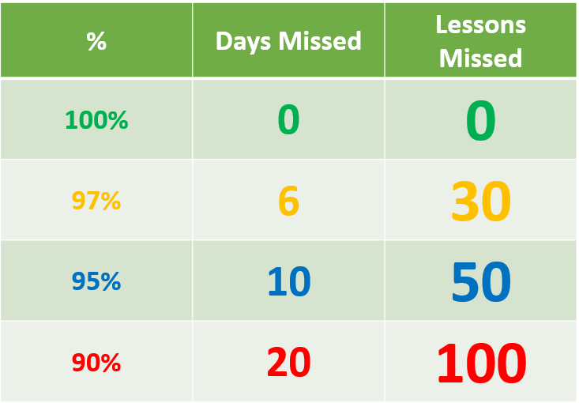
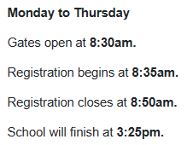
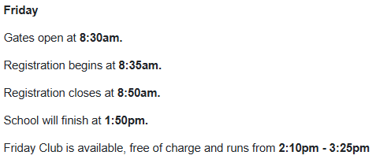
Attendance League – 97%

Slide 22

Thank you for listening, any questions?

